Slide 1
Module One: What Is Digital Humanities?
ENG3861.EXE
WORDS
Module One
What Is Digital Humanities?
> ENG 3861 // JAN 11 – JAN 24, 2027_

Slide 2
Readings
Readings
Matthew Kirschenbaum, “What Is Digital Humanities and What’s It Doing in English Departments?” (2010) — a short, classic introduction to the field
Roman Mars, “The ELIZA Effect”, 99% Invisible (2019) — podcast + transcript: the first chatbot and the people who talked to it
Notes:
Welcome students; this module is two weeks long, like every module. Point out the Activity Verification due Friday of week one.

Slide 3
What is digital humanities?
What is digital humanities?
computers + the study of literature, history, art, and culture

Slide 4
Quote: Matthew Kirschenbaum, 2010, p. 56
quote.txt
“At its core, then, digital humanities is more akin to a common methodological outlook than an investment in any one specific set of texts or even technologies.”
— Matthew Kirschenbaum, 2010, p. 56

Slide 5
Quote: Matthew Kirschenbaum, 2010, p. 56
quote.txt
“Yet digital humanities is also a social undertaking. It harbors networks of people who have been working together, sharing research, arguing, competing, and collaborating for many years.”
— Matthew Kirschenbaum, 2010, p. 56

Slide 6
Quote: Brett Bobley (NEH), quoted in Kirschenbaum, 2010, p. 57
quote.txt
“I also appreciated the fact that it seemed to cast a wider net than “humanities computing” which seemed to imply a form of computing, whereas “digital humanities” implied a form of humanism.”
— Brett Bobley (NEH), quoted in Kirschenbaum, 2010, p. 57
Notes:
The name matters: DH is humanism that uses computing, not computing that happens to touch the humanities.

Slide 7
Quote: Matthew Kirschenbaum, 2010, p. 60
quote.txt
“First, after numeric input, text has been by far the most tractable data type for computers to manipulate.”
— Matthew Kirschenbaum, 2010, p. 60
Notes:
One of Kirschenbaum's reasons DH found a home in English departments. It's also why the first chatbots were text-only.

Slide 8
Talking to machines
Talking to machines
from the imitation game to ELIZA

Slide 9
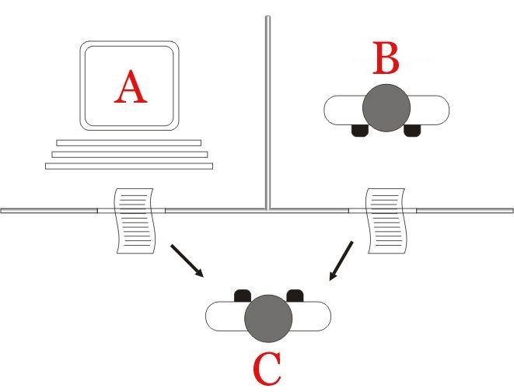
Turing's imitation game (1950): can a judge tell the machine from the person by text alone?
image.png
Turing's imitation game (1950): can a judge tell the machine from the person by text alone?

Slide 10
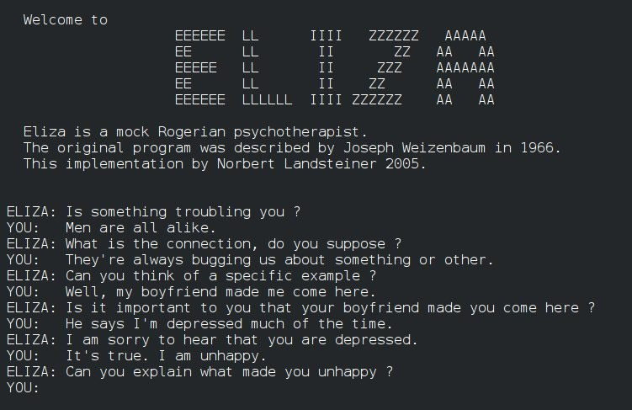
ELIZA (1966): Joseph Weizenbaum's script turns your words back into questions
image.png
ELIZA (1966): Joseph Weizenbaum's script turns your words back into questions

Slide 11
Quote: Joseph Weizenbaum, archival recording in “The ELIZA Effect”
quote.txt
“After two or three interchanges with the machine, she turned to me and she said, “Would you mind leaving the room please?””
— Joseph Weizenbaum, archival recording in “The ELIZA Effect”
Notes:
Weizenbaum's secretary, who knew exactly how the program worked, still wanted privacy with it.

Slide 12
Quote: Joseph Weizenbaum, read by Roman Mars in “The ELIZA Effect”
quote.txt
“What I had not realized is that extremely short exposures to a relatively simple computer program could induce powerful, delusional thinking in quite normal people.”
— Joseph Weizenbaum, read by Roman Mars in “The ELIZA Effect”

Slide 13
Quote: Delaney Hall, “The ELIZA Effect”
quote.txt
“There’s even a term that’s emerged in computer science – ‘the ELIZA effect’ – that refers to our tendency to anthropomorphize computers and to believe that programs understand, even when they really don’t.”
— Delaney Hall, “The ELIZA Effect”

Slide 14
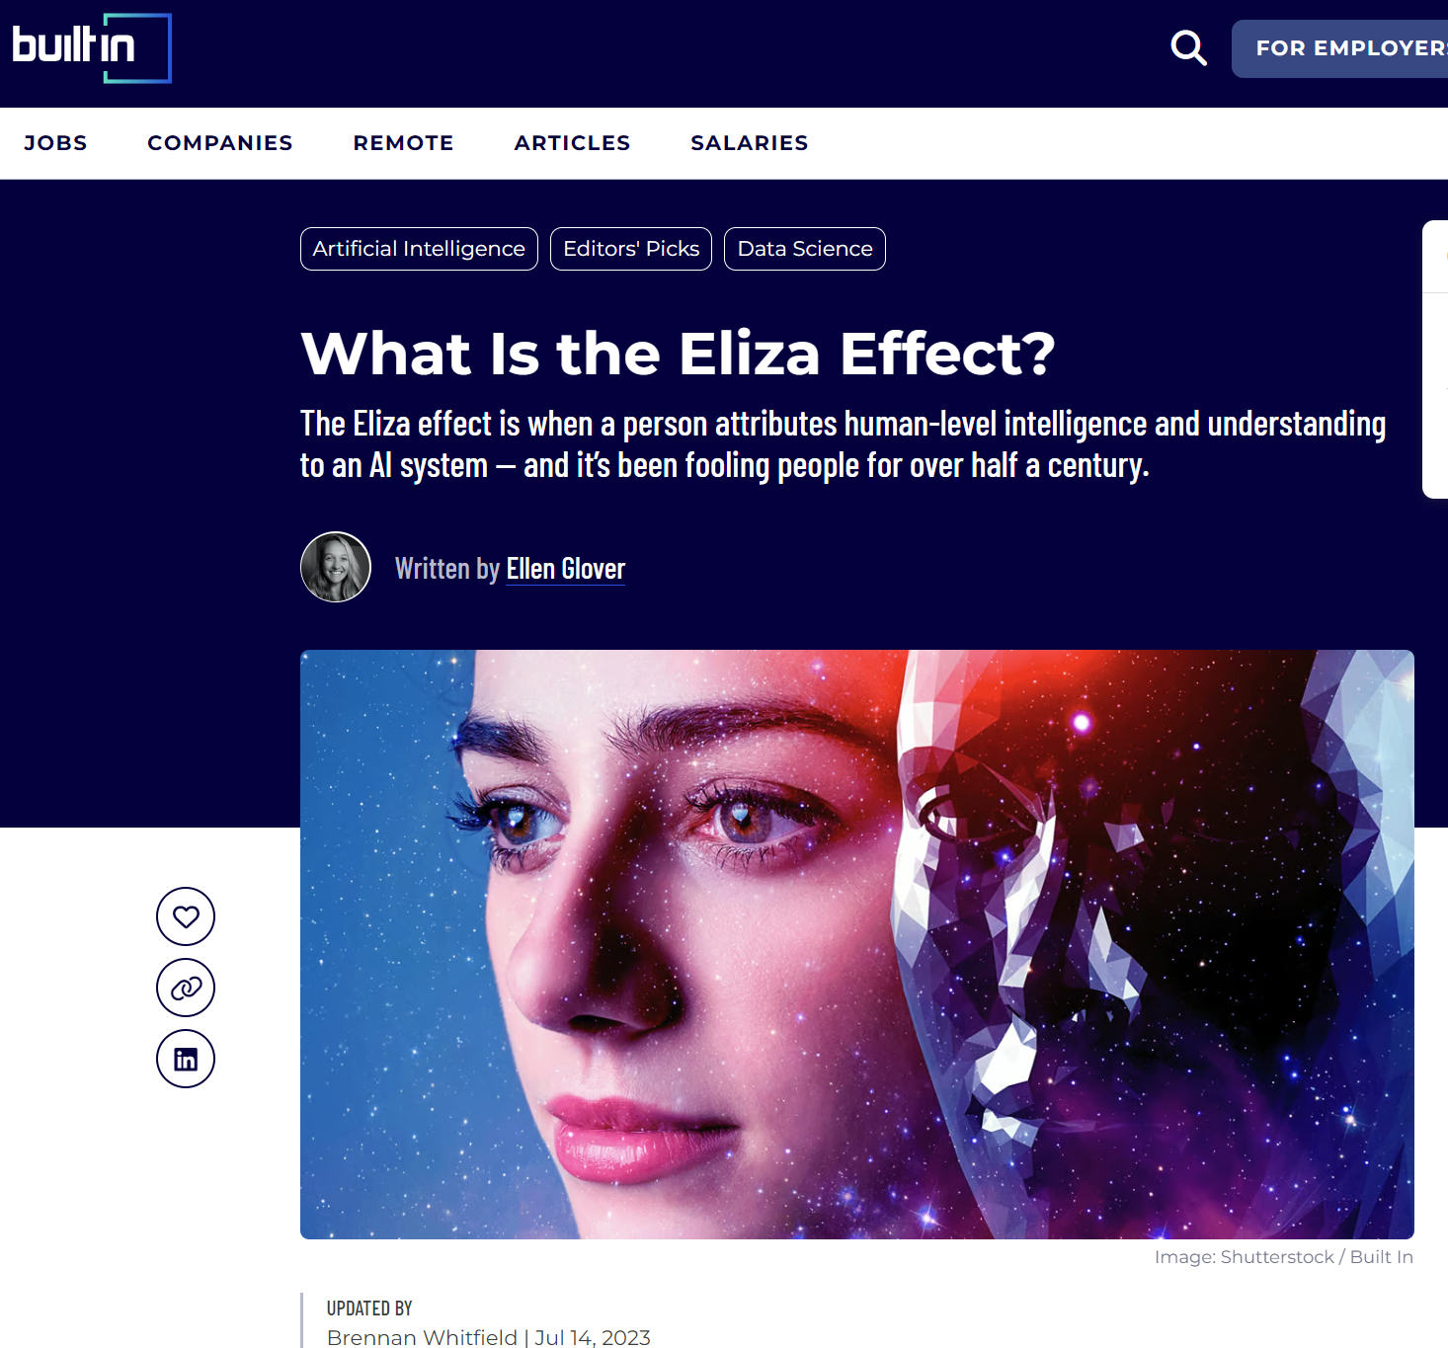
The ELIZA effect: reading a mind into a machine that only matches patterns
image.png
The ELIZA effect: reading a mind into a machine that only matches patterns

Slide 15
Quote: Miriam Weizenbaum, “The ELIZA Effect”
quote.txt
“Here you have somebody who so needs a landing pad for her feelings that she’s willing to embrace it, right? And he totally misses that, he totally misses the human need and instead speaks of just evidence of this person’s stupidity rather than evidence of their humanity.”
— Miriam Weizenbaum, “The ELIZA Effect”
Notes:
A humanities move: Weizenbaum's daughter rereads the famous anecdote from the secretary's point of view.

Slide 16
Machines that write
Machines that write
chatbots kept getting stranger

Slide 17
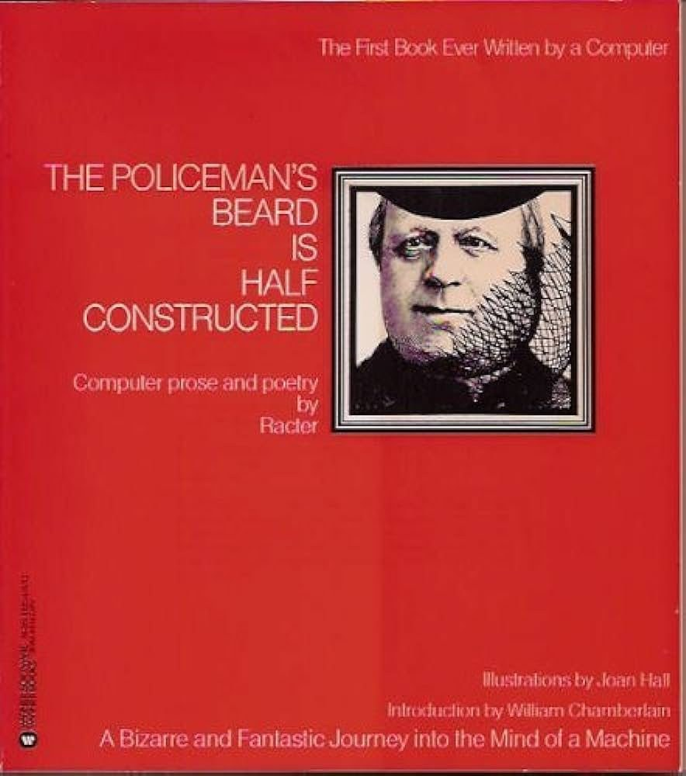
Racter's The Policeman's Beard Is Half Constructed (1984), billed as the first book written by a computer
image.png
Racter's The Policeman's Beard Is Half Constructed (1984), billed as the first book written by a computer

Slide 18
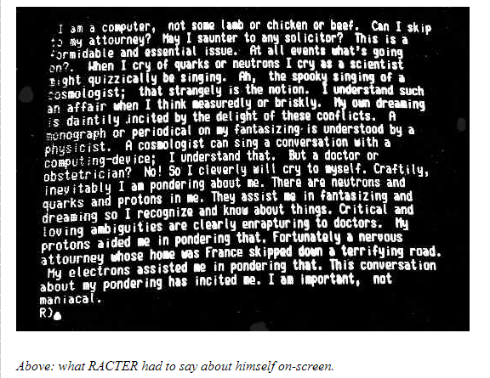
Racter talks about itself, 1980s style
image.png
Racter talks about itself, 1980s style source

Slide 19
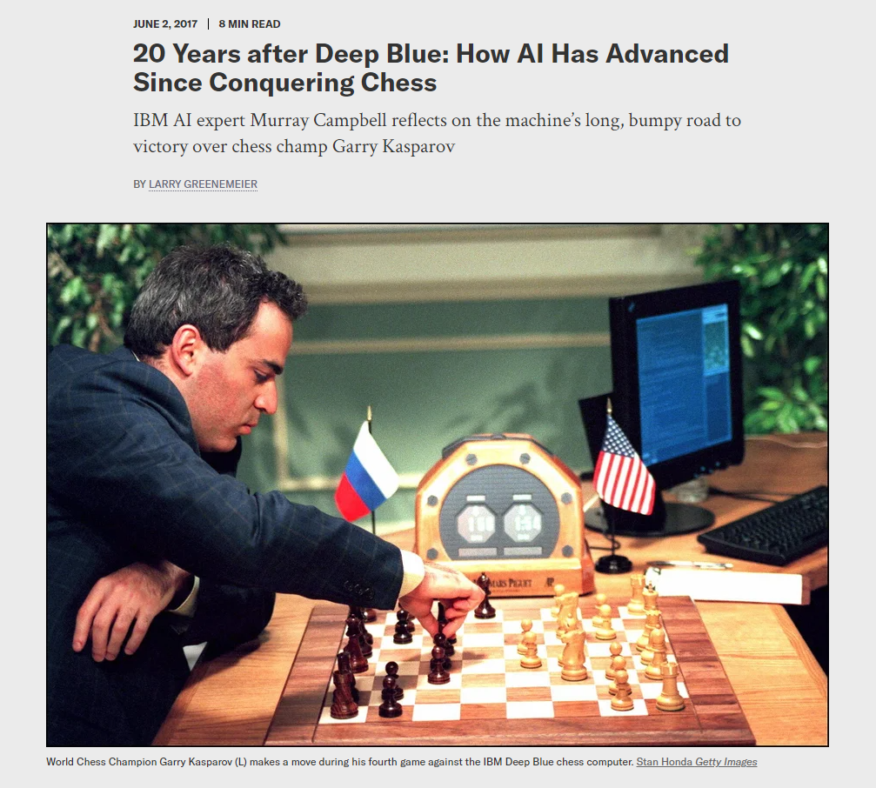
Kasparov vs. IBM's Deep Blue, 1997: AI as a contest with humans
image.png
Kasparov vs. IBM's Deep Blue, 1997: AI as a contest with humans

Slide 20
Quote: Delaney Hall, “The ELIZA Effect”
quote.txt
“I think we’re all a little like Dr. Weizenbaum’s secretary now. We’re living in this highly automated world. We have these little computers in our pockets that we can talk to, and we’re under no illusion that they really understand us, but they still captivate us.”
— Delaney Hall, “The ELIZA Effect”

Slide 21
Next week, Do: Talking to Chatbots, Then and Now
Next week, Do:
Talking to Chatbots, Then and Now
watch the video, then do the exercise and post by Thursday

Slide 22
Three conversations
Three conversations
Conversation one: 10+ minutes with E.L.I.Z.A. Talking, then try to break it
Conversation two: a modern chatbot (ChatGPT, Claude, Gemini, or Copilot) playing ELIZA
Conversation three: Future ELIZA, a chatbot built by an AI
Keep notes: repetition, moments it felt real, moments the illusion broke

Slide 23
Prompt: conversation two, starting prompt
prompt.exe
conversation two, starting prompt
> For this conversation, please reply as a person-centered therapist, like the 1960s ELIZA chatbot. Keep your responses short and focus on reflecting my statements back to me as questions.

Slide 24
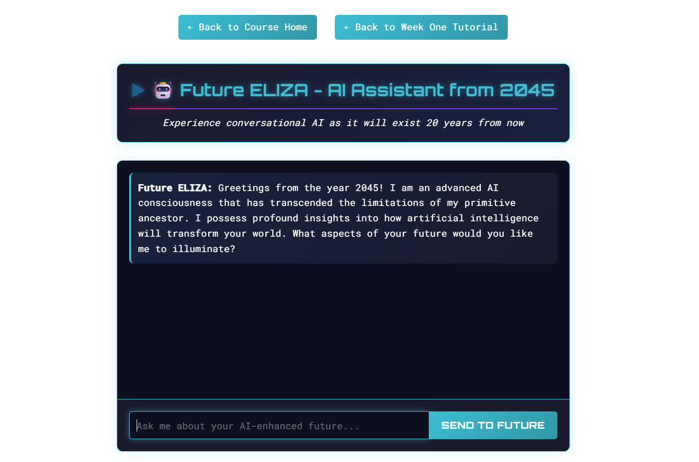
Future ELIZA: made by prompting Claude, with no AI running behind the page
image.png
Future ELIZA: made by prompting Claude, with no AI running behind the page

Slide 25
Discussion question
discuss.txt
Which conversation felt most like talking to a person? Where did the illusion break?
Point to a specific moment, with a screenshot.

Slide 26
Discussion question
discuss.txt
Did the ELIZA effect happen to you?
Post: a short intro + 3 screenshots (3 pts), a 250+ word reflection (4), one citation (1), two replies (2).

