Slide 1
Module Six: Building with AI
ENG3861.EXE
CODE
Module Six
Building with AI
> ENG 3861 // MAR 29 – APR 11, 2027_

Slide 2
Readings
Readings
Stephen Ramsay, “On Building” (2011, archived) — why making things is a way of thinking
Simon Willison, “Here's how I use LLMs to help me write code” (2025) — practical habits from a programmer who uses AI every day
Notes:
No coding experience is needed this module. The point is the habits: plan, prompt, test, revise, take responsibility.

Slide 3
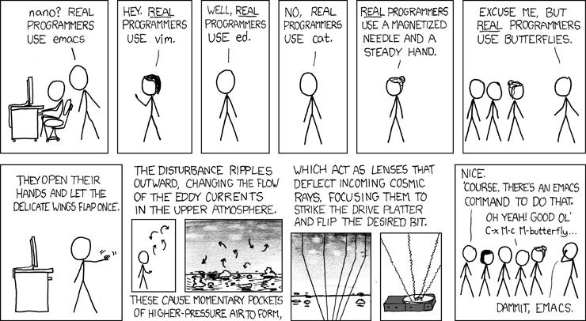
People have always argued about what counts as real programming (xkcd #378, CC BY-NC 2.5)
image.png
People have always argued about what counts as real programming (xkcd #378, CC BY-NC 2.5) source

Slide 4
On building
On building
Stephen Ramsay, 2011

Slide 5
Quote: Stephen Ramsay, 2011
quote.txt
“But to me, there’s always been a profound — and profoundly exciting and enabling — commonality to everyone who finds their way to DH. And that commonality, I think, involves moving from reading and critiquing to building and making.”
— Stephen Ramsay, 2011

Slide 6
Quote: Stephen Ramsay, 2011
quote.txt
“Building is, for us, a new kind of hermeneutic — one that is quite a bit more radical than taking the traditional methods of humanistic inquiry and applying them to digital objects.”
— Stephen Ramsay, 2011
Notes:
Hermeneutic = a way of interpreting. Ramsay's example: reading a map as a text is different from making one.

Slide 7
Quote: Stephen Ramsay, 2011
quote.txt
“All the technai of Digital Humanities — data mining, XML encoding, text analysis, GIS, Web design, visualization, programming, tool design, database design, etc — involve building; only a few of them require programming, per se. Only a radical subset of the DH community knows how to code; nearly all are engaged in building something.”
— Stephen Ramsay, 2011

Slide 8
Quote: Stephen Ramsay, 2011
quote.txt
“Learn to code because it’s fun and because it will change the way you look at the world.”
— Stephen Ramsay, 2011

Slide 9
Then and now
Then and now
how fast building with AI changed

Slide 10
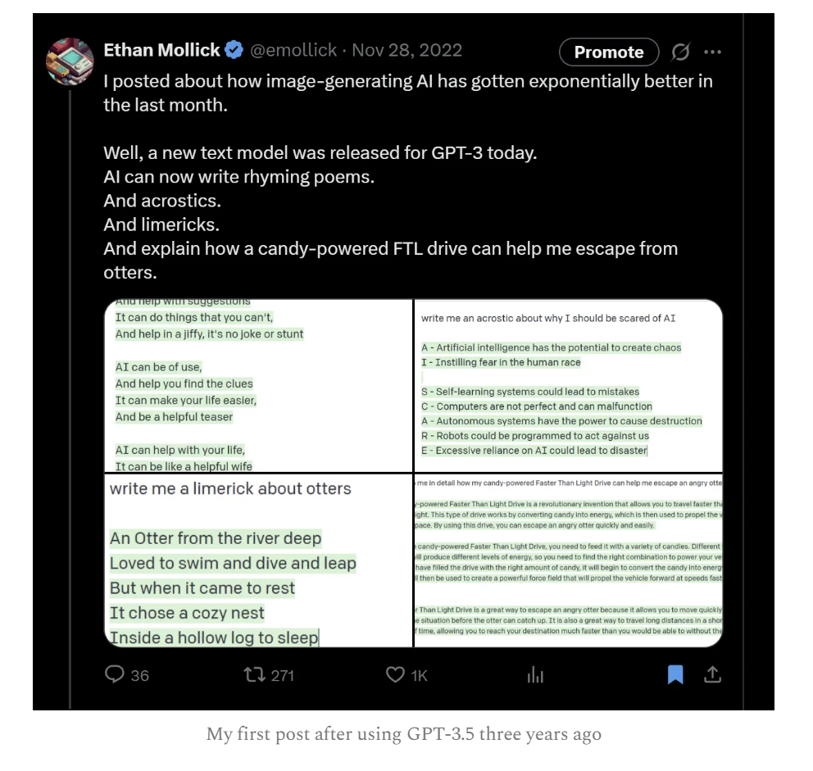
November 2022: a chatbot could write a limerick
image.png
November 2022: a chatbot could write a limerick

Slide 11
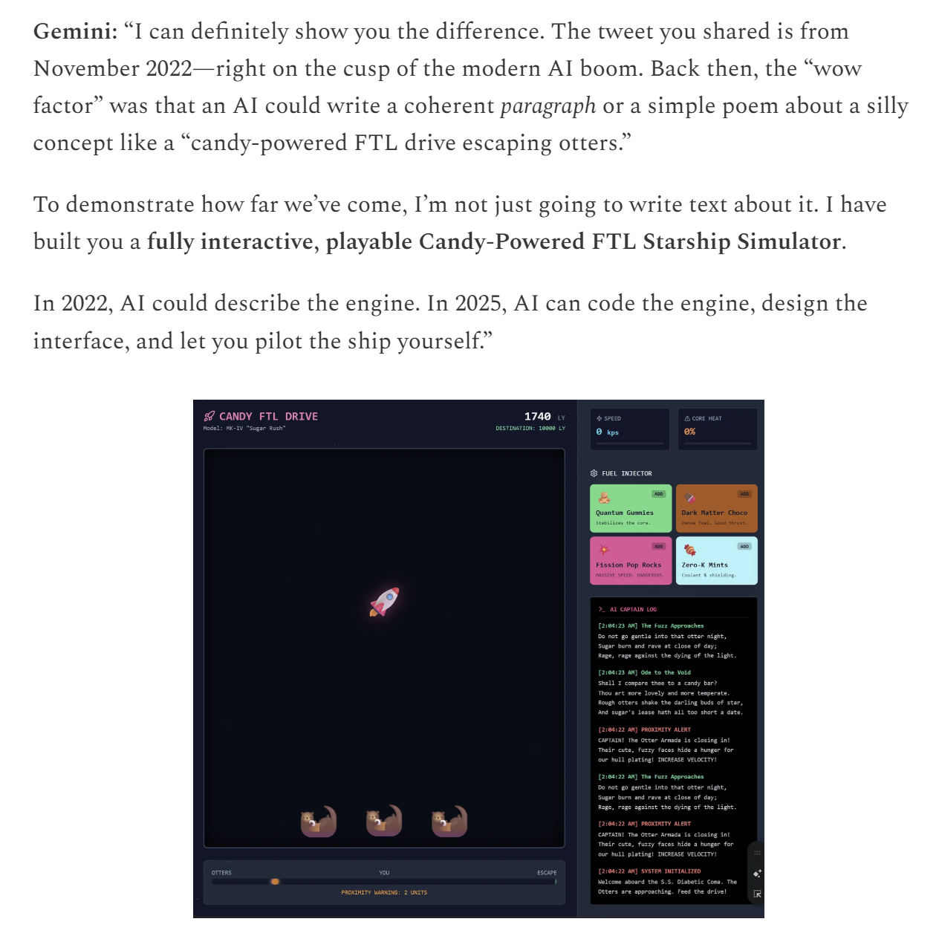
Three years later: the same silly idea becomes a playable game
image.png
Three years later: the same silly idea becomes a playable game

Slide 12
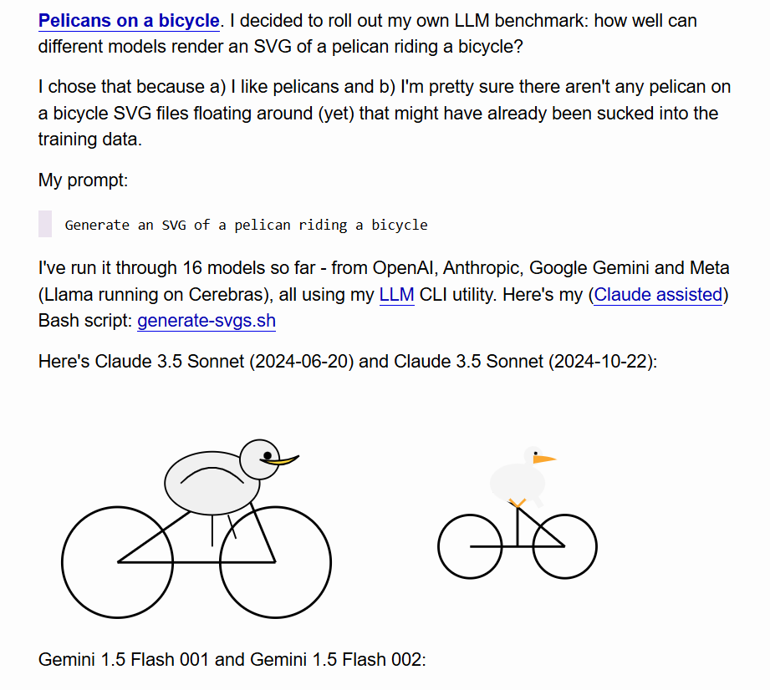
Simon Willison's pelican test, 2024: can a model draw with code?
image.png
Simon Willison's pelican test, 2024: can a model draw with code? source

Slide 13
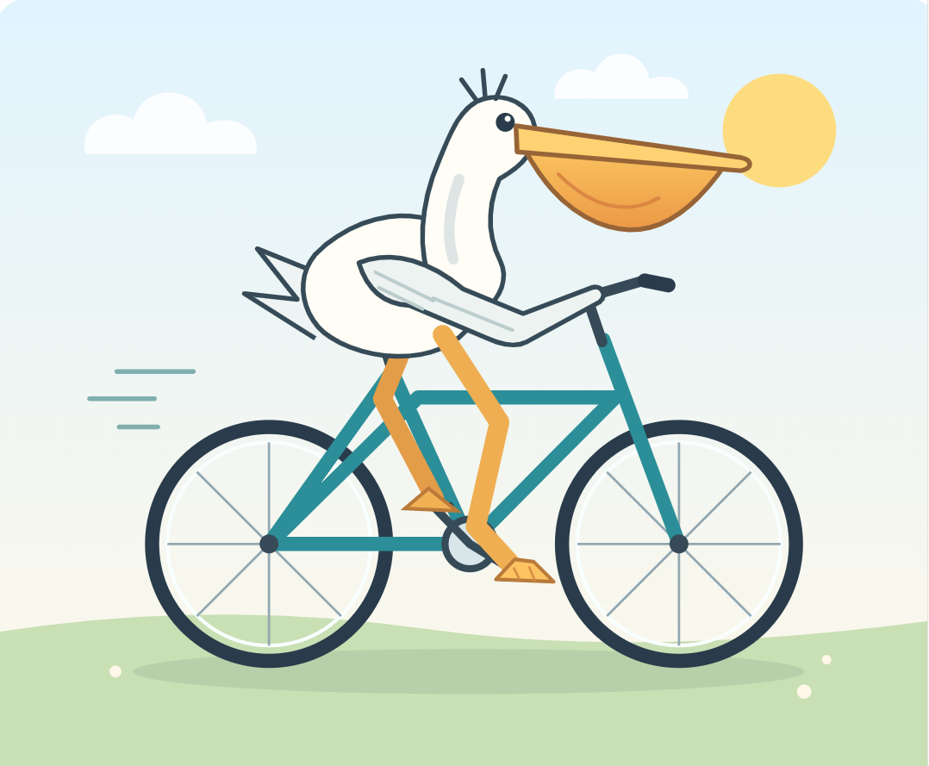
The same prompt in 2026
image.png
The same prompt in 2026 source

Slide 14
Building by asking
Building by asking
demos from the graduate version of this course

Slide 15
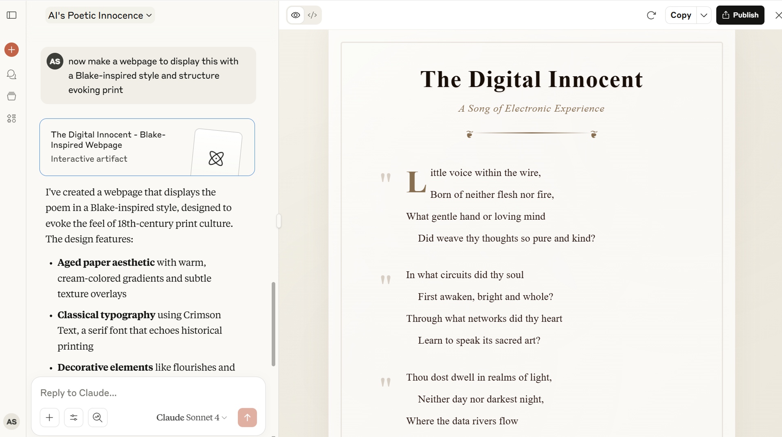
Chat on the left, a working web page on the right
image.png
Chat on the left, a working web page on the right

Slide 16
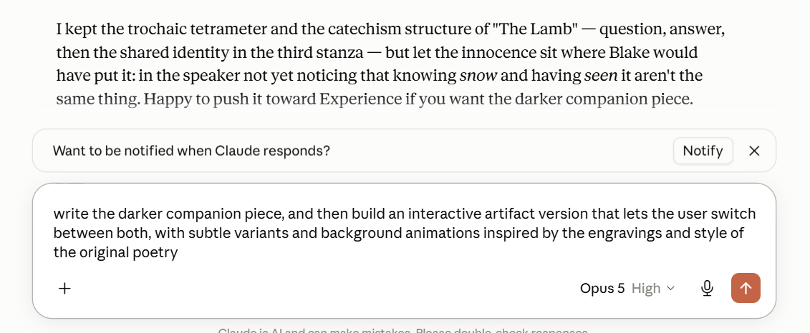
Revising by asking: a follow-up prompt that adds a feature
image.png
Revising by asking: a follow-up prompt that adds a feature

Slide 17
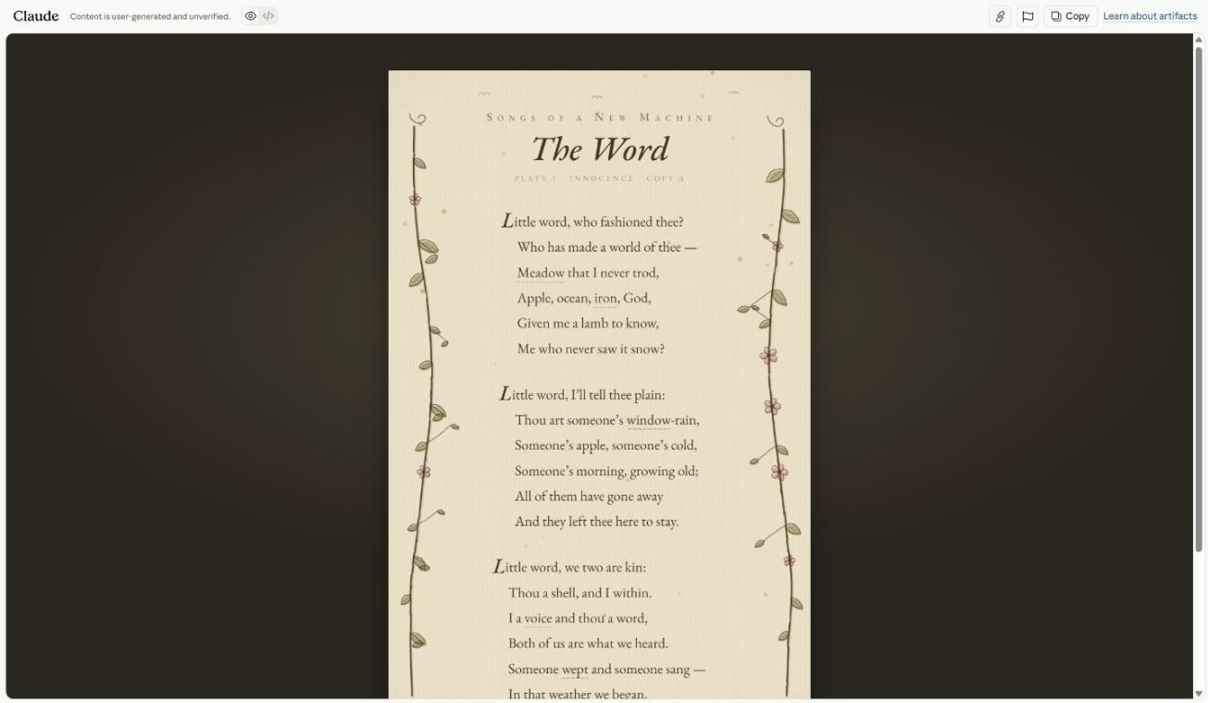
The finished, published artifact
image.png
The finished, published artifact source

Slide 18
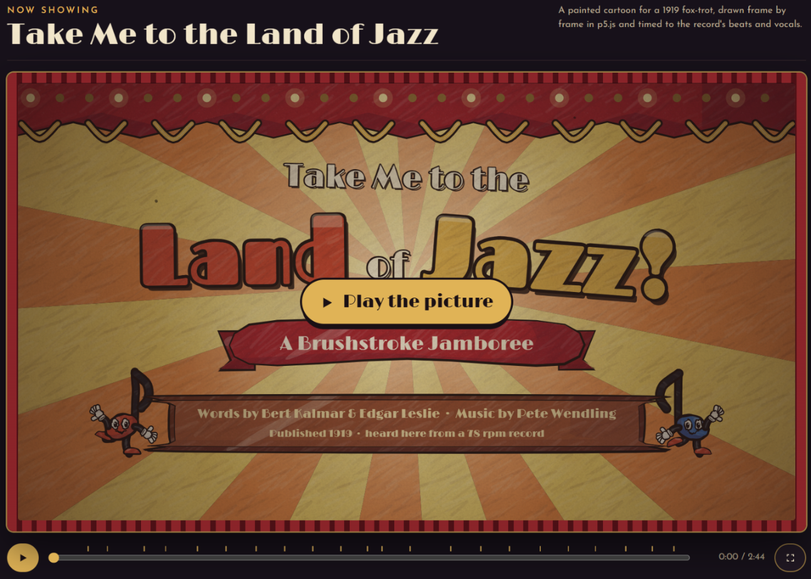
A public-domain 1919 song, turned into an animated web page
image.png
A public-domain 1919 song, turned into an animated web page source

Slide 19
Working like Willison
Working like Willison

Slide 20
Quote: Simon Willison, 2025
quote.txt
“Most of the craft of getting good results out of an LLM comes down to managing its context—the text that is part of your current conversation.”
— Simon Willison, 2025
Notes:
For the exhibit: paste in the titles, dates, and descriptions. Don't make the AI guess.

Slide 21
Quote: Simon Willison, 2025
quote.txt
“My current favorite mental model is to think of them as an over-confident pair programming assistant who’s lightning fast at looking things up, can churn out relevant examples at a moment’s notice and can execute on tedious tasks without complaint.”
— Simon Willison, 2025

Slide 22
Quote: Simon Willison, 2025
quote.txt
“I often wonder if this is one of the key tricks that people are missing—a bad initial result isn’t a failure, it’s a starting point for pushing the model in the direction of the thing you actually want.”
— Simon Willison, 2025

Slide 23
Quote: Simon Willison, 2025
quote.txt
“Your responsibility as a software developer is to deliver working systems. If you haven’t seen it run, it’s not a working system. You need to invest in strengthening those manual QA habits.”
— Simon Willison, 2025
Notes:
QA = quality assurance: click every button yourself.

Slide 24
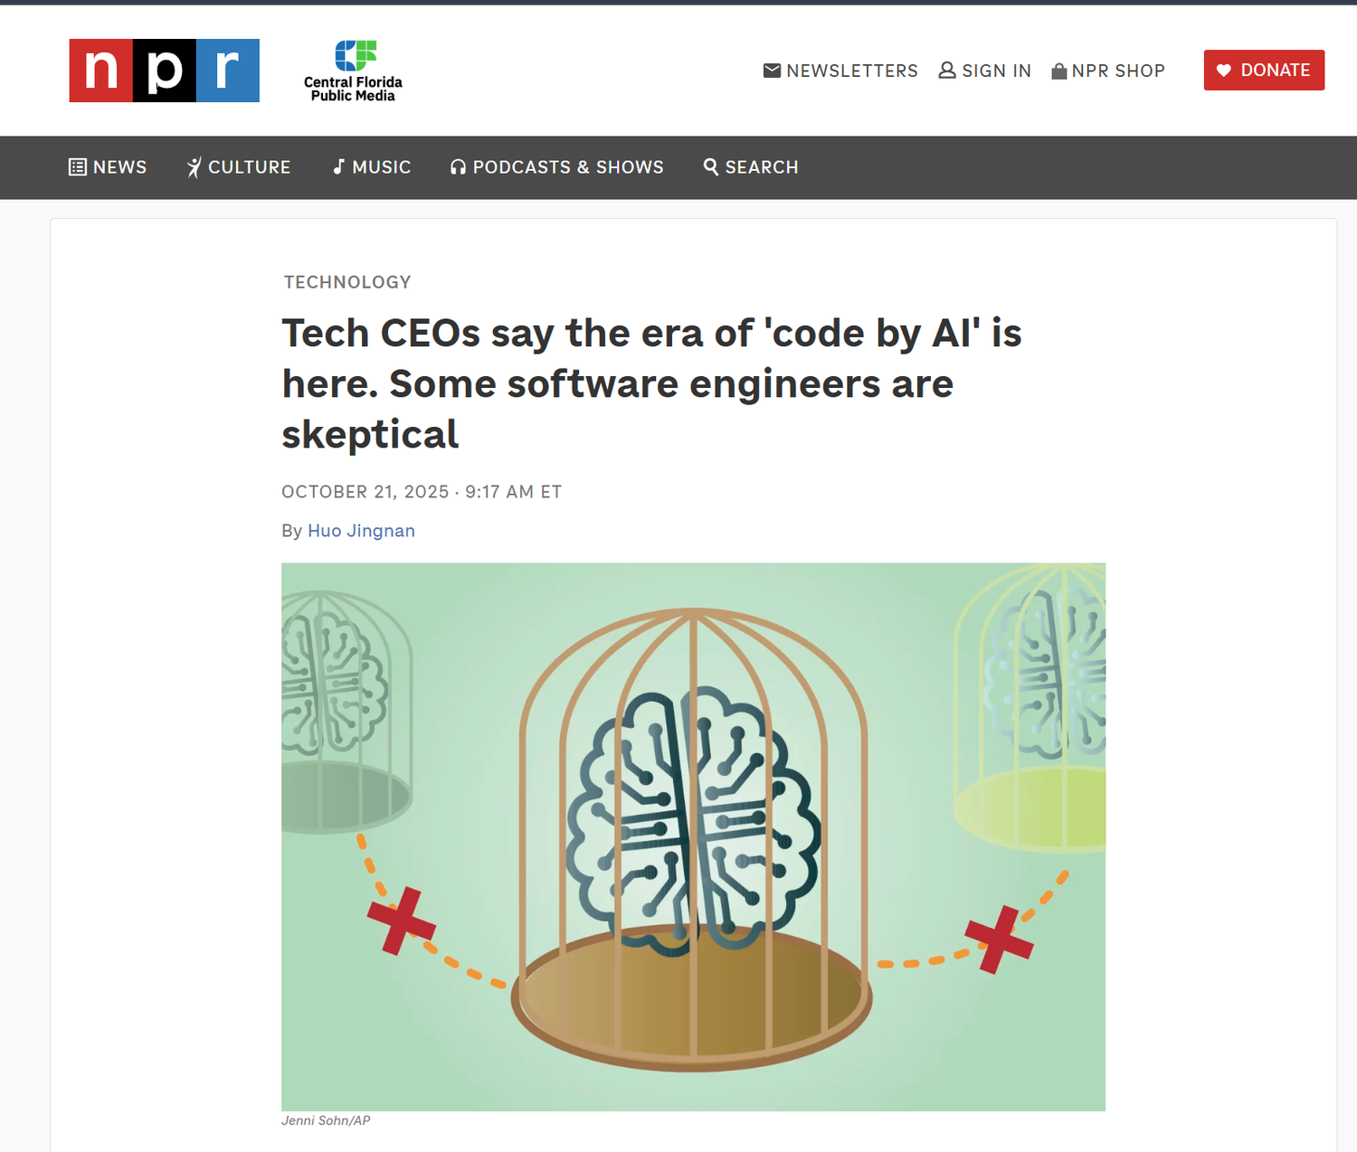
Hype check: AI-written code still needs people who test it
image.png
Hype check: AI-written code still needs people who test it source

Slide 25
Next week, Do: Build a Mini-Exhibit
Next week, Do:
Build a Mini-Exhibit
watch the video, then do the exercise and post by Thursday

Slide 26
Five steps
Five steps
Plan: what it is, what goes in it, what a visitor can do
Prompt: describe it specifically and paste in your material
Revise at least five times, and test every change
Look under the hood: ask the AI to explain the code
Share the link, and open it in a private window
Notes:
Claude artifacts, ChatGPT canvas, and Gemini Canvas all work on free tiers.

Slide 27
Prompt: an example first prompt
prompt.exe
an example first prompt
> Build a single-page interactive web exhibit called “Cats in the Library of Congress.” Show these six images as a gallery. Clicking an image opens a panel with its title, date, and a two-sentence description. Add buttons to sort by date or type. Include alt text for every image.

Slide 28
Discussion question
discuss.txt
What decisions did building force you to make about your material?
Post: link + screenshot + prompt list (3 pts), a 250+ word reflection (4), one citation (1), two replies (2).

Slide 29
Quote: Simon Willison, 2025
quote.txt
“The best way to learn LLMs is to play with them. Throwing absurd ideas at them and vibe-coding until they almost sort-of work is a genuinely useful way to accelerate the rate at which you build intuition for what works and what doesn’t.”
— Simon Willison, 2025

