Slide 1
Module Three: Reading at Scale
ENG3861.EXE
WORDS
Module Three
Reading at Scale
> ENG 3861 // FEB 8 – FEB 21, 2027_

Slide 2
Readings
Readings
Ted Underwood, “Seven ways humanists are using computers to understand text” (2015) — a friendly tour of text analysis
Miriam Posner, “How did they make that?” (2013) — real DH projects, and what you'd need to know to build them

Slide 3

Close reading: one passage, slowly. Distant reading: patterns across many texts.
image.png
Close reading: one passage, slowly. Distant reading: patterns across many texts.

Slide 4
Seven ways
Seven ways
Ted Underwood's map of text analysis

Slide 5
Quote: Ted Underwood, 2015
quote.txt
“In short, computational analysis of text is not a specific new technology or a subfield of digital humanities; it’s a wide-open conversation in the space between several different disciplines.”
— Ted Underwood, 2015

Slide 6
Underwood's seven ways
Underwood's seven ways
Visualize single texts
Choose features to represent texts
Identify distinctive vocabulary
Find or organize works
Model literary forms or genres
Model social boundaries
Unsupervised modeling
Notes:
Underwood's headings, in his order. Voyant this module mostly covers the first three.

Slide 7
Quote: Ted Underwood, 2015
quote.txt
“People make fun of word clouds, with some justice; they’re eye-catching but don’t give you a lot of information.”
— Ted Underwood, 2015
Notes:
Good warning before students open Voyant's Cirrus tool.

Slide 8
Quote: Ted Underwood, 2015
quote.txt
“I guess Wordsworth does write “alone” a lot: but does he really do so more than other writers? “Alone” is a common word. How do we distinguish real insights about diction from specious cherry-picking?”
— Ted Underwood, 2015
Notes:
Why comparing texts matters: a frequent word only means something relative to other writers.

Slide 9
Quote: Ted Underwood, 2015
quote.txt
“Because this representation of text is radically different from readers’ sequential experience of language, people tend to be surprised that it works. But the goal of computational analysis is not, after all, to reproduce the modes of understanding readers have already achieved.”
— Ted Underwood, 2015

Slide 10
Texts become data
Texts become data

Slide 11
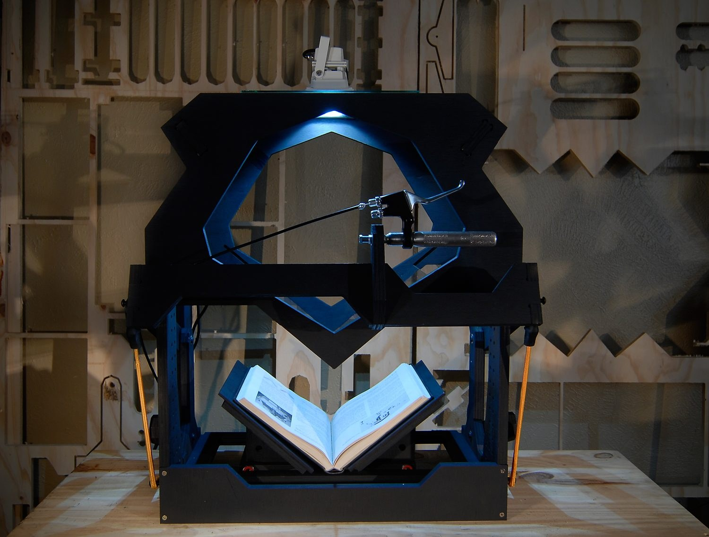
Before any of this works, someone has to digitize the books
image.png
Before any of this works, someone has to digitize the books

Slide 12
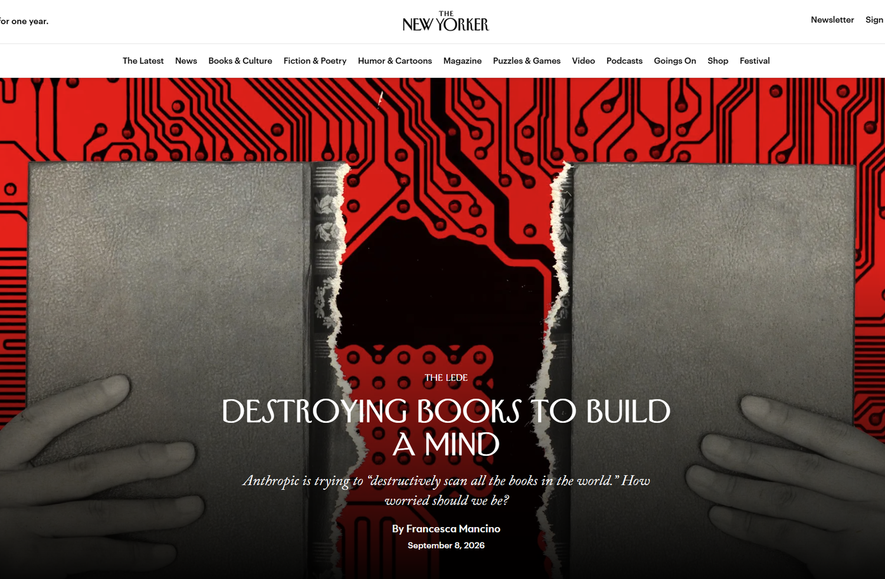
Today, whole libraries are scanned to train AI models
image.png
Today, whole libraries are scanned to train AI models source

Slide 13
How did they make that?
How did they make that?
Miriam Posner takes DH projects apart

Slide 14
Quote: Miriam Posner, 2013
quote.txt
“Many students tell me that in order to get started with digital humanities, they’d like to have some idea of what they might do and what technical skills they might need in order to do it.”
— Miriam Posner, 2013

Slide 15
Quote: Miriam Posner, 2013 (one of her example projects)
quote.txt
“A searchable map of the addresses contained in the 1956 Negro Travelers’ Green Book, which the user can filter by state or establishment type.”
— Miriam Posner, 2013 (one of her example projects)
Notes:
Each project in Posner's post gets a 'What it is', a 'What you'd need to know', and a 'Get started' section.

Slide 16
Posner's breakdown
Posner's breakdown
What it is: the project, in a sentence
What you'd need to know: the skills and tools behind it
Get started: where a beginner could begin

Slide 17
Quote: Miriam Posner, 2013
quote.txt
“Often, people who are new to text analysis enjoy starting with the web-based Voyant Tools. I also like the Lexos suite.”
— Miriam Posner, 2013

Slide 18
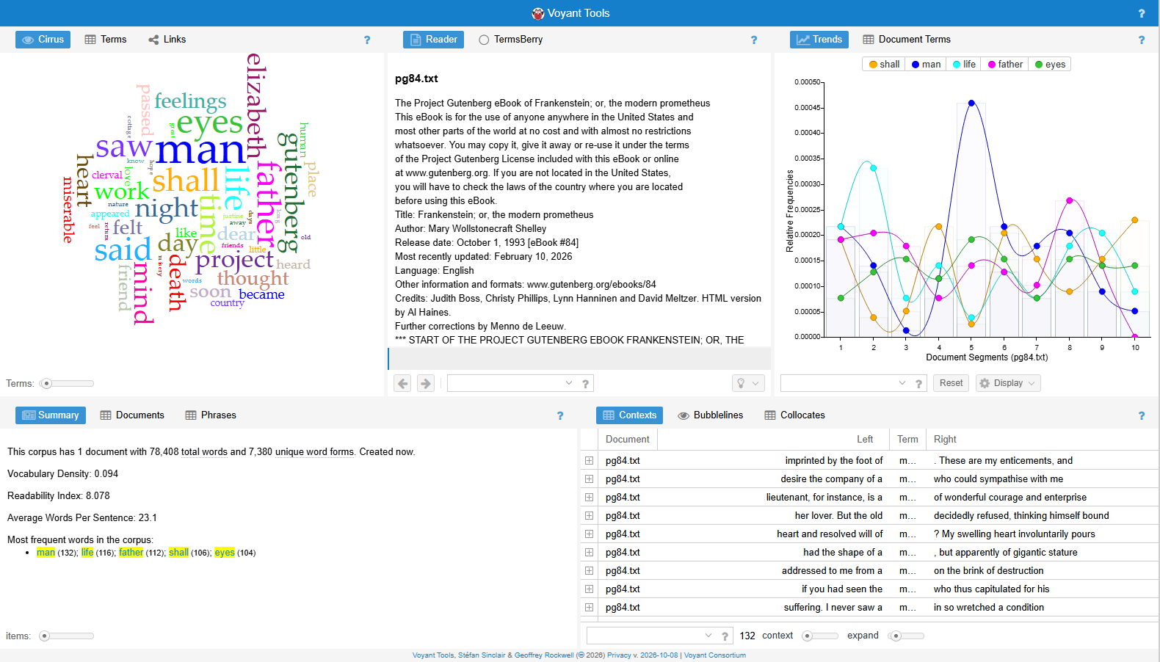
Frankenstein in Voyant. Spot the words that aren't from the novel.
image.png
Frankenstein in Voyant. Spot the words that aren't from the novel.
Notes:
'gutenberg' and 'project' are in the Cirrus cloud because Project Gutenberg's license text is counted along with the novel. Good moment to explain stopwords.

Slide 19
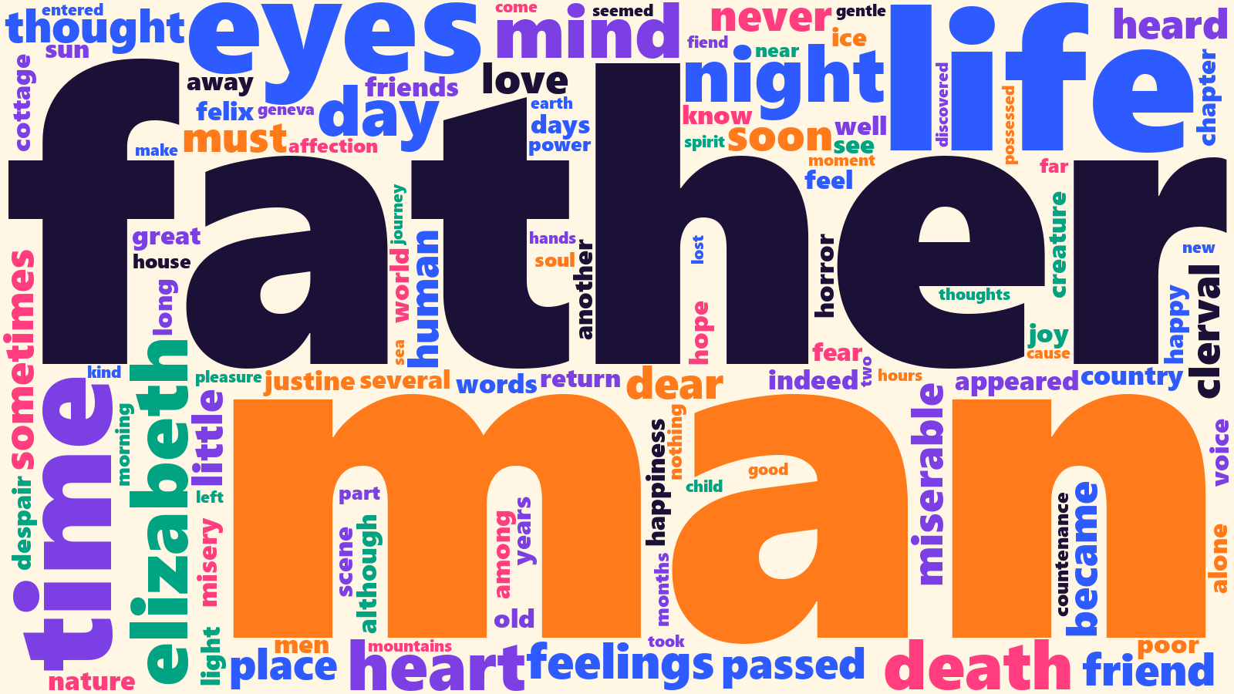
The same novel, cleaned: license text removed and common words filtered out
image.png
The same novel, cleaned: license text removed and common words filtered out
Notes:
Cleaning is an interpretive choice. 'chapter' still made it in. Underwood's warning applies: eye-catching, not much information.

Slide 20
Distant reading with AI
Distant reading with AI
a demo from the graduate version of this course

Slide 21
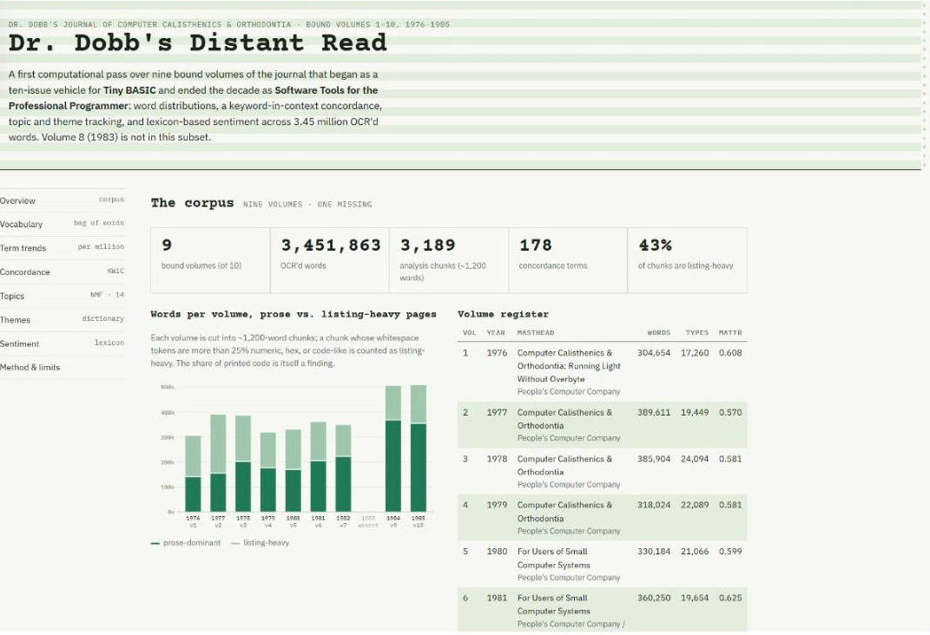
A decade of Dr. Dobb's Journal, distant-read with Claude
image.png
A decade of Dr. Dobb's Journal, distant-read with Claude source

Slide 22
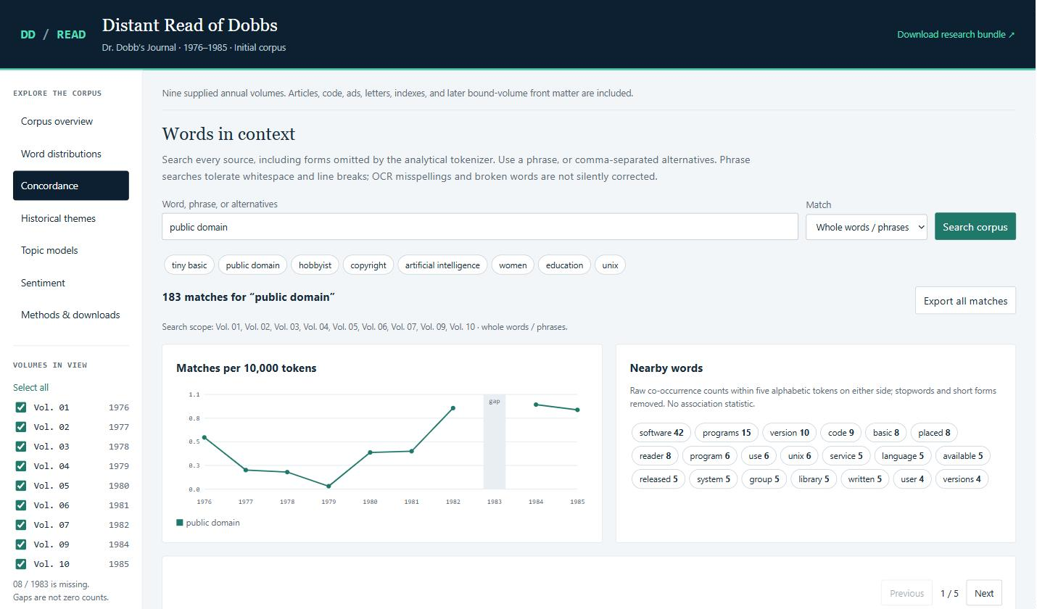
A concordance (keyword in context), the same idea as Voyant's Contexts tool
image.png
A concordance (keyword in context), the same idea as Voyant's Contexts tool source
Notes:
Ask: how would you check whether these counts are right? That's what Voyant is for this module.

Slide 23
Next week, Do: Distant Reading with Voyant and AI
Next week, Do:
Distant Reading with Voyant and AI
watch the video, then do the exercise and post by Thursday

Slide 24
Four steps
Four steps
Pick 2-3 related texts from Project Gutenberg (Plain Text UTF-8)
Explore them in Voyant Tools: Cirrus, Terms, Trends, Contexts
Ask an AI assistant the same questions
Check its counts and quotations against Voyant

Slide 25
Prompt: then search for those passages in Voyant's Contexts
prompt.exe
then search for those passages in Voyant's Contexts
> Find three passages where the word "[a word you explored in Voyant]" appears, and explain what it means in each.

Slide 26
Discussion question
discuss.txt
What pattern did you find that close reading alone would have missed?

Slide 27
Discussion question
discuss.txt
Why might a tool that generates text be worse at counting than a tool built only to count?
Post: 3 screenshots (3 pts), a 250+ word reflection (4), one citation (1), two replies (2).

