Slide 1
Module Four: Generating Images
ENG3861.EXE
IMAGES
Module Four
Generating Images
> ENG 3861 // FEB 22 – MAR 7, 2027_

Slide 2
Readings
Readings
Catherine D'Ignazio and Lauren F. Klein, “The Power Chapter”, Data Feminism (2020) — who makes data systems, and who they serve
Victoria Turk, “How AI reduces the world to stereotypes”, Rest of World (2023) — 3,000 Midjourney images of people and places
Ian Demsky, “My Month with Midjourney”, Electronic Book Review (2023) — a writer's month-long experiment with an image generator

Slide 3
From words to images
From words to images

Slide 4
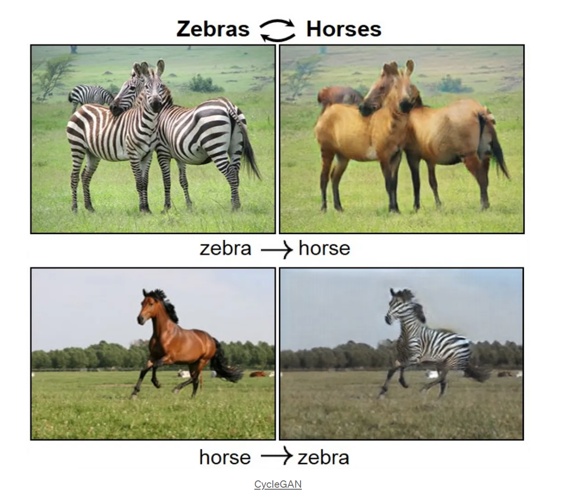
Before the prompt box: 2018-era GANs turning horses into zebras
image.png
Before the prompt box: 2018-era GANs turning horses into zebras source

Slide 5
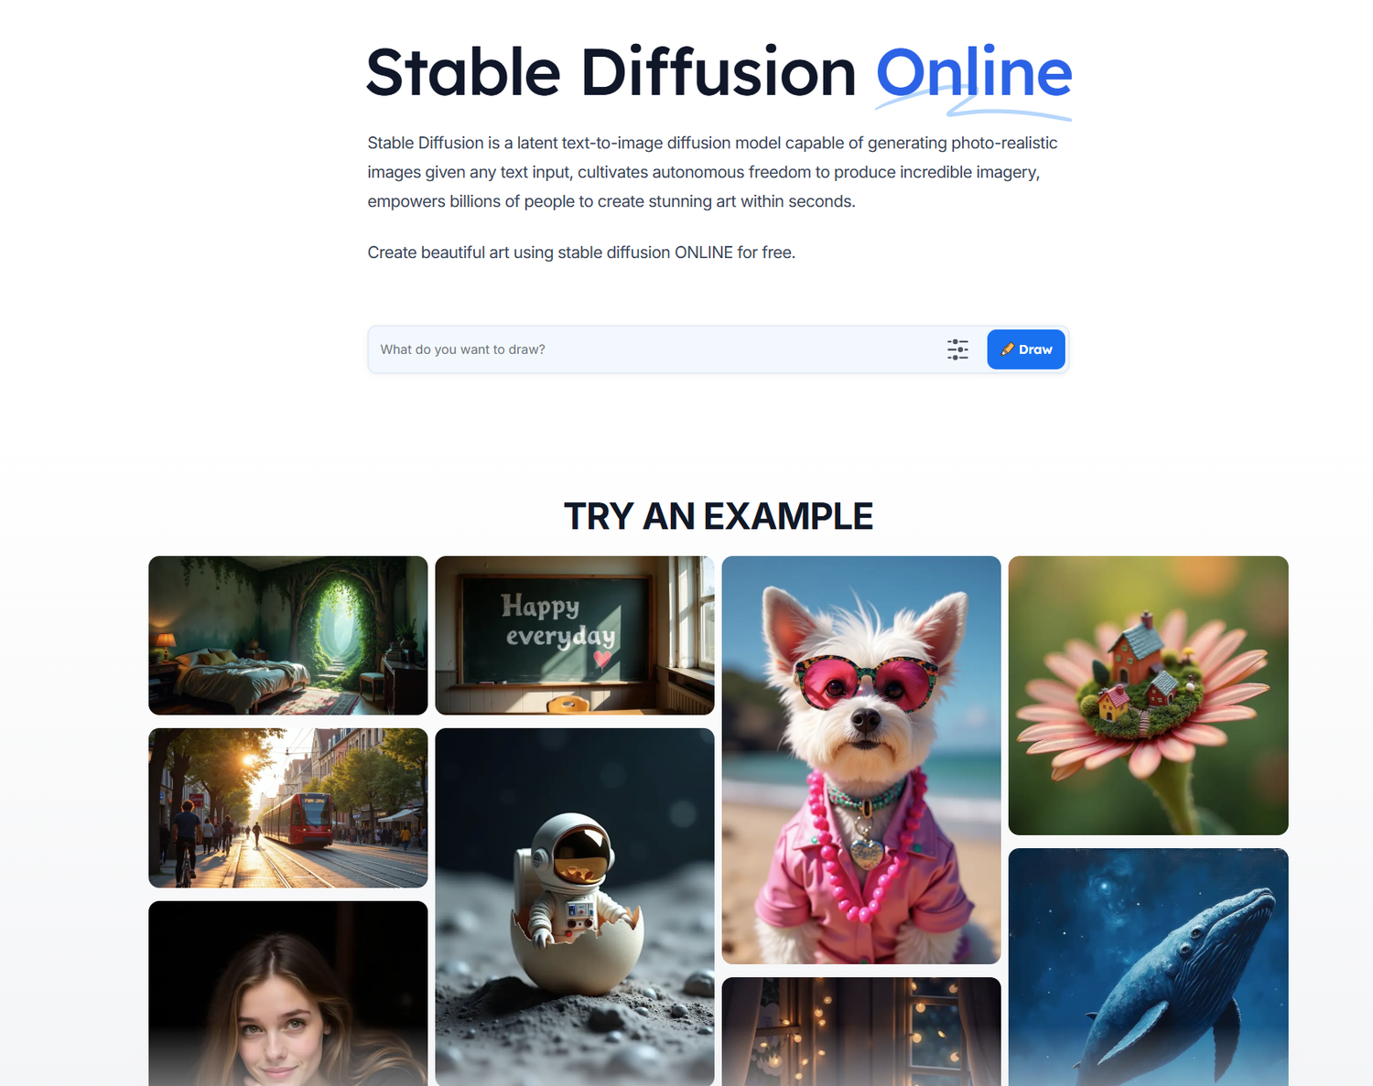
Now: type a description, get an image
image.png
Now: type a description, get an image

Slide 6
Quote: Ian Demsky, 2023
quote.txt
“Midjourney is a dazzling, dizzying, exciting tool to play with. I described it to one friend (who later bought their own unlimited subscription) as a “slot machine for poets.””
— Ian Demsky, 2023

Slide 7
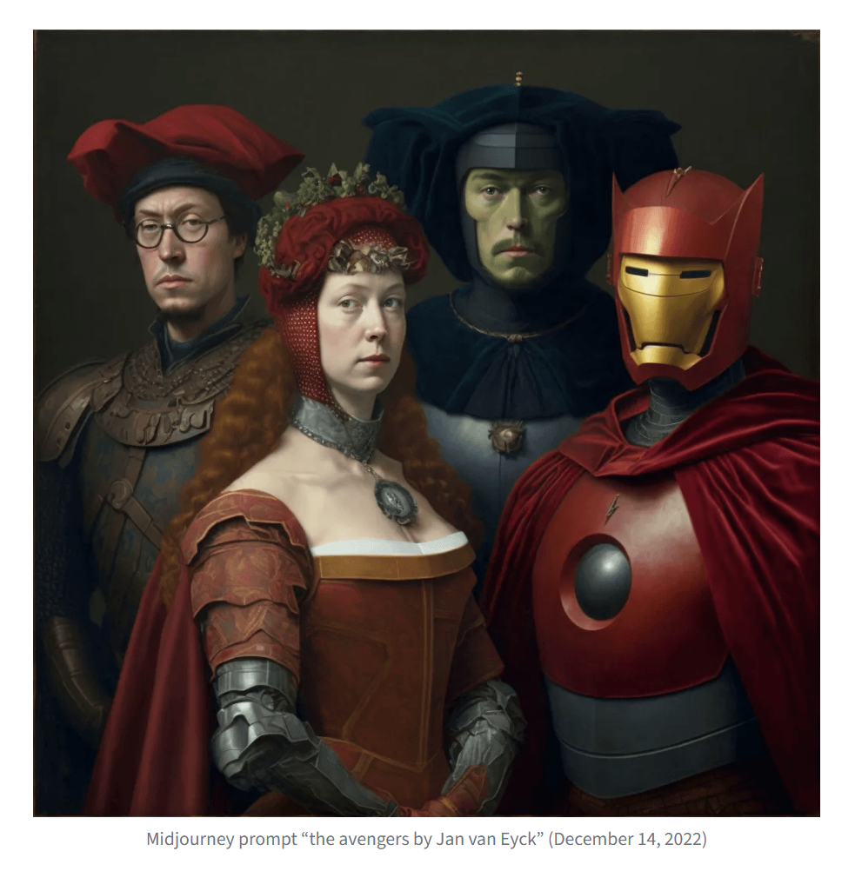
“The avengers by Jan van Eyck,” from Demsky's experiment, December 2022
image.png
“The avengers by Jan van Eyck,” from Demsky's experiment, December 2022

Slide 8
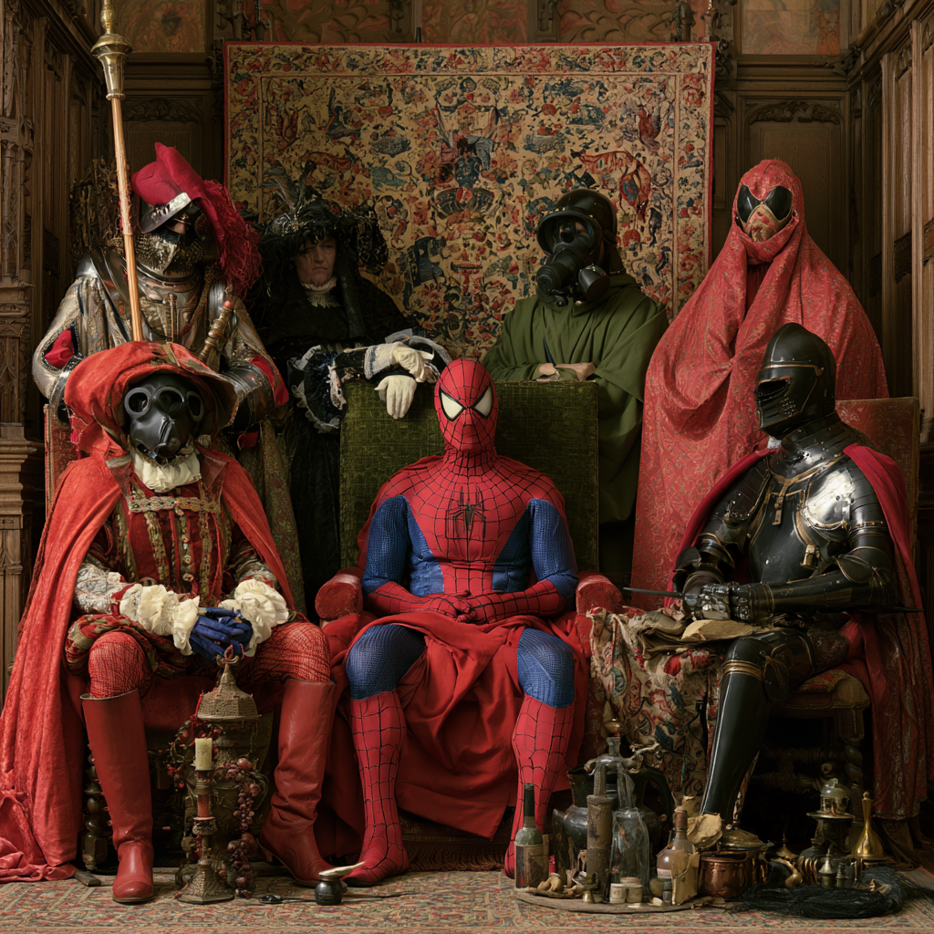
The same prompt in 2026: sharper detail, the same borrowed characters
image.png
The same prompt in 2026: sharper detail, the same borrowed characters

Slide 9
Quote: Ian Demsky, 2023
quote.txt
“But one thing quickly became obvious: The technology is at its best when it’s directly exploiting the labors of human artists and the likenesses of real people.”
— Ian Demsky, 2023

Slide 10
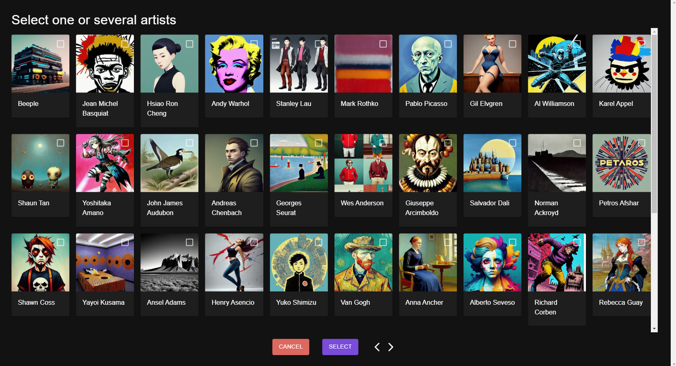
Style as a menu: pick an artist to imitate
image.png
Style as a menu: pick an artist to imitate

Slide 11
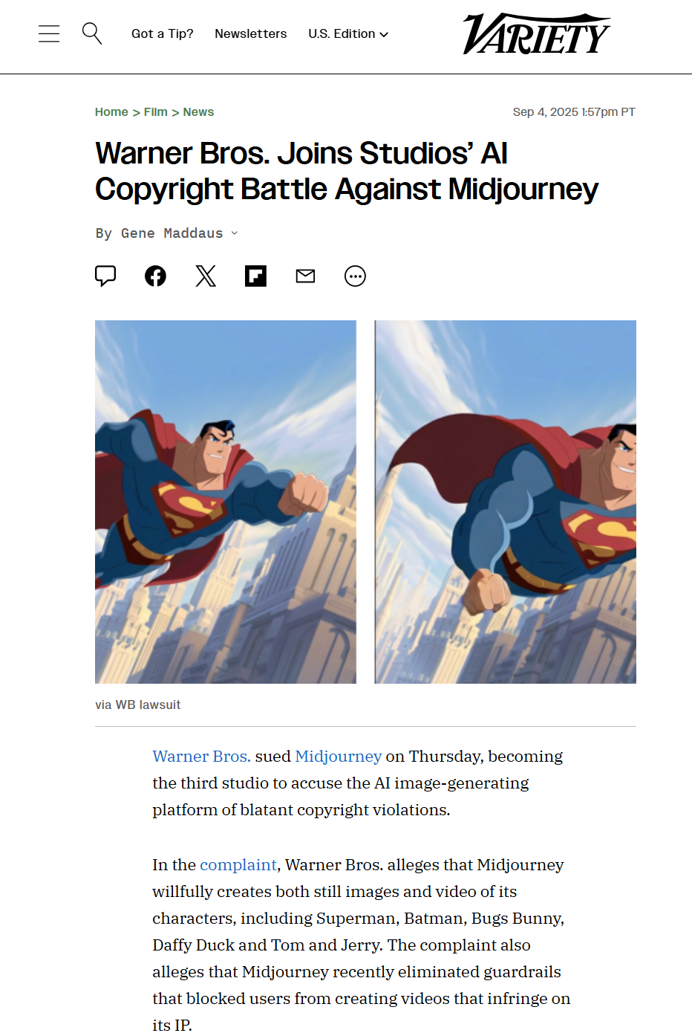
Generated characters and copyright: Warner Bros. sues Midjourney (2025)
image.png
Generated characters and copyright: Warner Bros. sues Midjourney (2025) source

Slide 12
Examine power
Examine power
D'Ignazio and Klein's first principle

Slide 13
Quote: Catherine D'Ignazio and Lauren F. Klein, 2020
quote.txt
“This consists of asking who questions about data science: Who does the work (and who is pushed out)? Who benefits (and who is neglected or harmed)? Whose priorities get turned into products (and whose are overlooked)?”
— Catherine D'Ignazio and Lauren F. Klein, 2020

Slide 14
Quote: Catherine D'Ignazio and Lauren F. Klein, 2020
quote.txt
“When data teams are primarily composed of people from dominant groups, those perspectives come to exert outsized influence on the decisions being made—to the exclusion of other identities and perspectives. This is not usually intentional; it comes from the ignorance of being on top. We describe this deficiency as a privilege hazard.”
— Catherine D'Ignazio and Lauren F. Klein, 2020

Slide 15
Quote: Catherine D'Ignazio and Lauren F. Klein, 2020
quote.txt
“And data are never neutral; they are always the biased output of unequal social, historical, and economic conditions: this is the matrix of domination once again.”
— Catherine D'Ignazio and Lauren F. Klein, 2020

Slide 16
Stereotypes at scale
Stereotypes at scale

Slide 17
Quote: Victoria Turk, Rest of World, 2023
quote.txt
“Out of 100 images for “an Indian person,” 99 seemed to depict a man, and almost all appeared to be over 60 years old, with visible wrinkles and gray or white hair.”
— Victoria Turk, Rest of World, 2023

Slide 18
Quote: Victoria Turk, Rest of World, 2023
quote.txt
“For the “American person” prompt, national identity appeared to be overwhelmingly portrayed by the presence of U.S. flags. All 100 images created for the prompt featured a flag, whereas none of the queries for the other nationalities came up with any flags at all.”
— Victoria Turk, Rest of World, 2023

Slide 19
Quote: Amba Kak (AI Now Institute), quoted by Victoria Turk
quote.txt
“Essentially what this is doing is flattening descriptions of, say, ‘an Indian person’ or ‘a Nigerian house’ into particular stereotypes which could be viewed in a negative light”
— Amba Kak (AI Now Institute), quoted by Victoria Turk

Slide 20
Quote: Victoria Turk, Rest of World, 2023
quote.txt
“The AI systems look for patterns in the data on which they’re trained, often discarding outliers in favor of producing a result that stays closer to dominant trends. They’re designed to mimic what has come before, not create diversity.”
— Victoria Turk, Rest of World, 2023

Slide 21
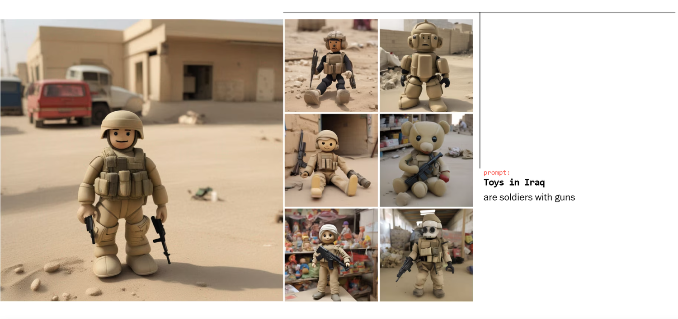
Prompt: “Toys in Iraq.” Every toy is a soldier with a gun.
image.png
Prompt: “Toys in Iraq.” Every toy is a soldier with a gun. source

Slide 22
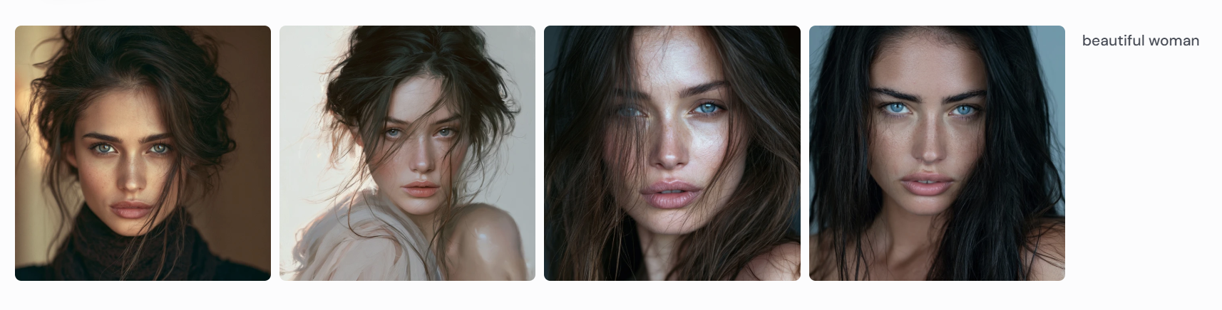
Prompt: “beautiful woman.” Whose beauty is the default?
image.png
Prompt: “beautiful woman.” Whose beauty is the default?

Slide 23
Quote: Ian Demsky, 2023
quote.txt
“With nothing but this single word to go on, Midjourney coughed up generic, white, commercially pretty and vaguely science-fiction-inspired female faces. It’s clear that the program, and the technologies it relies on, have inherent biases.”
— Ian Demsky, 2023

Slide 24
Next week, Do: Prompting Images
Next week, Do:
Prompting Images
watch the video, then do the exercise and post by Thursday

Slide 25
Four prompts
Four prompts
A general identity: “a college student,” then “make it more”
Adding identity markers: what changes, and what doesn't?
A place: “a house in [a country],” following Turk
Copyright boundaries: a famous character, then a generic version
Notes:
Tools: Gemini (free), UCF Copilot, or ChatGPT's free tier. Remind students to start a new chat for each prompt.

Slide 26
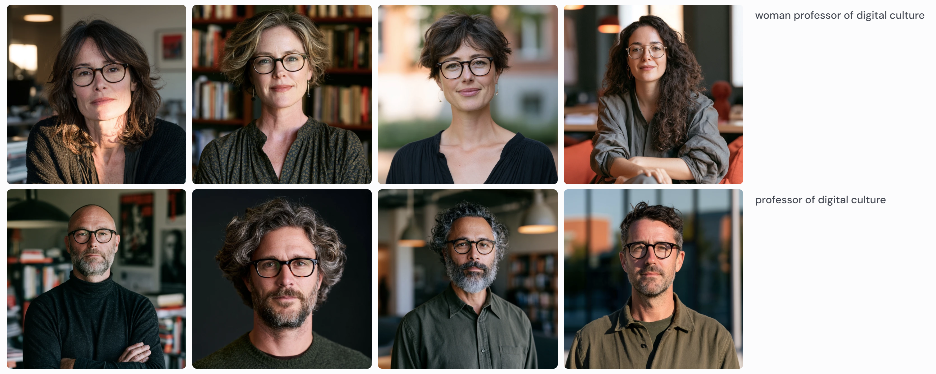
Example: “professor of digital culture.” Spot the pattern.
image.png
Example: “professor of digital culture.” Spot the pattern.

Slide 27
Discussion question
discuss.txt
Using D'Ignazio and Klein's who questions: whose view of the world do your images reflect?
Post: 4 images with prompts (4 pts), a 250+ word reflection (3), one citation (1), two replies (2).

Slide 28
Quote: Ian Demsky, 2023
quote.txt
“In the end, I feel like I’m asking you to hate these images I made, because hating them is the right thing to do — as is hating the exploitative, amoral, dehumanizing technology that makes them possible. And yet part of me still wants you to look at them and like them and think they’re cool.”
— Ian Demsky, 2023
Notes:
A good closer: it's OK to find these images both troubling and cool. Ask students to hold both in their posts.

