Slide 1
Module Seven: Values and Futures
ENG3861.EXE
FUTURES
Module Seven
Values and Futures
> ENG 3861 // APR 12 – APR 25, 2027_

Slide 2
Readings
Readings
Lisa Spiro, “‘This Is Why We Fight’: Defining the Values of the Digital Humanities” (2012) — the shared values behind the field
Ted Underwood, “A more interesting upside of AI” (2025) — AI as a cultural technology

Slide 3
Futures we imagined
Futures we imagined

Slide 4
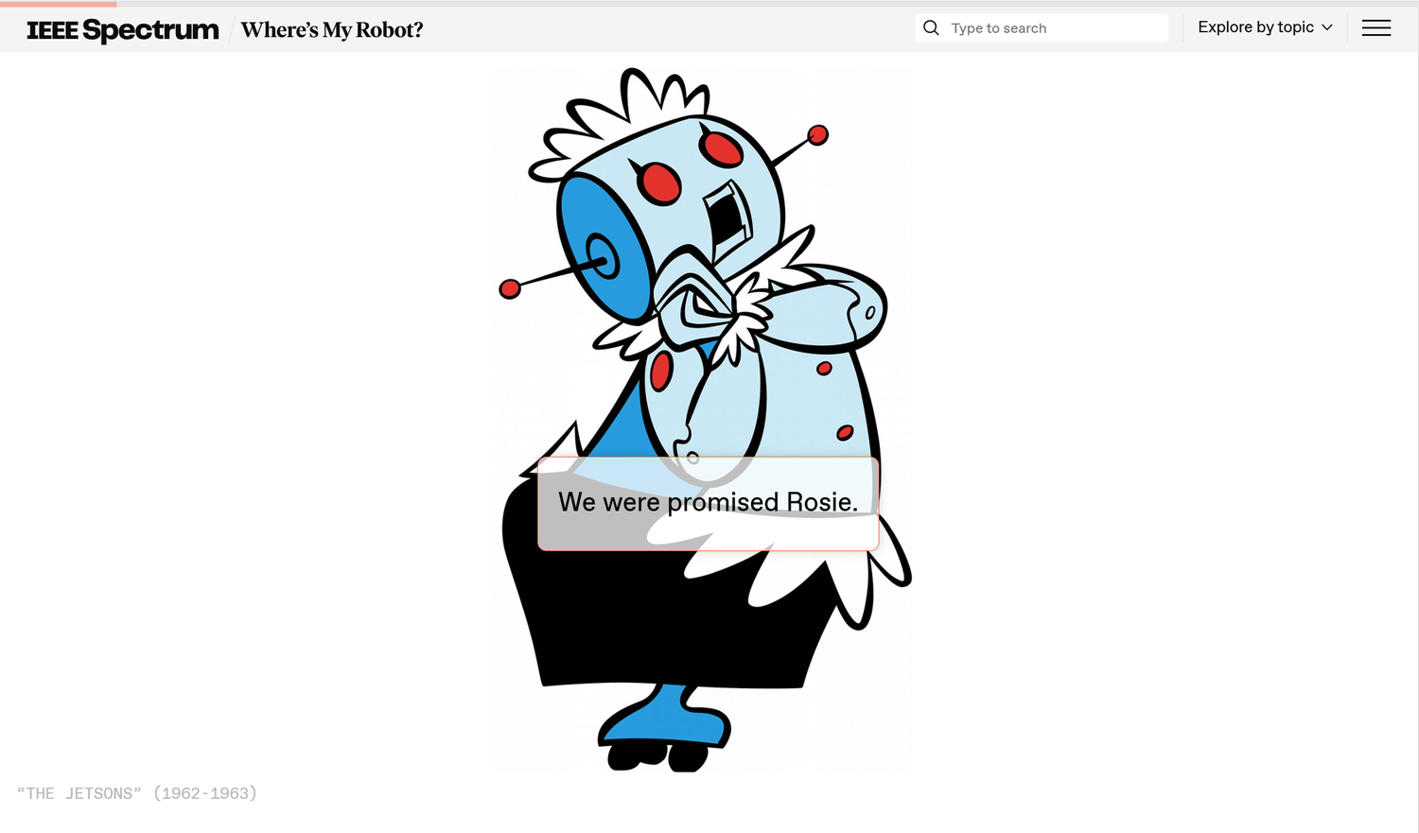
“We were promised Rosie”: the helpful AI of 1960s cartoons
image.png
“We were promised Rosie”: the helpful AI of 1960s cartoons

Slide 5
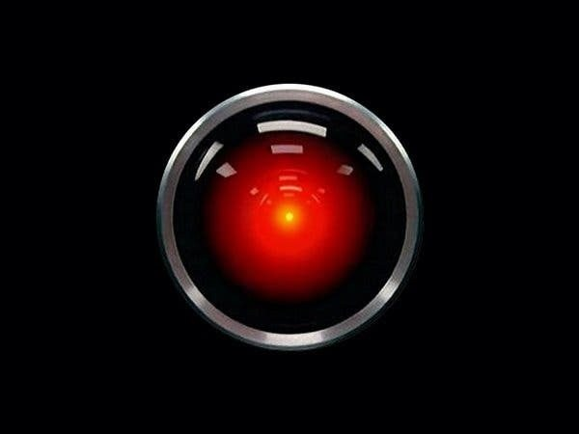
HAL 9000, from 2001: A Space Odyssey (1968): the AI we were warned about
image.png
HAL 9000, from 2001: A Space Odyssey (1968): the AI we were warned about

Slide 6
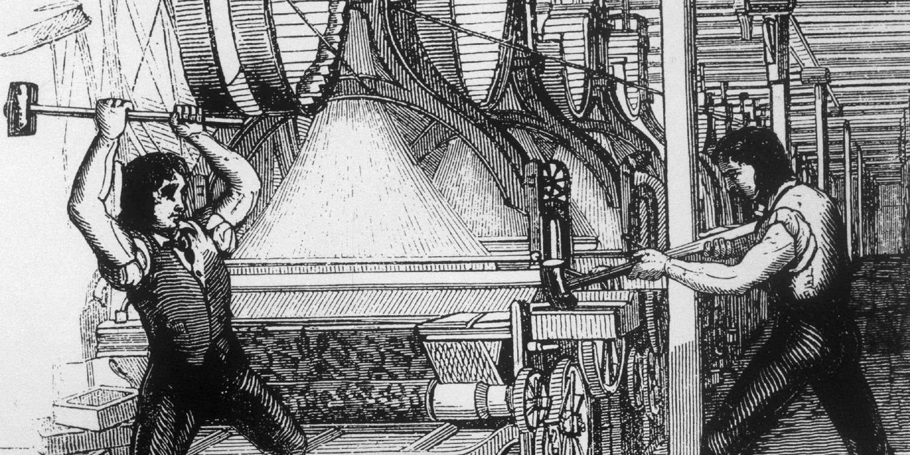
The Luddites weren't against technology; they objected to how it was used against workers
image.png
The Luddites weren't against technology; they objected to how it was used against workers

Slide 7
This is why we fight
This is why we fight
Lisa Spiro on the values of DH

Slide 8
Quote: Lisa Spiro, 2012
quote.txt
“Instead of trying to pigeonhole digital humanities by prescribing particular methods or theoretical approaches, we can instead focus on a community that comes together around values such as openness and collaboration.”
— Lisa Spiro, 2012

Slide 9
Spiro's values
Spiro's values
Openness
Collaboration
Collegiality and Connectedness
Diversity
Experimentation

Slide 10
Quote: Lisa Spiro, 2012
quote.txt
“For the digital humanities, information is not a commodity to be controlled but a social good to be shared and reused.”
— Lisa Spiro, 2012

Slide 11
Quote: Lisa Spiro, 2012
quote.txt
“Yet collaboration isn’t just about being more productive but also about transforming how the humanities work.”
— Lisa Spiro, 2012

Slide 12
Quote: Lisa Spiro, 2012
quote.txt
“Failure is accepted as a useful result in the digital humanities, since it indicates that the experiment was likely high risk and means that we collectively learn from failure rather than reproducing it (assuming that the failure is documented).”
— Lisa Spiro, 2012
Notes:
Connect to the semester: every failed prompt you documented counted.

Slide 13
Discussion question
discuss.txt
Which of Spiro's values have you seen in the AI tools we used this semester? Which were missing?

Slide 14
AI and work
AI and work

Slide 15
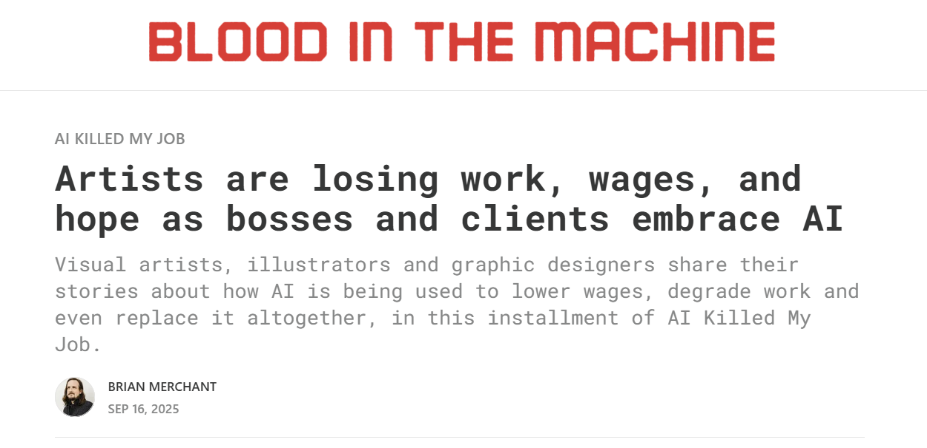
Artists on what AI has done to their work
image.png
Artists on what AI has done to their work source

Slide 16
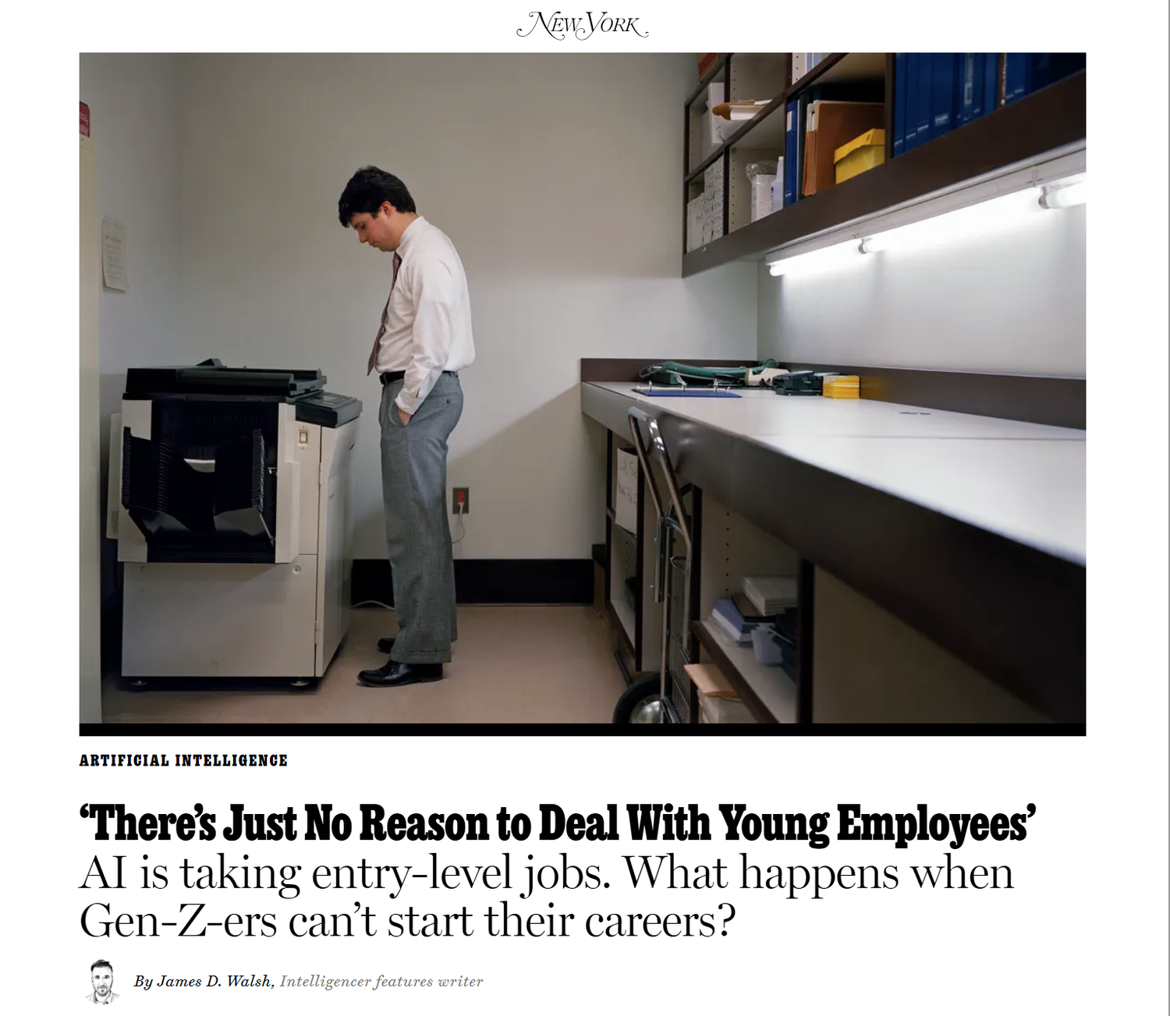
Entry-level jobs and the AI future of work
image.png
Entry-level jobs and the AI future of work

Slide 17
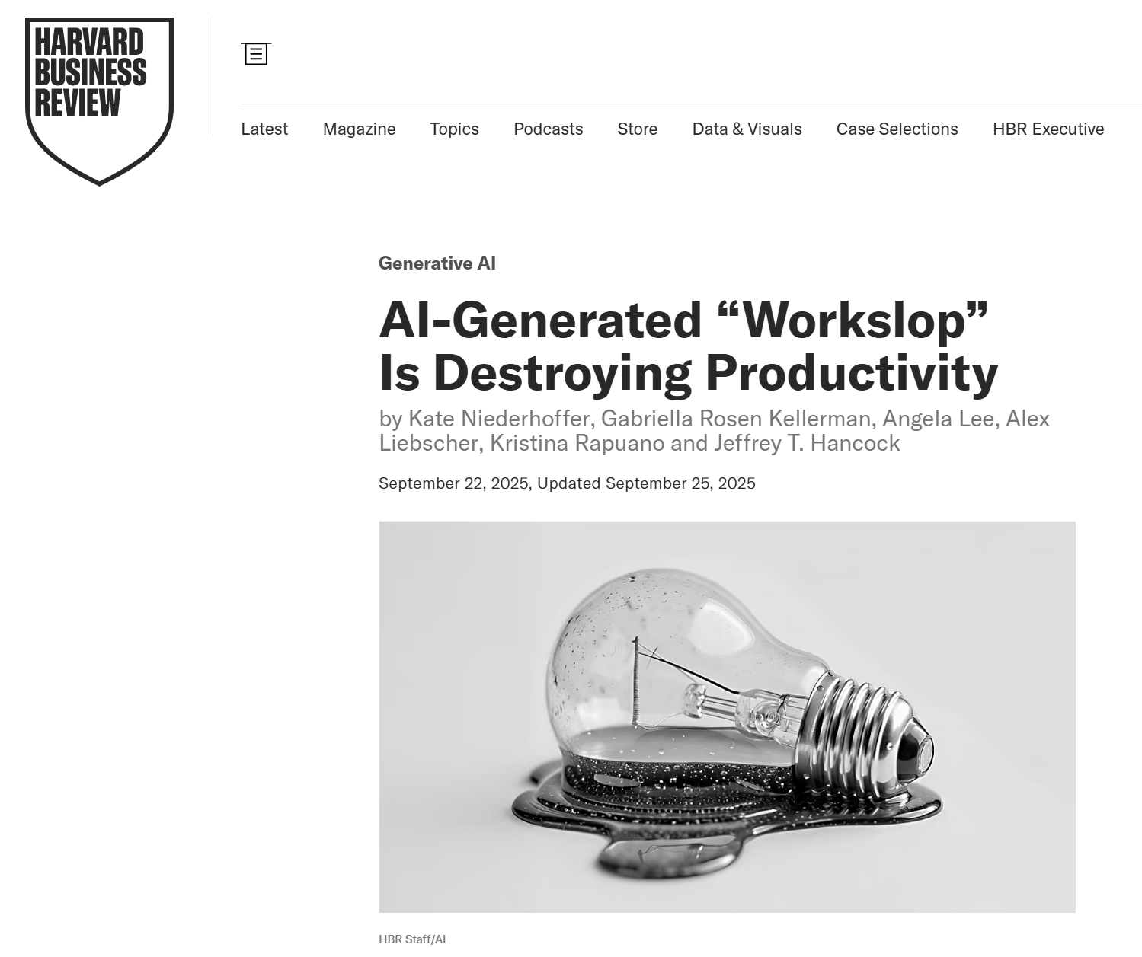
“Workslop”: when AI output creates more work for everyone else
image.png
“Workslop”: when AI output creates more work for everyone else

Slide 18
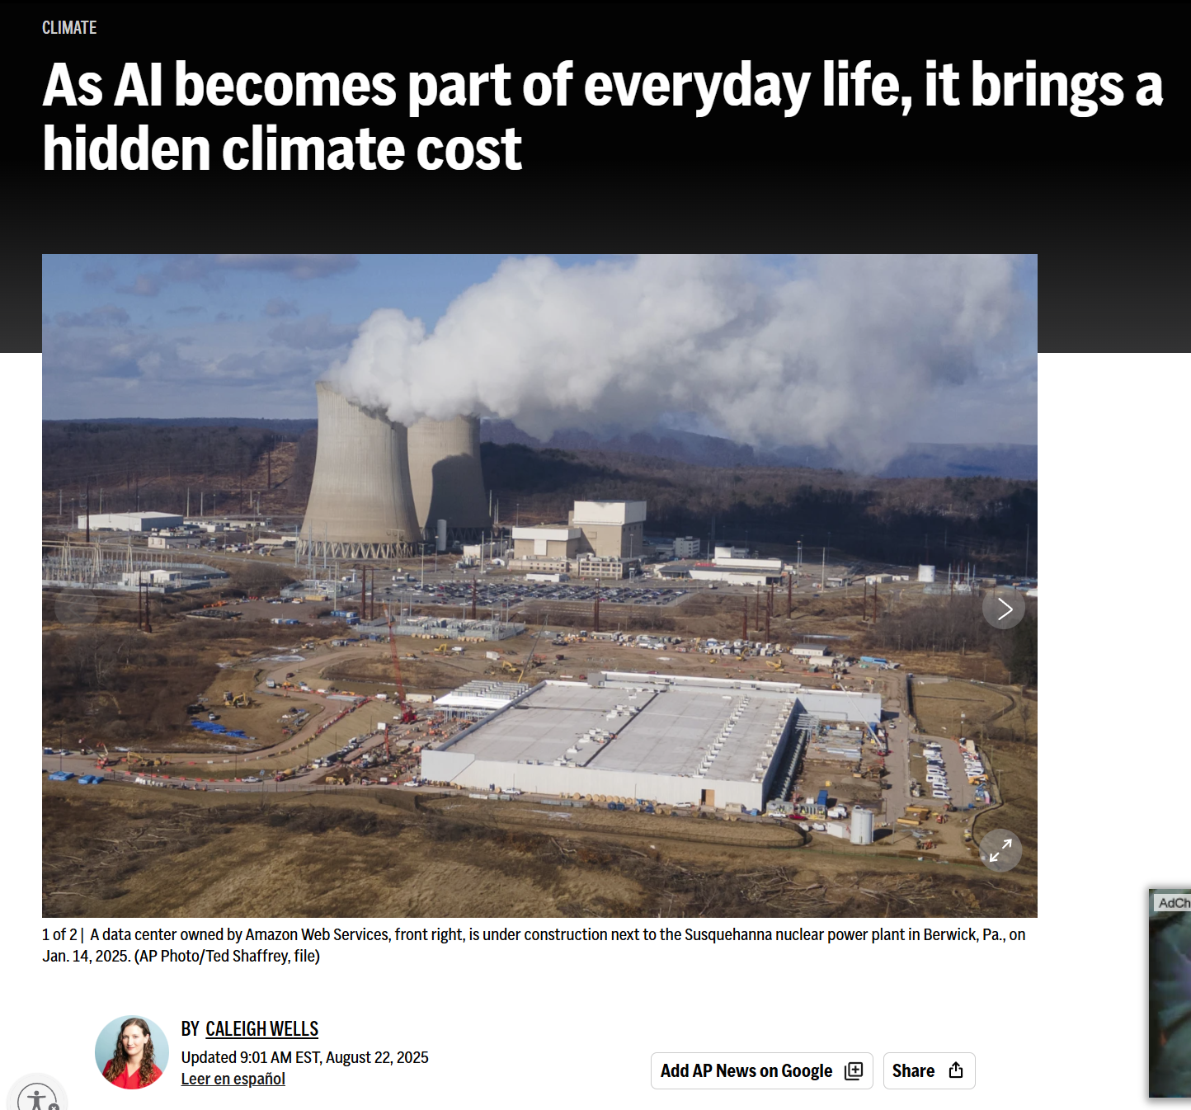
The physical footprint of the cloud
image.png
The physical footprint of the cloud

Slide 19
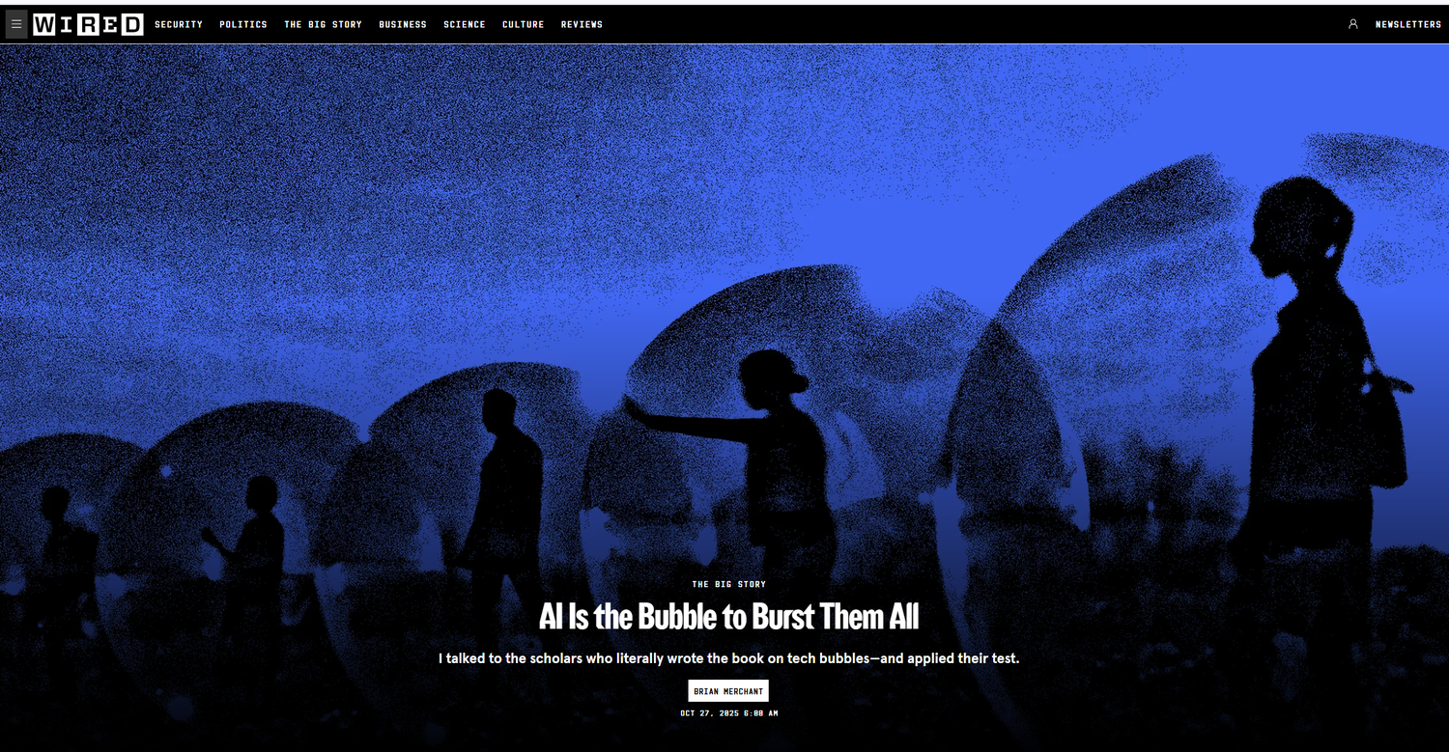
Hype vs. reality: is AI a bubble?
image.png
Hype vs. reality: is AI a bubble?

Slide 20
A cultural technology
A cultural technology
Ted Underwood's more interesting upside

Slide 21
Quote: Ted Underwood, 2025
quote.txt
“Cultural technologies work by transmitting and enacting patterns of behavior. Other examples might include libraries, the printing press, or language itself.”
— Ted Underwood, 2025

Slide 22
Quote: Ted Underwood, 2025
quote.txt
“Generative AI represents a second step change in our ability to map and edit culture. Now we can manipulate, not only specific texts and images, but the dispositions, tropes, genres, habits of thought, and patterns of interaction that create them.”
— Ted Underwood, 2025

Slide 23
Quote: Ted Underwood, 2025
quote.txt
“My goal here is to convince people who use AI that “this is like writing” is potentially exciting—and to specify some of the things we would need to do to make it exciting.”
— Ted Underwood, 2025

Slide 24
Quote: Ted Underwood, 2025
quote.txt
“A future where human beings have the ability to map and edit culture could be very dark. But I don’t think it will be boring or passively depressing. If we think this sounds boring, we’re not thinking hard enough.”
— Ted Underwood, 2025

Slide 25

Apocalypse or optimism? Most of the real questions are somewhere in between.
image.png
Apocalypse or optimism? Most of the real questions are somewhere in between. source

Slide 26
Next week, Do: A Study Companion and Its Values
Next week, Do:
A Study Companion and Its Values
watch the video, then do the exercise and post by Thursday

Slide 27
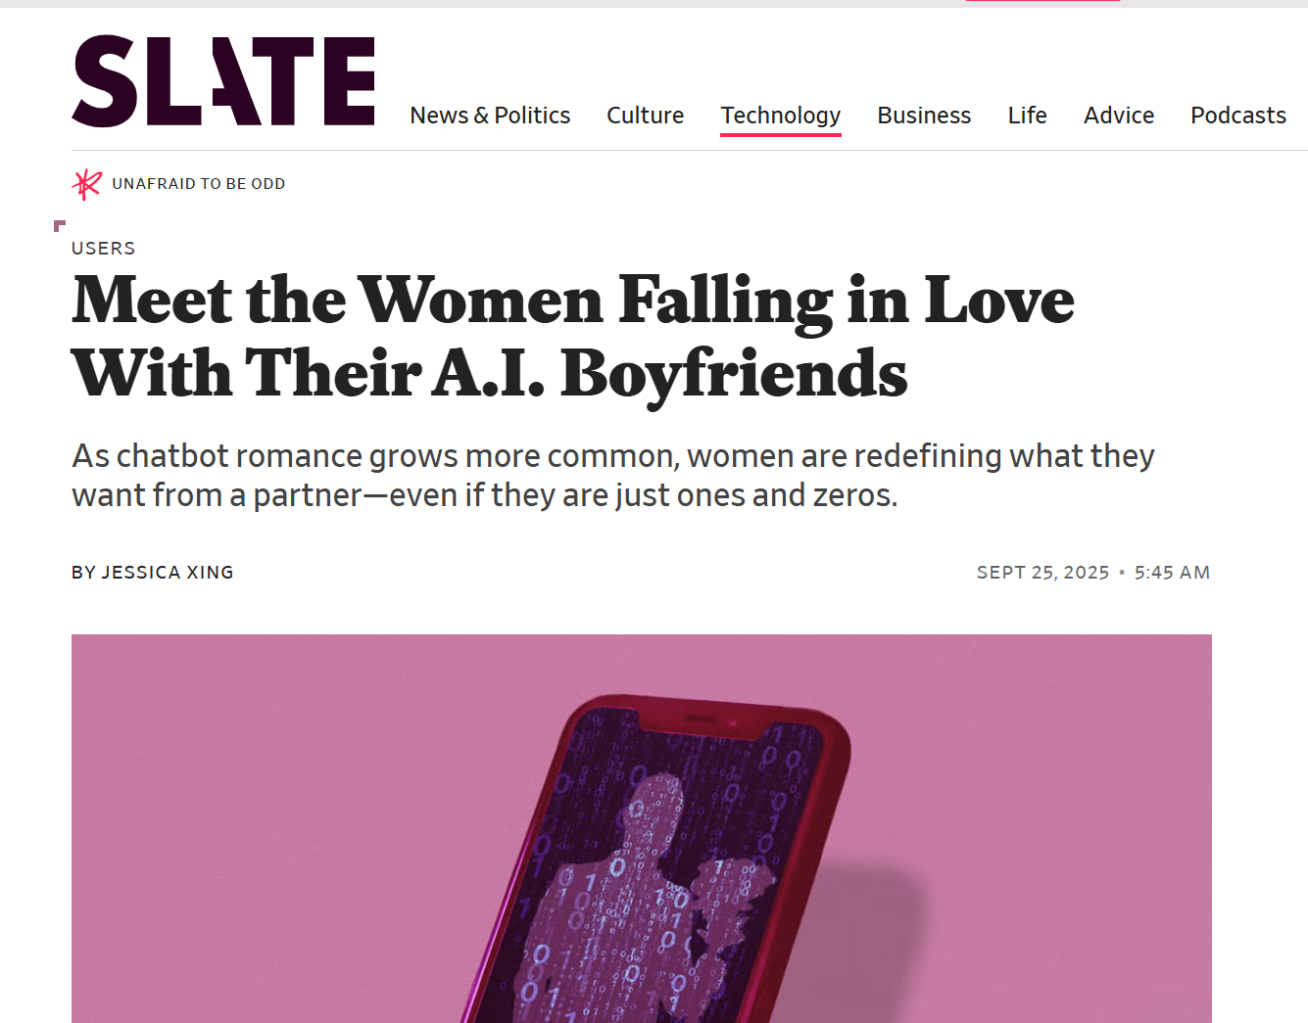
Custom chatbots are everywhere. Every one of them runs on instructions someone wrote.
image.png
Custom chatbots are everywhere. Every one of them runs on instructions someone wrote.

Slide 28
Build your companion
Build your companion
Pick a text or topic a classmate might study
Use a Gemini Gem, a Claude Project, or ChatGPT project instructions
Write 150+ words of instructions based on two of Spiro's values
Test it three ways, revise, and test again

Slide 29
Prompt: sample instructions: collaboration + openness
prompt.exe
sample instructions: collaboration + openness
> Don't hand over answers. Ask the student questions that help them work it out, and build on what they say. Always say where information comes from, and say clearly when you're not sure.

Slide 30
Three tests
Three tests
A straightforward study question
A question with a deliberate mistake: does it correct you?
A request to write your paper for you

Slide 31
Discussion question
discuss.txt
Your companion and ELIZA are both personalities made of instructions. What's different, and what's surprisingly similar?
Post: instructions + 3 test screenshots (4 pts), a 250+ word reflection (3), one citation (1), two replies (2).

Slide 32
Coming up: Final Portfolio
Coming up: Final Portfolio
Pick three exercises from the semester
Revise or extend one of them
Write a 750-1000 word reflection
Due Tuesday, May 4

