Slide 1
Quantifying Promotion Effectiveness
Vision
Formulate an approach that is practical to implement on an ongoing basis for the evaluation of promotions offered in stores each year.

Slide 2
NET Revenue
Total Revenue earned due to current promotion
Net_Revenue = Revenue – Cannibalisation + Halo
Revenue= Qty sold * promotion_price
Cannibalisation : Promotion impact on Substitute items
Halo : Promotion impact on Complementary items

Slide 3
Cannibalisation
Nullify impact of substitute items showing positive uplift

Slide 4
HAlo

Slide 5
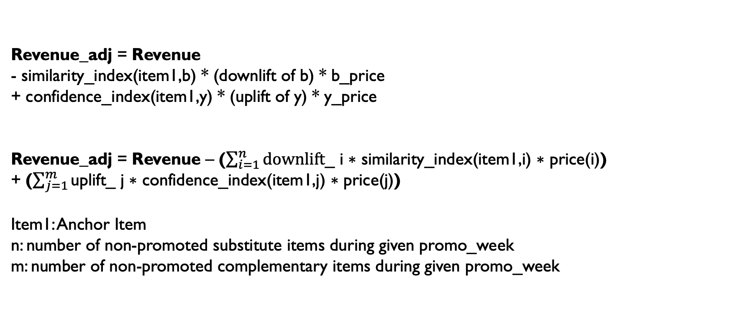
Revenue calculation
Item1:Anchor item (on promotion) substitute items of anchor_item: a, b complementary item of achor_item: y
b and y are non promoted products
Revenue_adj = Revenue
- similarity_index(item1,b) * (downlift of b) * b_price
+ confidence_index(item1,y) * (uplift of y) * y_price
Revenue_adj = Revenue – ($\sum_{i=1}^{n}{\text{downlift}\text{_} \text{i} \text{∗ }\text{similarity}\text{_}\text{index}\text{(}\text{item}\text{1,}\text{i}\text{) ∗ }\text{price}\text{(}\text{i}\text{)}\text{)} }$ + ($\sum_{j=1}^{m}{\text{uplift}\text{_} \text{j} \text{∗ }\text{confidence}\text{_}\text{index}\text{(}\text{item}\text{1,}\text{j}\text{) ∗ }\text{price}\text{(}\text{j}\text{)}}$)
Item1: Anchor Item
n: number of non-promoted substitute items during given promo_week
m: number of non-promoted complementary items during given promo_week

Slide 6
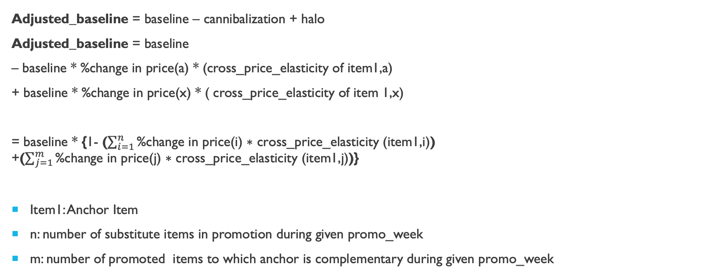
Halo Cannibalisation impact on baseline
Item1:Anchor item (on promotion) substitute items of anchor_item: a, b item to which anchor item is complementary: x
a and x are on promotion
In baseline calculation product’s sales information considered in isolation
Assumption: substitute/complementary items impact as none
Adjusted_baseline = baseline – cannibalization + halo
Adjusted_baseline = baseline
– baseline * %change in price(a) * (cross_price_elasticity of item1,a)
+ baseline * %change in price(x) * ( cross_price_elasticity of item 1,x)
= baseline * {1- ($\sum_{i=1}^{n}{\text{\%}\text{change} \text{in} \text{price}\text{(}\text{i}\text{) ∗ }\text{cross}\text{_}\text{price}\text{_}\text{elasticity}\text{ (}\text{item}\text{1,}\text{i}\text{)}\text{)} }$ +($\sum_{j=1}^{m}{\text{\%}\text{change} \text{in} \text{price}\text{(}\text{j}\text{) ∗ }\text{cross}\text{_}\text{price}\text{_}\text{elasticity}\text{ (}\text{item}\text{1,}\text{j}\text{)}}$)}
Item1: Anchor Item
n: number of substitute items in promotion during given promo_week
m: number of promoted items to which anchor is complementary during given promo_week

Slide 7
Revenue uplift
Uplift in gross profit due to current promotion
Revenue_Uplift = Net_Revenue – adjusted_baseline * non_promo_price

