Slide 1
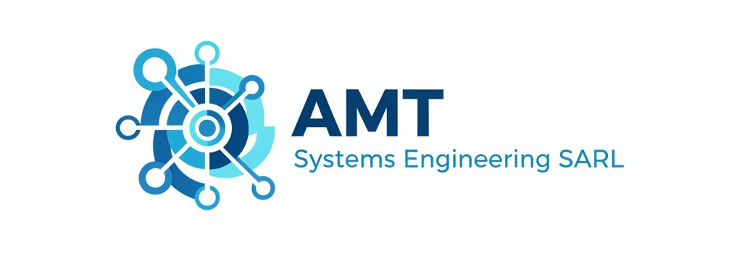
.
AMT SYSTEMS-ENGINEERING SERVICES
Engineering services
Procurement and supply services
A Unique Cross-Domain Ecosystem What sets AMT Systems Engineering SARL apart is our ability to break down silos. Traditional firms often specialize in just one area. We offer a unique selling point: a strong cross-connection between Hardware Engineering, Software Engineering, and Mechanical Engineering. By integrating Artificial Intelligence (AI) into this ecosystem, we link and enhance all these domains, delivering smart, innovative solutions from a single source.
There is no smart technology without the incorporation of IT-solutions. In today's rapidly advancing technological landscape, integrating Information Technology (IT) is crucial for creating smart and efficient solutions. At AMT Systems-Engineering SARL, we provide IT services that empower the uniqueness of potentials of your business, then making you be successful in the data-driven world. Our IT solutions enable you to access, analyze, and interpret vast amounts of data. This insight allows for more informed decision-making, optimizing operations and strategies
As companies and institutions increasingly focus on their core
competencies, the demand for outsourcing secondary activities like spare part procurement continues to rise. AMT Systems-Engineering SARL, a global player with associates worldwide, offers these
services to its customers. Connecting our business partners with potential suppliers or managing supplies on their behalf is a key aspect of our operations.
Feel free to reach out: you have no risk in contacting us, only
an opportunity you might want to pursue!
Prototyping, reverse engineering:
CAD-modelling
3D-Printing and 3D scanning
HW-Layout design & PCB prototyping.
Web & Mobile App Design:
Mobile App Design
Embedded SW design
Web App Design
Procurement services:
Customer needs Identification & Specification
Supplier Identification & Selection
Supplier Relationship Management.
Risk Management in procurement
Systems-Engineering services:
Requirement engineering
Architecture Design incl. technical implementation in HW /SW
Verification and validation50
Data Engineering & Analytics:
Data acquisition and transformation
Data analysis.
Data modeling
Supply management:
Inventory Management
Supply Chain Optimization

Slide 2
.
AMT SYSTEMS-ENGINEERING SERVICES
Engineering services
Procurement and supply services
A Unique Cross-Domain Ecosystem What sets AMT Systems Engineering SARL apart is our ability to break down silos. Traditional firms often specialize in just one area. We offer a unique selling point: a strong cross-connection between Hardware Engineering, Software Engineering, and Mechanical Engineering. By integrating Artificial Intelligence (AI) into this ecosystem, we link and enhance all these domains, delivering smart, innovative solutions from a single source.
There is no smart technology without the incorporation of IT-solutions. In today's rapidly advancing technological landscape, integrating Information Technology (IT) is crucial for creating smart and efficient solutions. At AMT Systems-Engineering SARL, we provide IT services that empower the uniqueness of potentials of your business, then making you be successful in the data-driven world. Our IT solutions enable you to access, analyze, and interpret vast amounts of data. This insight allows for more informed decision-making, optimizing operations and strategies
As companies and institutions increasingly focus on their core
competencies, the demand for outsourcing secondary activities like spare part procurement continues to rise. AMT Systems-Engineering SARL, a global player with associates worldwide, offers these
services to its customers. Connecting our business partners with potential suppliers or managing supplies on their behalf is a key aspect of our operations.
Feel free to reach out: you have no risk in contacting us, only
an opportunity you might want to pursue!
Prototyping, reverse engineering:
CAD-modelling
3D-Printing and 3D scanning
HW-Layout design & PCB prototyping.
Web & Mobile App Design:
Mobile App Design
Embedded SW design
Web App Design
Procurement services:
Customer needs Identification & Specification
Supplier Identification & Selection
Supplier Relationship Management.
Risk Management in procurement
Systems-Engineering services:
Requirement engineering
Architecture Design incl. technical implementation in HW /SW
Verification and validation50
Data Engineering & Analytics:
Data acquisition and transformation
Data analysis.
Data modeling
Supply management:
Inventory Management
Supply Chain Optimization

