Slide 1
USING ANGULARJS WITH SITEFINITY

Slide 2
ABOUT ME
Venkata Koppaka
Senior Software Engineer at Falafel Software
Focus on WebCMS products
Loves AngularJS, and mobile development with Xamarin
Twitter: @vkoppaka
Blog: http://blog.falafel.com/author/venkata-koppaka/

Slide 3
AGENDA
Goal of the talk is to build a full web and mobile application powered by Angular
We will be talking about basics of AngularJS
We will be talking basics of WebAPI (which will expose Sitefinity’s data)
We will be talking about an easy way to create WebAPIS in Sitefinity using Babaganoush
Building a Conference web app which shows how to get and put data into Sitefinity using widgets powered by Angular
Building a Conference mobile app which shows how to get data from Sitefinity to a hybrid app powered by AngularJS

Slide 4
WHAT IS ANGULAR
AngularJS is a super heroic javascript MVVM framework from Google
Open sourced and has a really huge community behind it https://github.com/angular/angular.js
NOT a DOM manipulation library like jQuery but uses a subset of jQuery (jqLite)
V1.2.x is the current stable version. V1.3.x is the beta release and V2.0.x is where Angular team is making big changes
Declarative HTML

Slide 5
KEY FEATURES
Declarative HTML
2 way databinding
Expressions
MVC / MVVM Pattern
Dependency Injection
Routing
Templating
Modules
Services / Factories / Providers

Slide 6
PRIMITIVE DIRECTIVES ng-app
Bootstraps angular application
Only one ng-app per HTML document
Syntax: <body ng-app=“myapp”>

Slide 7
PRIMITIVE DIRECTIVES ng-controller
Determines which javascript controller is bound to specific portions of a page
A single HTML document can have many ng-controller
Syntax: <div ng-controller=“mycontroller”>

Slide 8
PRIMITIVE DIRECTIVES ng-model
Determines what model the value of an input field will be bound to
Two way databinding
Syntax: <input type=“text” ng-model=“propertyvalue”>

Slide 9
MORE DIRECTIVES
ng-if
ng-repeat
ng-show
ng-click
Expressions {{ 1 + 2 }}
And more… we will learn more as we go

Slide 10
ASP.NET WEB API
A modern restful framework for building HTTP APIs
Nuget powered and minimal friction framework
Open source
Ships with Sitefinity (no Nuget needed)
Personal preference: I use Web API more than ServiceStack
And more… we will learn more as we go

Slide 11
DEMO

Slide 12
BABAGANOUSH
An SDK for Sitefinity developers
API Extensions for Rapid Development
Adds needed plugins and utilities
Opinionated framework

Slide 13
BABAGANOUSH FEATURES
Models
Managers
Web services
Widgets
Themes / Master pages
Utilities and more…

Slide 14
DEMO

Slide 15
LETS BUILD THE APP
Add script reference angular.js
<script src="//ajax.googleapis.com/ajax/libs/angularjs/1.2.14/angular.min.js"></script>

Slide 16
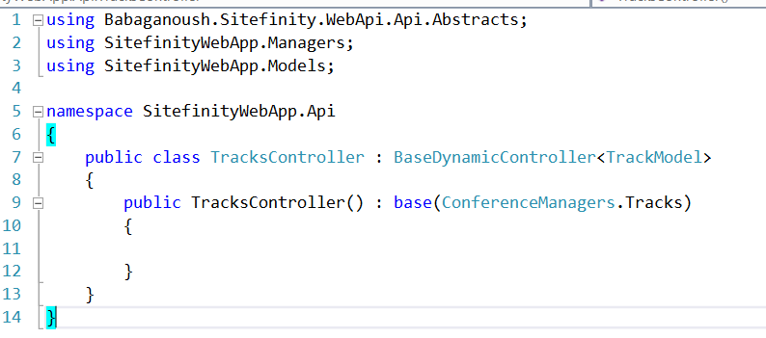
TRACKS WEB API

Slide 17
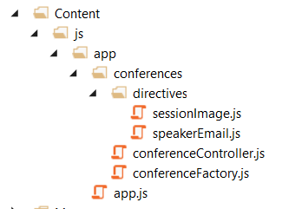
STRUCTURING ANGULAR APPs
There are lot of ways to structure Angular app, below is one

Slide 18

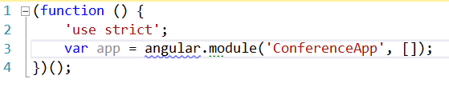
NG-APP - CONFERENCEAPP
Defining ng-app
App.js

Slide 19
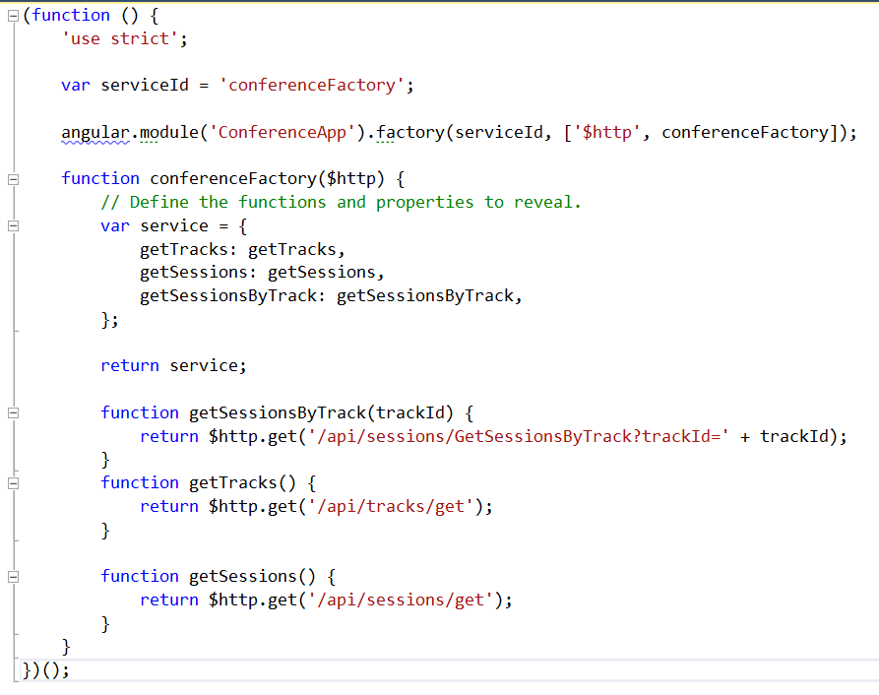
CONFERENCE FACTORY

Slide 20
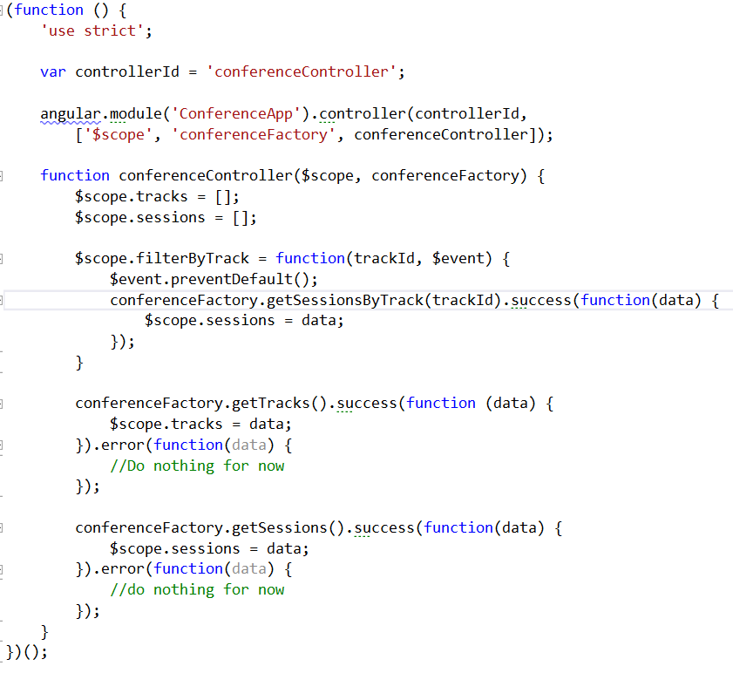
CONFERENCE CONTROLLER

Slide 21
CONFERENCE LIST WIDGET
MVC Widget
Razor syntax
Register the widget

Slide 22
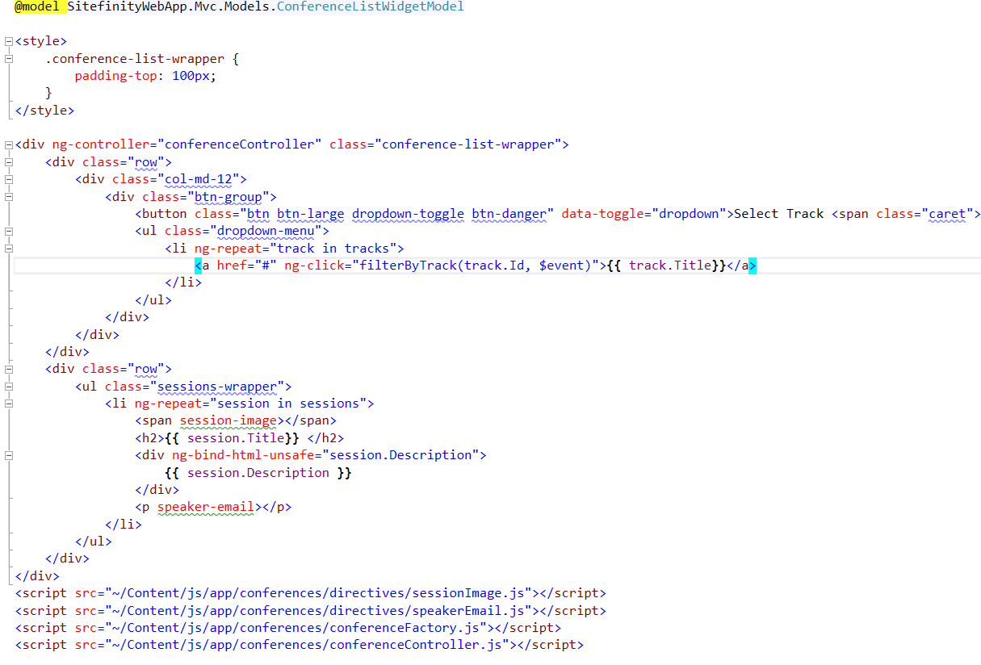
CONFERENCE LIST VIEW

Slide 23
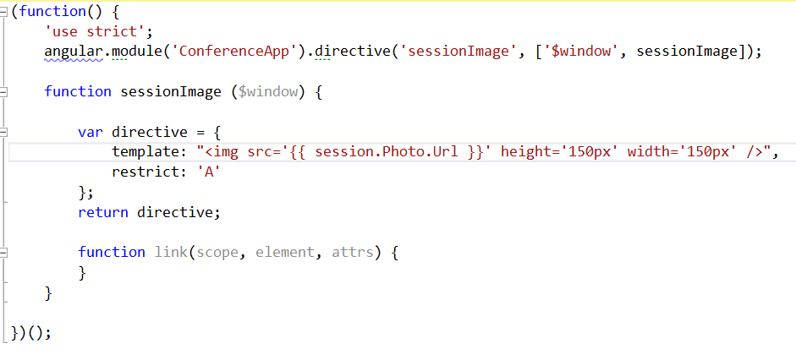
DIRECTIVES

Slide 24
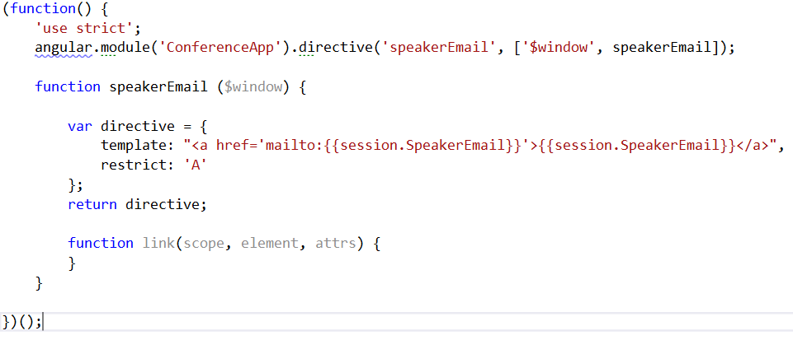
DIRECTIVES

Slide 25
RECAP – WEB APP GET
app.js
employeesFactory.js
employeesController.js
Employees ASP.NET Web API Controller
Employees List MVC Widget

Slide 26
MOBILE APP – INTRODUCTION TO IONIC
HTML5 app development framework powered by Angular
Open source http://ionicframework.com/

Slide 27
DEMO

Slide 28
TELERIK PLATFORM - INTRODUCTION
Cross platform development platform for iOS, Android and Windows Phone
AppBuilder - In Browser, Windows Application, Visual Studio Extension, Sublime text plugin.
Telerik Backend services
Automated Testing framework
Telerik Analytics

Slide 29
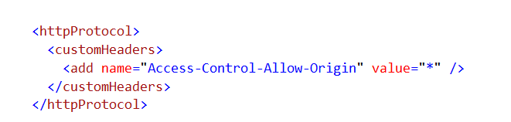
CONFIGURING WEB SERVICES

Slide 30
DEMO

Slide 31
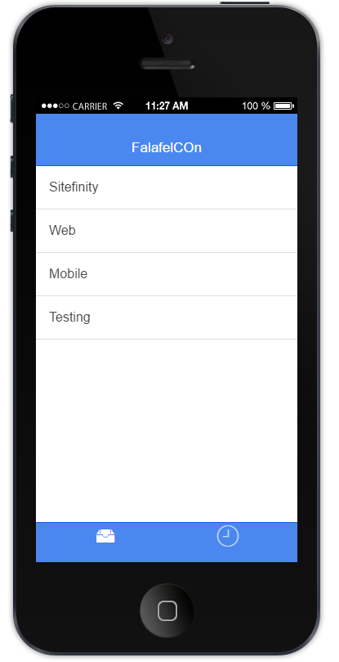
iOS App

Slide 32
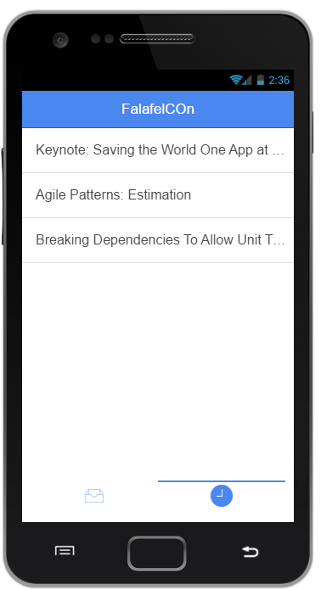
Android App

Slide 34
QUESTIONS

