Slide 1
AngularJS

Slide 2
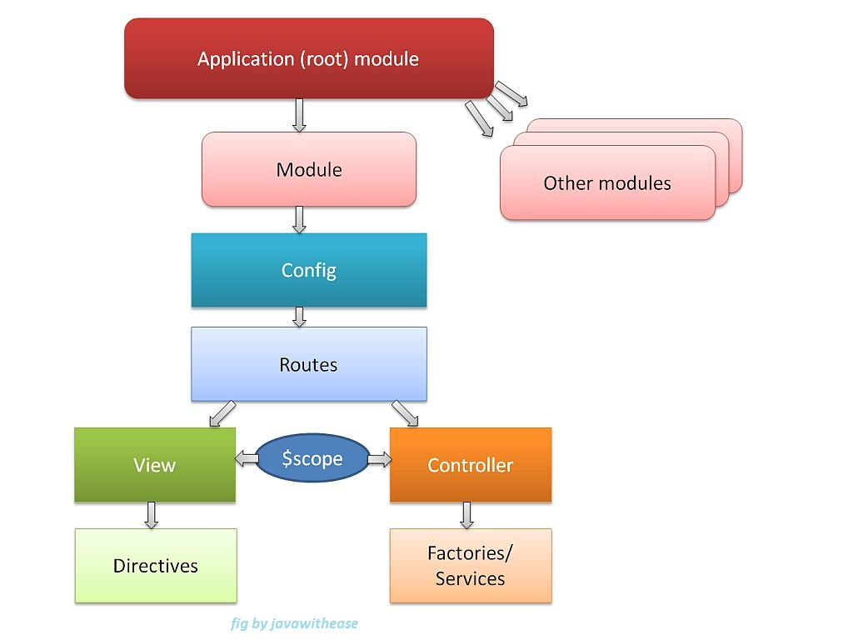
AngularJS
Angular is a front-end framework built to ease the burden of writing complex apps while keeping everything testable and organized. JavaScript Frameworks for Building SPAs (“single-page application”).

Slide 3
AngularJS core features
Modules
Directives
Templates
Scope
Expressions
Data-Binding
MVC (Model, View & Controller)
Validations
Filters
Services
Routing
Dependency Injection
Testing

Slide 4
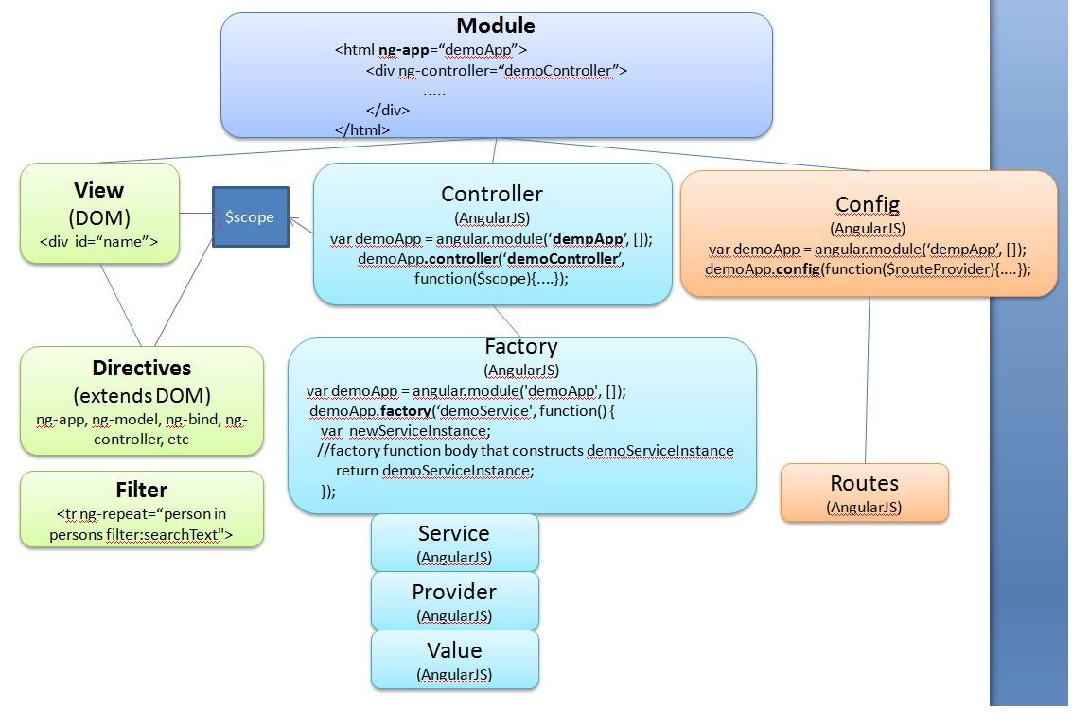
AngularJS overview

Slide 5
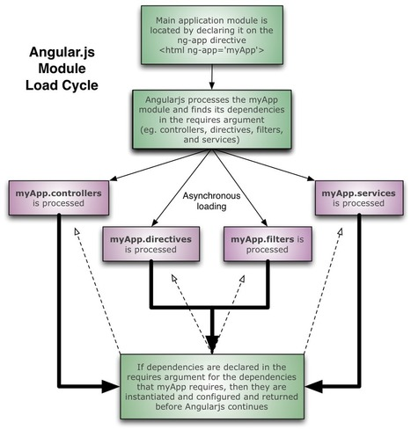
AngularJS load cycle

Slide 6
AngularJS Directives
AngularJS directives are extended HTML attributes with the prefix ng-
ng-app directive initializes an AngularJS application
ng-init directive initializes application data
ng-model directive binds the value of HTML controls (input, select, textarea) to application data

Slide 7
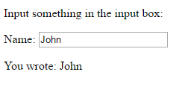
Examples of directives..
<div ng-app="" ng-init="firstName='John'"> <p>Name: <input type="text" ng-model="firstName"></p> <p>You wrote: {{ firstName }}</p> </div>
Result:

Slide 8
Data Binding
The {{firstName}} expression, in the previous example is an AngularJS data binding expression
Data binding in AngularJS binds AngularJS expressions with AngularJS data
{{firstName}} is bound with ng-model=“firstName”

Slide 9
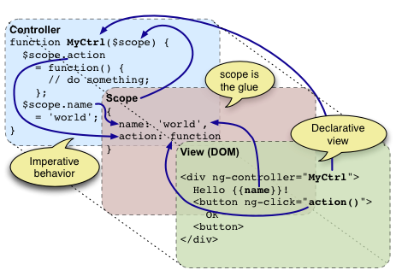
Two-way data binding
AngularJS is a library written in JavaScript and can be included in a web page before the closing body tag.

Slide 10
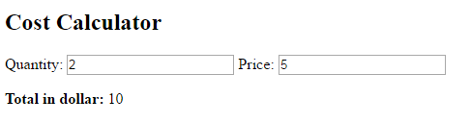
Example..
<div ng-app="" ng-init="quantity=1;price=5"> Quantity: <input type="number" ng-model="quantity"> Price: <input type="number" ng-model="price"> Total in dollar: {{ quantity * price }} </div>
Result:

Slide 11
Angular Expressions
Angular js binds data to html using expressions.
Expressions can be written inside double braces: {{expression}}
It can also be written inside a directive: ng-bind=“expression”
AngularJS will resolve the expression and return the result exactly where the expression is written.

Slide 12
Examples using braces..
Expressions can contain literals, operators, and variables.
Example: {{ 5 + 5 }} or {{ firstName + " " + lastName }}
<div ng-app=""> <p>My first expression: {{ 5 + 5 }}</p> </div>
Result:
My first expression: 10

Slide 13
Examples using ng-bind..
<div ng-app=""> <p>Total in dollar: <span ng-bind=“5*5"></span></p> </div>
Result:
Total in dollar: 25

Slide 14
AngularJS Strings
AngularJS strings are like JavaScript strings:
<div ng-app="" ng-init="firstName='John';lastName='Doe'"> <p>The name is {{ firstName + " " + lastName }}</p> </div>
Result:
The full name is: John Doe

Slide 15
Same example using ng-bind..
<div ng-app="" ng-init="firstName='John';lastName='Doe'"> <p>The name is <span ng-bind="firstName + ' ' + lastName"></span></p> </div>
Result:
The full name is: John Doe

Slide 16
AngularJS Modules
The module is a container for the different parts of an application
The module is a container for the application controllers
Controllers always belong to a module

Slide 17
Creating a module
A module is created by using the AngularJS function angular.module
Example:
div ng-app="myApp">...</div> <script> var app = angular.module("myApp", []); </script>
The "myApp" parameter refers to an HTML element in which the application will run.
Now controllers, filters, directives and more can be added to this angular js application

Slide 18
Adding a Controller
AngularJS applications are controlled by controllers
The ng-controller directive defines the application controller
A controller is a JavaScript Object, created by a standard JavaScript object constructor

Slide 19
Example of a controller..
<div ng-app="myApp" ng-controller="myCtrl"> First Name: <input type="text" ng-model="firstName"><br> Last Name: <input type="text" ng-model="lastName"><br> <br> Full Name: {{firstName + " " + lastName}} </div> <script> var app = angular.module('myApp', []); app.controller('myCtrl', function($scope) { $scope.firstName = "John"; $scope.lastName = "Doe"; }); </script>

Slide 20
Continued..
In the previous example, the ng-controller=‘myCtrl’ directive defines a controller and myCtrl function is a JavaScript function.
In AngularJS, $scope is the application object (the owner of application variables and functions)
AngularJS will invoke the controller with a $scope object
The controller creates two properties (variables) in the scope (firstName and lastName) and ng-model directives bind the input fields to the controller properties (firstName and lastName)

Slide 21
Contoller Methods
A controller can also have methods
Example:
<div ng-app="myApp" ng-controller="personCtrl"> First Name: <input type="text" ng-model="firstName"><br> Last Name: <input type="text" ng-model="lastName"><br> <br> Full Name: {{fullName()}} </div> <script> var app = angular.module('myApp', []); app.controller('personCtrl', function($scope) { $scope.firstName = "John"; $scope.lastName = "Doe"; $scope.fullName = function() { return $scope.firstName + " " + $scope.lastName; }; }); </script>

Slide 22
Controllers in external files
In larger applications, it is common to store controllers in external files.
Example:
<div ng-app="myApp" ng-controller="namesCtrl"> <ul> <li ng-repeat="x in names"> {{ x.name + ', ' + x.country }} </li> </ul> </div> <script src="namesController.js"></script>

Slide 23
Continued..
For the previous example, create a new controller file and save it as namesController.js.
Use the controller file in the application as shown in the previous example.
angular.module('myApp', []).controller('namesCtrl', function($scope) { $scope.names = [ {name:'Jani',country:'Norway'}, {name:'Hege',country:'Sweden'}, {name:'Kai',country:'Denmark'} ]; });

Slide 24
AngularJS Scope
The scope is the binding part between the HTML (view) and the JavaScript (controller).
It is an object with the available properties and methods.
When you make a controller in AngularJS, you pass the $scope object as an argument
Properties made in the controller, can be referred to in the view

Slide 25
Example of a scope..
<div ng-app="myApp" ng-controller="myCtrl"> <h1>{{carname}}</h1> </div> <script>
var app = angular.module('myApp', []); app.controller('myCtrl', function($scope) { $scope.carname = "Volvo"; });
</script>
When adding properties to the $scope object in the controller, the view (HTML) gets access to these properties

