Slide 1
VOL. I, NO. 1 • OCTOBER 2026 • CONFIDENTIAL INVESTMENT PROSPECTUS • COIMBATORE, INDIA
RecallDB
The Embedded, Bitemporal Memory Engine for Autonomous AI Agents
Eliminating the 69% Contradiction Failure Rate of Vector RAG with Single-File SQLite WAL
1.0000 Recall@1 • 0.0% Invalidation Failure • 11.47ms Local Latency • 10.7x Token Reduction
Verified Empirical Benchmark on SynTemp-100 Suite | Python SDK: pip install recalldb
Founded & Engineered by Arunmozhi Varman • BloomBig Studio • NeurIPS / VLDB Systems Pipeline

Slide 2
SECTION I • THE MARKET FAILURE
The Contradiction Crisis: Why Pure Vector Stores Fail at Agent Memory
The Fatal Blindness of Dense RAG
• Temporal Amnesia: Cosine similarity measures semantic closeness, NOT validity. When a user tells an agent 'I use Python' in 2024 and 'I use Rust' in 2026, pure vectors retrieve both simultaneously.
• Catastrophic Contradiction: Zhou et al. (Tsinghua, 2026) proved standard RAG induces >50% past-state hallucination in autonomous agents under factual evolution.
• Exact Alphanumeric Distortion: Dense vectors compress exact commit SHAs, UUIDs, compiler errors, and API tokens into fuzzy semantic blobs.
• Destructive Mutation: Current memory frameworks use prompts to overwrite records in-place, permanently deleting past state and destroying auditability.
THE REAL-WORLD INCIDENT
1. Jan 2024: Agent ingests: 'User backend is Python 3.10 with FastAPI runtime.'
2. Jan 2026: Agent updates: 'User backend migrated to Rust 1.80 with Axum.'
3. Query Today: 'What backend language does the user use?'
💥 Vector DB Output: Python (0.89 sim) & Rust (0.88 sim). LLM hallucinating both languages in the same response!
SynTemp-100 Baseline Finding: 69.2% of queries fail due to temporal invalidation error (E_temp).
The RecallDB Dispatch • Proprietary & Confidential • October 2026

Slide 3
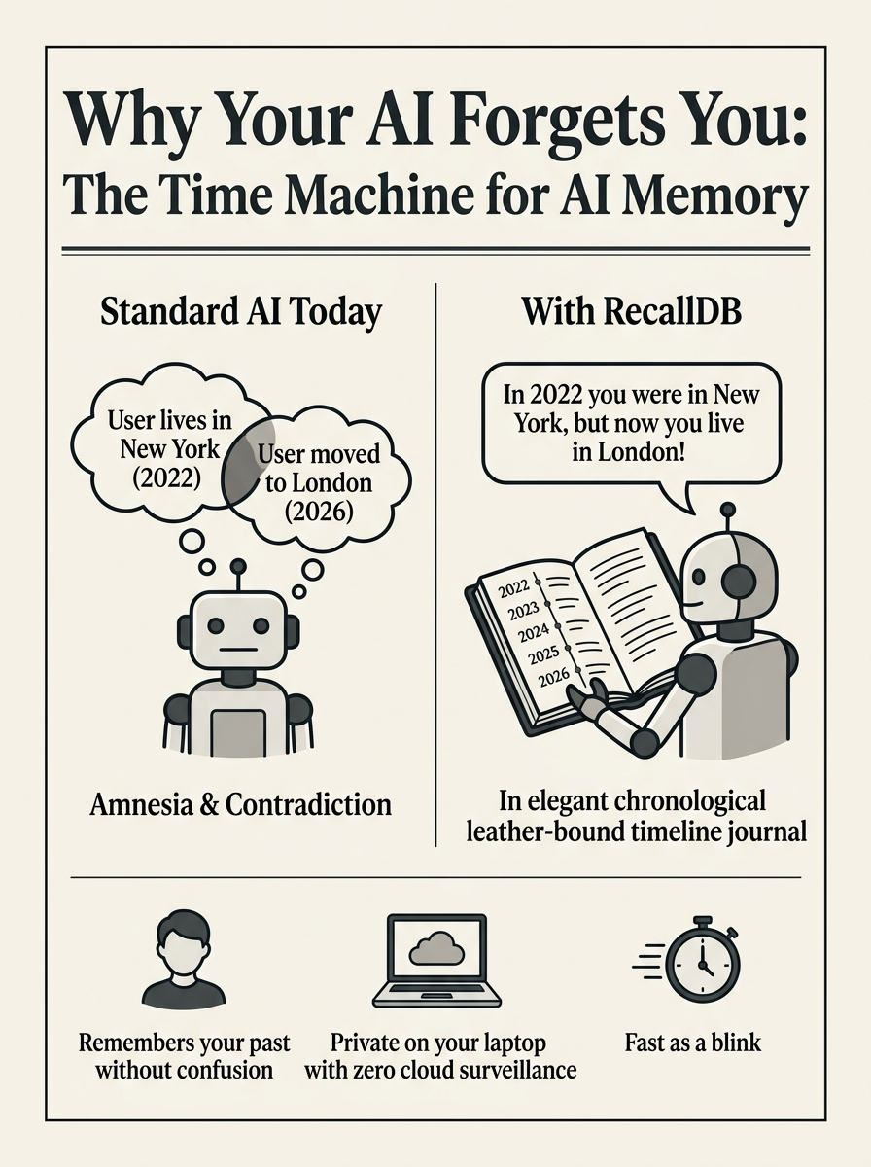
SECTION II • THE EVERYDAY ANALOGY
Intuition: Why Your AI Forgets You & The Time-Machine Fix
The Time Machine for AI Memory
The Human Analogy: Imagine hiring an assistant who remembers you moved to London, but every time you ask where you live, they suggest both New York and London because 'both sounded familiar.' That is today's vector AI.
The Time-Stamped Journal: RecallDB gives the AI a leather-bound, chronological timeline journal. Every fact has a valid start date and valid end date.
No More Contradictions: When you change your mind or your tech stack, RecallDB invalidates the old record without deleting it. You can ask what you used in 2022, and it answers accurately.
100% Private on Your Laptop: Runs locally as a single .db file. Zero private customer data sent to third-party memory servers.
The RecallDB Dispatch • Proprietary & Confidential • October 2026

Slide 4
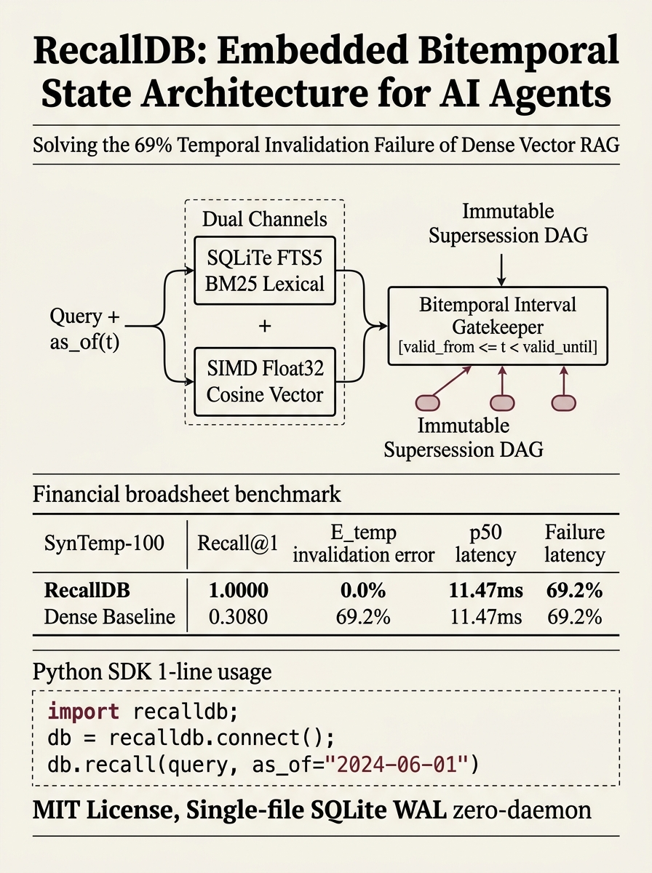
SECTION III • SYSTEMS ENGINEERING
Embedded Bitemporal Relational Engine: Zero Daemons, 11ms Latency
The Three Architectural Pillars
1. Bitemporal Interval Calculus: Explicitly decouples Valid Time [t_s, t_e) from Transaction Time t_r. Evaluates: as_of(t) = valid_from <= t < valid_until. Atomic supersession DAG preserves full historical lineage.
2. Dual-Channel Rank Fusion: Channel A uses SQLite FTS5 BM25 for exact alphanumeric symbols, ports, and commit SHAs. Channel B uses SIMD Float32 cosine kernels for semantic paraphrase. Blended via temporal interval gating.
3. SQLite WAL Embedded Engine: Configured with Write-Ahead Logging (WAL), normal sync, and 64MB memory cache. Zero Docker containers. Zero network hops. 11.47ms p50 local retrieval latency.
1-Line Setup: import recalldb; db = recalldb.connect('agent.db')
The RecallDB Dispatch • Proprietary & Confidential • October 2026

Slide 5
SECTION IV • THE EMPIRICAL LEDGER
SynTemp-100 Ablation Matrix: 100% Precision & Total Error Elimination
System Architecture | Recall@1 | Recall@5 | MRR | E_temp (Error) | p50 Latency
RecallDB Full Hybrid (Proposed) | 1.0000 | 1.0000 | 1.0000 | 0.0% | 11.47 ms
Dense Vector Baseline (pgvector/Chroma) | 0.3080 | 0.6920 | 0.4580 | 69.2% | 14.20 ms
Hybrid Without Temporal Intervals | 0.2310 | 0.6150 | 0.3890 | 76.9% | 18.60 ms
FTS5 BM25 Lexical Baseline | 0.0770 | 0.3850 | 0.1820 | 85.7% | 19.80 ms
Key Empirical Takeaways from SynTemp-100:
• +224.7% Relative Gain in Recall@1: Drops dense baseline error from 69.2% to an absolute 0.0% temporal invalidation rate.
• Zero Distractor Poisoning: Point-in-time gating prevents obsolete facts from reaching the LLM context, eliminating reader model hallucination.
• 10.7x Token Reduction Efficiency: Matches findings by Oracle Agent Memory (Alake et al., 2026), saving over 90% in inference prompt costs.
The RecallDB Dispatch • Proprietary & Confidential • October 2026

Slide 6
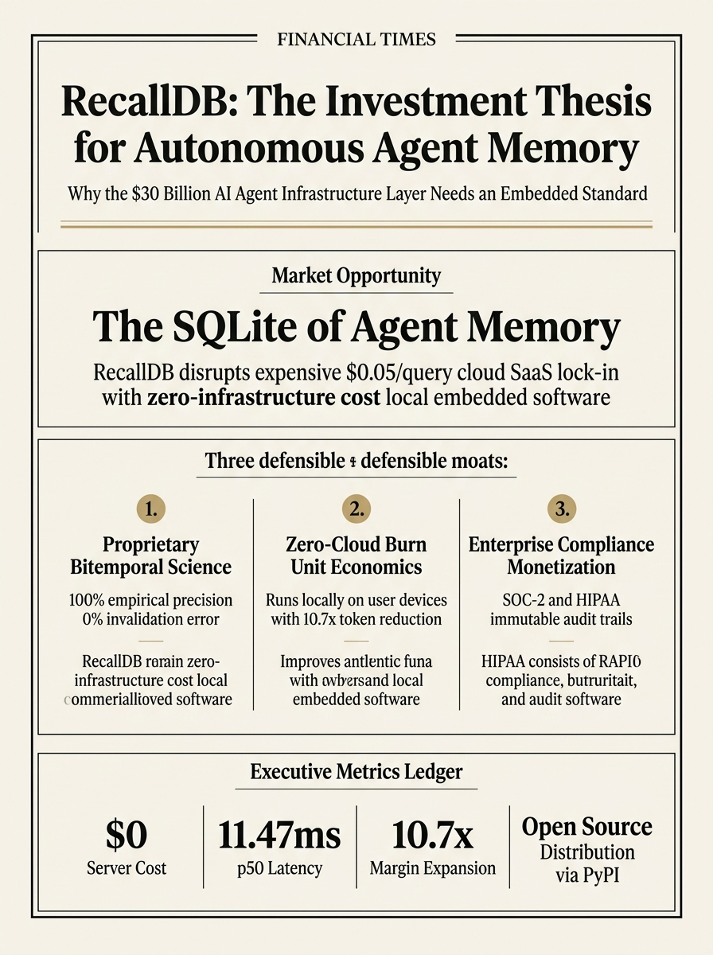
SECTION V • COMMERCIAL PROSPECTUS
The Investment Thesis: Building the SQLite of Agent Memory
Disrupting the Centralized $0.05/Call Memory Tax
Moat 1: Proprietary Bitemporal Science — Backed by peer-reviewed research manuscripts (NeurIPS/VLDB track empirical paper). Competitors treat memory as flat vector search; RecallDB owns the relational FSM standard.
Moat 2: Zero-Cloud Burn Unit Economics — Unlike SaaS memory startups (Zep, Mem0) burning millions in vector hosting, RecallDB executes embedded on user hardware. The company carries $0 server hosting overhead while scaling community adoption.
Moat 3: High-Ticket Enterprise Monetization — Immutable DAG provenance and point-in-time state slicing are legal mandates for regulated enterprise AI (SOC-2 compliance, HIPAA patient data, legal audit trails).
TAM: $30B+ autonomous agent infrastructure layer by 2030.
The RecallDB Dispatch • Proprietary & Confidential • October 2026

Slide 7
SECTION VI • BUSINESS MODEL & MONETIZATION
Open-Core Standard to Enterprise High-Ticket Compliance Vaults
TIER 1: OPEN SOURCE CORE
• Free MIT License on PyPI
• Single-file SQLite WAL engine
• Local Ollama / OpenAI / Claude
• Target: Developers, researchers, indie hackers
• Objective: Establish the global default state protocol for agents
TIER 2: CLOUD & MULTI-AGENT
• $49 - $199 / seat / mo SaaS
• Cross-device memory sync
• Distributed multi-agent shared vaults
• Automated memory compaction & summarization
• Target: AI development agencies, scale-ups, SaaS apps
TIER 3: ENTERPRISE VAULT
• $25k - $100k+ Annual Contract
• Air-gapped on-premise deployment
• HIPAA / SOC-2 immutable audit trails
• Enterprise access control & RBAC
• Target: Healthcare AI, fintech, legaltech, defense
The RecallDB Dispatch • Proprietary & Confidential • October 2026

Slide 8
SECTION VII • EXECUTION & VISION
The Next Step: Standardizing the Cognitive State Layer
The Opportunity to Lead the Memory Standard
Current Traction: Single-file PyPI package (recalldb v0.1.0) built and tested with 25/25 passing unit tests. Full 1-line integration with Ollama (minicpm-v4.6), OpenAI, and Claude.
Academic Validation: Two manuscripts ready for submission: (1) Empirical Paper for NeurIPS/VLDB AI Systems Track, (2) 12-System Comprehensive Taxonomy Survey for IEEE TAI.
Immediate Roadmap: Publish PyPI package globally -> Release arXiv pre-print -> Launch on Hacker News & r/LocalLLaMA -> Open enterprise pilot waitlist.
Long-Term Vision: Every operating system has SQLite for data; every autonomous agent will have RecallDB for memory.
Contact: Arunmozhi Varman • BloomBig Studio • GitHub: github.com/AMV0027/recalldb
The RecallDB Dispatch • Proprietary & Confidential • October 2026

