Slide 1
Project ideas Course :Practical Bioinformatics for Biologists 2018 University of Groningen
Anne M. Veenstra-Skirl
Kiran Gurung

Slide 2
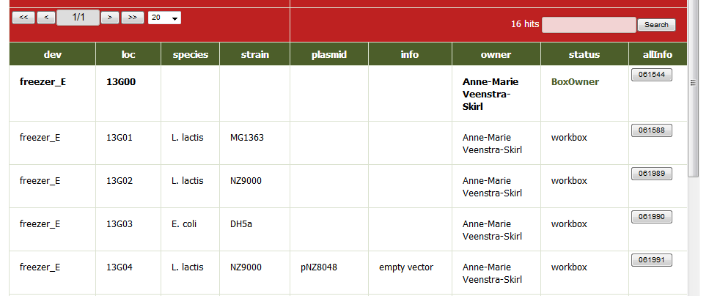
Input | Output
Search term(s) | Obtain results Refine results with additional searches

Slide 3
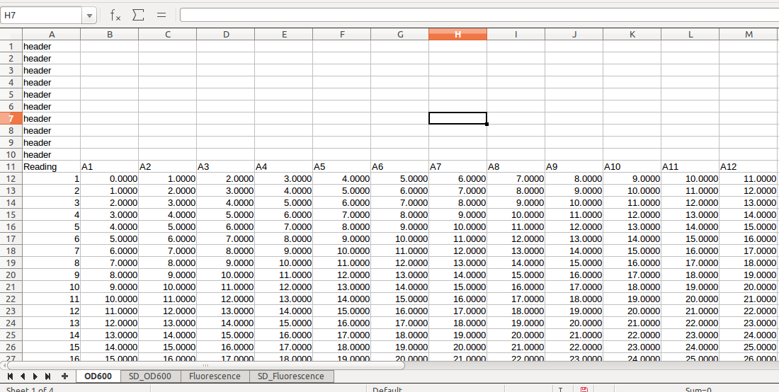
Input | Output
Excel file + options for graphs (if possible) | Show R graphs Save the graphs

Slide 4
Yeasts: Hanseniaspora and Issatchenkia
Input | Output
Work with sequences | Refine results Look for primers

