Slide 1
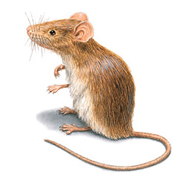

Hantavirus
Team name:
The rats
Team 6
Keizer Karel College
Rei Yamada, Kevin Kang and Leon van den Pol

Slide 2
The index
Infographic
The folder
The website
-Video
-Information
-Symptoms
-Prevention
-Other peoples thoughts
-Quiz
-Questions

Slide 3
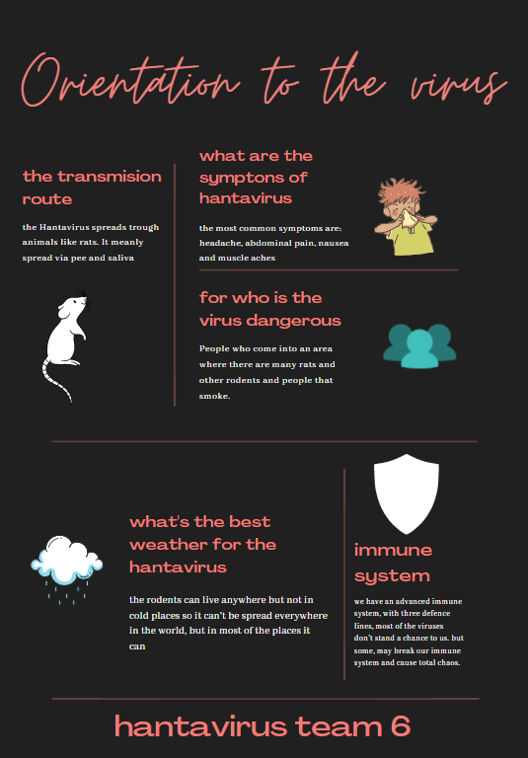
The infographic

Slide 4
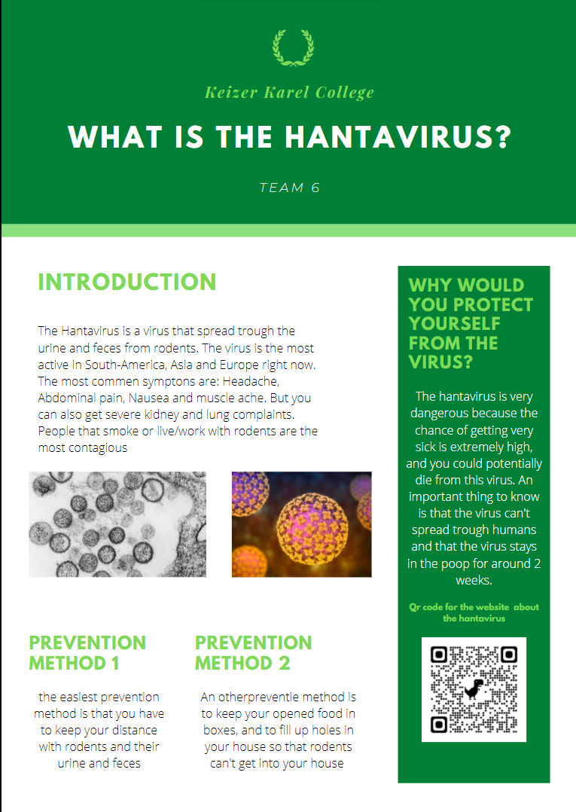
The folder

Slide 5
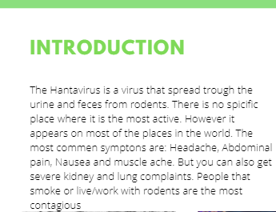
Information HantaVirus
Active places
Symptomps

Slide 6
Prevention Methods
Keep distance with Rodents
Keep opened food in boxes
Fill up holes in your house

Slide 7
Why would you protect yourself from the virus?
The virus is dangerous.
Important things to know.
A qr code to a website with more information.

Slide 8
The website
Link: http://hantavirus.tk/

Slide 9
Feedback concept
Positive feedback
Negative feedback
Useful information
The folder looks good
Good acces
Realistic concept
Doesn’t look attractive (solved)
Not possible to spread further(solved)

Slide 10
Quiz
Go to kahoot.it

Slide 11
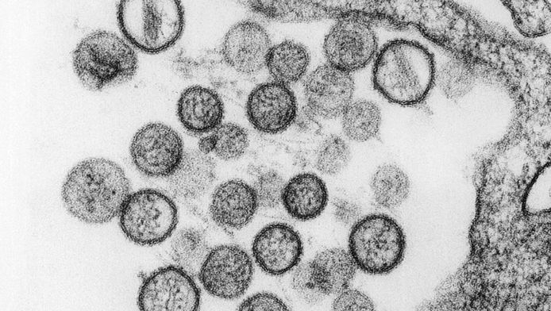
Questions?

