Slide 1
Lending Case Study
Shahrukh Khan

Slide 2
Tools
Python 3.0
Anaconda Jupyter Notebook
StatsModels
Pandas
Numpy
Scikit learn

Slide 3
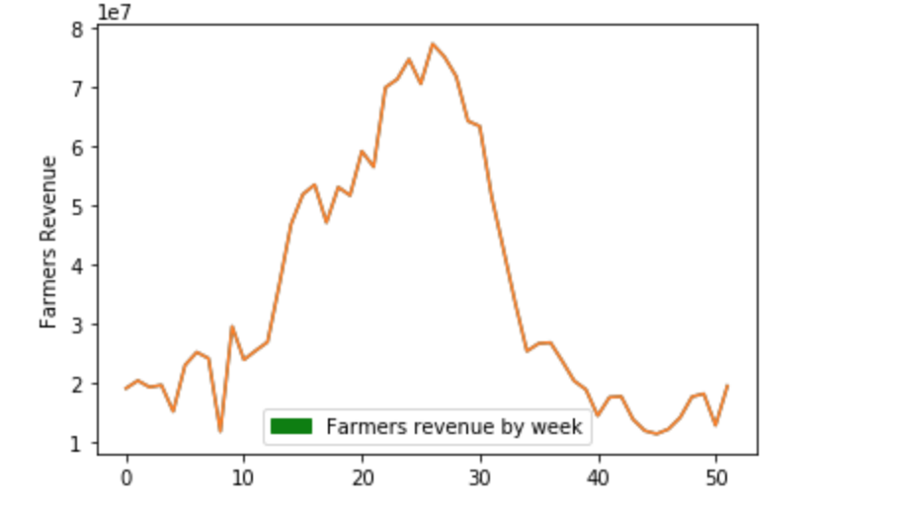
Data Insights (Trend)

Slide 4
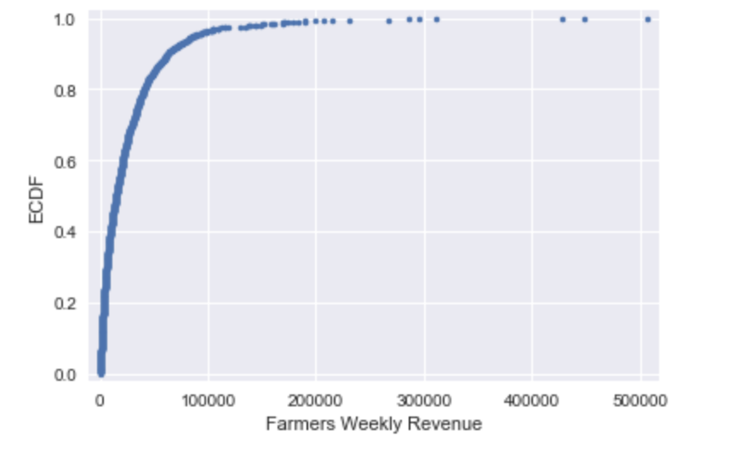
Data Insights (Distribution)

Slide 5
Modeling
First Model
Double exponential smoothing
Since data had no seasonality
But that only forecasted well for short term
Second Model
Autoregressive Integrated Moving Average Model
Scales well for long term forecasting
Takes care of trends and seasonality
For forecasting initially a model was optimized for each time series then forecasted next 13 weeks for each farmer

Slide 6
Assumptions
Only farmers with more than 40 weeks of historical data would qualify for the loan evaluation stage
Four scores to be used for Eligibility of farmers for loan as follows:
Score Name | Weightage
Error Score | 0.4
Value Score | 0.1
Novelty Score | 0.2
Stability Trend Score | 0.3

Slide 7
Cont.
Farmer rating was computing using the following formula:
Farmer rating = (0.4 * Error Score) + (0.1 * Value Score) + (0.2 * Novelty Score) + (0.3 * Stability Trend Score)
Farmers with rating above 0.5 out of 1.0 were allocated the loan
Loan amount is decided upon the percentile of farmers mean weekly forecasted revenue

Slide 8
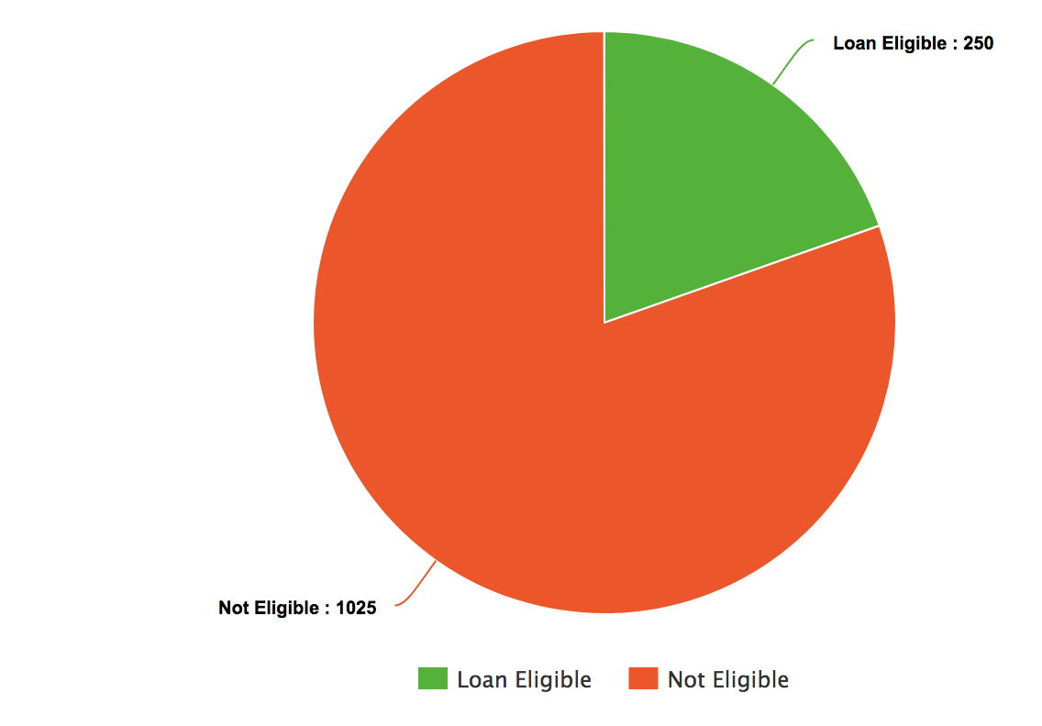
Results
250 farmers qualified the for the loan, loan amounts are mentioned in the Results CSV file.

