Slide 1


Are MLB Players Worth Their Salary?
Augustus Madsen

Slide 2
Hypothesis
For this project, my hypothesis was a two part question: “If Major League Baseball players are paid more for performing better, then players with a higher salary should have a higher WAR.” The statement boils down to the idea that higher paid athletes would generally have a higher wins above replacement, but is this always the case? Secondly, “If a player’s salary is contingent upon performance, then he should only be paid for the value he contributes.” This is where it gets a little controversial. There are players making $30 million a year, but they do not have the highest WAR value. Additionally, for my investigation, the wins they are contributing to their team might not be worth that high of a pay scale.

Slide 3
Variables from Data Set and Baseball Reference
The variables I used:
-Player Name: String
-Salary (dollars): Numeric
-WAR (Wins Above Replacement): Numeric
-Offensive WAR: Numeric (for analysis on batting performance only)
-Defensive WAR: Numeric (for analysis on field performance only)
-Team Name: String
-League: String

Slide 4

Histogram
This histogram provides a brief look at the most common salary ranges for MLB players in the 2015 season. Over 50% (478) of players made somewhere between $507,000 and $2,607,000, while only 1 player made over $30,000,000 that year (Clayton Kershaw – arguably the best pitcher in the entire Major Leagues) who contributed a 7.4 WAR that season

Slide 5
Summary Statistics
Mean = $4,000,000 salary in 2015
Mode = $507,000 (Rookie minimum contract)
Average WAR = 816 players / 588.8 total WAR from all 30 teams = 1.38 average WAR for the 2015 season, which means the average player contributed 1.38 wins to his team above what a replacement level position would have contributed.

Slide 6


PMFs
Sample space (S) I looked at as the events that contributed to the WAR value – hits, homeruns, fielding, etc. or anything that a player does that is a random phenomenon (we do not know what will occur when a player comes up to bat or when they field a ball). A discrete variable (X) is defined on this outcome, and the formula is the PMF of X. The PMF can show the distribution of the player value as seen by the total score, while also comparing it towards a monetary amount. This is the same variable but in a different scenario, as seen through the eyes of a fan or a front office manager.

Slide 7
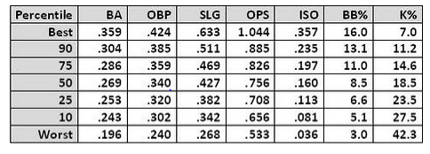
CDFs
I found this percentile chart from FanGraphs to be particularly useful in visualizing the rankings useful for WAR. Unfortunately, I was unable to determine this rank for the value itself, but I wanted to explain the process if I did have the information available. If we assume the best WAR percentile falls around 8.0 wins, with the 90th being 7, 75th being 6, 50th being 5, 25th being 3 and 10th being 1, and then Worst as 0 or any negative WAR (yes this is possible).

Slide 8
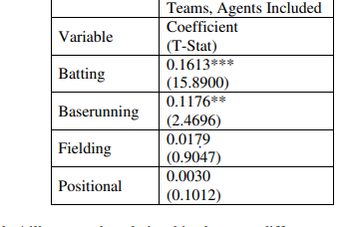
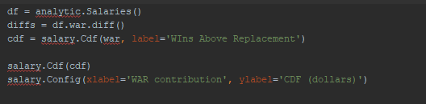
Analytical Distribution
I had attempted to create a distribution of WAR values from the dataset containing salaries and plot the CDF with a few different parameters – most likely a 0-8 WAR range and a rookie -> max contact salary level to showcase to compare to the actual level when determining a team’s overall expenditure for their victories. I wanted to explain my thought process, but I did not succeed in figuring out a way to represent it well graphically.

Slide 9
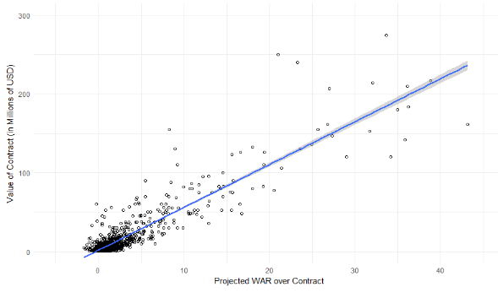
Scatterplots
The first plot shows the distribution of salaries for all ~800 MLB players, the higher points indicating the greater contract amount. The plot on the right shows the WAR projection for players based on the contract they received projected over that contract length. Generally, the higher paid players are projected to have a higher total WAR during this time

Slide 10
Hypothesis Test
With C. Kershaw’s 2015 campaign, he was paid roughly $4 million per win he achieved for the LA Dodgers. If you were to multiply this by their number of wins for the year (92), this would be $368 million spent per win if Kershaw was the sole contribution. The team’s total payroll was about $227,000,000 meaning they spent $2.4 million per win in 2015. This could be argued that if Kershaw was projected as a 7+ WAR player, his contract should essentially be cut in half. The Dodgers could pay him less for the same outcome while staying within the range of their cost per victory. This goes back to the initial hypothesis of a player only earning his true contribution, in this case for LA, he would be overpaid for the wins for his team compared to everyone else.

Slide 11
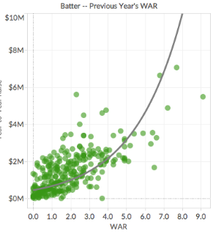
Regression Analysis
Multiple regression analysis could be used to estimate the relationship between a dependent value (Salary – dependent on a projected WAR value from previous seasons), if we assumed that teams could make this decision during the 2015 offseason to budget for 2016 – with a independent variable of WAR, which is measured over the course of the season on both offense and defense. Multiple instances could be run with other value stats such as Isolated Power, Runs Created, or weighted On Base Percentage to see if WAR is an efficient way to measure contribution, or if another stat is more valuable in allowing teams to figure out their best spending practices.
This regression analysis from FanGraphs shows an example of how the method could be applied – looking at previous year data and the salary level to indicate how valuable a win truly is.

Slide 12
Sources
https://www.kaggle.com/open-source-sports/baseball-databank/version/1#Salaries.csv
http://greenteapress.com/thinkstats2/thinkstats2.pdf
https://library.fangraphs.com/statistic-percentile-charts/
https://community.fangraphs.com/on-war-its-linearity-and-efficient-free-agent-contracts/
https://medium.com/@InDataLabs/why-start-a-data-science-project-with-exploratory-data-analysis-f90c0efcbe49
https://interworks.com/blog/kriddett/2018/09/25/data-always-tells-a-story-salary-disparity-in-major-league-baseball/
https://surface.syr.edu/cgi/viewcontent.cgi?article=1098&context=honors_capstone
https://www.baseball-reference.com/teams/LAD/2015.shtml
https://blogs.fangraphs.com/modeling-salary-arbitration-introduction/

