Slide 1

Stock Predictions Using Machine Learning Models in Python
Augustus Madsen

Slide 2
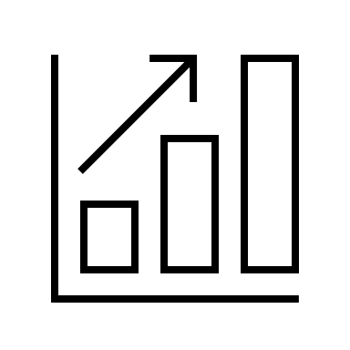
Introduction
-Similarities of the past
-the goals of the experiment
-methods involved

Slide 3
Domain and Data
https://www.kaggle.com/shreyams/stock-price-prediction-94-xgboost/#data
-Kaggle Daily News Stock Prediction
-NYSE
-Yahoo Finance
-NASDAQ Financials
-Variables involved: ending price, starting price, ROE, start/end dates, ticker symbol, etc.

Slide 4
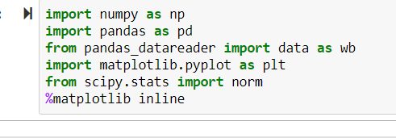
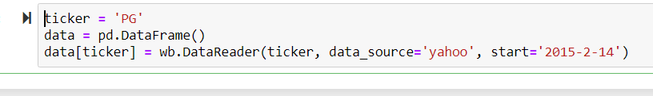
Methods
-Panda/Jupyter Notebooks
-NumPy, Matplotlib, SciPy

Slide 5
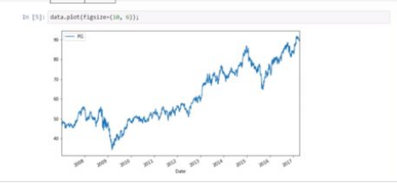


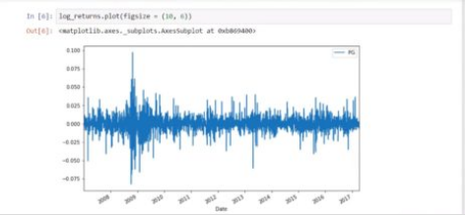
Plot sample for figure comparison

Slide 6
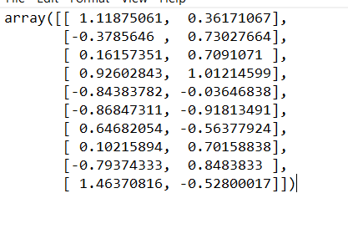
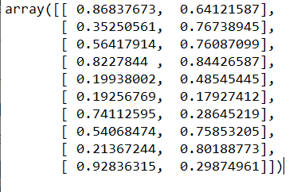
Random Arrays
2x10 random array of variabilities for x and y mean distribution
Normal distribution

Slide 7
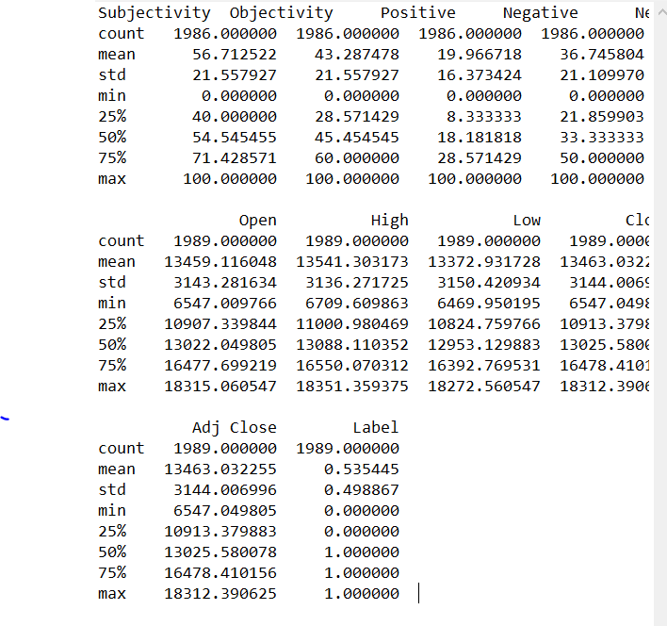

Merging Data Frames

Slide 8
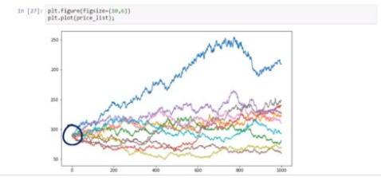
Different Pathways/Prices

Slide 9


-Monte Carlo distribution -Better PPF pathway -More historical data -Price fluctuations and randomness -Additional machine learning models
Conclusion

Slide 10
References
https://datascienceplus.com/how-to-apply-monte-carlo-simulation-to-forecast-stock-prices-using-python/
https://www.kaggle.com/dgawlik/nyse
https://www.kaggle.com/datasets?search=stock
https://www.kaggle.com/shreyams/stock-price-prediction-94-xgboost/#data

