Slide 1
TeloTracker
Subtelomere recombination analysis from ONT long-read sequencing
1. Reference creation
2. Feature labeling
3. Recombination analysis

Slide 2
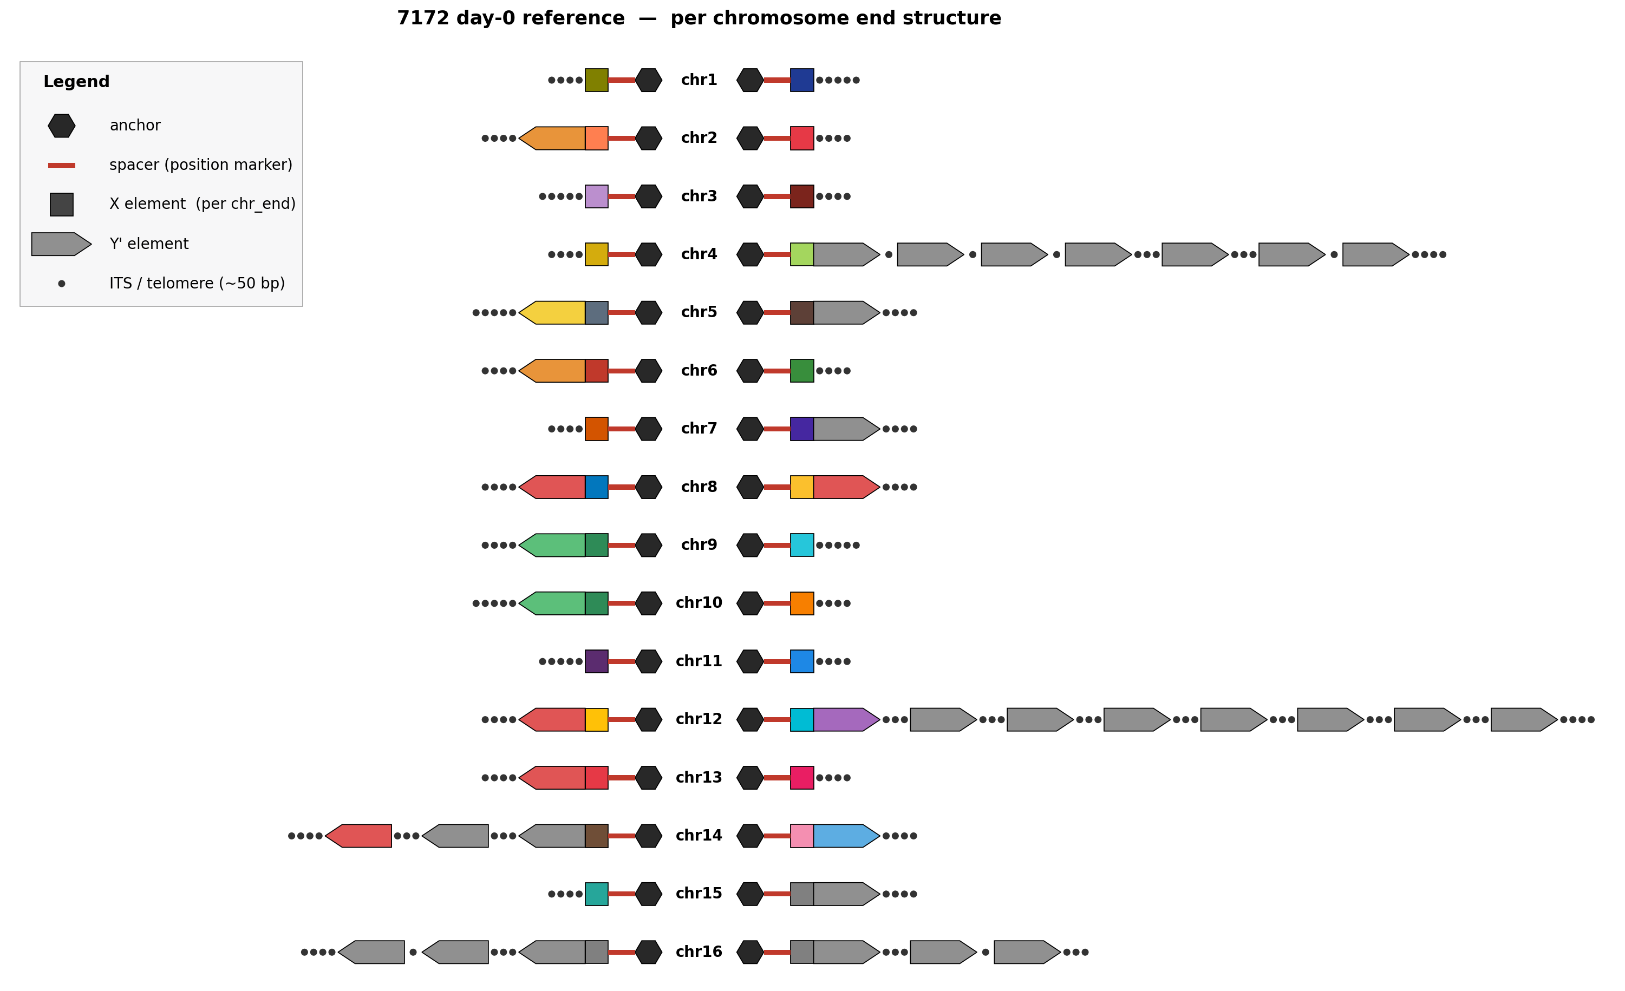
1. Reference creation
• Selects high-quality day-0 reads anchored at each chromosome end
• Extends contigs through the pretelomere using long-read soft-clips
• Polishes with Flye (3 iterations) + Dorado
• Produces one contig per chromosome covering centromere → telomere (all 32 ends)
Reference structure overview for 7172 — all 32 chr_ends

Slide 3
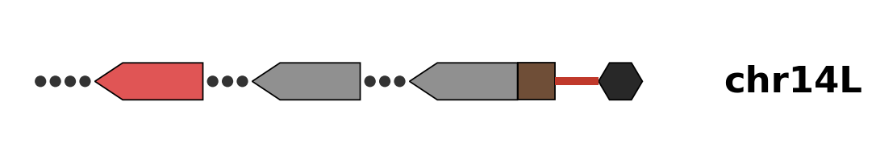
2. Feature labeling
• Annotates anchor, X-element, spacer, Y' array, and inter-Y' spacers per chr_end
• BLAST + RepeatMasker drive feature identification
• Y' elements clustered by sequence identity — colored IDs become the donor-tracking key for the recombination step
• Per-chr_end schematic auto-generated for QC
7172 chr14L — 3 Y' elements (ID1 / ID1 / ID2), X element, spacer, anchor

Slide 4
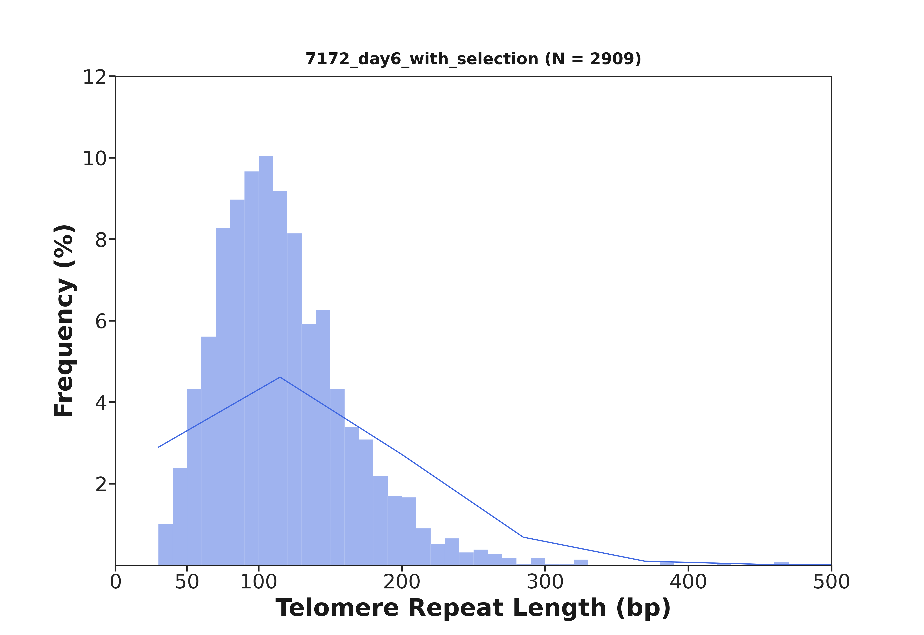
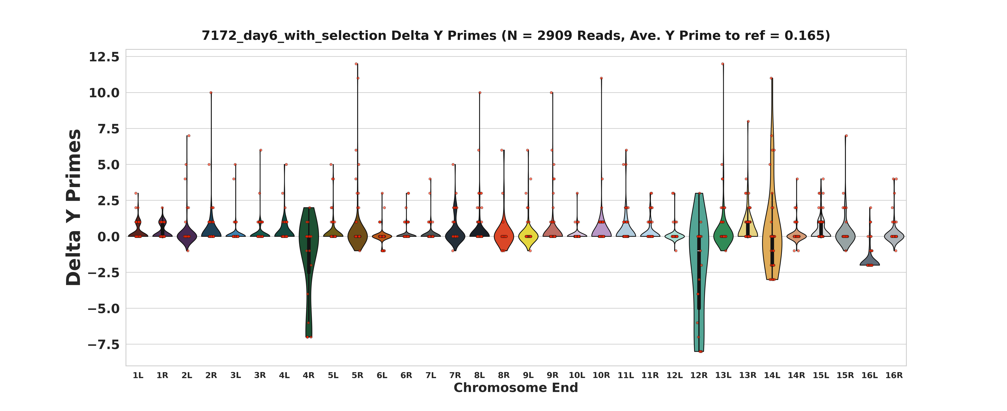
3. Recombination analysis — population view
• For each time-point sample, every read compared against day-0 features
• Feature switches (Y' / X-element / spacer) flagged as recombination events
• Outputs per-chr_end recombination summary, Y' delta plots, telomere-length distributions
• 7172 day 6: Y' loss at chr14L / chr16L, Y' gain at chr5L / chr12L
Y' count change per chr_end — 7172 day 6
Telomere repeat length distribution — 7172 day 6

Slide 5
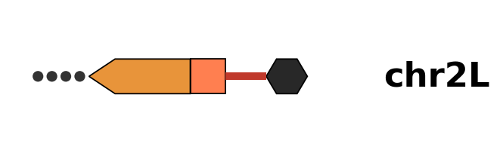
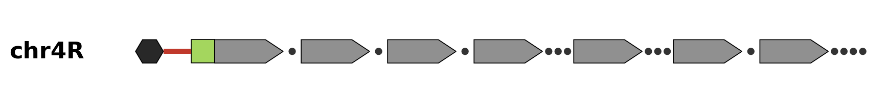
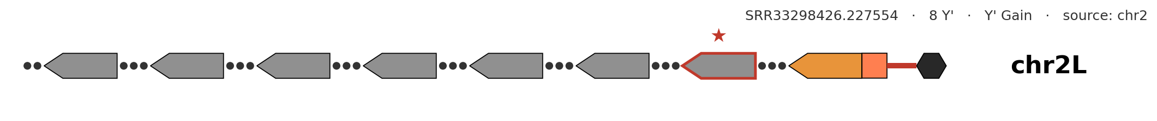
3. Recombination analysis — per-read view
• Example: chr2L day-6 read — native ID4 Y' preserved, then mid-array jump to chr4R's exact 7-Y' signature
• Donor portion of the read is identical to chr4R's day-0 Y' array — no extension, no amplification, clean transfer
• Red ★ marks the divergence point: chr2L's anchor / spacer / X / Y-1 stay native; everything telomere-side of Y-1 is chr4R
BEFORE
chr2L day 0
chr2L day-0 reference — 1 Y' element (Y-1 ID4, orange — chr2L's native signature)
DONOR
chr4R day 0
chr4R day-0 reference — 7 Y' elements (all ID1, grey — chr4R's distinctive 7-Y' signature)
AFTER
chr2L day 6 read
chr2L day-6 read SRR33298426.227554 — Y-1 native (ID4 orange) preserved, then ★ jump at Y-2 to chr4R's exact 7-Y' pattern

