Slide 1
Song Suggest
Tyler Armstrong, Jason Hua, Amar Vukovic

Slide 2
Project description
SongSuggest is an application serves as a search engine for finding songs
The application relates any specific song to other entries in the database by range of different variables

Slide 3

Architectural overview
PostgreSQL and Neo4J used to store and manipulate song data
Flask with Python used for the backend logic
Simple html/css/js used as a frontend the user is presented
Data Layer
Backend
Frontend

Slide 4
Data sources used and statistics
A dataset of songs containing relevant song information such as artist name, the album it belongs to
It also comes with other descriptive attributes such as
Popularity, duration, danceability, energy, loudness, speechiness, acousticness, instrumentalness, liveness, valence, tempo, and the genre.
A total of 114,000 entries x 21 columns
Dataset via Kaggle: Pandya, Maharshi, Spotify Tracks Dataset, DOI:10.34740/kaggle/dsv/4372070
Notes:
114,000 rows by 21 columns

Slide 5
Database Systems
PostgreSQL
Familiarity
Data consistency and integrity
Larger dataset
Horizontally taxing to the database
Neo4J
Relational capabilities
Relating different data from dataset
Artists, Songs, Albums, Genre – A lot of potential relations
Notes:
Jason

Slide 6
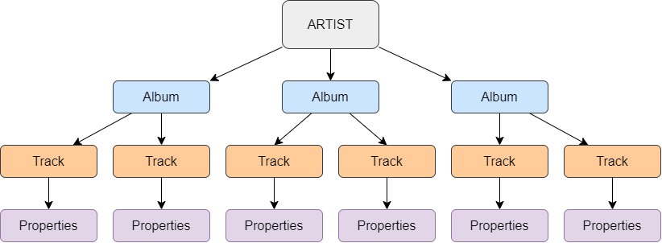
DB schema/structure
PostgreSQL
Column separated properties; normalization did not necessarily make sense with the data worked with
Neo4J

Slide 7
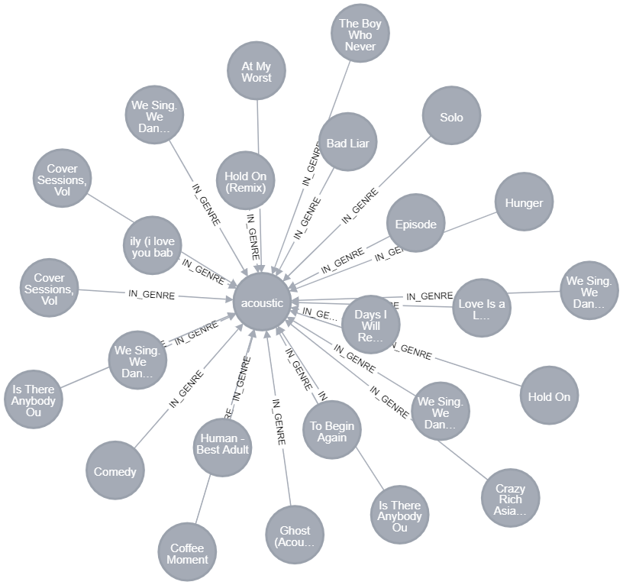
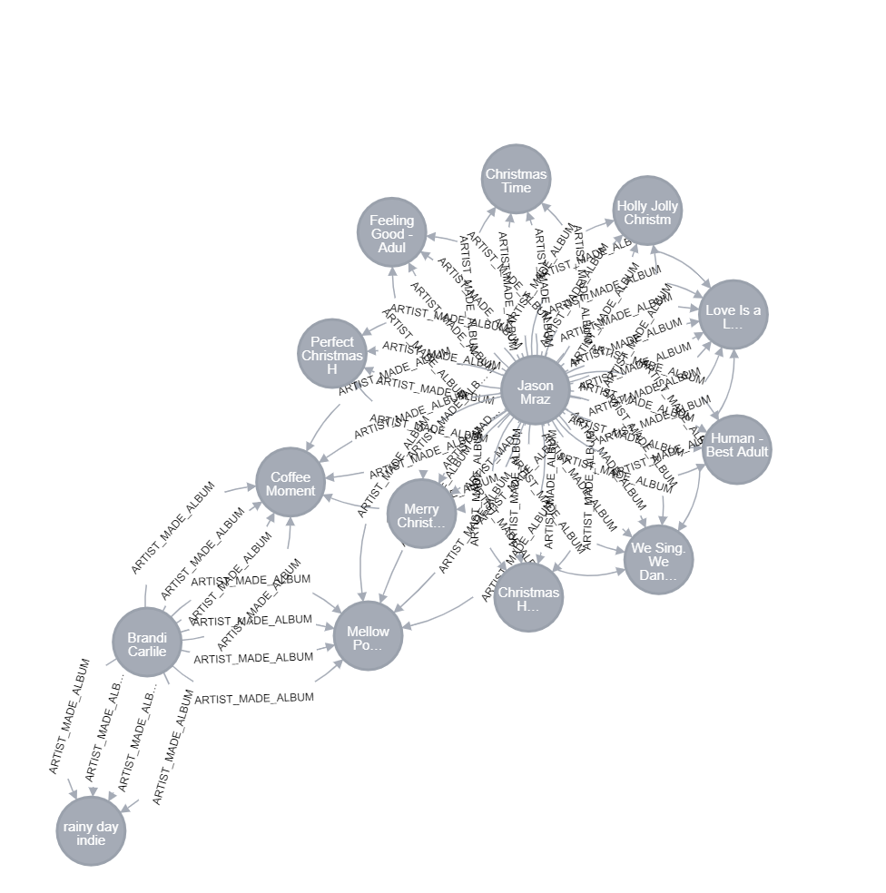
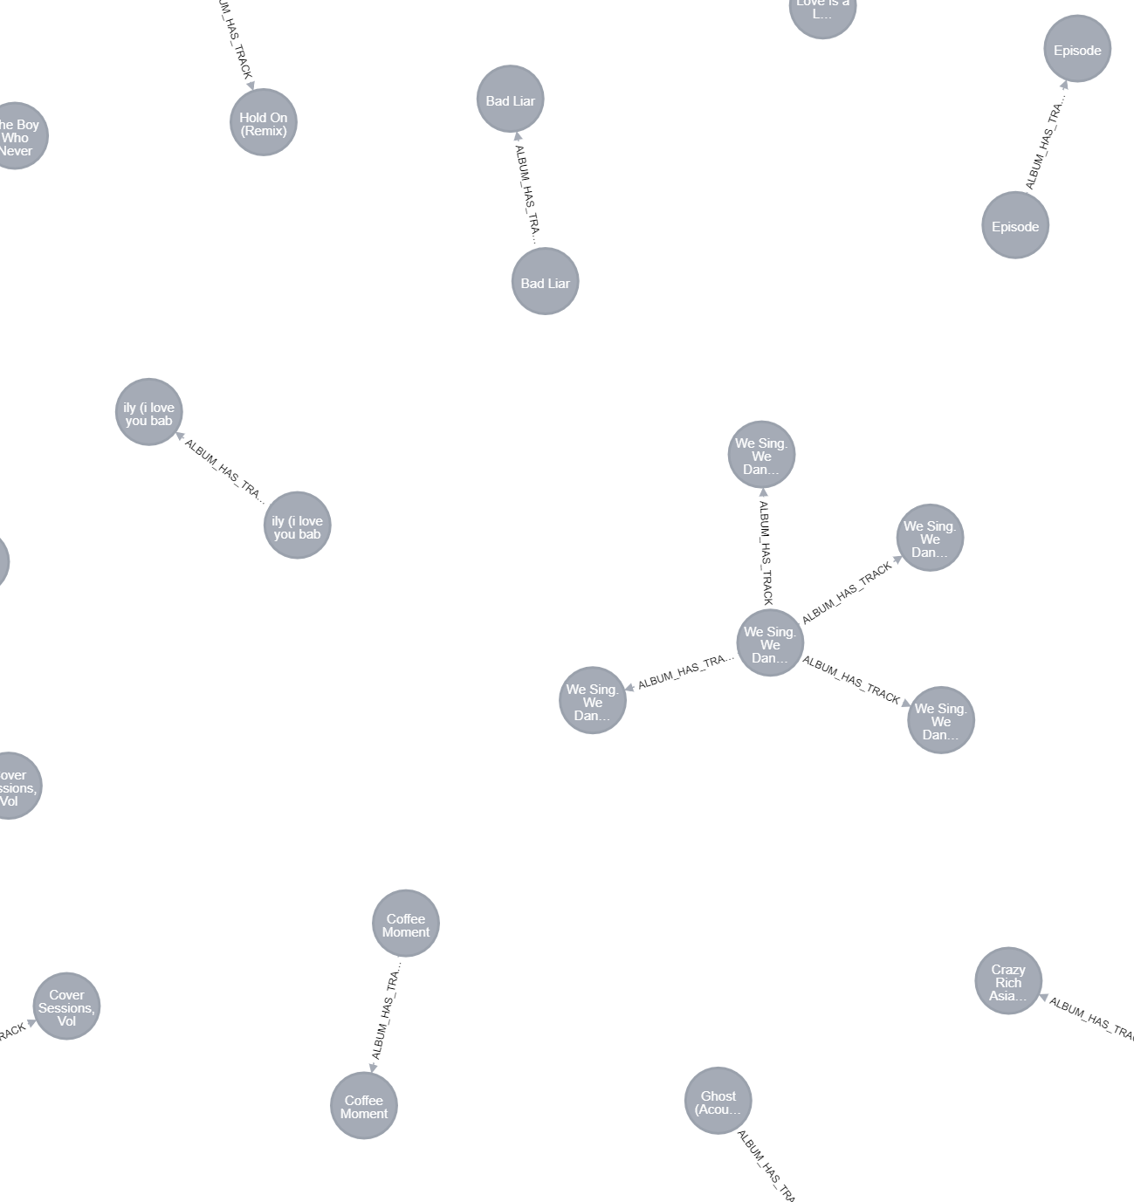
Db schema/structure
(:Artists)-[:ARTIST_MADE_ALBUM]-(:Album)
(:Album)-[:ALBUM_HAS_TRACK]-(:Songs)
(:Songs)–[:IN_GENRE]-(:Genre)

Slide 8




Tools USED
Python as the programming language
Flask for the WEB framework
Git for version control, GitHub to store repository
Visual Studio Code as the IDE

Slide 9
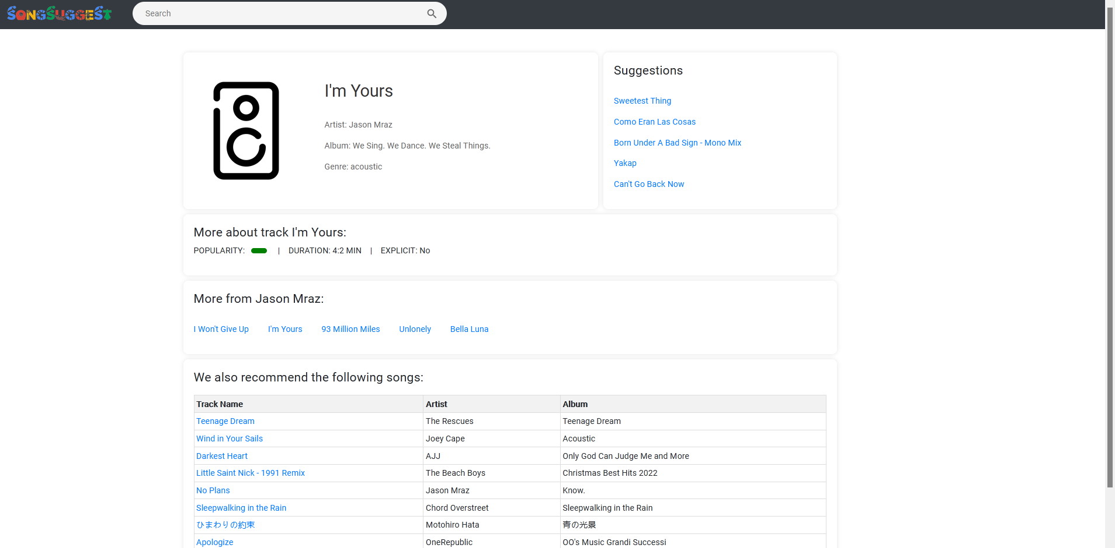
Features
Search different songs from dataset of 114,000 entries
Recommend new songs in a variety of different way using different kinds of data
Get info on any specific song from dataset
Notes:
Tyler

Slide 10
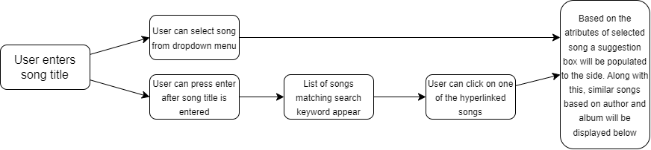
FUNCTIONALITY

Slide 11
Queries
Suggestion Query
This query uses Postgres, taking all the measurable features from a select song id, giving each of them a range, and finding songs that satisfy all of those ranges simultaneously
Songs from similar genre and artists
This query uses Neo4j to recommend songs based a similar genre and overlapping artists.

Slide 12
Lessons Learned
Indexing is extremely useful in speeding up the process when querying databases with a lot of information
PostgreSQL and Neo4J thrive with different tasks

Slide 13
Open Issues
A new feature that could be added is song samples for recommended songs. A 15 second clip for users to listen to.
Limited user input and customization. Future work could incorporate more metrics such as time signature, key, mode etc. to better match with a user’s preferences.
With the dataset, they included the same song multiple times if it was used in more than one album, which gave some issues to our queries that go off title.
Performance
Small delay with real-time search
Delay with Neo4J query

