Slide 1

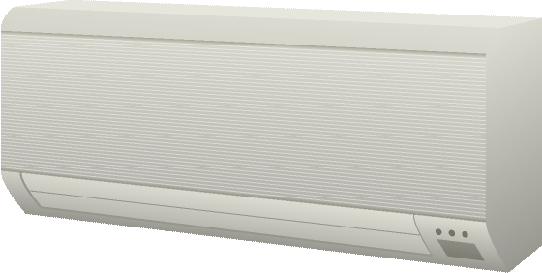

Electronic
Appliance
Remote
Controller

Slide 2

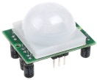
Electronic
Appliance
Control Agent

Slide 3
Remote
Controller
Electronic
Appliance
Remote
Controller

Slide 4
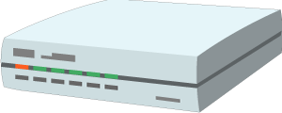
Remote
Controller
Gateway
Electronic
Appliance

Slide 5
Proxy
Electronic
Appliance
Remote
Controller

Slide 6
Agent
Gateway
Electronic
appliance
Remote
controller

Slide 7


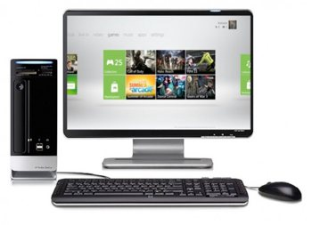


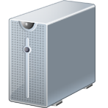
Services
Monitor
RS-485
EtherCAT

Slide 8
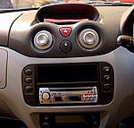
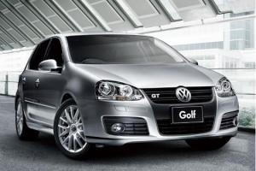

Services
DCU
Gateway
CAN
CAN
ECU
ECU
ECU

