Slide 1

W3C Web of Things Test Planning
25 October 2018

Slide 2
Agenda
Timeline
Test Categories
Test Coverage
Tooling
To Do

Slide 3
Timeline
6-Month Extension has been requested
Director still needs to be approved, but is expected
Existing charter deadline is 31 December 2018
Six-month extension goes to 30 June 2019
But we need to get to REC by then
W3C REC Milestone Calculator gives worst-case deadlines of
REC: 27 June 2019
PR: 28 May 2019
CR: 16 April 2019 (planned: 22 Jan 2019)
Requirements
CR Start: Test plan and tooling in place. Partial test coverage (may be) acceptable.
CR Exit/PR Start: Completed all testing.

Slide 4
Test Categories
See: https://github.com/w3c/wot/blob/master/testing/plan.md
Functional Testing:
Thing Description Validation
Thing Network Interface Testing
Does a Thing satisfy the contract given by a specific TD
Including functional security testing
Scripting API Testing
Non-Functional Testing
Fuzz Testing (robustness testing)
Adversarial Security Testing (required by charter)
Adequate Representation of Appropriate Target Ecosystem Standards

Slide 5
Test Coverage
Technically, we need "evidence of implementation experience"
In practice we want to…
Have a test case for each normative assertion
Have at least one example that passes the test and one that fails it
Evidence that our set of normative assertions sufficiently constrains implementations so they can interoperate
Some normative assertions in our spec need many tests to cover them adequately, and/or specific tooling (eg conformance with JSON-LD specification, tests for set of all security schemas).

Slide 6
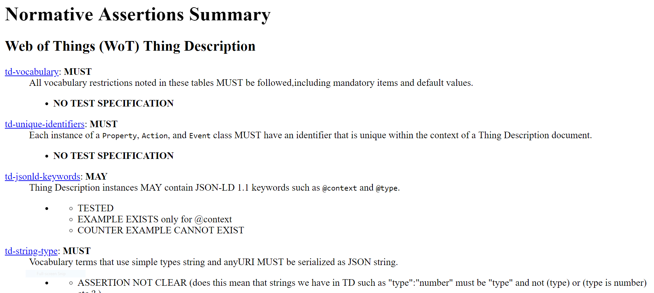
Assertion Collector

Slide 7
What We (Probably) Want
Assertion | Test Case | Example | Counterexample | Implementations
td-vocabulary | T1 | E1-1, E1-2 | CE1-1 | I1, I2
 | T2 | E2-1 | CE2-1 | I2, I3
td-json-keywords | T3 | E3-1, E3-2 | CE3-1 | I1/I4, I2/I4
 | T4 | E4-1 | CE4-1, CE4-2 | I1, I2
td-unique-identifiers | T5 | E5-1 | CE5-1 | I2, I3
 | T6 | E6-1, E6-2 | CE6-1 | I3, I4, I5
At least two tests that work on two different implementations for each assertion. For interop tests, need two pairs.

Slide 8
Tooling
JSON Schema
JSON-LD Parser
SHACL
SHEX
Special Case Tests
Postman (Elena)
Burp Suite (Elena)
CoAP testing scripts (Elena)
Thing Network Tester (Ege Korkan)
Playground (TD Validation)
Arena Interop (Dave Raggett)

Slide 9
To Do

