Slide 1
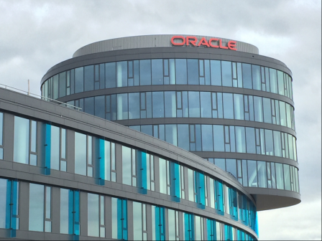
Summary of PlugFest (24-25 March 2018) @Oracle, Prague
Participants(12):
Oracle, Ericsson, EURECOM, Fujitsu, Hitachi, Intel, Internet Research Institute, The Paciello Group, Panasonic, SmartThings/Samsung Research, Siemens, Technical University of Munich
26 March 2018
Ryuichi Matsukura, Fujitsu

Slide 2
Plugfest summary in Prague, 24-25 March 2018
Car App.
(Eurecom)
NodeRED
(Panasonic)
Overflow protection
(Siemens)
mashup.jp
(TUM)
Scripting
(Fujitsu)
Application
(Hitachi)
IoT Cloud service
(Oracle)
NodeRED
(Fujitsu)
Application
(SmartThings)
Scripting
(Siemens)
NodeRED
(IRI)
Paciello Accesibility
(Paciello)
Ari.jp
(Siemens)
Iot.schema
TD directory
(Siemens)
TD directory
(Fujitsu)
Remote proxy
(Fujitsu)
http://192.168.1.163:8080
Local proxy
(Fujitsu)
TD directory
(Fujitsu)
Local proxy
(Fujitsu)
Munich Proxy
Node-wot+Oracle binding
(Siemens)
http://192.168.1.99:18081
LWM2M TD generator
(Ericsson)
LWM2M MS
(Ericsson)
Lamp
(SmartThings)
WebSpeech
(Intel)
LWM2M client
(Ericsson)
LED Light
(Fujitsu)
Rotating Light
(Fujitsu)
Air conditioner
(Panasonic)
Event Source
(Siemens)
BMW X5
(Eurecom)
Iot.schema
IoT Dev. Sim.
(Oracle)
Counter.js
(Siemens)
Air conditioner
(Fujitsu)
Illumination sensor
(Fujitsu)
Iot.schema
Unicorn
(Siemens)
OCF Smart home
(Intel)
Device Sim.
(Panasonic)
Iot.schema
Motion sensor
(SmartThings)
Web Camera
(Intel)
Pump
HVAC
Connected car
Festo plant
Cleaner
Rotating light
LED light
(Fujitsu)
Blind
(Fujitsu)
BMW 7S
(Eurecom)
Iot.schema
Festo Live
(Siemens)
Iot.schema
Iot.schema
Iot.schema

