Slide 1
Results and Issues for Burlingame Plugfest
December 13th, 2017
Ryuichi Matsukura
Fujitsu Laboratories Ltd. / Fujitsu Ltd.
See TPAC2017 plugfest github
https://github.com/w3c/wot/blob/master/plugfest/2017-burlingame/preparation.md

Slide 2
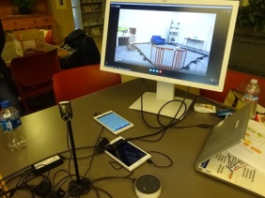
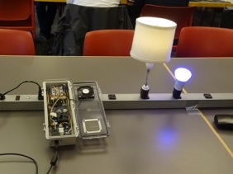
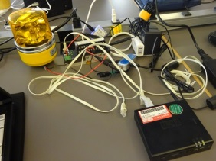
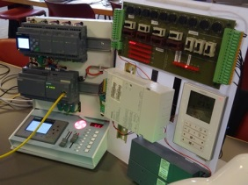
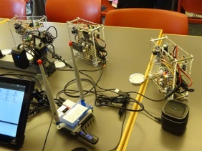

Servients diagram on TPAC2017
Application Servient
Node-RED
(Panasonic)
Application Servient
Scripting
(Panasonic)
Application Servient
(Siemens)
Application Servient
(IRI)
Application Servient
(Intel)
Application Servient
Node-RED
(SmartThings)
Application Servient
Scripting
(Fujitsu)
Application Servient
Node-RED
(Fujitsu)
Remote Proxy Servient
(Siemens)
Thing Directory (Siemens)
Remote Proxy Servient
(Intel)
Remote Proxy Servient
(smartthings)
Remote Proxy Servient
(Fujitsu)
Thing Directory (Fujitsu)
Internet
Implemented inside Remote proxy
Device Servient
(Intel)
Device Servient
(SmartThings)
(Client Requests)
NAT / Firewall
WebUI WoT Client (Siemens)
Application Servient
Node-RED
(SmartThings)
Local Proxy Servient
(Siemens)
Local Proxy Servient
(lemonbeat)
Local Proxy Servient
(Intel)
Local Proxy Servient
(SmartThings)
Local Proxy Servient
(Fujitsu)
Local Proxy Servient
(Fujitsu)
Device Servient
(Panasonic)
Device Servient
(Panasonic)
Device Servient
(Panasonic)
Device Servient
(Panasonic)
Device Servient
(Lemonbeat)
Device Servient
LED Light
(Fujitsu)
Device Servient
(Panasonic)
Device Servient
(Panasonic)
Device Servient
BACnet
(Siemens)
Device Servient
Modbus/TCP
(Siemens)
Device Servient
(Lemonbeat)
Device Servient
(Intel)
Device Servient
(SmartThings)
Device Servient
(EURECOM)
Device Servient
Rotating light
(Fujitsu)
Device Servient
Air Conditioner
(Fujitsu)
Device Servient
(Panasonic)
Device Servient Festo Plant
(Siemens)
Osaka, Japan
Munich, Germany
Local network
San Francisco
Kanazawa, Japan

Slide 3
TPAC2017 Plugfest results
Application Servient
Node-RED
(Panasonic)
Application Servient
Scripting
(Panasonic)
Application Servient
(Siemens)
Application Servient
(IRI)
Application Servient
(Intel)
Application Servient
Node-RED
(SmartThings)
Application Servient
Scripting
(Fujitsu)
Application Servient
Node-RED
(Fujitsu)
Remote Proxy Servient
(Siemens)
Thing Directory (Siemens)
Remote Proxy Servient
(Intel)
Remote Proxy Servient
(smartthings)
Remote Proxy Servient
(Fujitsu)
Thing Directory (Fujitsu)
Internet
Implemented inside Remote proxy
Device Servient
(Intel)
Device Servient
(SmartThings)
(Client Requests)
NAT / Firewall
WebUI WoT Client (Siemens)
Application Servient
Node-RED
(SmartThings)
Local Proxy Servient
(Siemens)
Local Proxy Servient
(lemonbeat)
Local Proxy Servient
(Intel)
Local Proxy Servient
(SmartThings)
Local Proxy Servient
(Fujitsu)
Local Proxy Servient
(Fujitsu)
Device Servient
(Panasonic)
Device Servient
(Panasonic)
Device Servient
(Panasonic)
Device Servient
(Panasonic)
Device Servient
(Lemonbeat)
Device Servient
LED Light
(Fujitsu)
Device Servient
(Panasonic)
Device Servient
(Panasonic)
Device Servient
BACnet
(Siemens)
Device Servient
Modbus/TCP
(Siemens)
Device Servient
(Lemonbeat)
Device Servient
(Intel)
Device Servient
(SmartThings)
Device Servient
(EURECOM)
Device Servient
Rotating light
(Fujitsu)
Device Servient
Air Conditioner
(Fujitsu)
Device Servient
(Panasonic)
Device Servient Festo Plant
(Siemens)
Osaka, Japan
Munich, Germany
Local network
San Francisco
Kanazawa, Japan

Slide 4
Summary of achievements
Proxy servients can help to set up a larger scale system
Proxy servients aggregate applications and devices to easily connect to each other.
Connectivity and security
Some resolutions were given for the local and the Internet connections including NAT / Firewall traversal
Many devices can connect using WoT framework
Sensors and actuators of house, building, factory and vehicle
ECHONET Lite, OCF, SmartThings, IPSO, BACnet, KNX, Lemonbeat, Modbus, EtherCAT, and VISS
Applications are developed on Scripting API and Node-RED
Applications were connected to the proxies and the devices using the external WoT interface.

Slide 5
Issues for the next
Inter-Servient Interface
Detailed specification is necessary for the plugfest participants
-> Share your interface descriptions if possible
See Fujitsu implementations on the appendix of the plugfest preparation document
https://github.com/w3c/wot/blob/master/plugfest/2017-burlingame/preparation.md
Some mismatches on the implementations: Action vs. Set, payload format, …
Architecture
Proxy servient: function should be specified
Connectivity and security
Interoperable firewall and NAT traversal patterns between remote/local proxies
Security consideration
TD management
Functions and Interface of Thing directory should be specified.
Life cycle management of TD
TD Model
Event representation
Complex Action representation
Semantic annotations
Protocol bindings to specific protocols, for examples OCF, EHONET lite,…

Slide 6
Action plans
Plugfest call
Plugfest guideline document
Detailed specification will be shown for new participants
Part of them should be merged to WG documents and others to notes or appendix after the discussions
Setup the document on IG repository

