Slide 2
Diamonds
Mariea Deshommes, Nichelle Nesbitt, Audrey Bouldin

Slide 3
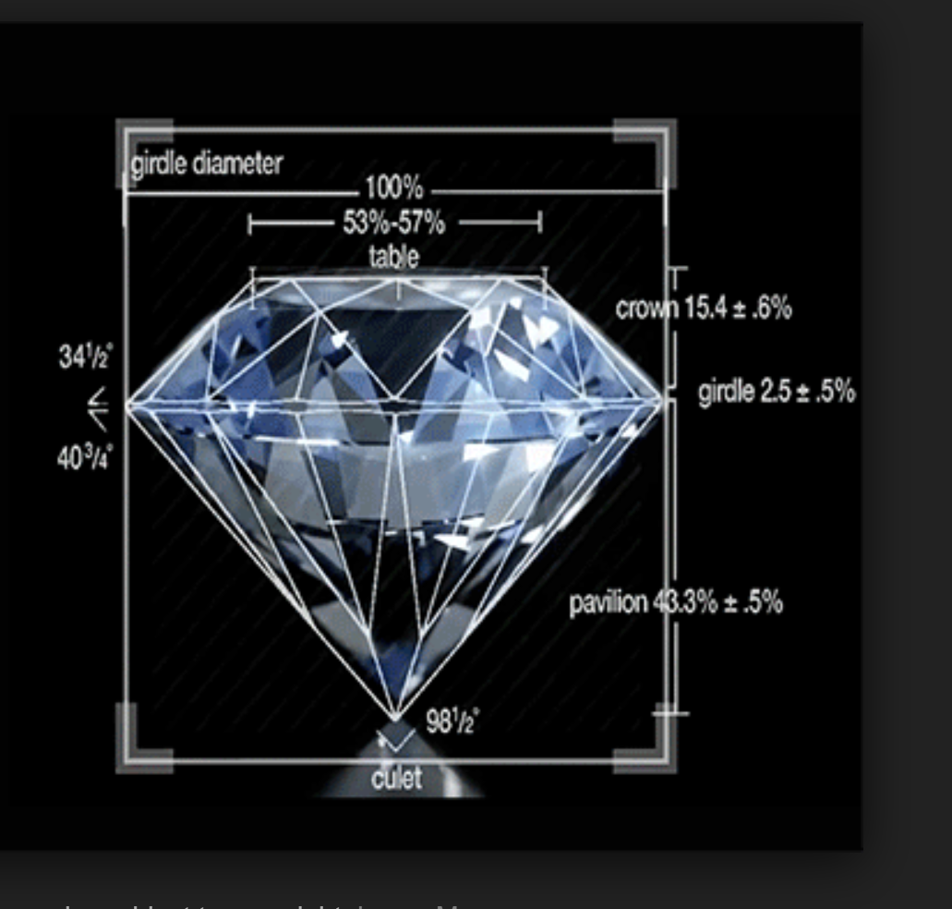
Goal
To predict diamond prices using Machine Learning
Using the following programs:
- Python Pandas
- Tableau

Slide 4
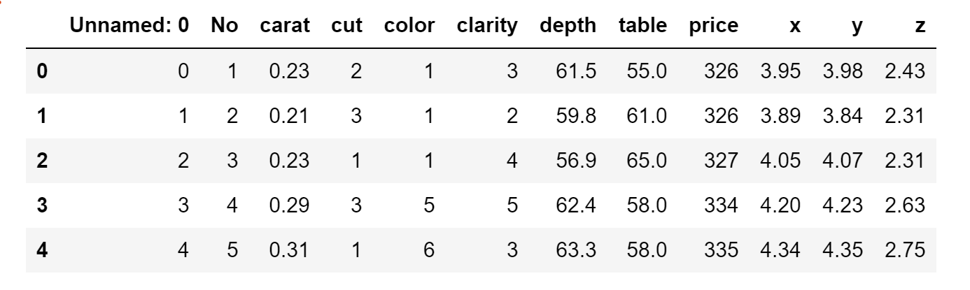
Cleaning data
Step 1 Extract
Download data from Kaggle
Step 2 Transpose
Step 3 Load
Visual Studio Code
Quantify Columns

Slide 5
Extracting the data:
Download from Kaggle.com
Quantified and added columns for

Slide 6
Machine Learning
First bullet point here
Second bullet point here
Third bullet point here
Class | Group 1 | Group 2
Class 1 | 82 | 95
Class 2 | 76 | 88
Class 3 | 84 | 90

Slide 7
Predicting Diamond Prices

Slide 8
Sample Vs Predicted Diamond Prices

Slide 9
Add a Slide Title - 4

