Slide 1
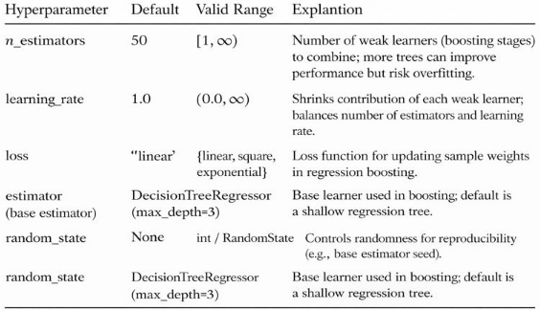
Hope Artificial Intelligence
AdaBoost Regression
AdaBoost (Adaptive Boosting) is an ensemble learning algorithm that combines multiple weak learners to create a strong predictive model. It trains models sequentially, giving more weight to data points that were previously misclassified. By focusing on errors and updating weights, AdaBoost improves accuracy and reduces bias.
AdaBoost Hyperparameter table

Slide 2
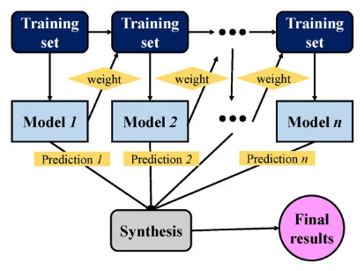
Ada Boost - Algorithm

Slide 3

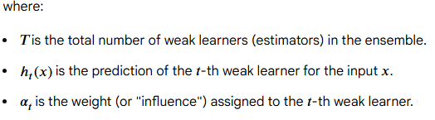
AdaBoost Regression Prediction Formula
The AdaBoost regression prediction is the weighted median or weighted mean of the predictions from all the individual weak learners in the ensemble. The general formula for the final ensemble prediction is:

Slide 4
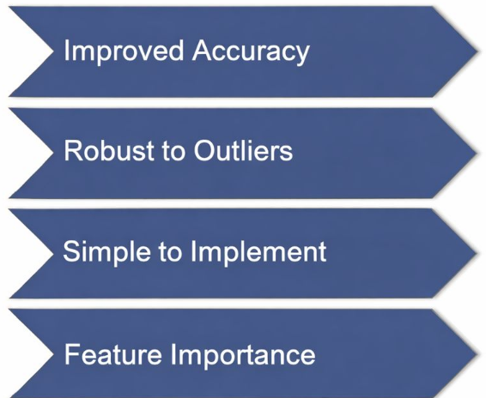
Why AdaBoost?

