Slide 1
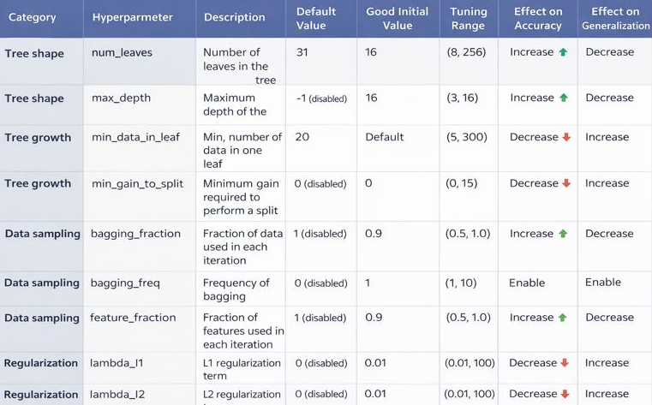
Hope Artificial Intelligence
LG Boost Regression
LGBoost regression (commonly referring to LightGBM regression) is a gradient boosting framework designed for high performance. It uses tree-based learning with histogram-based splitting for faster training and lower memory usage. LightGBM handles large datasets and high-dimensional features efficiently. It often achieves high accuracy with good scalability.
LG Boost Hyperparameter table

Slide 2
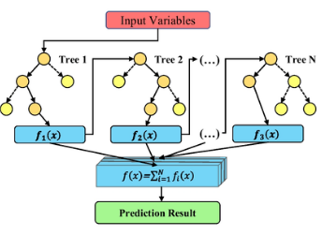
LG Boost - Algorithm

Slide 3

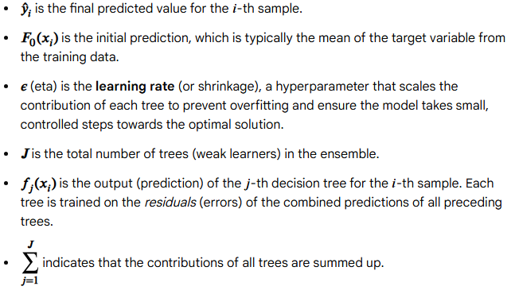
LGBoost Regression Prediction Formula
The LGBoost (LightGBM) regression prediction for a given input is an ensemble of the predictions from all the individual decision trees built during the training process.

Slide 4
