Slide 1
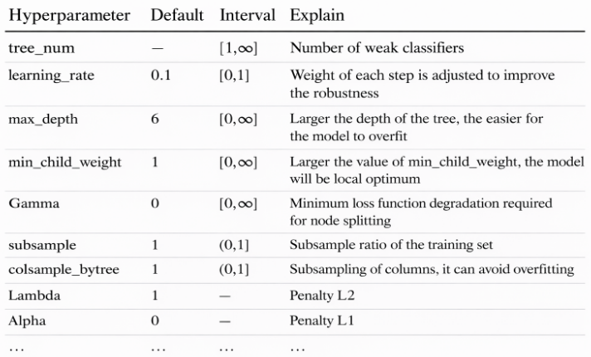
Hope Artificial Intelligence
XGBoost Regression
XGBoost Regression combines many decision trees to make accurate predictions for continuous values. It improves performance by sequentially correcting errors and controlling over fitting through regularization.
XGBoost Hyperparameter table

Slide 2
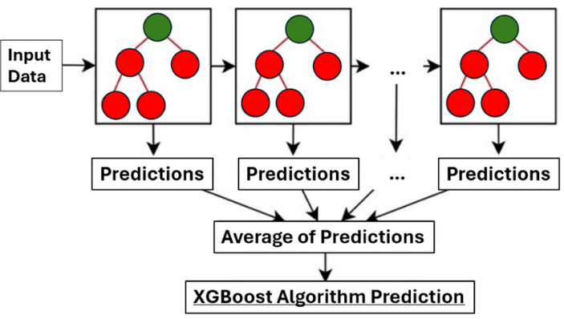
XG Boost - Flow chart

Slide 3
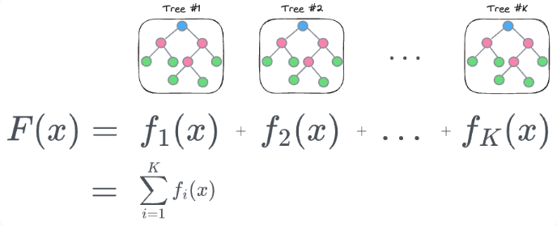
XGBoost Regression Prediction Formula
F(x) represents the final predicted value for input xxx.
Each f1(x) is an individual decision tree in the model.
Trees are added sequentially, each learning from previous errors.
The final output is the sum of predictions from all trees.
This additive model improves accuracy while reducing bias.

Slide 4
Why XGBoost?
High Accuracy
Handles Non-linearity
Regularization
Fast & Scalable

