Slide 1
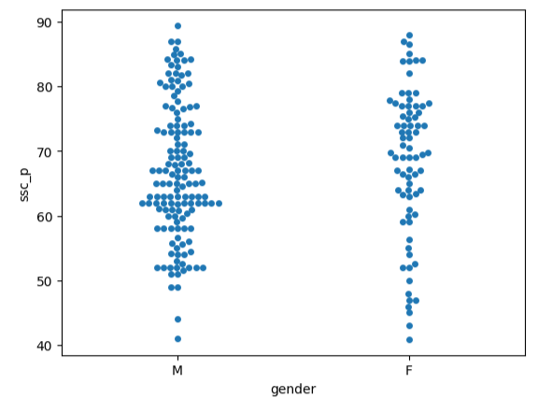
Hope Artificial Intelligence
Seaborn
Uses of Swormplot
Shows individual data points for each category.
Displays data distribution within categories.
Compares values between groups.
Prevents overlapping of points for clearer visualization.
Works well with boxplots/violin plots to show detailed data.

Slide 2
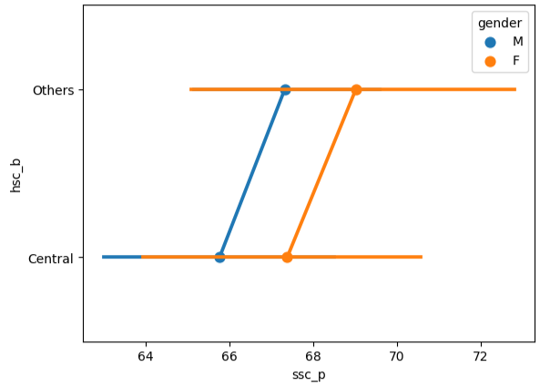
Uses of Pointplot
Shows the average (mean) of a numerical variable for each category.
Compares values between categories.
Displays trends or relationships across categories.
Shows confidence intervals around the mean.

Slide 3
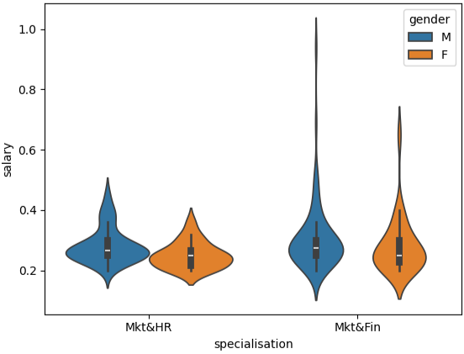
Summary of the Violin Plot
Variables shown
Specialisation: Mkt&HR, Mkt&Fin
Gender: Male (M), Female (F)
Measure: Salary
Key Observations
In both specializations, males generally have slightly higher salaries than females.
Mkt&Fin shows higher salary ranges and greater variation compared to Mkt&HR.
Mkt&HR salaries are more concentrated around the mid-range values.
Mkt&Fin male salaries show the widest spread, indicating higher possible earnings.
Conclusion: Students specializing in Mkt&Fin tend to receive higher and more varied salaries, while Mkt&HR salaries are more stable, with males earning slightly more than females on average.

Slide 4
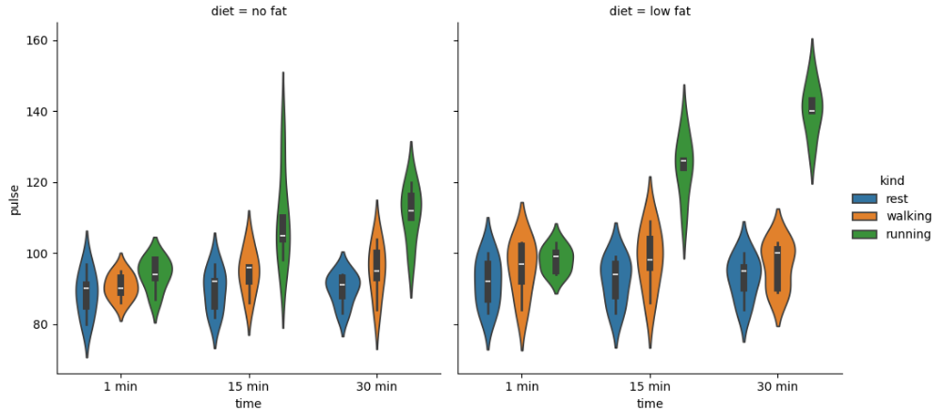
Summary of the Cat Plot (ie, Factor plot)
Variables shown
Time: 1 min, 15 min, 30 min
Activity: Rest, Walking, Running
Diet: No-fat vs Low-fat
Measure: Pulse rate
Key Observations
Running produces the highest pulse rates, especially at 30 minutes.
Walking shows moderate pulse increase over time.
Rest maintains the lowest and most stable pulse.
Pulse generally increases as time increases (1 to 30 minutes).
The no-fat diet group tends to have slightly higher pulse values, especially during running.
Conclusion: Pulse rate increases with exercise intensity and time, with running causing the largest increase, and the no-fat diet group showing slightly higher pulse responses compared to the low-fat group.

