Slide 1
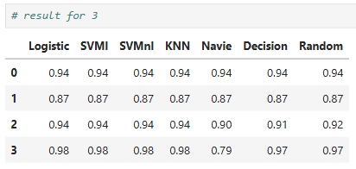
Hope Artificial Intelligence
RFE Classication Result
Most models like Logistic, SVM (linear & non-linear), and KNN show consistent performance (~0.94–0.98), indicating stable and reliable predictions across different feature sets.
Naive Bayes shows a significant drop (down to 0.79), suggesting it is less suitable for this dataset compared to other models.`
Overall, Decision Tree and Random Forest perform competitively, but simpler models like Logistic and SVM already achieve high accuracy, making them efficient choices.

Slide 2
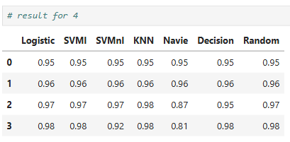
Most models achieve high accuracy (0.95–0.98), with Logistic, SVM (linear), KNN, Decision Tree, and Random Forest showing strong and consistent performance.
KNN and Random Forest slightly outperform others in some cases (up to 0.98), indicating better adaptability to feature variations.
Naive Bayes again underperforms (dropping to ~0.81–0.87), confirming it is less suitable for this dataset compared to other models.

Slide 3
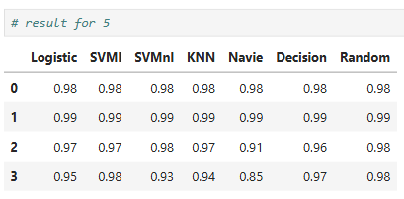
Most models achieve very high accuracy (0.97–0.99), showing that the selected features provide strong predictive power.
SVM (linear), Logistic, and Random Forest consistently perform at the top, indicating stable and reliable performance across different cases.
Naive Bayes again shows lower accuracy (down to ~0.85–0.91), confirming it is less effective for this dataset compared to other models.
Final Summary
Across feature sets (3, 4, and 5 features), model performance improves as the number of selected features increases, with the best accuracy observed using 5 features (up to 0.99).
Logistic Regression, SVM (linear), and Random Forest consistently deliver high and stable accuracy across all cases, making them the most reliable models.
Naive Bayes shows comparatively lower performance, indicating it is less suitable for this dataset.
Overall, using 5 important features provides the best balance between accuracy and feature reduction, making it the optimal choice.

Slide 4
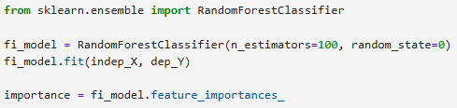
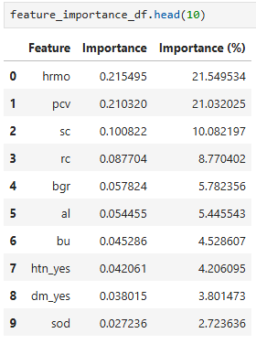
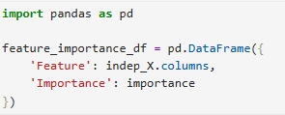
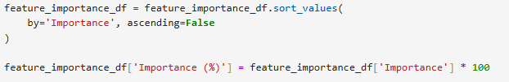
Feature Importance Algorithm

Slide 5
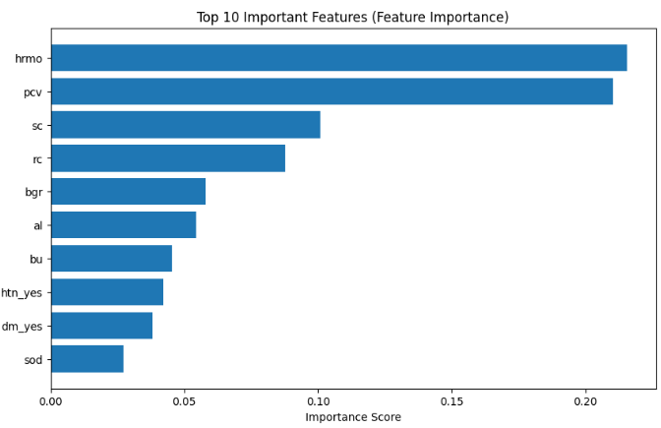
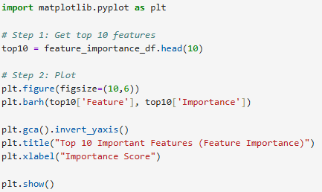
The top features hrmo (21.5%) and pcv (21.0%) dominate the model, contributing over 40% of total importance, indicating they are the most critical factors for prediction.
Features like sc, rc, and bgr provide moderate influence, while others such as htn_yes and dm_yes have comparatively lower impact.
Overall, the model relies heavily on a small set of key features, suggesting effective dimensionality reduction is possible without major accuracy loss.

