Slide 1
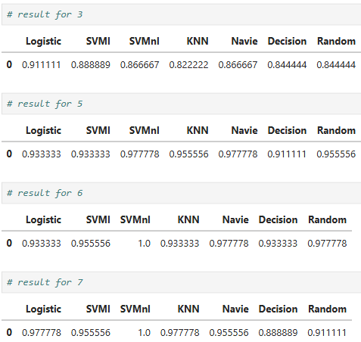
Hope Artificial Intelligence
PCA Classification Result
Optimal features = 6, as accuracy reaches 100% and does not improve further with more features.
Best model = SVM (RBF kernel), consistently achieving highest accuracy across feature sets.
Increasing features beyond 6 adds complexity without improving performance, so it’s unnecessary.

Slide 2
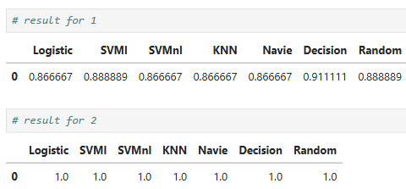
LDA Classification Result
Optimal components = 2, since it achieves 100% accuracy across all models, while 1 component gives lower performance (~0.86–0.91).
With 2 components, LDA fully separates all classes, making the dataset perfectly classifiable.
Increasing components beyond 2 is not possible (limit = classes − 1), so 2 is both optimal and maximum.

Slide 3
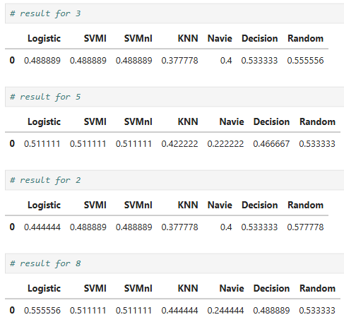
Kernel PCA Classification Result
Kernel PCA performs poorly overall, with accuracy mostly in the 0.37–0.57 range, much lower than PCA/LDA/RFE.
Best performance ≈ 0.55 (with 8 components), but still not competitive, indicating poor feature representation.
This suggests the dataset is not benefiting from non-linear transformation, and simpler methods (like LDA/PCA) are more suitable.

Slide 4
Summary
The best approach for this dataset is LDA, because it achieves 100% accuracy using only 2 components, which means it separates the classes perfectly with minimal information. This makes it both efficient and highly effective.
Among the models, SVM with RBF kernel performs the best, as it consistently gives top accuracy across different feature methods and especially with LDA.
In comparison, PCA also performs well but requires more features (around 6) to reach the same accuracy, while Kernel PCA performs poorly, indicating that non-linear transformation is not suitable for this dataset.

