Slide 1
Modeling magnetic braking of Pleiades stars
Alex Meredith
Data from: Rebull, L. M., Stauffer, J. R., Bouvier, J., Cody, A. M., Hillenbrand, L. A., Soderblom, D. R., Valenti, J., Barrado, D., Bouy, H., Ciardi, D., Pinsonneault, M., Stassun, K., Micela, G., Aigrain, S., Vrba, F., Somers, G., Christiansen, J., Gillen, E., & Cameron, A. C. (2016). Rotation in the Pleiades with K2. I. Data and first results. The Astronomical Journal, 152(5), 113. https://doi.org/10.3847/0004-6256/152/5/113

Slide 2
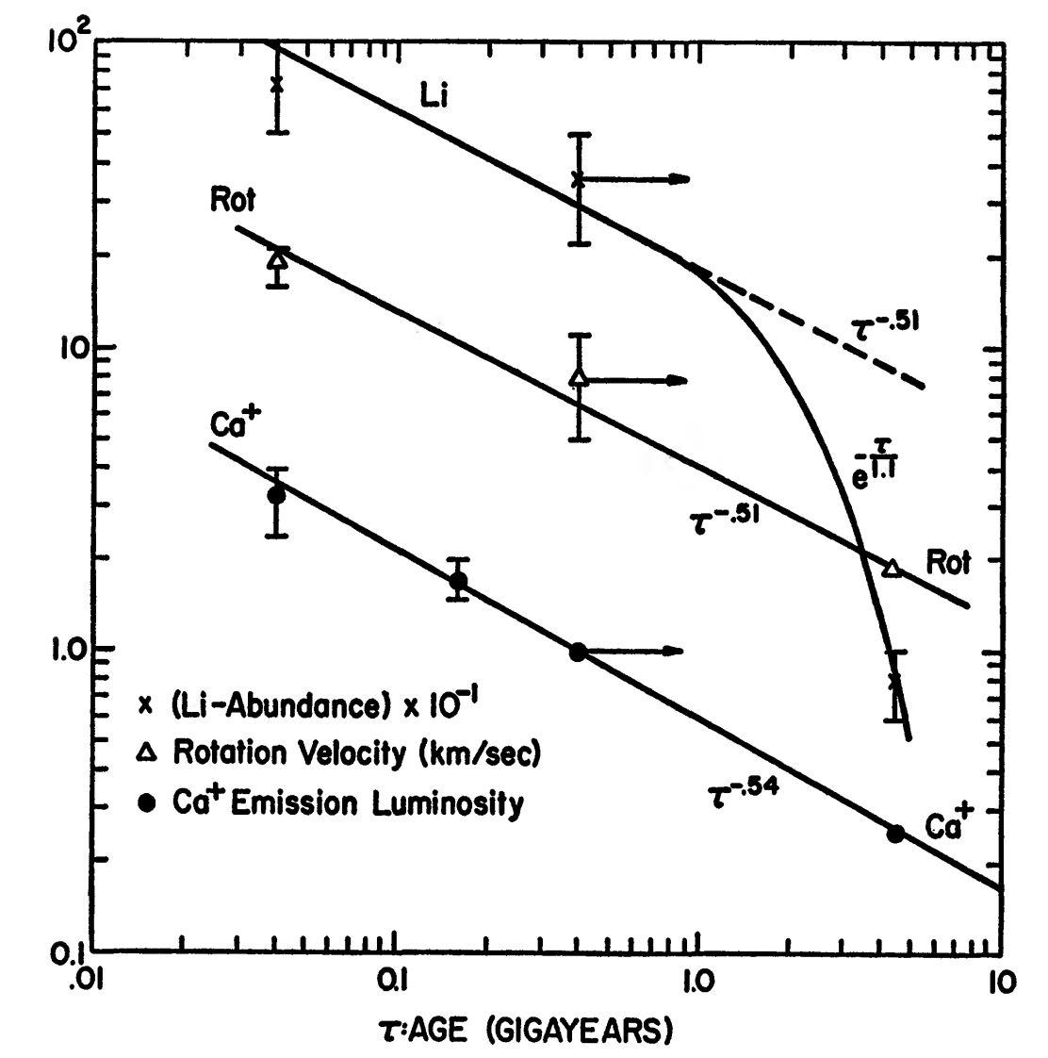
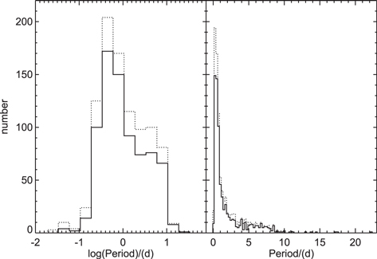
Expectations
Findings
A Weibull distribution of rotational periods
Calculated periods should match the periods found by K2
Spin evolution with a constant rate of change
A lognormal distribution best fits the rotational period data (Pleiades)
Calculated periods of the model match the observed data
Spin evolution follows a more exponential rate of change

Slide 3
Computational methods
Languages/libraries: numpy, pandas, scipy, matplotlib
Statistical methods: Population monte carlo, error checking & validation
Simulation and modeling: Population modeling, backward spin-evolution modeling, forward spin-evolution modeling, mass-dependent moment of inertia
Visualization: Rotational period histograms, spin evolution tracks, Mass/color diagnostics,
Data sources: Rebull et al. 2016, T2: rotation periods, membership, photometry
Animation: matplotlib.animation

Slide 4
Flow chart of coding
Load/clean data tables
Star evolution IVP
Define spin down diff eq.
Star spin evolution & reverse evolution
Monte carlo: rotational periods

Slide 5
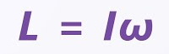
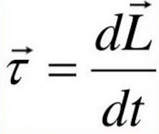
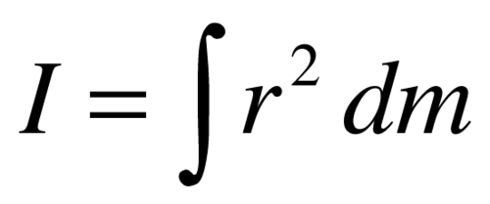
Physical concepts
Physical Interpretation
Torque represents the magnetic braking experienced by stars, a process in which celestial bodies lose angular momentum due to ineraction with its own magnetic field and outflowing stellar wind/plasma.
For stars to lose angular momentum, there must be a torque acting on the body. This torque results from the exerted plasma with the magnetic field acting as a lever arm.
Moment of inertia for celestial bodies decreases w.r.t time. For dI/dt<0, a star contracts and spins faster.
Conservation of Angular momentum
Torque law
Moment of inertia

Slide 6
Assuming moment of inertia from (V-K) color index
Improved models of the initial Skumanich braking law allow for a star’s radius and moment of inertia to change w.r.t time
As young stars age, they evolve towards Zero-age Main Sequence (ZAMS) where it completes its’ radial contraction and begins stable hydrogen fusion in the core
During the evolution process solar radius decreases, mass decreases, and the rotation rate increased due to conservation of angular momentum
At the same time, magnetic braking slows the star down, so there are two contrasting effects w.r.t rotational velocity

Slide 7
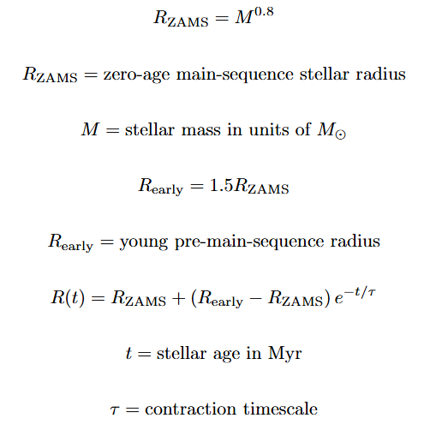
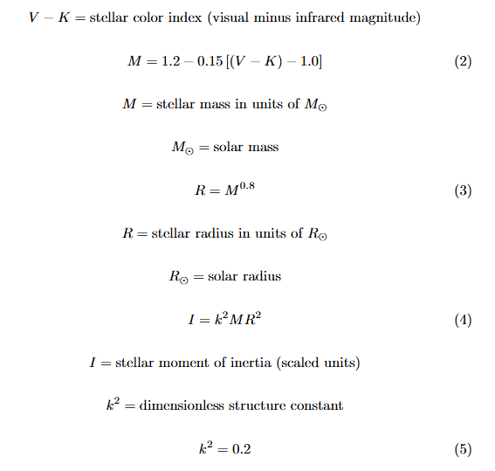
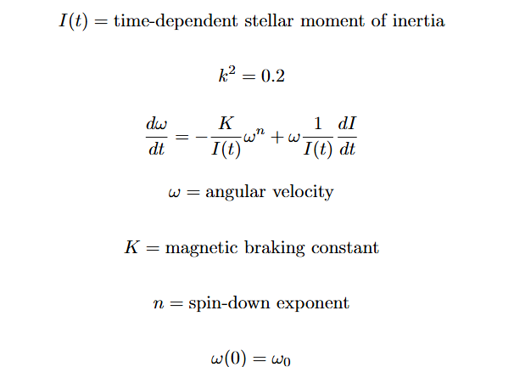
Assuming moment of inertia from (V-K) color index

Slide 8
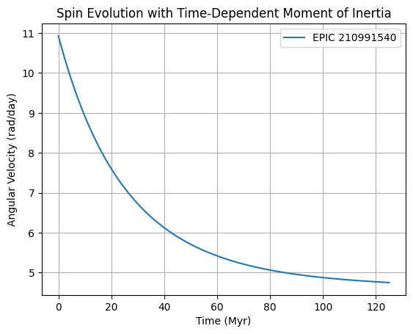
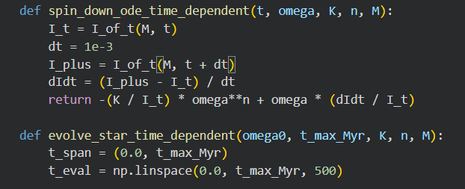
Explaining the IVP
The differential equation is a Skumanich braking law, which expresses how the rotational velocity of stars decays over time, following a power law.
solve_ivp integrates the ode from t=0 to tmax, producing the full evolution of ⍵(t). This result is then converted into rotational period.

Slide 9
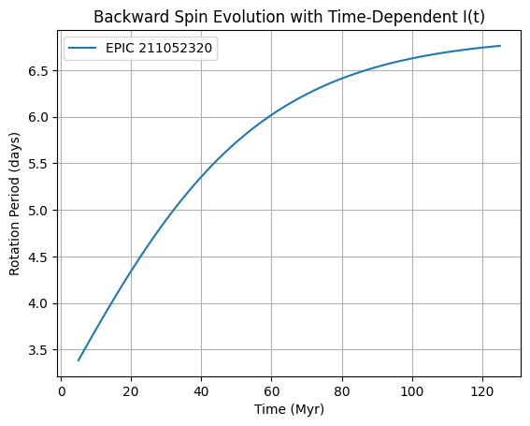
Reverse spin evolution of a star
211052320
This allows us to infer initial and earlier rotational periods of stars under the skumanich-braking law.
By measuring how long a star has been spinning down, astronomers can estimate any given star’s age. This aids the formulation of theories of how stellar clusters form and evolve
Knowing the initial rotational period can tell us about the conditions during star formation. I.e “Did the stars of a certain cluster form with similar rotation rates, or is there a wide range?”

Slide 10
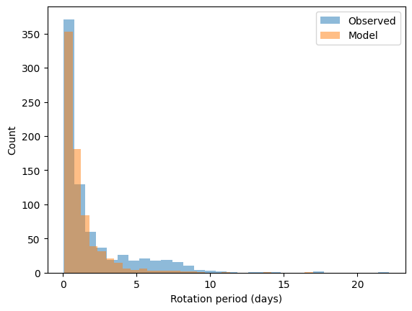
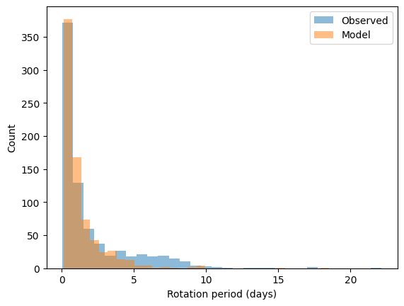
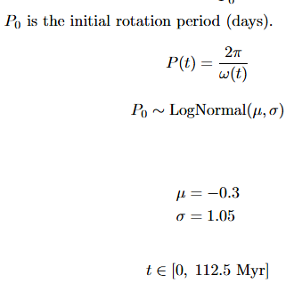
Population monte carlo
Gives stars in Pleiades a distribution of initial spin periods, if these stars lose angular velocity over time due to braking, what rotation period distribution should we see in the present?
Multiple rotational sequences in the observed K2 dataset, so one lognormal function cannot fully accurately match the left mode with the right shoulder.

Slide 11
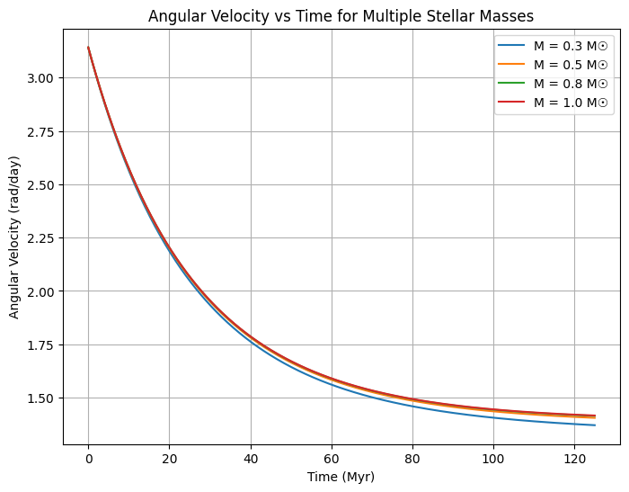
Extra plots

