Slide 1

safest way of transportation
April Meyer

Slide 2

Introduction
Airplanes are one of the safest ways of transportation. The likelihoods of perishing in an airline accident are about one in 11,000,000 (1). People are more probable to be struck by lightning, with a one in 13,000 chance for a lifetime.

Slide 3

Background
Fatalities do happen, but media outlets make society more aware of them, so people tend to think they happen all the time. From 1982 and 2010, 3,288 people in the U.S. died from airplane related causes (1). That comes out to about 110 fatalities per year which include all flight types (military, private, commercial, etc.). Boeing came out and said that fatal accidents occurred once every 200,000 flights in the 50s and 60s (1). Currently they have gotten better with only occur once every two million flights (1). Lastly it is essential to understand that typically aviation incidents are not fatal. Some examples are airplanes lose altitude, slide off the runway, and hit extreme turbulence without any injuries (1). There is a 95 percent chance of survival in an airline accident according to the National Transportation Safety Board (1).

Slide 4
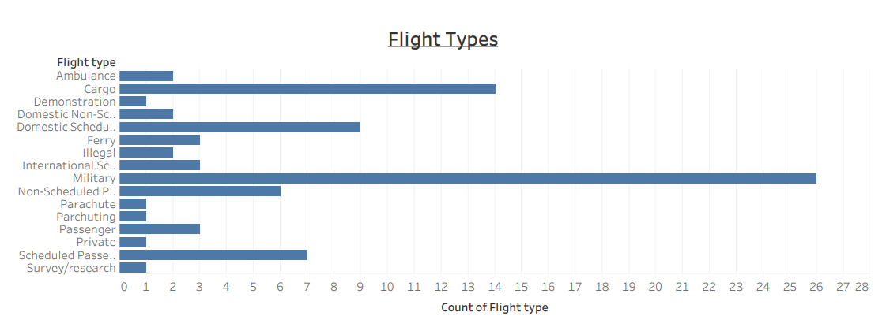
Total by Different Flight Types

Slide 5
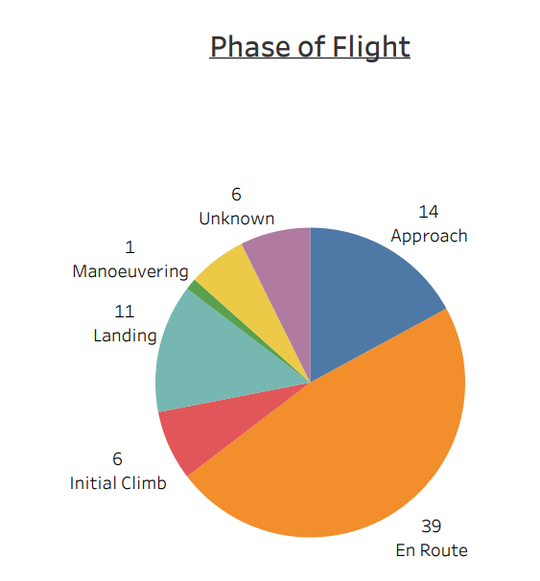
At what Stage of the Flight?
Pie chart showing at what point in the flight does an incident occur.

Slide 6
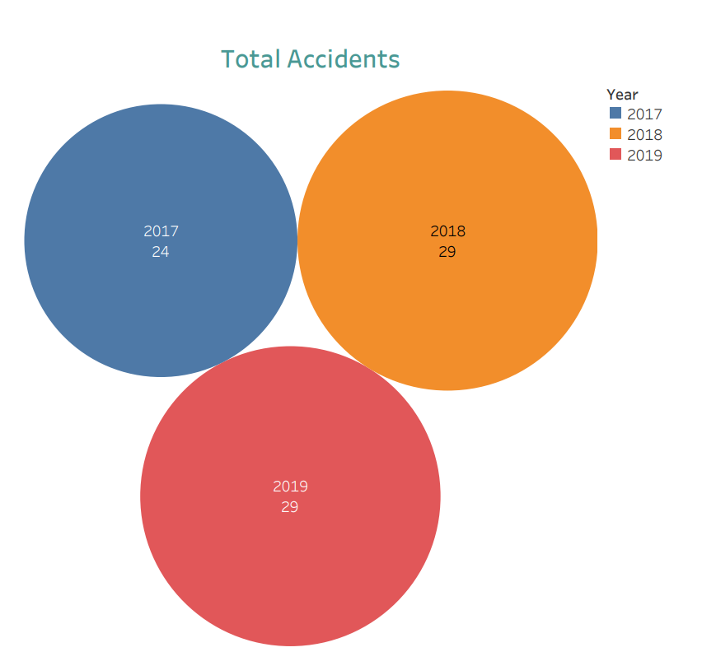
Total Accidents over the last three years

Slide 7
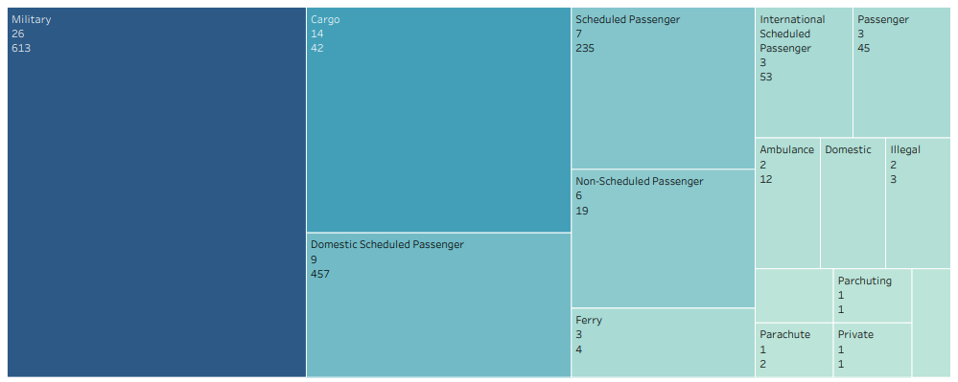
Accidents and Fatalities by Flight Type

Slide 8
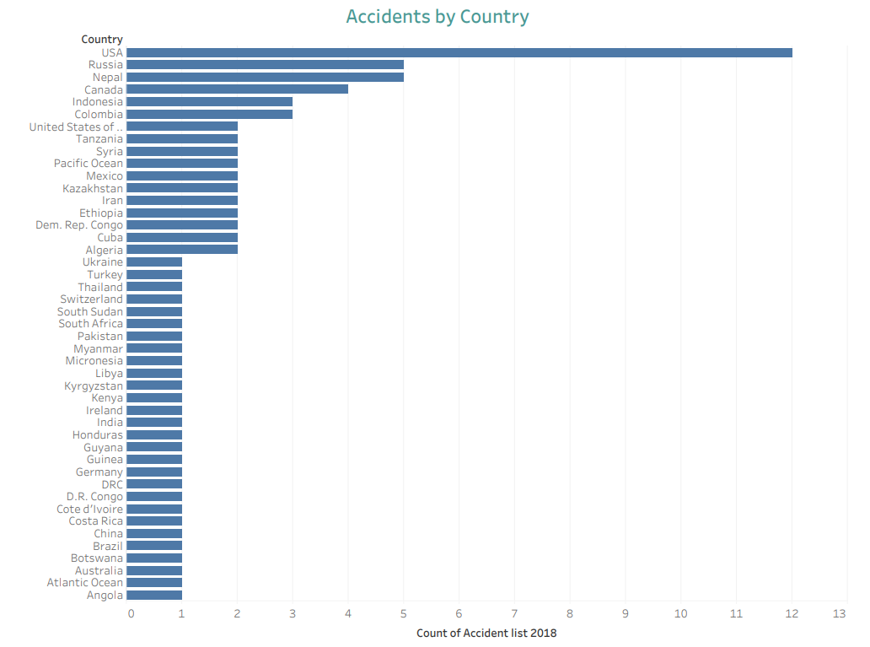
Countries

Slide 9
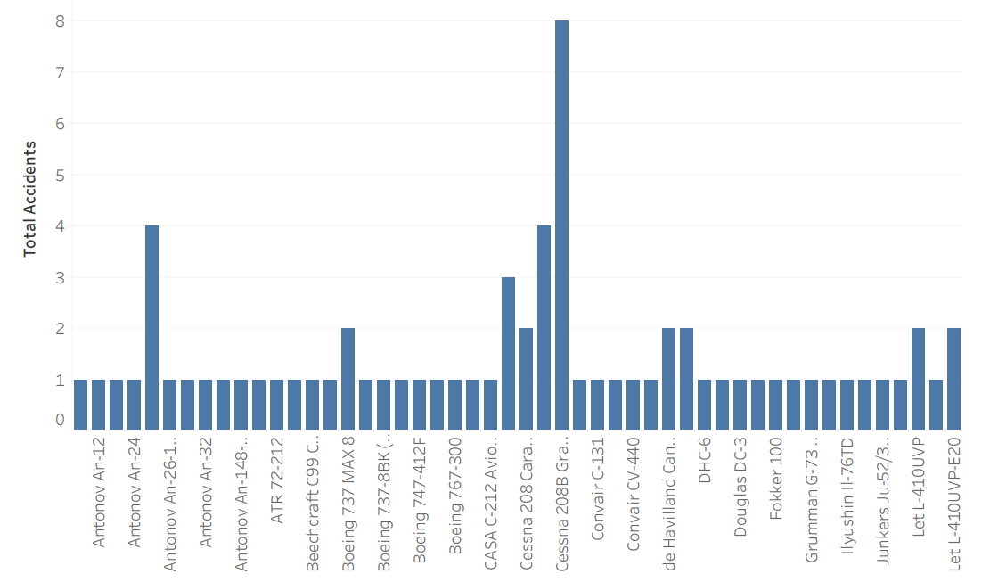
Type of Airplane

Slide 10

Thank You
Email Address here

Slide 11
Data and REferences
Supplemental Dataset Source: https://www.bts.dot.gov/newsroom/final-full-year-2019-traffic-data-us-airlines-and-foreign-airlines-usflights
References: 1. https://lifehacker.com/six-airplane-facts-to-cure-your-fear-of-flying1788654431#:~:text=Air%20travel%20is%20the%20safest%20mode%20of%20mass%20transpor tation&text=And%20your%20odds%20of%20dying,are%20about%20one%20in%2011%2C000% 2C000.&text=That's%20an%20average%20of%20about,flying%20is%20only%20getting%20safer.

