Slide 1

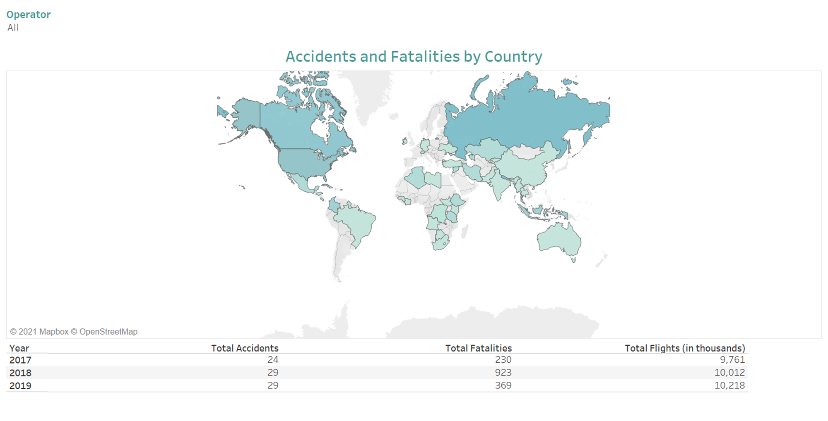
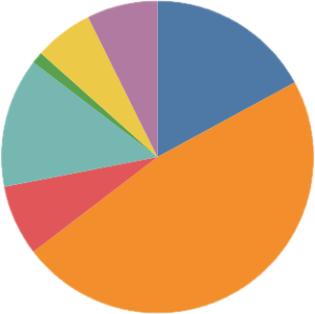
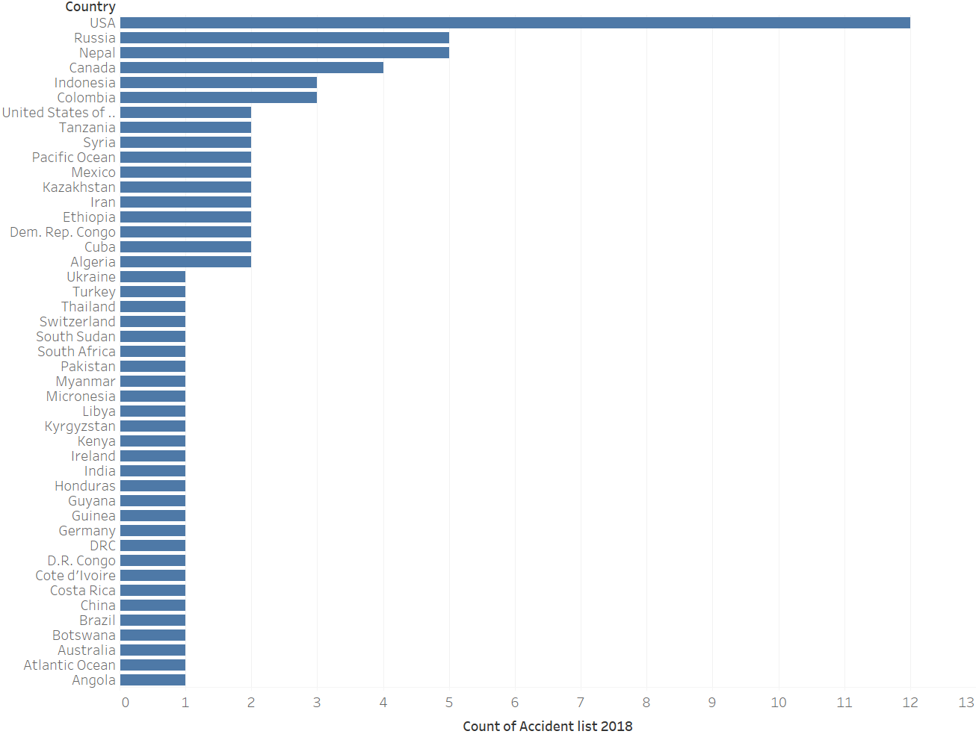
SAFEST WAY OF TRANSPORTATION
EXPERIENCE
INTERNATIONAL
MORE LIKELY TO BE STRUCK BY LIGHTNING
Airplanes are one of the safest ways of transportation. The likelihoods of perishing in an airline accident are about one in 11,000,000 (1). People are more probable to be struck by lightning, with a one in 13,000 chance for a lifetime.
FATALITIES PER YEAR
Fatalities do happen, but media outlets make society more aware of them, so people tend to think they happen all the time. From 1982 and 2010, 3,288 people in the U.S. died from airplane related causes (1). That comes out to about 110 fatalities per year which include all flight types (military, private, commercial, etc.).
ACCIDENTS BY COUNTRY
PHASE OF FLIGHT
EN ROUTE
39
APPROACH
14
INITIAL CLIMB
6
LANDING
11
https://www.blogger.com/blog/post/edit/8457238173531041721/2476437679228508791
MANOEUVERING
1
apmeyer@my365.Bellevue.edu
TAKEOFF
5
UNKNOWN
123.456.7890
6

