Slide 1
Algorithms assemble!
Jaro-Winkler
Cosine similarity
Variations of Levenshtein distance
Soundex
Double Metaphone

Slide 2
Attempt #1
What we tried
Challenges faced
Normalize names
Compute scores using individual algorithms
Considere the maximum score for comparison with threshold
Low score when
Either of the names contained initials (W B H, Will Benjamin)
Presence of nicknames (Chuck, Charlie)
One name was of one word and the other was a long name with multiple words (Michael Tyler Stewart, Mike)

Slide 3
Attempt #1
What we tried
Challenges faced
Normalize names
Compute scores using individual algorithms
Considere the maximum score for comparison with threshold
Low score when
Either of the names contained initials (W B H, Will Benjamin)
Presence of nicknames (Chuck, Charlie)
One name was of one word and the other was a long name with multiple words (Michael Tyler Stewart, Mike)

Slide 4
Attempt #2
What we tried
Challenges faced
Normalize names
If either of the names contained only initials, direct match the initials, otherwise compute scores using individual algorithms consider the maximum score for comparison with threshold
Low score when
Either of the names contained initials (W B H, Will Benjamin) –solved
Presence of nicknames (Chuck, Charlie)
One name was of one word and the other was a long name with multiple words (Michael Tyler Stewart, Mike)

Slide 5
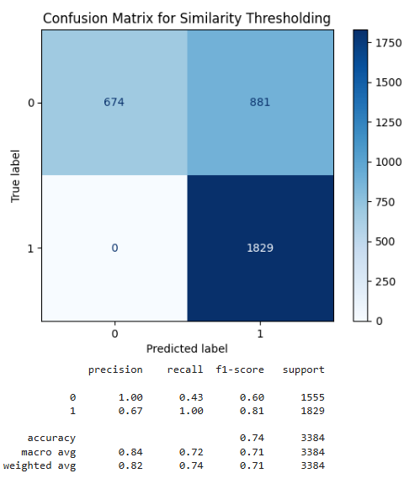
Threshold = 0.54

Slide 6
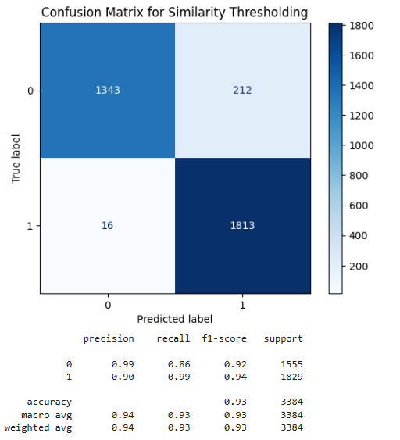
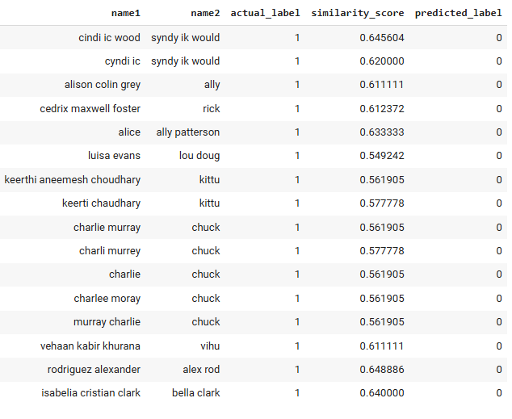
Next step:
Target threshold = ~0.65
Needs improvement for matching nicknames

Slide 7
Above and beyond!
Enhance score calculation
Especially when accounting for phonetic algorithms
Consider using weights for different algorithms

