Slide 1

CSE 3042 - Machine Intelligence for Medical Image Analysis An ensemble approach to Prediction and Classification of Gastrointestinal diseases
By Vishal L – 20BAI1038
Jhagan AM – 20BAI1042
Amaan Mohamed K - 20BAI1081

Slide 2
Abstract
Gastrointestinal diseases are a major cause of illness and death around the world. Early and accurate diagnosis is essential for effective treatment and better patient outcomes. This research aims to improve the prediction and classification of gastrointestinal diseases using a carefully selected dataset of colon images.
The problem statement focuses on the need for a more efficient and accurate method for diagnosing gastrointestinal diseases. Current diagnostic methods can be invasive, time-consuming, and depend on the subjective judgment of medical professionals. Our research proposes a new approach to address this issue. We use a multi-fused Convolutional Neural Network (CNN) with auxiliary layers, alpha dropouts, and a fusion residual block to diagnose gastrointestinal diseases from endoscopy images. This method allows for the extraction of complex features from the images, thereby improving the accuracy of disease classification.
The proposed model has the potential to revolutionize the diagnosis of gastrointestinal diseases by providing a non-invasive, quick, and highly accurate method. It could significantly reduce the time taken for diagnosis, enable early detection, and consequently improve treatment outcomes. This research contributes to the ongoing efforts in medical science to leverage artificial intelligence for disease prediction and classification, ultimately aiming to enhance patient care and health outcomes.

Slide 3
Introduction
Gastrointestinal (GI) diseases encompass a wide range of conditions affecting the digestive system, posing a significant global health concern. These conditions range from common ailments like gastroenteritis and peptic ulcers to more severe diseases like colorectal cancer and Crohn's disease. The impact of these diseases is substantial, leading to considerable morbidity, mortality, and economic burden.
Traditionally, diagnosing GI diseases often involves invasive procedures such as endoscopy and biopsy, which can be uncomfortable for the patient and require significant medical expertise for interpretation. Additionally, these methods can be time-consuming, delaying the initiation of appropriate treatment.
Inspired by the work of Montalbo (2022), who employed a multi-fused CNN model for diagnosing gastrointestinal diseases from endoscopy images, we propose an innovative methodology that incorporates auxiliary layers, alpha dropouts, and a fusion residual block to enhance feature extraction from colon images. By doing so, it aims to improve the accuracy of disease classification and prediction.

Slide 4
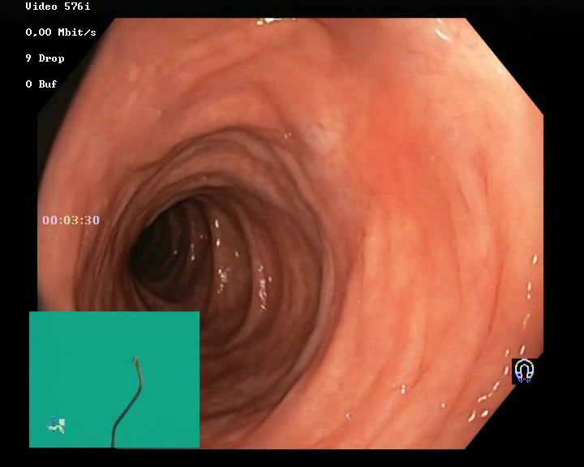
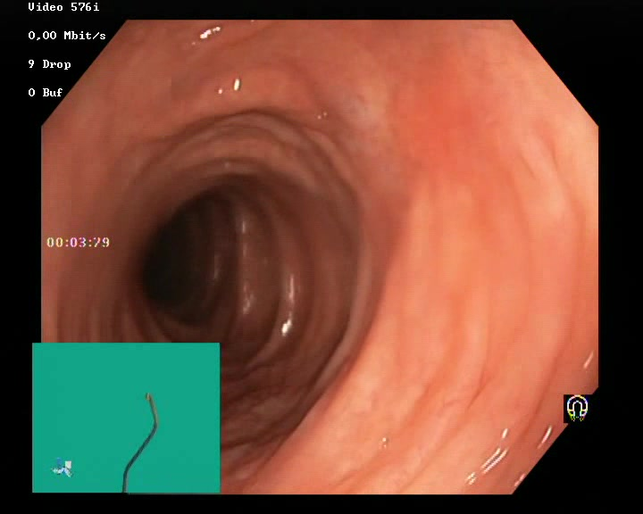
Normal Image Class

Slide 5
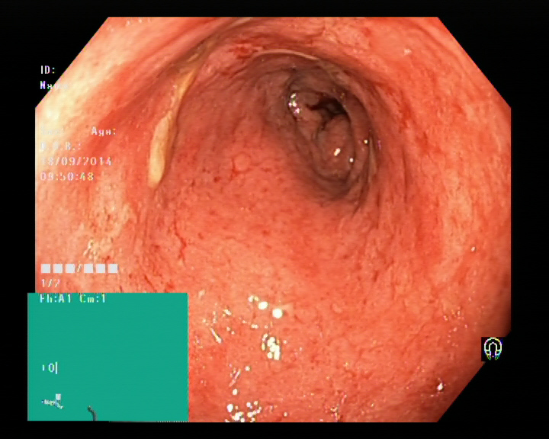
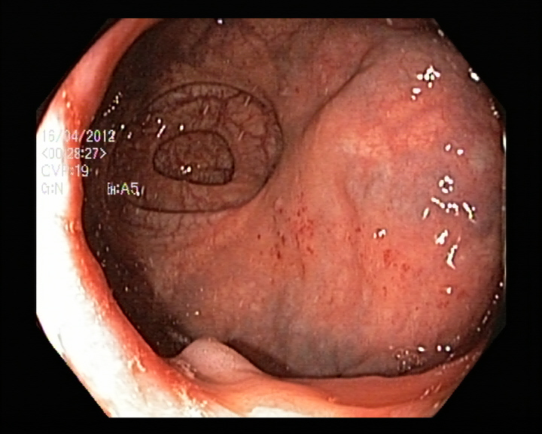
Ulcer Image Class

Slide 6
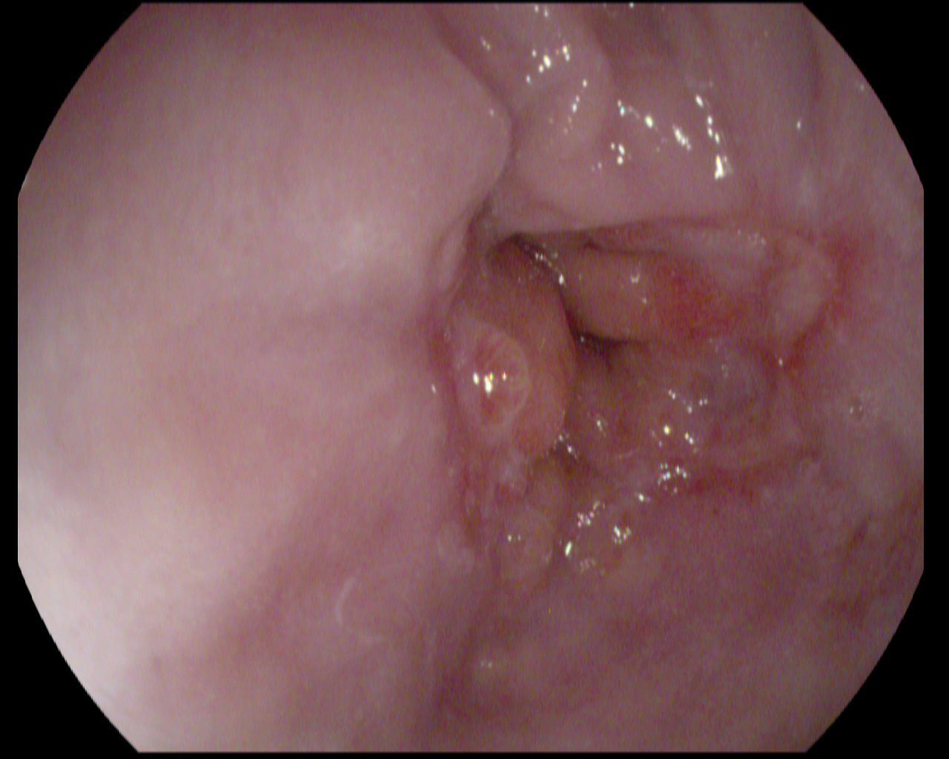
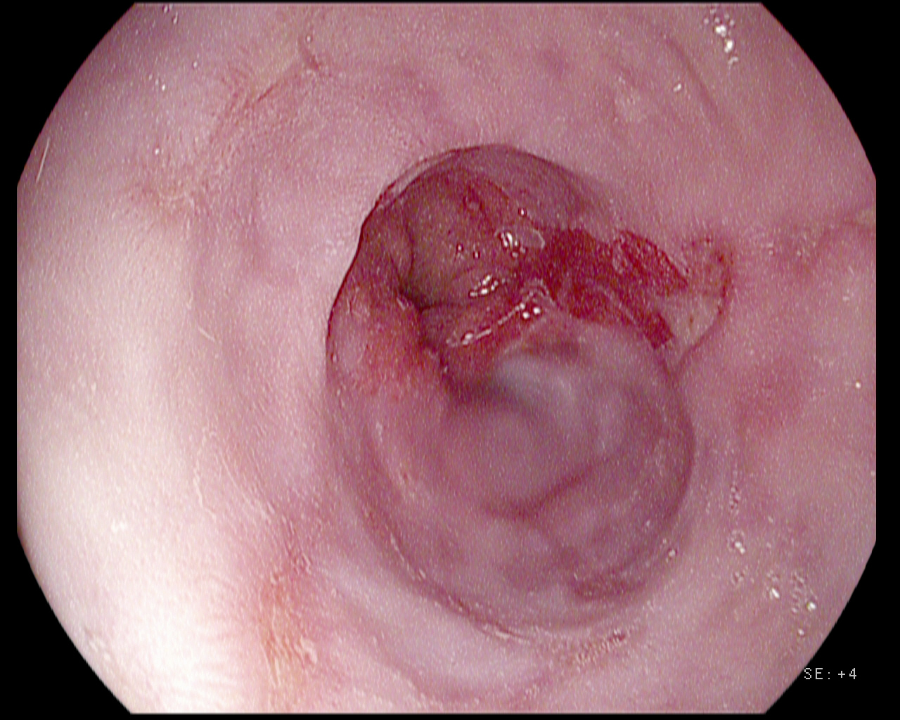
Esophagitis Image Class

Slide 7
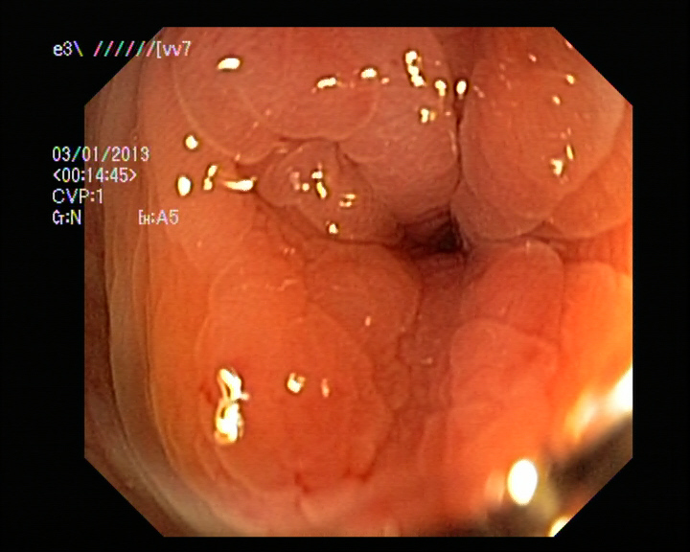
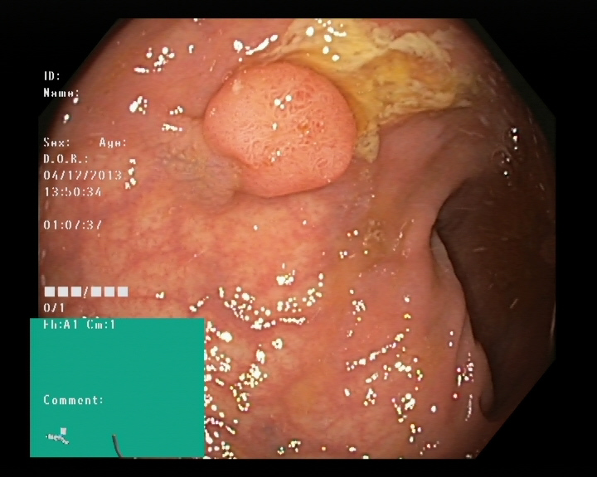
Polyps Image Class

Slide 8
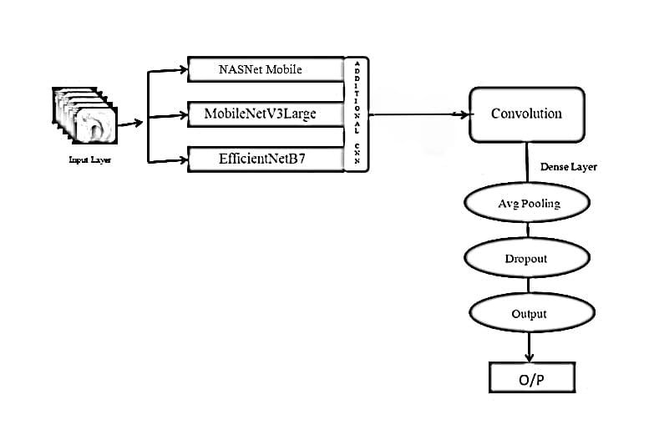
Proposed Methodology Diagram
Model Architecture Multi-fused CNN

Slide 9
Workings of the Model
The architecture is a fusion of three pre-trained models and a convolutional neural network (CNN) specifically designed for the prediction and classification of gastrointestinal diseases. It comprises the following components:
Pre-trained models: These models include NASNet Mobile, MobileNetV3 Large, and EfficientNetB7. These models represent state-of-the-art deep learning models, trained on an extensive dataset of images, such as ImageNet. They serve to extract features from the input image, which is a gastrointestinal endoscopy image.
The extracted features are high-dimensional vectors that encapsulate the visual information in the image, encompassing aspects like color, texture, shape, and object. Each pre-trained model employs a distinct architecture and set of parameters, enabling them to capture different aspects of the image.
The pre-trained models are combined with a CNN tailored for the task of classification. This CNN takes the extracted features as input and processes them further to classify the input image into one of several categories of gastrointestinal diseases.

Slide 10
Why CNN?
This specialized neural network, designed for classification purposes, incorporates a dense layer, average pooling, dropout, and output layers.
The dense layer receives the combined features from the three pre-trained models and transforms them into a lower-dimensional vector.
Subsequently, the average pooling layer reduces the spatial dimensions of the vector by averaging the values within each region. The dropout layer randomly removes certain units of the vector to prevent overfitting.
Finally, the output layer, a softmax layer, generates a probability distribution over the potential classes of gastrointestinal diseases, including ulcers, polyps, and cancer.
The CNN is trained utilizing a dataset of labeled gastrointestinal endoscopy images, where the labels represent the true diagnoses. Upon completion of training, the CNN can make predictions for new images.

Slide 11
Why did we use Multi-Fused Approach?
The Multi-Fused Residual CNN model incorporates three pre-trained models, namely NASNet Mobile, MobileNetV3 Large, and EfficientNetB7, in a synergistic manner, capitalizing on their respective strengths.
This model utilizes an input layer to receive the input image, followed by parallel branches that feed into each of the three pre-trained models. As the outputs of these models emerge, they are concatenated to form a comprehensive representation of the input image.
Subsequently, this fused feature representation is processed through a series of residual blocks. These blocks, illustrated in , play a crucial role in enabling the model to effectively learn complex patterns and relationships within the data.
The model is a softmax layer, responsible for producing probability distributions for the various gastrointestinal diseases. This layer enables the model to make predictions regarding the most likely disease based on the input data. Notably, this model leverages transfer learning to facilitate training.
Transfer learning involves replacing the final learnable layer and the classification layer in each network with new layers tailored for the specific task of gastrointestinal disease prediction and classification. This approach streamlines the training process and enhances the model's specialization in gastrointestinal disease identification.

Slide 12
NASNet Mobile
NASNet represents Neural Search Architecture Network and serves as a Machine Learning model. It features a convolutional neural network meticulously trained on over a million images from the ImageNet database.
This model boasts the capability of classifying images into 1000 distinct object categories, encompassing familiar items like keyboards, mice, pencils, and a vast array of animals. As a consequence, NASNet has assimilated rich feature representations for a diverse spectrum of images.
NASNet-Mobile emerges as a variation of NASNet specifically tailored for mobile applications. Characterized by a smaller and more streamlined design, NASNet-Mobile proves well-suited for operation on devices constrained by limited computational resources.

Slide 13
MobileNet V3 Large
MobileNetV3 Large represents a variation of MobileNetV3 specifically crafted for applications demanding larger models. Its enhanced capabilities render it suitable for operation on devices boasting more abundant computational resources.
The underlying components of MobileNetV3 comprise normal and reduction cells. These cells emanate from a process termed neural architecture search, which streamlines the design of neural networks.
Transfer learning techniques can seamlessly integrate with MobileNetV3 Large for retraining purposes, encompassing a new collection of images. This process entails substituting the final learnable layer and the classification layer within your network with novel layers crafted for retraining objectives.

Slide 14
EfficientNet B7
EfficientNet B7, the largest model in the EfficientNet series, holds the distinction of attaining superior performance across the ImageNet and CIFAR-100 datasets. With remarkable accuracy scores of 84.4% (top-1) and 97.3% (top-5) on ImageNet, EfficientNet B7 emerged as a groundbreaking innovation in the realm of convolutional neural networks (CNNs).
Its compact size, a mere 8.4 times smaller than its predecessor, combined with its exceptional speed, 6.1 times faster than the previous best CNN model, further underscores its efficiency and versatility.
As a powerful and adaptable model, EfficientNet B7 demonstrates remarkable capabilities in handling a diverse range of image classification tasks. Its underlying design principles and inherent adaptability to retraining on new tasks elevate it to an invaluable tool for a myriad of applications.

Slide 15
Research Gaps
The advancement of deep learning models for gastrointestinal (GI) disease diagnosis hinges heavily on the availability of extensive, representative datasets of GI images.
However, a significant challenge lies in the lack of standardization and harmonization in the collection, annotation, and preprocessing of these datasets.
This inconsistency in data quality and uniformity can impede the generalizability of deep learning models and make it difficult to accurately compare the performance of different models.
Therefore, future research should prioritize the development of standardized protocols and guidelines for the collection, annotation, and preprocessing of GI image datasets.
This would ensure greater consistency and comparability among datasets, enabling more reliable evaluation and comparison of deep learning models.

Slide 16
Despite the remarkable performance demonstrated by deep learning models in various medical imaging tasks, including GI disease diagnosis, they are often criticized as "black boxes" due to their intricate internal mechanisms.
This lack of explainability can hinder trust and adoption of deep learning models in clinical practice.
Hence, future research should focus on developing methods for explaining and interpreting deep learning models for GI disease diagnosis. This would empower clinicians to better understand the reasoning behind the model's predictions and facilitate more informed diagnostic decisions.
GI disease diagnosis using deep learning models is often constrained by the domain shift between the training and testing datasets. This domain shift can arise from discrepancies in image quality, patient demographics, and imaging equipment.
Consequently, models trained on one dataset may not perform well on another dataset, leading to reduced generalizability and clinical applicability. Therefore, future research should prioritize the development of domain adaptation techniques that can effectively bridge the gap between different datasets.
These techniques could involve employing data augmentation methods to synthesize training data that more closely resembles the testing data, or developing transfer learning approaches that can extract and transfer knowledge from a source domain to a target domain.

Slide 17
Results and Conclusion
The multi-fused CNN model was trained for the dataset for predicting 4 classes of gastrointestinal diseases 'normal', 'ulcerative colitis', 'polyps' and 'esophagitis'.
The model predicts the class normal with 92% f1-score, ulcerative colitis with 86%, polyps with 87% and esophagitis with 99%. The model achieved an overall accuracy of 91%.
In conclusion, the Multi-Fused Residual Convolutional Neural Network (CNN) model, which harnesses the strengths of NASNet Mobile, MobileNetV3Large, and EfficientNetB7, has exhibited remarkable performance in the prediction and classification of gastrointestinal diseases.
The model was trained on a dataset for predicting four classes of gastrointestinal diseases: 'normal', 'ulcerative colitis', 'polyps', and 'esophagitis'. The model achieved an overall accuracy of 91%, demonstrating its robustness and reliability in classifying these diseases.
The F1-scores for the individual classes were also high, with 92% for 'normal', 86% for 'ulcerative colitis', 87% for 'polyps', and an exceptional 99% for 'esophagitis'.
These results underscore the model's ability to effectively distinguish between different gastrointestinal conditions, making it a valuable tool in the field of medical diagnostics.

Slide 18
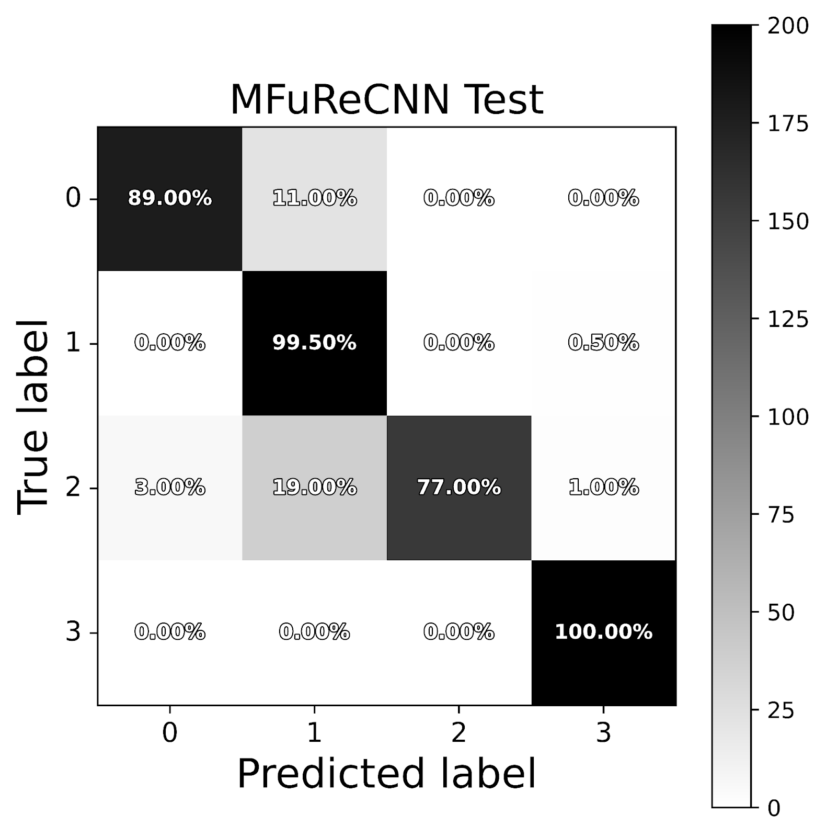
Confusion Matrix of Model Performance

Slide 19
Results Table
Therefore, the Multi-Fused Residual CNN model represents a significant advancement in the application of deep learning techniques to healthcare, providing a powerful, efficient, and accurate tool for the diagnosis of gastrointestinal diseases. Its high performance and the ability to retrain it on new tasks make it a promising model for future research and applications in the medical field.
Table 1: Prediction results of Multi-fused CNN for 4 classes of gastrointestinal diseases
Classes | F1-Score
Normal | 0.92
Ulcerative Colitis | 0.86
Polyps | 0.87
esophagitis | 0.99

Slide 20
Advantages of our Model
A lightweight deep learning model tailored for mobile CPU execution holds the potential to revolutionize gastrointestinal (GI) disease classification by offering a range of compelling advantages to individuals seeking convenient and readily accessible diagnostic tools.
Primarily, portability and accessibility: The lightweight nature of the model enables seamless integration with mobile devices, empowering individuals to conduct GI disease classification anytime, anywhere. This eliminates the need for costly and time-consuming visits to medical facilities, making diagnosis more accessible and convenient.
Secondly, real-time feedback and early intervention: The ability to execute the model on mobile devices facilitates real-time feedback, allowing individuals to promptly evaluate their GI health and seek medical attention if necessary. This expedites early intervention, potentially improving treatment outcomes and mitigating the severity of GI conditions.

Slide 21

THANK YOU

