Slide 1


Slide 2
STRATEGIC OPTIMIZATION
Group 2 Proposal
Temi Dada - Peter Galambos - Anas Mohammed - Hugo Sharpe

Slide 3
STRATEGIC OPTIMIZATION
Group 2 Proposal
Temi Dada - Peter Galambos - Anas Mohammed - Hugo Sharpe

Slide 4
STRATEGIC OPTIMIZATION

Slide 5

Unique
Secure
Portable

Slide 6
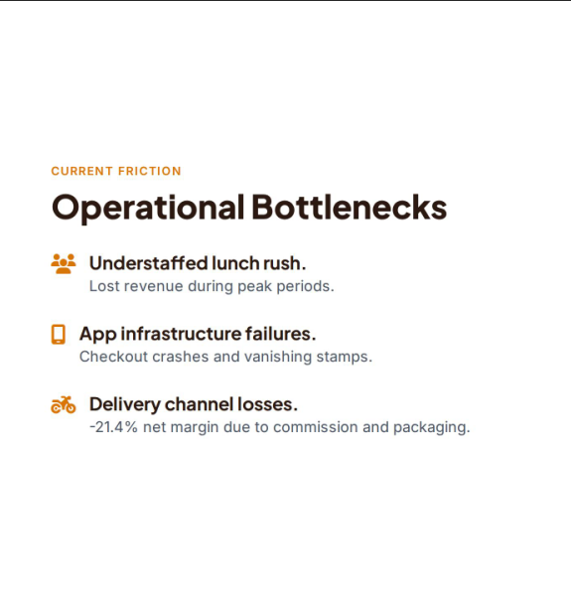
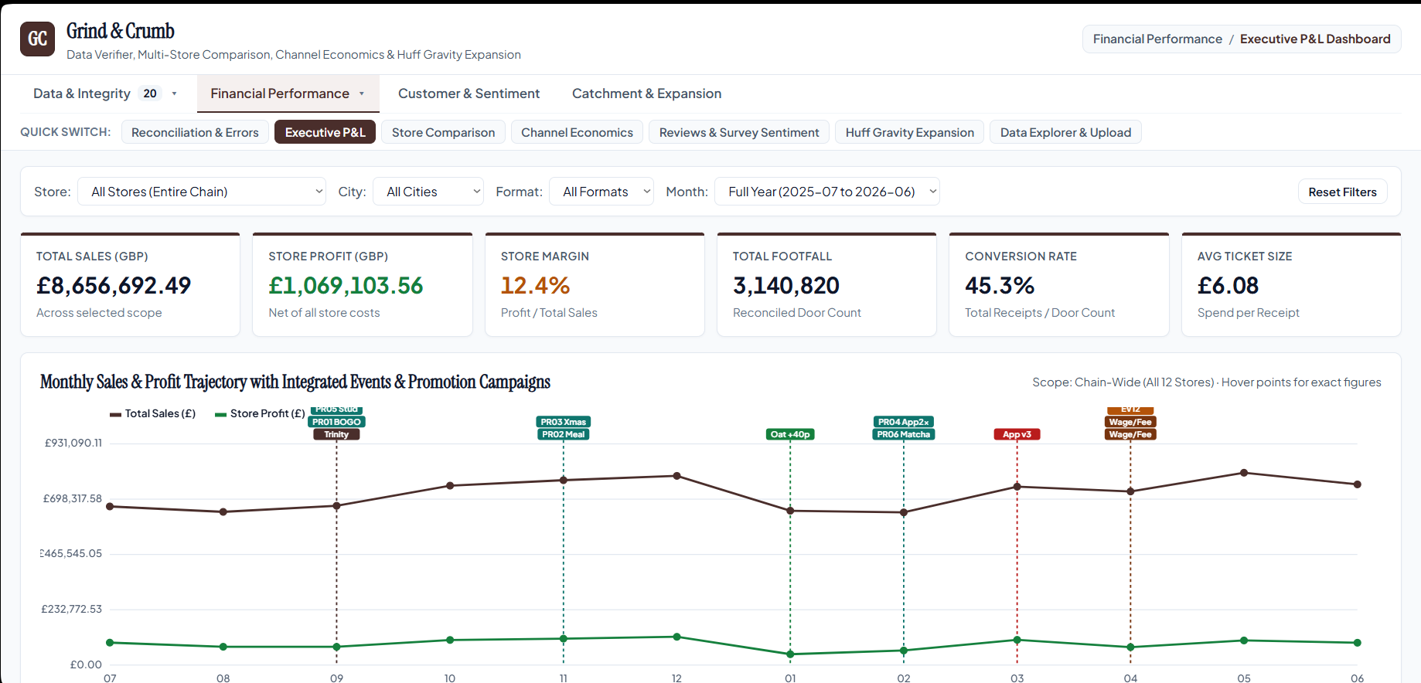
U
INTRODUCTION
For our proposal we designed a website that would take information from each dataset and provide a holistic report that will give the CEO visibility
The website will display sentiment analysis and demonstrate users what metric is working against G&C across its multiple stores.

Slide 7
U
INTRODUCTION
For our proposal we designed a website that would take information from each dataset and provide a holistic report that will give the CEO visibility
The website will display sentiment analysis and demonstrate users what metric is working against G&C across its multiple stores.

Slide 8
INTRODUCTION
For our proposal we designed a website that would take information from each dataset and provide a holistic report that will give the CEO visibility
The website will display sentiment analysis and demonstrate users what metric is working against G&C across its multiple stores.
THE TEAM
THE TEAM

Slide 9
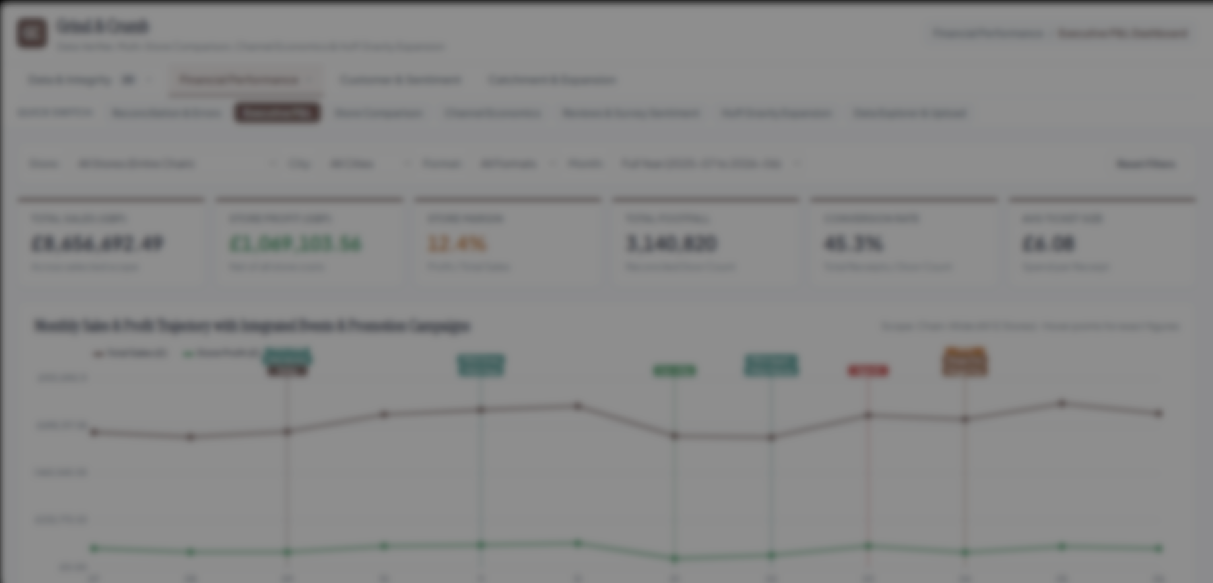
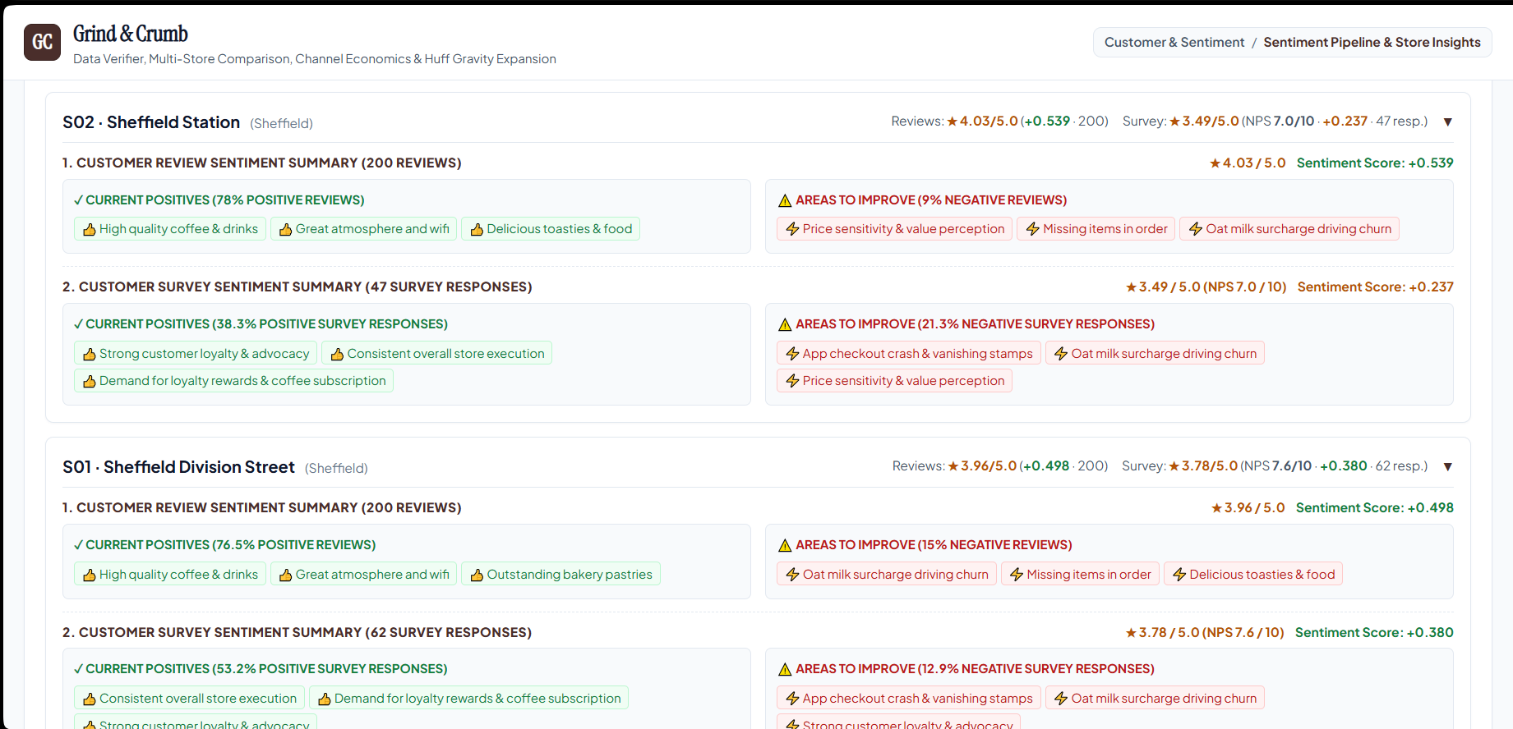
Our tool utilises Gemini 2.5 Flash model to identify customer sentiemnt and determine key issues within various branches.
The tool produces a discepancy audit log indicating anomalies in dataset and a summary onwhat has been resolved.

Slide 10




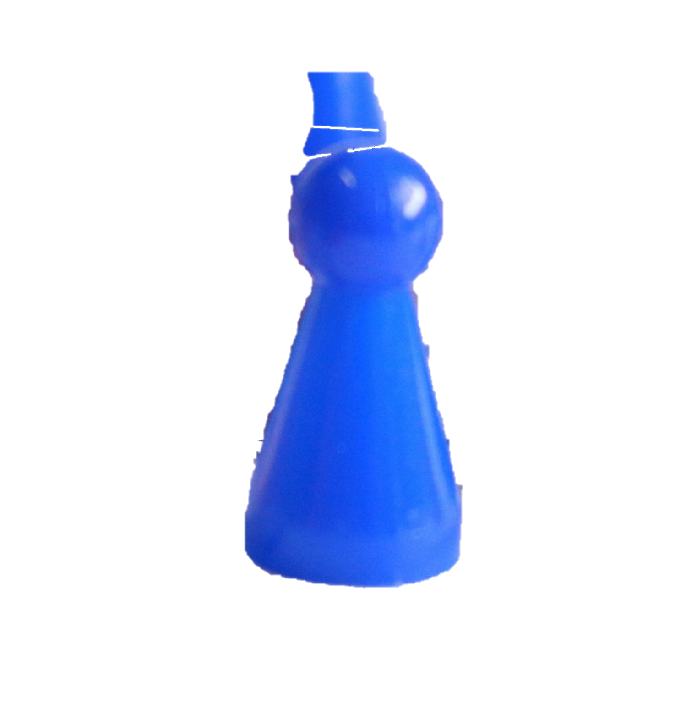

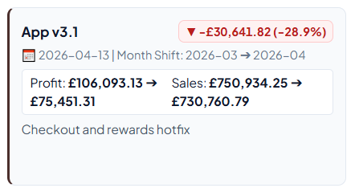
Our tool utilises Gemini 2.5 Flash model to identify customer sentiemnt and determine key issues within various branches.
The tool produces a discepancy audit log indicating anomalies in dataset and a summary onwhat has been resolved.
THE TEAM
THE TEAM
THE TEAM

Slide 11
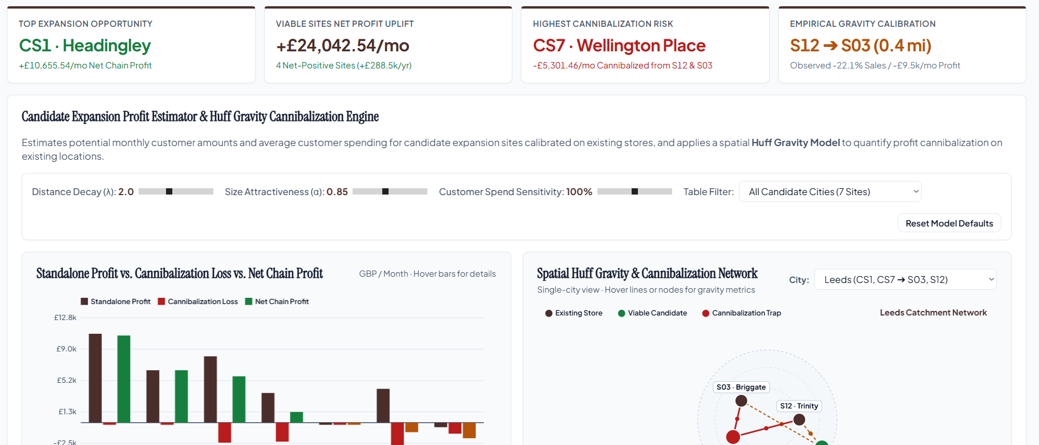
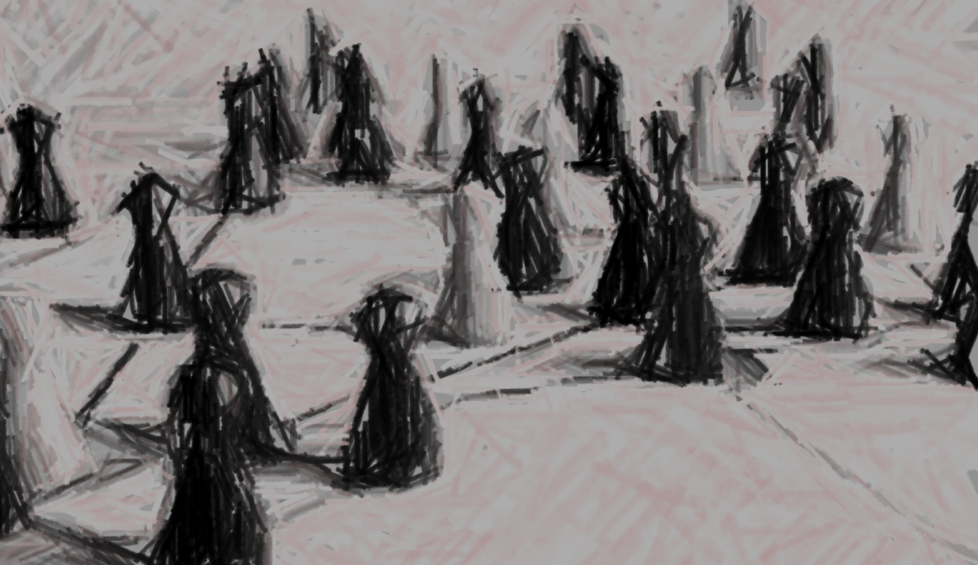
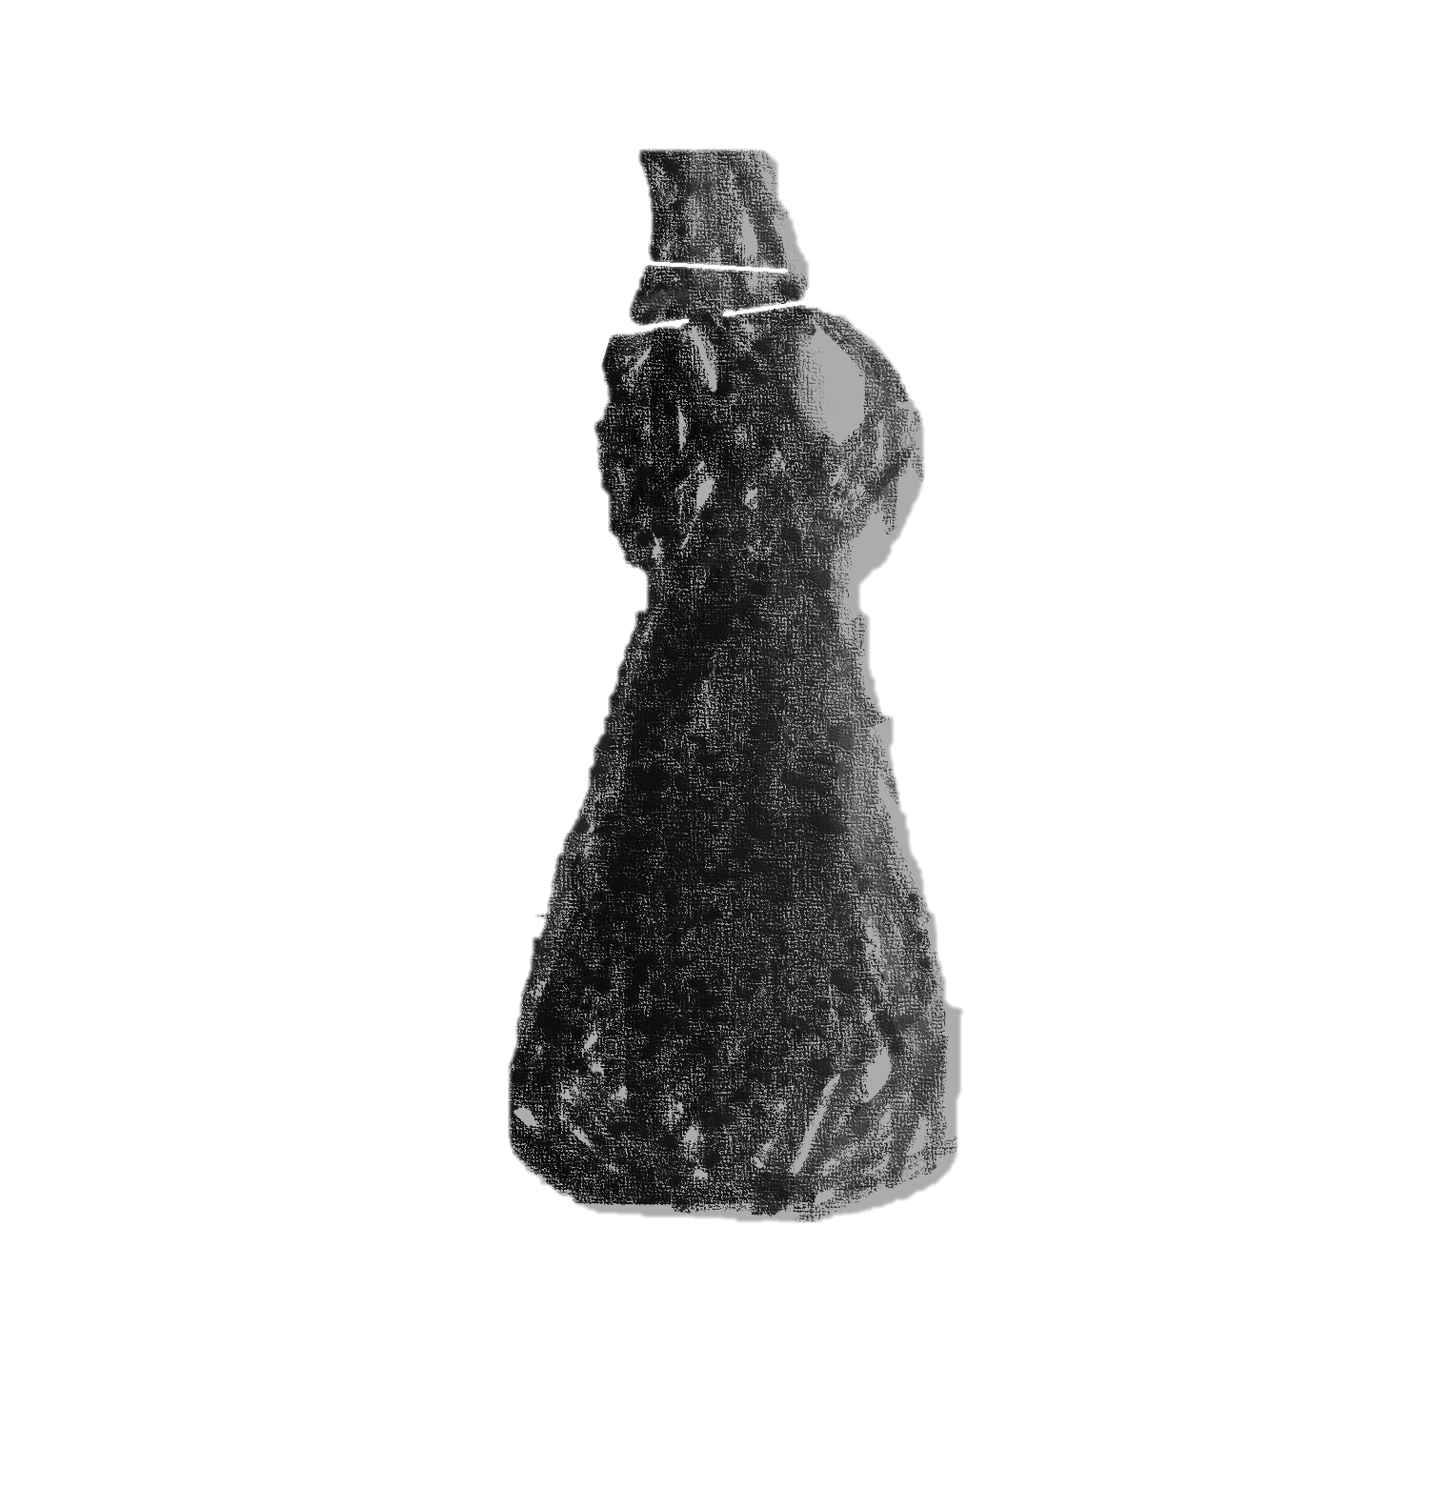
From our sentiment analysis using customer surveys and reviews, we found that 11 of 12 stores had user complaints regarding app checkout crashes and vanishing stamps.
This was reflected in the monthly P&L graph in the tool showing a decrease in net
sales and net profit across all stores
following the v3.1 app hotfix attempt

Slide 12
From our sentiment analysis using customer surveys and reviews, we found that 11 of 12 stores had user complaints regarding app checkout crashes and vanishing stamps.
This was reflected in the monthly P&L graph in the tool showing a decrease in net
sales and net profit across all stores
following the v3.1 app hotfix attempt

Slide 13
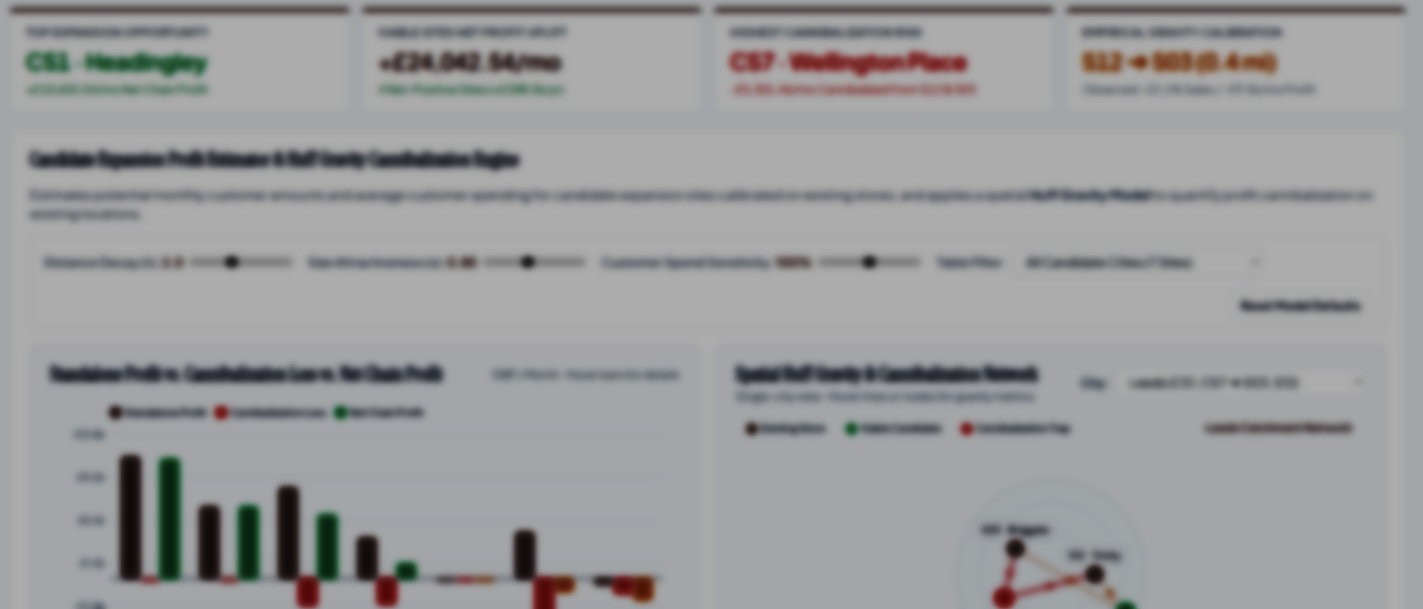
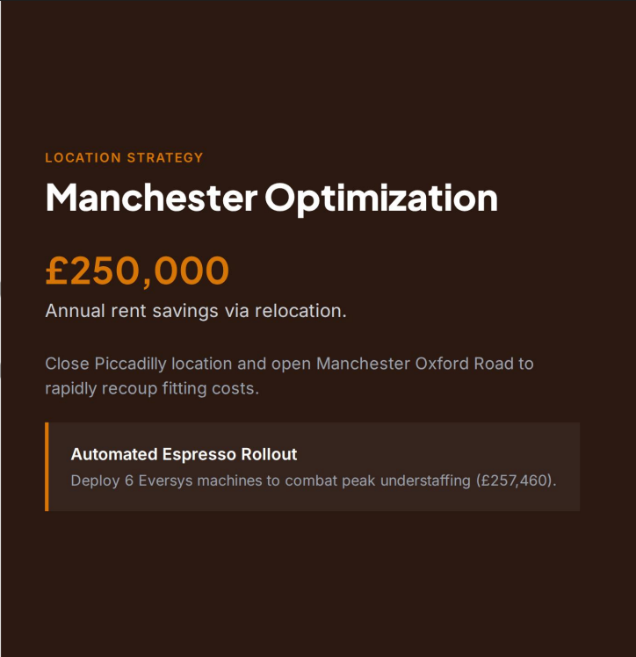
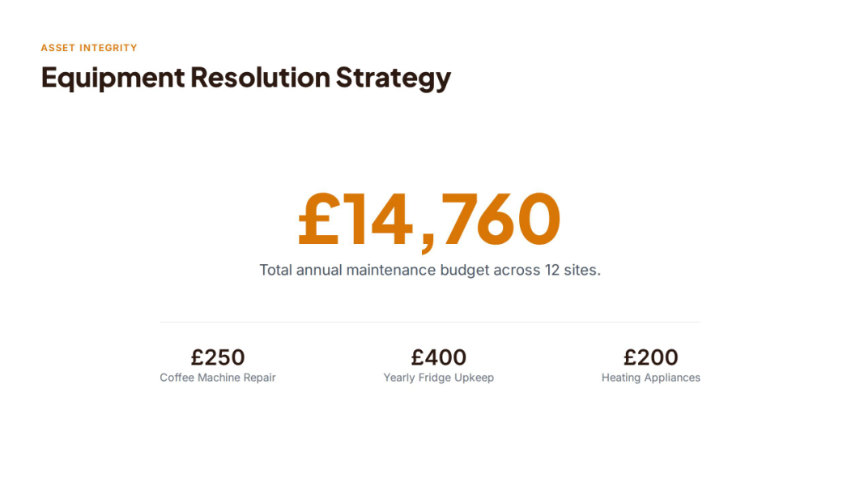
Through our tool’s Huff Gravity Cannibalisation Model, it determines the viable net profit, accounting for cannibalisation from existing sites and the cost of fitting.
From the given candidate_sites.csv, our model identified Leeds Headingley as the prime candidate for expansion and Wellington place as a cannibalization trap.

Slide 14
Through our tool’s Huff Gravity Cannibalisation Model, it determines the viable net profit, accounting for cannibalisation from existing sites and the cost of fitting.
From the given candidate_sites.csv, our model identified Leeds Headingley as the prime candidate for expansion and Wellington place as a cannibalization trap.

Slide 15
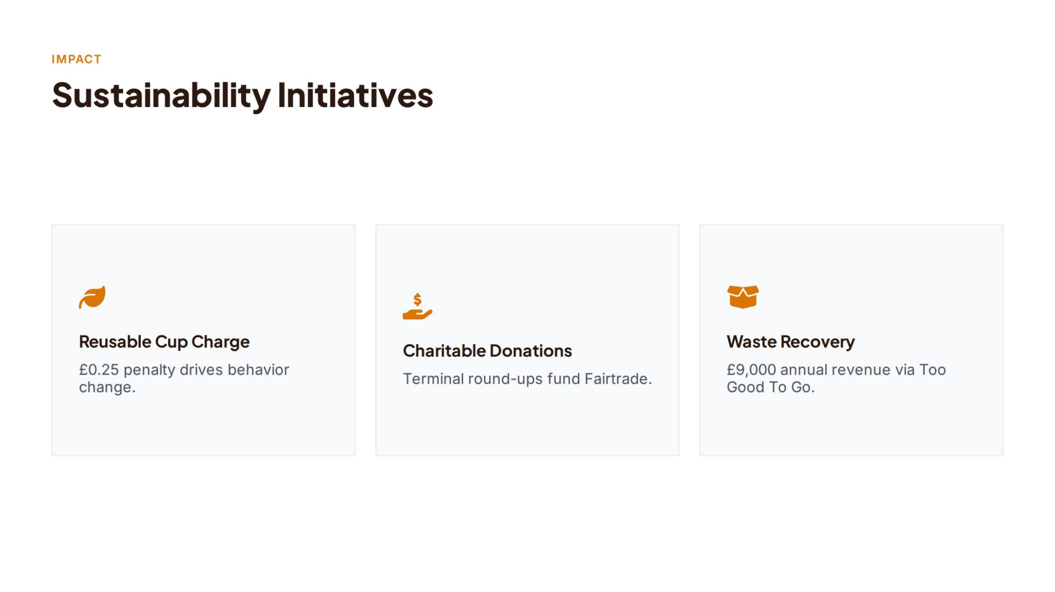
Through our tool’s Huff Gravity Cannibalisation Model, it determines the viable net profit, accounting for cannibalisation from existing sites and the cost of fitting.
From the given candidate_sites.csv, our model identified Leeds Headingley as the prime candidate for expansion and Wellington place as a cannibalization trap.

Slide 16
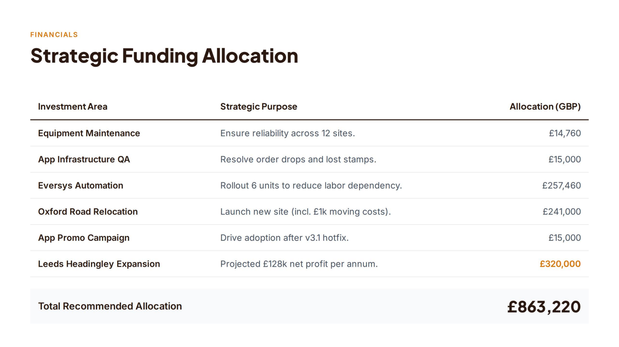
Through our tool’s Huff Gravity Cannibalisation Model, it determines the viable net profit, accounting for cannibalisation from existing sites and the cost of fitting.
From the given candidate_sites.csv, our model identified Leeds Headingley as the prime candidate for expansion and Wellington place as a cannibalization trap.

Slide 17
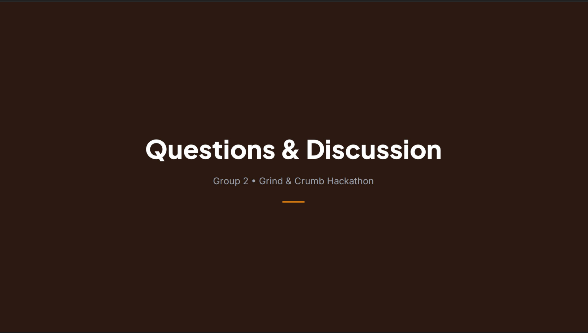
Through our tool’s Huff Gravity Cannibalisation Model, it determines the viable net profit, accounting for cannibalisation from existing sites and the cost of fitting.
From the given candidate_sites.csv, our model identified Leeds Headingley as the prime candidate for expansion and Wellington place as a cannibalization trap.

Slide 18
Through our tool’s Huff Gravity Cannibalisation Model, it determines the viable net profit, accounting for cannibalisation from existing sites and the cost of fitting.
From the given candidate_sites.csv, our model identified Leeds Headingley as the prime candidate for expansion and Wellington place as a cannibalization trap.

