Slide 1

Vue.js Lyon

Slide 2
Workshop summer 2018

Slide 3

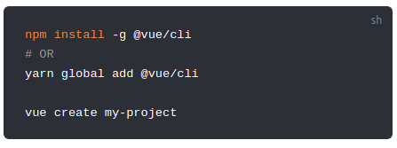

Mise en place du projet
Vue-cli 3
Vue-cli UI

Slide 4
Mise en place du projet
Typescript

Slide 5

Internationalisation
vue-i18n
@/lang/
@/setup/i18n-setup.js
@/main.js
@/views/Home.vie

Slide 6
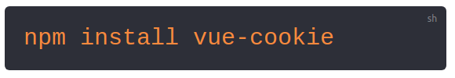
Internationalisation
Vue-cookie
@/main.js
@/views/Home.vue
/public/img/flag

Slide 7
CodeSplitting
@/main.js
@/views/Home.vue
@/components/HeavyImage.vue
/public/img/heasy-png-HD.png
@/router.js

Slide 8
ComponentRegistration
@/main.js
@/setup/componentRegistration.js
@/components/HelloWorld.vue
@/components/tools/

Slide 9
Vuex Namespace & import
@/store/
@/views/Home.vue

Slide 10
Bonus: Login

Slide 11
TODO use webpack beforeChunk to build other artifacts ?

