Slide 1
Site key
6LdmogcTAAAAAKOF6Rr86qahuYlVYDdbADp0ypWZ
Secret key
6LdmogcTAAAAADXc-fQqXwcr4XssVbCeTB2dfdxY

Slide 2
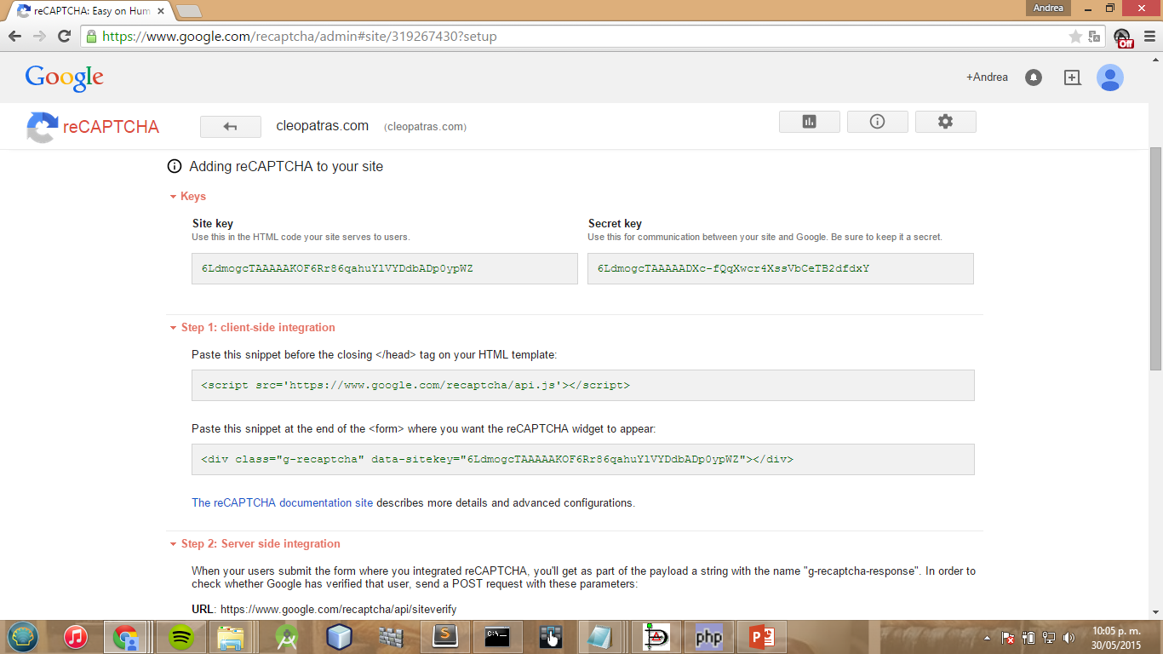

Slide 3
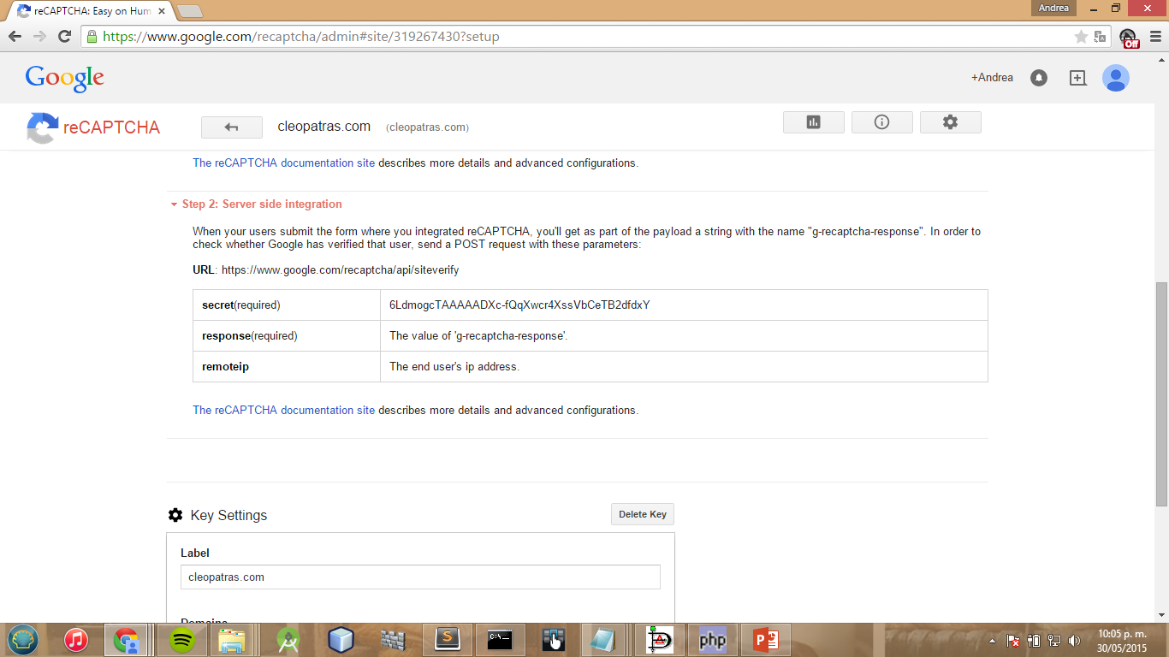

Slide 4
