Slide 1
Irit to PowerPoint Example
IRIT2POWERPOINT

Slide 2
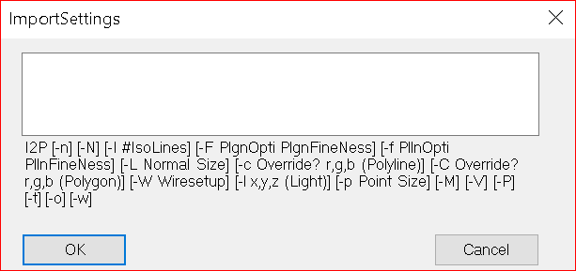
After successful loading of the plugin the above should appear
Import settings are specified via command line arguments
Please check docs/importSettings.txt for detailed documentation

Slide 3
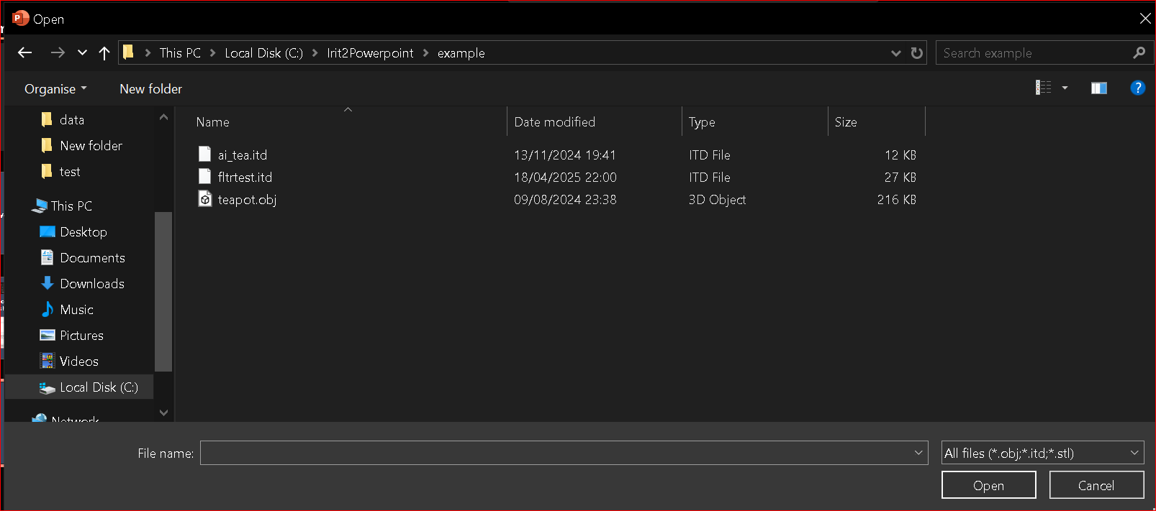
Once import settings are specified a file can be picked via the import dialog, and a slideshow must be started to launch the renderer
IRIT2POWERPOINT

Slide 4
Features
Supports import of all supported Irit geometry types via ITD, OBJ, STL, etc…
The window is made transparent so that only the relevant 3D data is displayed
Supports a wide range of import parameters (see docs/ImportSettings.txt)
Saves the Irit2Powerpoint state within the presentation
Dynamically handles paths so that when a presentation is moved along with the 3D files it’ll still be able to find them
Projection/view matrices can be set from within the ITD file
Each slide has its own scope for Import Settings
Anti-aliasing
All 3D objects are loaded in parallel on presentation start up
IRIT2POWERPOINT

Slide 5
Constraints
Only one Irit2Powerpoint container per slide
3D files aren’t embedded within the presentation file, they must be maintained separately
The renderer only allows global transformations, no per object distinction
No textures, or transparency
IRIT2POWERPOINT

