Slide 1
CSE 316 Microcontroller Project
AUTOMATED FACTORY

Slide 2
Group members
2005009 Ahmmad Nur Swapnil
2005013 Al Muhit Muhtadi
2005022 Ekramul Haque Amin

Slide 3
Motivation
In factory operations, product classification and differentiation are crucial tasks performed by workers to organize inventory and maintain quality standards.
In the quest for greater efficiency, a cutting-edge solution can be introduced via the integration of computer vision and weight sensors in automated factories.
These advanced systems can detect and sort products with remarkable precision.
With the ability to process vast amounts of data in real-time, they not only streamline operations but also minimize errors, ultimately enhancing productivity and optimizing resource utilization.

Slide 4
Description
Our project will take different type of objects moving on a ramp as input and it will detect the object using computer vision.
A camera will take snapshots of the object and send it to backend using a wifi signal for processing.
Then it will measure the weight and then combining the information it will sort the product according to its characteristic.
Display boards will update the client on plausible Object type, Object count and Weight.

Slide 5
Components
Micro controller (I) | Arduino Uno | 1
Micro controller (II) | ATmega32 | 3
Camera | ESP32 cam | 1
Weight sensor | HX711 | 1
Servo motor | SG90 | 1+
360˚ motor | 37GB-555 | 2
LCD display | LCD1602 | 2

Slide 6
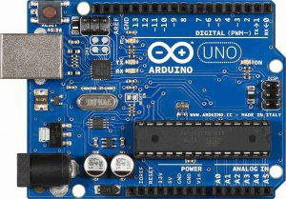
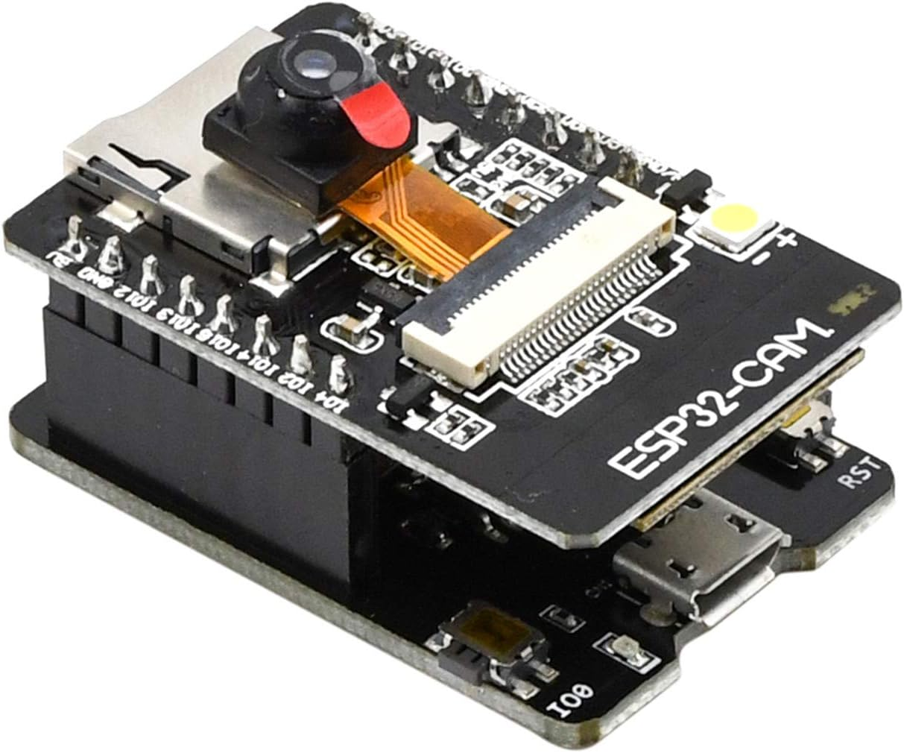
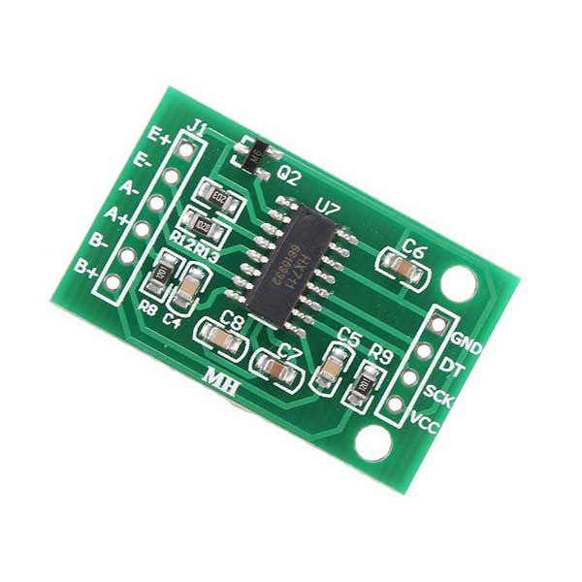
components
Arduino UNO
ESP-32 cam
HX711

Slide 7
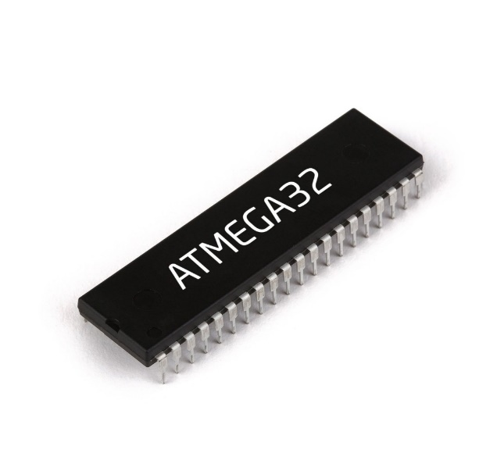
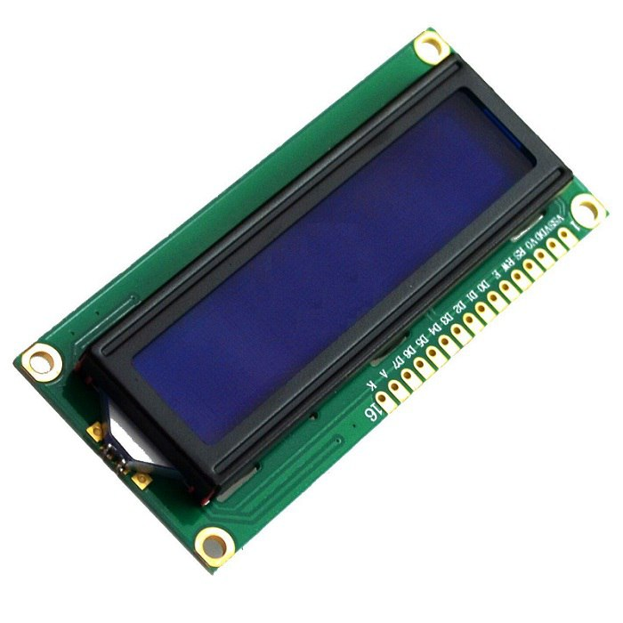
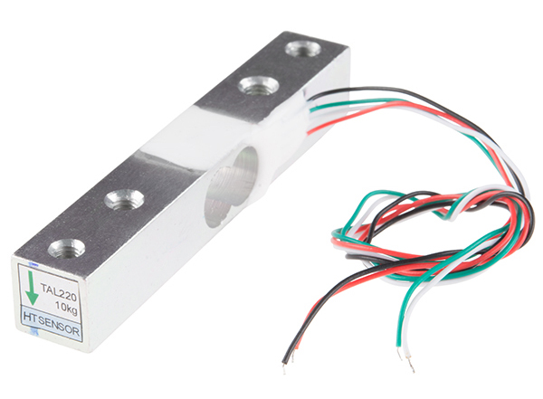
components
ATmega32
LCD Display
Load Cell

