Slide 1
NP-Completeness and Reduction Techniques
Notes:
Frame 1/16, 0:00–0:10. Introduce yourself and the learning objective. This is a rehearsed overview for students familiar with basic graphs, Boolean logic and polynomial time. The main text, tables and equations in this version are editable PowerPoint objects. Text inside the original TikZ figures is part of those images.

Slide 2
Element 2
How Efficient Transformations Prove Computational Hardness
Most. Sonia Khatun
BSc in Department of Computer Science and Engineering Bangladesh University of Engineering and Technology (BUET)
Demo Lecture for the Position of Lecturer Department of Computer Science and Engineering Green University of Bangladesh

Slide 3
Why Do We Need NP-Completeness?
Notes:
Frame 2/16, 0:10–0:30 across all reveals. Distinguish solving, verifying and comparing. Preview the direction: a known hard problem reduces to the new target.

Slide 4
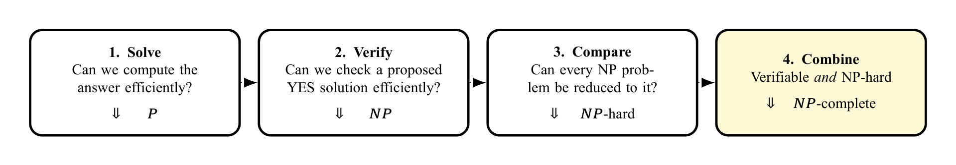
Element 4

Slide 5
Why Do We Need NP-Completeness?
Notes:
Frame 2/16, 0:10–0:30 across all reveals. Distinguish solving, verifying and comparing. Preview the direction: a known hard problem reduces to the new target.

Slide 6
Element 6

Slide 7
Element 7
The central proof question
How can we transfer the known hardness of one problem to a new problem?

Slide 8
Why Do We Need NP-Completeness?
Notes:
Frame 2/16, 0:10–0:30 across all reveals. Distinguish solving, verifying and comparing. Preview the direction: a known hard problem reduces to the new target.

Slide 9
Element 9

Slide 10
Element 10
The central proof question
How can we transfer the known hardness of one problem to a new problem?

Slide 11
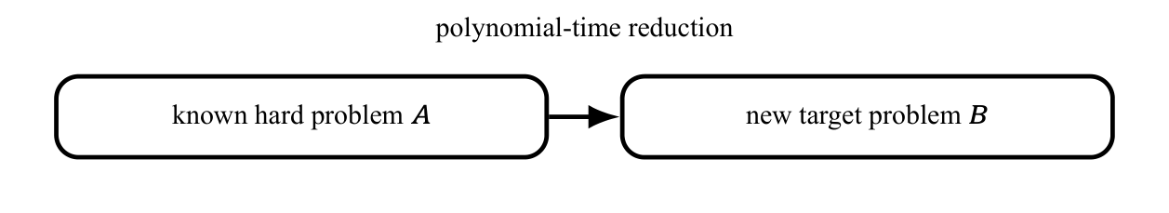
Element 11

Slide 12
Element 12
The dotted arrows show the learning sequence, not set containment.

Slide 13
Start with P and NP
Notes:
Frame 3/16, 0:30–1:05. Explain the formula verbally: a YES instance has a short accepting certificate, and a NO instance has none. A verifier checks the color domain as well as the edges. The solver can ignore a certificate, proving P is contained in NP.

Slide 14
Element 14
P: solve efficiently
Decision problems solvable by a deterministic algorithm in polynomial time.

Slide 15
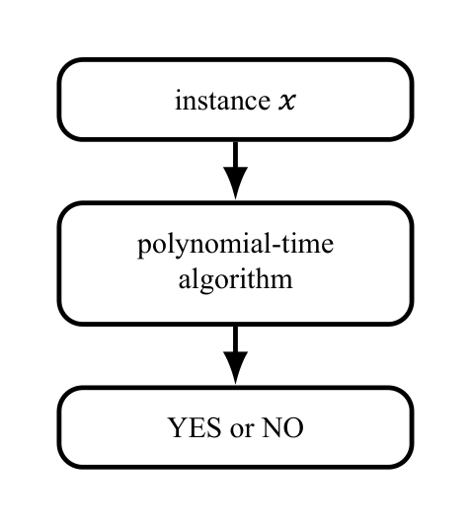
Element 15

Slide 16
Element 16
Example: reachability can be solved by BFS or DFS.

Slide 17
Start with P and NP
Notes:
Frame 3/16, 0:30–1:05. Explain the formula verbally: a YES instance has a short accepting certificate, and a NO instance has none. A verifier checks the color domain as well as the edges. The solver can ignore a certificate, proving P is contained in NP.

Slide 18
Element 18
P: solve efficiently
Decision problems solvable by a deterministic algorithm in polynomial time.

Slide 19
Element 19

Slide 20
Element 20
Example: reachability can be solved by BFS or DFS.

Slide 21
Element 21
NP: verify efficiently
There are a polynomial-time verifier $V$ and polynomial $p$ such that
$$x∈L⇔∃c: \begin{matrix}|c|≤p(|x|), \\ V(x,c)=1.\end{matrix}$$

Slide 22
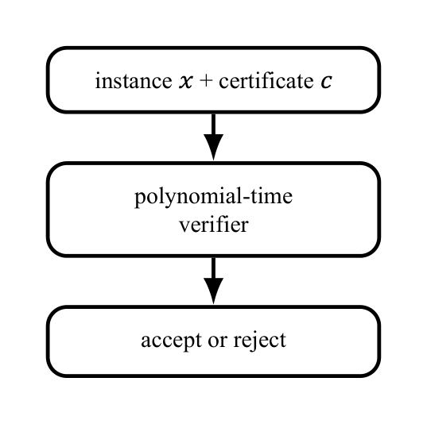
Element 22

Slide 23
Element 23
For 3-COLOR, $c$ assigns one of three colors to every vertex; check every edge.

Slide 24
Start with P and NP
Notes:
Frame 3/16, 0:30–1:05. Explain the formula verbally: a YES instance has a short accepting certificate, and a NO instance has none. A verifier checks the color domain as well as the edges. The solver can ignore a certificate, proving P is contained in NP.

Slide 25
Element 25
P: solve efficiently
Decision problems solvable by a deterministic algorithm in polynomial time.

Slide 26
Element 26

Slide 27
Element 27
Example: reachability can be solved by BFS or DFS.
$P⊆NP$: a polynomial-time solver can serve as a verifier and ignore the certificate.

Slide 28
Element 28
NP: verify efficiently
There are a polynomial-time verifier $V$ and polynomial $p$ such that
$$x∈L⇔∃c: \begin{matrix}|c|≤p(|x|), \\ V(x,c)=1.\end{matrix}$$

Slide 29
Element 29

Slide 30
Element 30
For 3-COLOR, $c$ assigns one of three colors to every vertex; check every edge.
NP means nondeterministic polynomial time, not “non-polynomial.” Whether $P=NP$ is open.

Slide 31
From NP-Hard to NP-Complete
Notes:
Frame 4/16, 1:05–1:40. Point at the intersection. NP-hardness does not imply membership in NP. NP-completeness does not prove that a polynomial algorithm is impossible; P versus NP remains open.

Slide 32
Element 32
NP-hard: hard for all of NP
A problem $H$ is NP-hard if
$$∀L∈NP, L≤_{p}H.$$
$L≤_{p}H$ means an efficient, answer-preserving translation from $L$ to $H$. An NP-hard problem need not itself belong to NP.
NP-complete: both properties
$$H∈NP \text{and} H\text{ is NP-hard}.$$
These are the hardest efficiently verifiable decision problems.

Slide 33
From NP-Hard to NP-Complete
Notes:
Frame 4/16, 1:05–1:40. Point at the intersection. NP-hardness does not imply membership in NP. NP-completeness does not prove that a polynomial algorithm is impossible; P versus NP remains open.

Slide 34
Element 34
NP-hard: hard for all of NP
A problem $H$ is NP-hard if
$$∀L∈NP, L≤_{p}H.$$
$L≤_{p}H$ means an efficient, answer-preserving translation from $L$ to $H$. An NP-hard problem need not itself belong to NP.
NP-complete: both properties
$$H∈NP \text{and} H\text{ is NP-hard}.$$
These are the hardest efficiently verifiable decision problems.

Slide 35
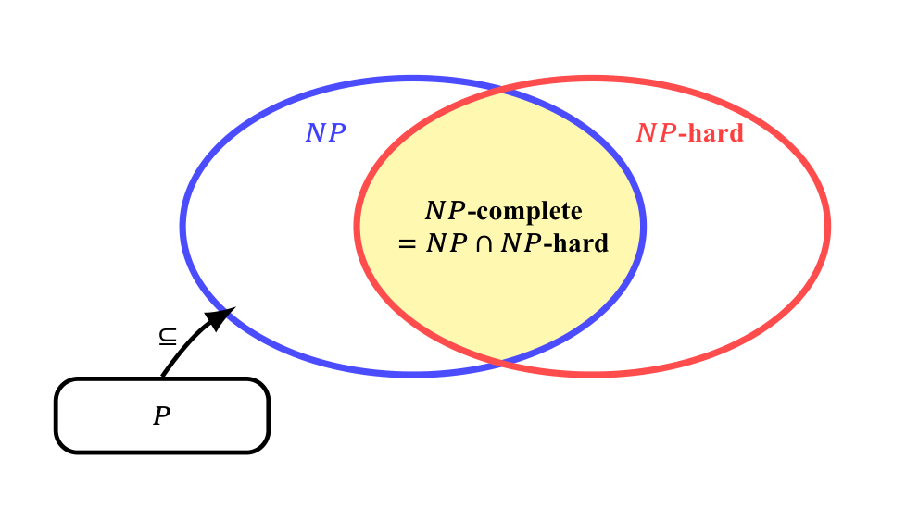
Element 35

Slide 36
Element 36
$P⊆NP$ is known. The exact boundary of $P$ is not drawn because whether $P=NP$ is open.
If one NP-complete problem is in $P$, then $P=NP$.

Slide 37
Polynomial-Time Reduction: an Answer-Preserving Translator
Notes:
Frame 5/16, 1:40–2:20. Demonstrate both a YES and a NO instance. Doubling a binary integer is linear in its bit length. The reduction transforms instances without solving the hard source instance.

Slide 38
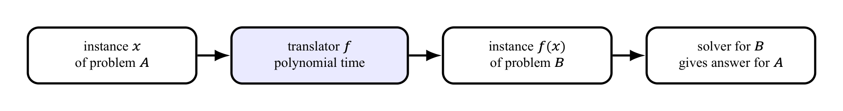
Element 38

Slide 39
Polynomial-Time Reduction: an Answer-Preserving Translator
Notes:
Frame 5/16, 1:40–2:20. Demonstrate both a YES and a NO instance. Doubling a binary integer is linear in its bit length. The reduction transforms instances without solving the hard source instance.

Slide 40
Element 40

Slide 41
Element 41
Formal meaning
$A≤_{p}B$: there exists a polynomial-time computable function $f$ such that
$$∀x, x∈A⇔f(x)∈B.$$
A solver for $B$ would also solve $A$: $B$ is at least as hard as $A$.
To prove $B$ hard: known hard $A→$ target $B$.

Slide 42
Polynomial-Time Reduction: an Answer-Preserving Translator
Notes:
Frame 5/16, 1:40–2:20. Demonstrate both a YES and a NO instance. Doubling a binary integer is linear in its bit length. The reduction transforms instances without solving the hard source instance.

Slide 43
Element 43

Slide 44
Element 44
Formal meaning
$A≤_{p}B$: there exists a polynomial-time computable function $f$ such that
$$∀x, x∈A⇔f(x)∈B.$$
A solver for $B$ would also solve $A$: $B$ is at least as hard as $A$.
To prove $B$ hard: known hard $A→$ target $B$.

Slide 45
Element 45
Tiny example: EVEN reduces to MULTIPLE-OF-4
Use $f(n)=2n$. Then
$$n\text{ is even}⇔4∣2n.$$

Slide 46
Element 46
n | f(n) | Preserved?
6: YES | 12: YES | YES
7: NO | 14: NO | YES

Slide 47
Element 47
This illustrates the mechanics; a hardness proof starts from a known hard problem.

Slide 48
Reusable Recipe: Proving a Problem NP-Complete
Notes:
Frame 6/16, 2:20–2:45. Both obligations are necessary. Reducing an easy problem to B alone does not establish NP-hardness. The displayed implication requires A to be NP-hard.

Slide 49
Element 49
1. Membership in NP
State a polynomial-size certificate.
Give a polynomial-time verifier.
$$B∈NP.$$

Slide 50
Reusable Recipe: Proving a Problem NP-Complete
Notes:
Frame 6/16, 2:20–2:45. Both obligations are necessary. Reducing an easy problem to B alone does not establish NP-hardness. The displayed implication requires A to be NP-hard.

Slide 51
Element 51
1. Membership in NP
State a polynomial-size certificate.
Give a polynomial-time verifier.
$$B∈NP.$$

Slide 52
Element 52
2. NP-hardness
Choose a known NP-complete problem $A$.
Construct $f$ in polynomial time.
Prove $x∈A⇔f(x)∈B$.
If $A$ is NP-hard and $A≤_{p}B$, then $B$ is NP-hard.

Slide 53
Reusable Recipe: Proving a Problem NP-Complete
Notes:
Frame 6/16, 2:20–2:45. Both obligations are necessary. Reducing an easy problem to B alone does not establish NP-hardness. The displayed implication requires A to be NP-hard.

Slide 54
Element 54
1. Membership in NP
State a polynomial-size certificate.
Give a polynomial-time verifier.
$$B∈NP.$$

Slide 55
Element 55
2. NP-hardness
Choose a known NP-complete problem $A$.
Construct $f$ in polynomial time.
Prove $x∈A⇔f(x)∈B$.
If $A$ is NP-hard and $A≤_{p}B$, then $B$ is NP-hard.

Slide 56
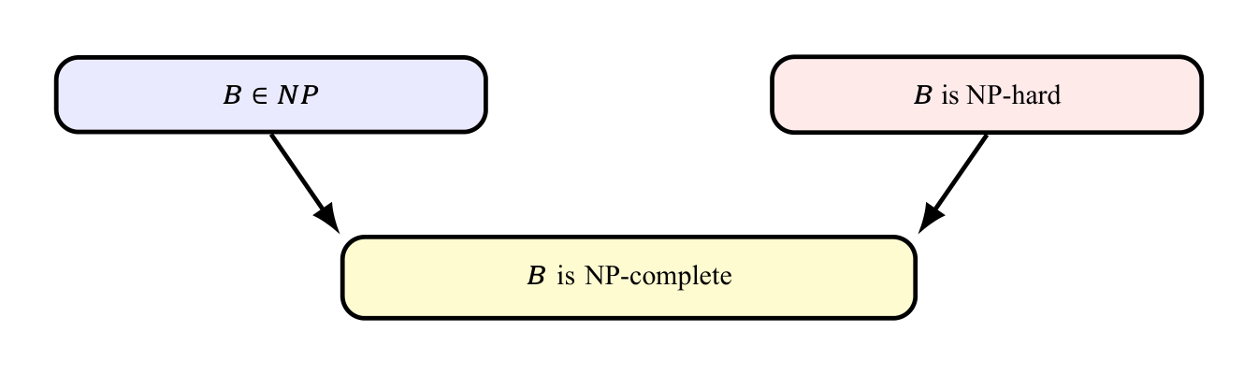
Element 56

Slide 57
Element 57
Direction mnemonic: the known hard problem goes into the target problem.

Slide 58
Worked Reduction: 3-SAT reduces to 3-COLOR
Notes:
Frame 7/16, 2:45–3:10. State the two decision questions before showing the construction. The translator builds the graph without knowing a satisfying assignment.

Slide 59
Element 59
Source: 3-SAT
A 3-CNF formula is an AND of clauses, each an OR of three literals:
$$ϕ=C_{1}∧⋯∧C_{m}.$$
Can a truth assignment satisfy every clause? A literal is a variable or its negation.

Slide 60
Element 60
Target: 3-COLOR
Can the graph’s vertices be colored with three colors so that adjacent vertices have different colors?

Slide 61
Worked Reduction: 3-SAT reduces to 3-COLOR
Notes:
Frame 7/16, 2:45–3:10. State the two decision questions before showing the construction. The translator builds the graph without knowing a satisfying assignment.

Slide 62
Element 62
Source: 3-SAT
A 3-CNF formula is an AND of clauses, each an OR of three literals:
$$ϕ=C_{1}∧⋯∧C_{m}.$$
Can a truth assignment satisfy every clause? A literal is a variable or its negation.

Slide 63
Element 63
Target: 3-COLOR
Can the graph’s vertices be colored with three colors so that adjacent vertices have different colors?

Slide 64
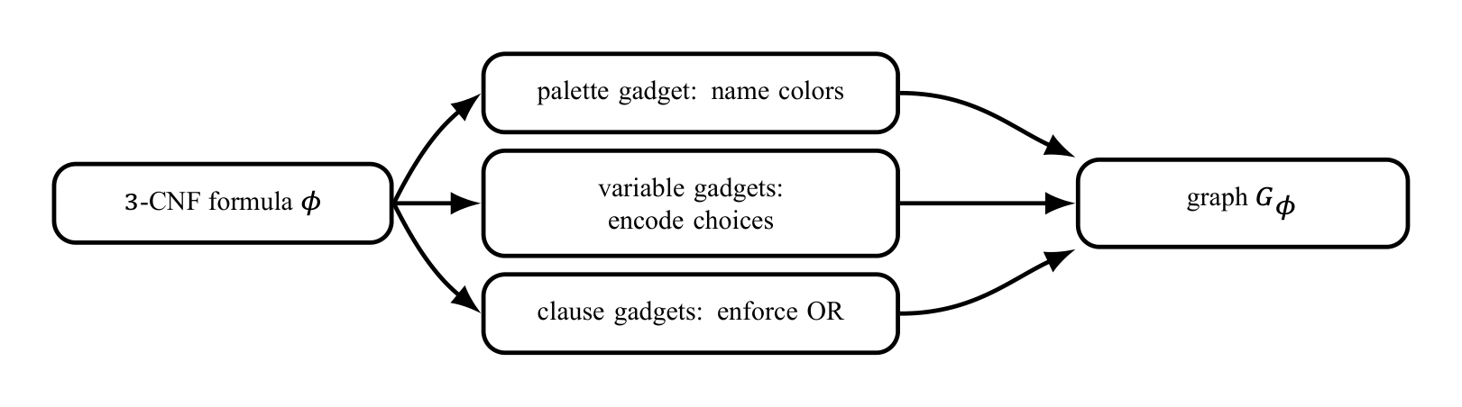
Element 64

Slide 65
Worked Reduction: 3-SAT reduces to 3-COLOR
Notes:
Frame 7/16, 2:45–3:10. State the two decision questions before showing the construction. The translator builds the graph without knowing a satisfying assignment.

Slide 66
Element 66
Source: 3-SAT
A 3-CNF formula is an AND of clauses, each an OR of three literals:
$$ϕ=C_{1}∧⋯∧C_{m}.$$
Can a truth assignment satisfy every clause? A literal is a variable or its negation.

Slide 67
Element 67
Target: 3-COLOR
Can the graph’s vertices be colored with three colors so that adjacent vertices have different colors?

Slide 68
Element 68

Slide 69
Element 69
Design invariant: $ϕ$ is satisfiable if and only if $G_{ϕ}$ is 3-colorable.
This illustrates the general proof recipe; it is not the definition of reduction.

Slide 70
Encoding Truth with Colors
Notes:
Frame 8/16, 3:10–3:40. Ask which color the negated variable must take once xi=T. The names T/F/B are relative to the palette; the physical paint colors can be permuted.

Slide 71
Element 71
Palette gadget
A triangle forces three distinct colors. Name them $T$, $F$ and $B$ (base/helper).

Slide 72
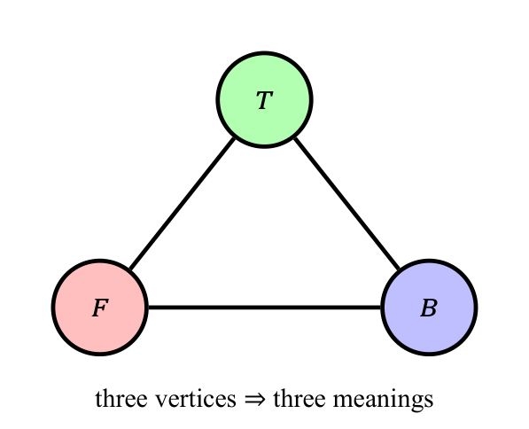
Element 72

Slide 73
Encoding Truth with Colors
Notes:
Frame 8/16, 3:10–3:40. Ask which color the negated variable must take once xi=T. The names T/F/B are relative to the palette; the physical paint colors can be permuted.

Slide 74
Element 74
Palette gadget
A triangle forces three distinct colors. Name them $T$, $F$ and $B$ (base/helper).

Slide 75
Element 75

Slide 76
Element 76
Variable gadget
Connect $x_{i}$ and $¬x_{i}$ to each other and to $B$.

Slide 77
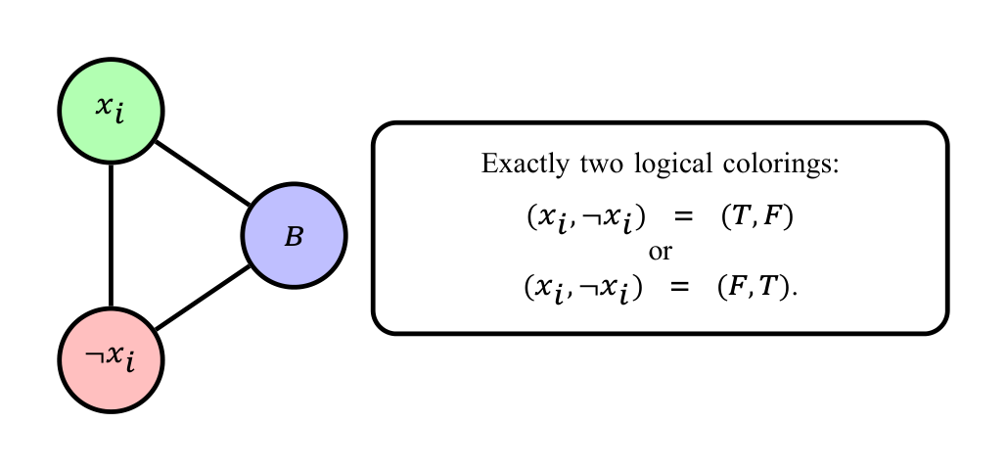
Element 77

Slide 78
Element 78
Exactly one of $x_{i}$ and $¬x_{i}$ receives color $T$.

Slide 79
Constructing the Exact Clause Gadget
Notes:
Frame 9/16, 3:40–4:20 across four reveals. Show the vertices, literal arms, T links, and forcing path in order. Literal vertices already connect to B, so their fixed colors are T/F. Line crossings without a vertex circle are not junctions. The fixed palette edges still exist even when omitted here. The gadget’s result is extendability, not an output vertex color.

Slide 80
Element 80
For $C=(ℓ_{1}∨ℓ_{2}∨ℓ_{3})$, add six fresh vertices $a_{i},b_{i}$ and 13 edges:
$$\begin{aligned}&(ℓ_{i},a_{i}),(a_{i},b_{i}),(T,a_{i}) \\ & \text{for }i=1,2,3, \\ &(T,b_{1}),(b_{1},b_{2}), \\ &(b_{2},b_{3}),(b_{3},F).\end{aligned}$$

Slide 81
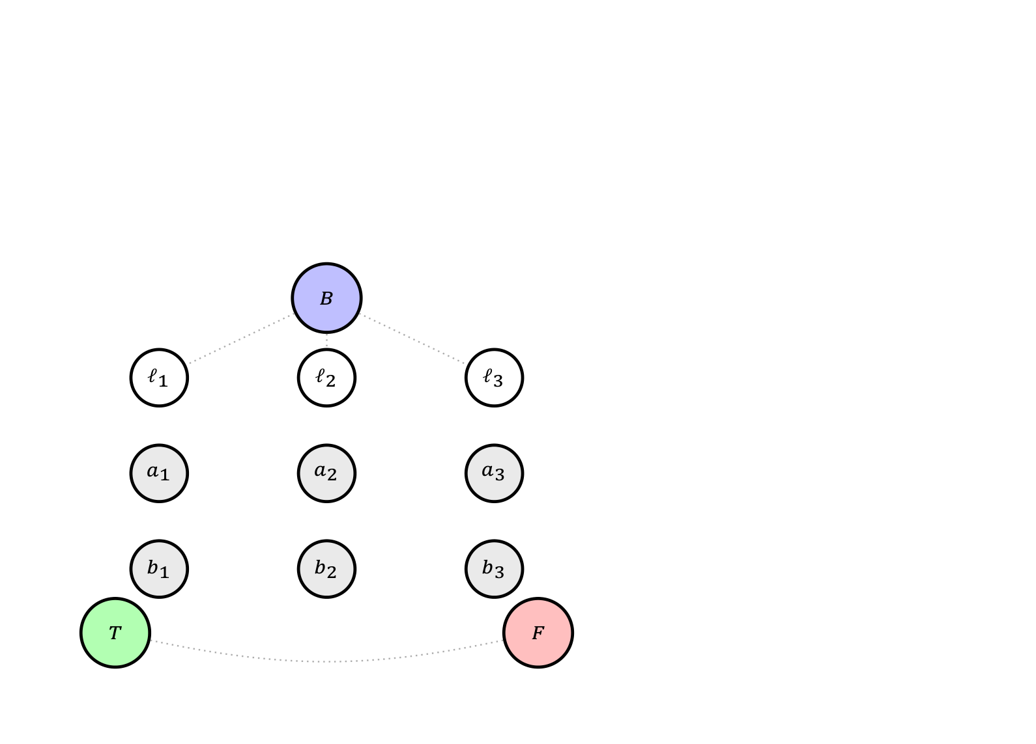
Element 81

Slide 82
Constructing the Exact Clause Gadget
Notes:
Frame 9/16, 3:40–4:20 across four reveals. Show the vertices, literal arms, T links, and forcing path in order. Literal vertices already connect to B, so their fixed colors are T/F. Line crossings without a vertex circle are not junctions. The fixed palette edges still exist even when omitted here. The gadget’s result is extendability, not an output vertex color.

Slide 83
Element 83
For $C=(ℓ_{1}∨ℓ_{2}∨ℓ_{3})$, add six fresh vertices $a_{i},b_{i}$ and 13 edges:
$$\begin{aligned}&(ℓ_{i},a_{i}),(a_{i},b_{i}),(T,a_{i}) \\ & \text{for }i=1,2,3, \\ &(T,b_{1}),(b_{1},b_{2}), \\ &(b_{2},b_{3}),(b_{3},F).\end{aligned}$$

Slide 84

Element 84

Slide 85
Constructing the Exact Clause Gadget
Notes:
Frame 9/16, 3:40–4:20 across four reveals. Show the vertices, literal arms, T links, and forcing path in order. Literal vertices already connect to B, so their fixed colors are T/F. Line crossings without a vertex circle are not junctions. The fixed palette edges still exist even when omitted here. The gadget’s result is extendability, not an output vertex color.

Slide 86
Element 86
For $C=(ℓ_{1}∨ℓ_{2}∨ℓ_{3})$, add six fresh vertices $a_{i},b_{i}$ and 13 edges:
$$\begin{aligned}&(ℓ_{i},a_{i}),(a_{i},b_{i}),(T,a_{i}) \\ & \text{for }i=1,2,3, \\ &(T,b_{1}),(b_{1},b_{2}), \\ &(b_{2},b_{3}),(b_{3},F).\end{aligned}$$

Slide 87
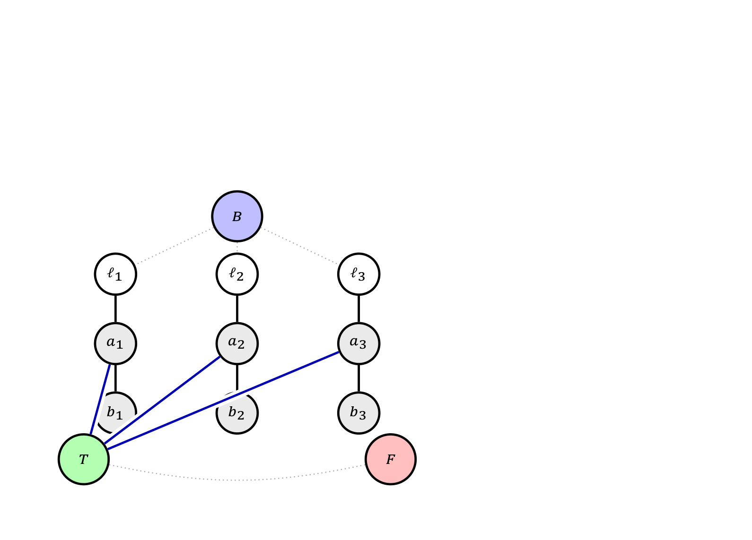
Element 87

Slide 88
Constructing the Exact Clause Gadget
Notes:
Frame 9/16, 3:40–4:20 across four reveals. Show the vertices, literal arms, T links, and forcing path in order. Literal vertices already connect to B, so their fixed colors are T/F. Line crossings without a vertex circle are not junctions. The fixed palette edges still exist even when omitted here. The gadget’s result is extendability, not an output vertex color.

Slide 89
Element 89
For $C=(ℓ_{1}∨ℓ_{2}∨ℓ_{3})$, add six fresh vertices $a_{i},b_{i}$ and 13 edges:
$$\begin{aligned}&(ℓ_{i},a_{i}),(a_{i},b_{i}),(T,a_{i}) \\ & \text{for }i=1,2,3, \\ &(T,b_{1}),(b_{1},b_{2}), \\ &(b_{2},b_{3}),(b_{3},F).\end{aligned}$$
Result: can we complete the coloring?
With inputs fixed in $\{T,F\}$, the internal coloring extends exactly when at least one input is $T$.
There is no output vertex.

Slide 90
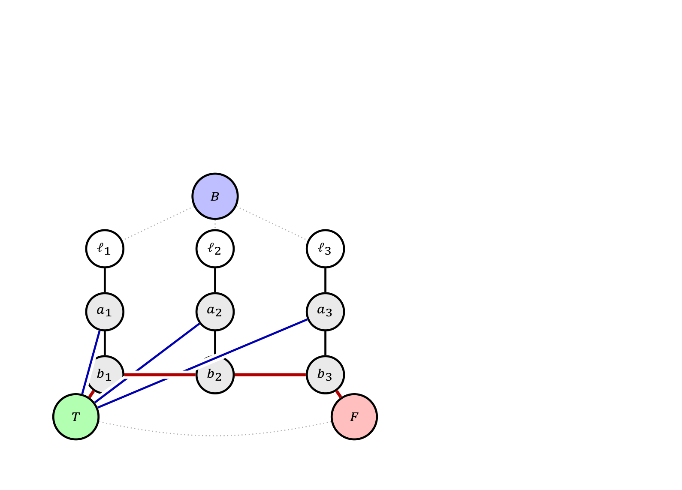
Element 90

Slide 91
Element 91
Black: literal arms. Blue: $T$ links. Red: forcing path. Dotted gray: existing edges.
All lines are ordinary edges. White/gray vertices are unassigned, not extra colors.

Slide 92
Why the Clause Gadget Encodes OR
Notes:
Frame 10/16, 4:20–4:55. Trace the all-false conflict before the successful case. Choose only one true input to supply the B-colored b vertex. The other a vertices can all be B even if their literals are also true. The three witness rows cover every satisfying pattern. The image on the left is a forced failed coloring, not a legal coloring.

Slide 93
Element 93
All inputs are $F$: impossible
Each $a_{i}$ is forced to $B$. Each $b_{i}$ can therefore use only $T$ or $F$.

Slide 94
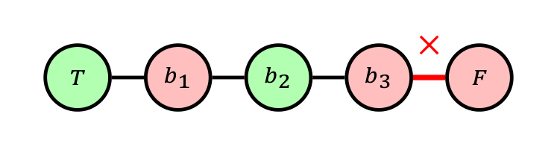
Element 94

Slide 95
Element 95
From $T$, the first three edges force $F,T,F$. The last edge then joins two $F$ vertices.

Slide 96
Why the Clause Gadget Encodes OR
Notes:
Frame 10/16, 4:20–4:55. Trace the all-false conflict before the successful case. Choose only one true input to supply the B-colored b vertex. The other a vertices can all be B even if their literals are also true. The three witness rows cover every satisfying pattern. The image on the left is a forced failed coloring, not a legal coloring.

Slide 97
Element 97
All inputs are $F$: impossible
Each $a_{i}$ is forced to $B$. Each $b_{i}$ can therefore use only $T$ or $F$.

Slide 98
Element 98

Slide 99
Element 99
From $T$, the first three edges force $F,T,F$. The last edge then joins two $F$ vertices.

Slide 100
Element 100
At least one input is $T$: possible
Choose one true input $ℓ_{i}$. Set $a_{i}=F$, $b_{i}=B$ and every other $a_{j}=B$.

Slide 101
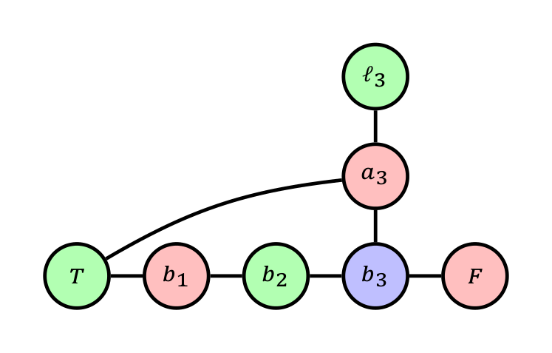
Element 101

Slide 102
Element 102
Chosen true position | (b₁, b₂, b₃)
i = 1 | (B, F, T)
i = 2 | (F, B, T)
i = 3 (shown) | (F, T, B)

Slide 103
Why the Clause Gadget Encodes OR
Notes:
Frame 10/16, 4:20–4:55. Trace the all-false conflict before the successful case. Choose only one true input to supply the B-colored b vertex. The other a vertices can all be B even if their literals are also true. The three witness rows cover every satisfying pattern. The image on the left is a forced failed coloring, not a legal coloring.

Slide 104
Element 104
All inputs are $F$: impossible
Each $a_{i}$ is forced to $B$. Each $b_{i}$ can therefore use only $T$ or $F$.

Slide 105
Element 105

Slide 106
Element 106
From $T$, the first three edges force $F,T,F$. The last edge then joins two $F$ vertices.
$F,F,F$: no extension. All seven other input patterns have an extension.

Slide 107
Element 107
At least one input is $T$: possible
Choose one true input $ℓ_{i}$. Set $a_{i}=F$, $b_{i}=B$ and every other $a_{j}=B$.

Slide 108
Element 108

Slide 109
Element 109
Chosen true position | (b₁, b₂, b₃)
i = 1 | (B, F, T)
i = 2 | (F, B, T)
i = 3 (shown) | (F, T, B)

Slide 110
Evaluating One Complete Formula
Notes:
Frame 11/16, 4:55–5:15. Evaluate both clauses. This assignment is a demonstration after graph construction; the reduction does not need to find it.

Slide 111
Element 111
$$ϕ=(x_{1}∨¬x_{2}∨x_{3})∧(¬x_{1}∨x_{2}∨¬x_{3}).$$

Slide 112
Evaluating One Complete Formula
Notes:
Frame 11/16, 4:55–5:15. Evaluate both clauses. This assignment is a demonstration after graph construction; the reduction does not need to find it.

Slide 113
Element 113
$$ϕ=(x_{1}∨¬x_{2}∨x_{3})∧(¬x_{1}∨x_{2}∨¬x_{3}).$$

Slide 114
Element 114
Clause input ports
$$C_{1}:(x_{1},¬x_{2},x_{3}),$$
$$C_{2}:(¬x_{1},x_{2},¬x_{3}).$$
Each clause receives its own six fresh internal vertices.

Slide 115
Evaluating One Complete Formula
Notes:
Frame 11/16, 4:55–5:15. Evaluate both clauses. This assignment is a demonstration after graph construction; the reduction does not need to find it.

Slide 116
Element 116
$$ϕ=(x_{1}∨¬x_{2}∨x_{3})∧(¬x_{1}∨x_{2}∨¬x_{3}).$$

Slide 117
Element 117
Clause input ports
$$C_{1}:(x_{1},¬x_{2},x_{3}),$$
$$C_{2}:(¬x_{1},x_{2},¬x_{3}).$$
Each clause receives its own six fresh internal vertices.

Slide 118
Element 118
One satisfying assignment
$$x_{1}=T, x_{2}=T, x_{3}=F.$$
Thus
$$C_{1}=(T,F,F), C_{2}=(F,T,T).$$
Both clause gadgets can be extended.

Slide 119
Assembling the Formula Graph
Notes:
Frame 12/16, 5:15–5:40. This is an assembly schematic: the boxes represent copies of the exact gadget already proved. Shared literals enforce a consistent assignment across clauses. Each copy also uses palette T and F. No edges between distinct clauses’ internal vertices are needed.

Slide 120
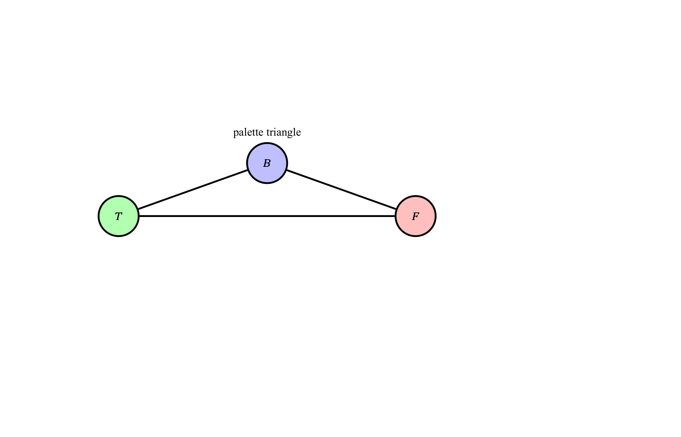
Element 120

Slide 121
Assembling the Formula Graph
Notes:
Frame 12/16, 5:15–5:40. This is an assembly schematic: the boxes represent copies of the exact gadget already proved. Shared literals enforce a consistent assignment across clauses. Each copy also uses palette T and F. No edges between distinct clauses’ internal vertices are needed.

Slide 122
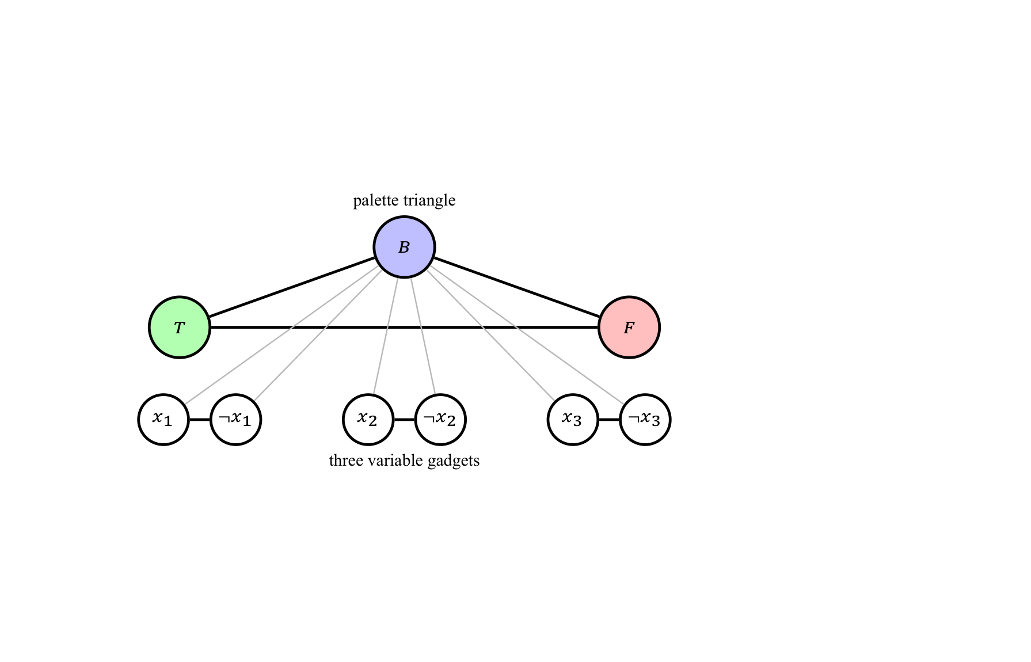
Element 122

Slide 123
Assembling the Formula Graph
Notes:
Frame 12/16, 5:15–5:40. This is an assembly schematic: the boxes represent copies of the exact gadget already proved. Shared literals enforce a consistent assignment across clauses. Each copy also uses palette T and F. No edges between distinct clauses’ internal vertices are needed.

Slide 124
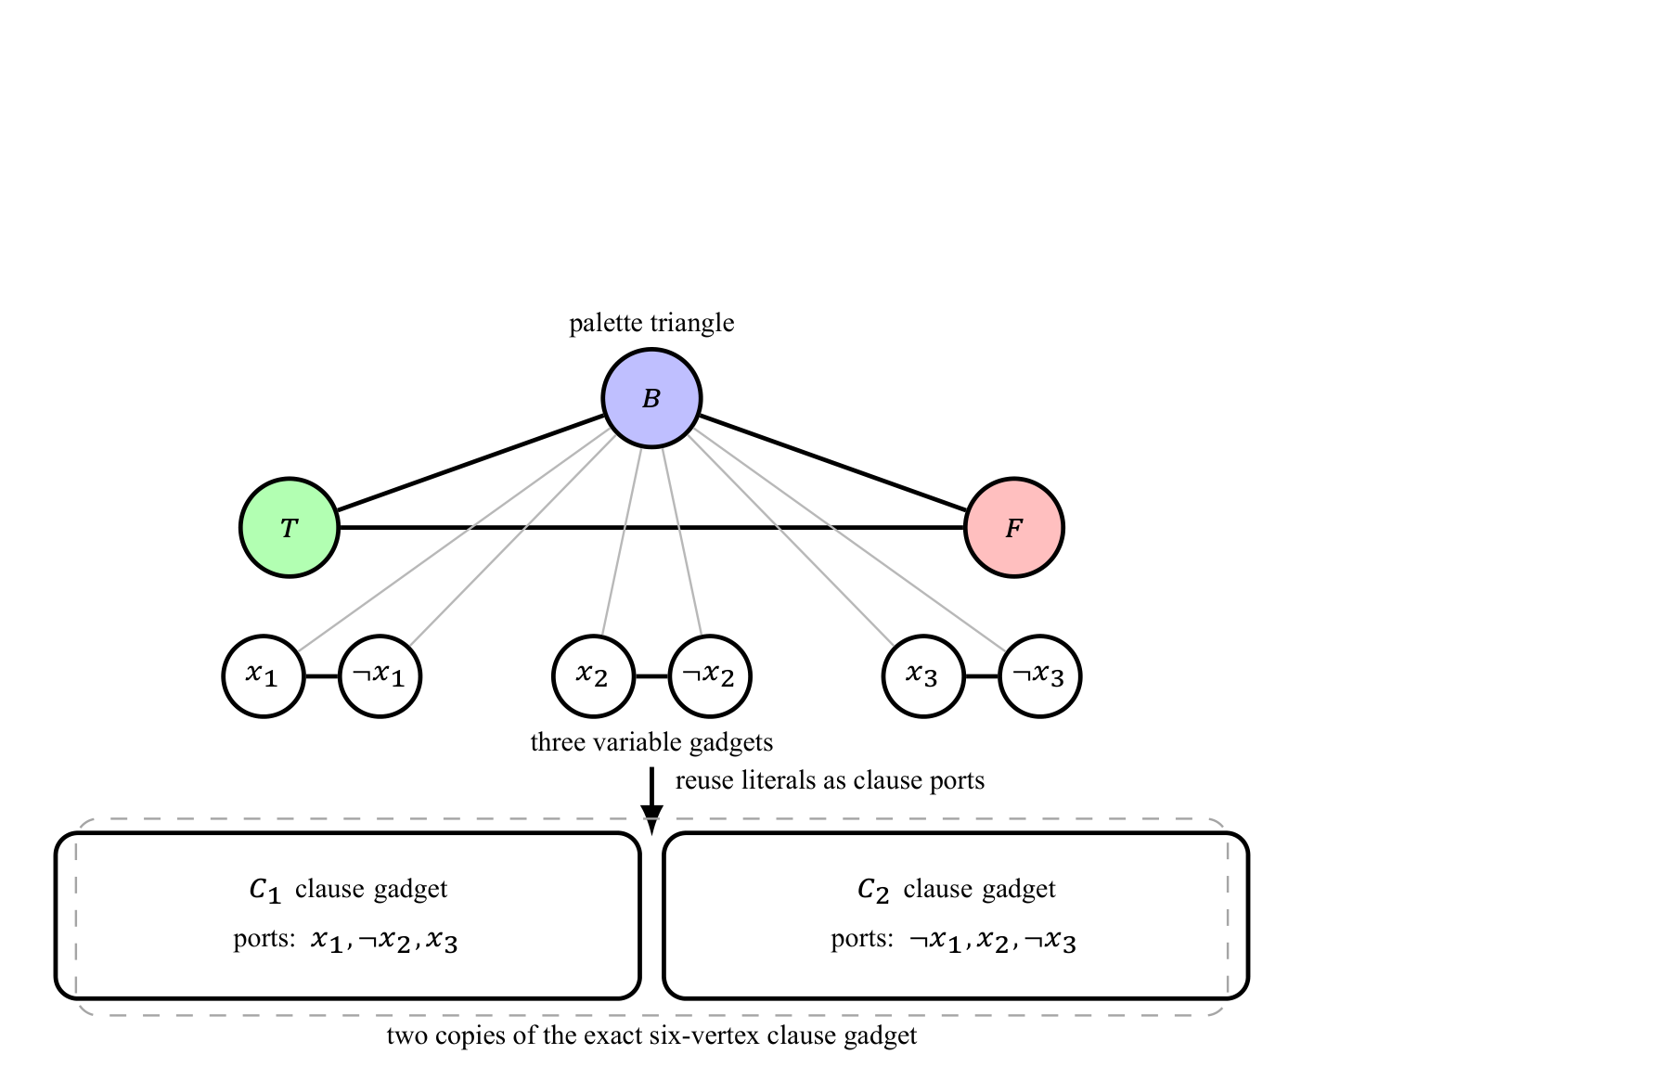
Element 124

Slide 125
Element 125
The palette and literal vertices are shared; each clause has fresh internal vertices.

Slide 126
Correctness and Complexity of the Reduction
Notes:
Frame 13/16, 5:40–6:20. State both directions, then the counts. Palette: three vertices/edges. Each variable: two vertices and three edges. Each clause: six vertices and thirteen edges. Verification is O(V+E); with NP-hardness this proves 3-COLOR NP-complete. Linear many graph records can require logarithmic-size vertex indices in a bit encoding.

Slide 127
Element 127
$ϕ$ satisfiable $⇒G_{ϕ}$ 3-colorable
Give each literal its truth color.
Every clause has a true literal.
Every clause gadget therefore extends to a legal coloring.

Slide 128
Correctness and Complexity of the Reduction
Notes:
Frame 13/16, 5:40–6:20. State both directions, then the counts. Palette: three vertices/edges. Each variable: two vertices and three edges. Each clause: six vertices and thirteen edges. Verification is O(V+E); with NP-hardness this proves 3-COLOR NP-complete. Linear many graph records can require logarithmic-size vertex indices in a bit encoding.

Slide 129
Element 129
$ϕ$ satisfiable $⇒G_{ϕ}$ 3-colorable
Give each literal its truth color.
Every clause has a true literal.
Every clause gadget therefore extends to a legal coloring.

Slide 130
Element 130
$G_{ϕ}$ 3-colorable $⇒ϕ$ satisfiable
Read $x_{i}=true$ exactly when vertex $x_{i}$ has color $T$.
Every colorable clause has a $T$ input.
Every clause is therefore satisfied.

Slide 131
Correctness and Complexity of the Reduction
Notes:
Frame 13/16, 5:40–6:20. State both directions, then the counts. Palette: three vertices/edges. Each variable: two vertices and three edges. Each clause: six vertices and thirteen edges. Verification is O(V+E); with NP-hardness this proves 3-COLOR NP-complete. Linear many graph records can require logarithmic-size vertex indices in a bit encoding.

Slide 132
Element 132
$ϕ$ satisfiable $⇒G_{ϕ}$ 3-colorable
Give each literal its truth color.
Every clause has a true literal.
Every clause gadget therefore extends to a legal coloring.

Slide 133
Element 133
$G_{ϕ}$ 3-colorable $⇒ϕ$ satisfiable
Read $x_{i}=true$ exactly when vertex $x_{i}$ has color $T$.
Every colorable clause has a $T$ input.
Every clause is therefore satisfied.

Slide 134
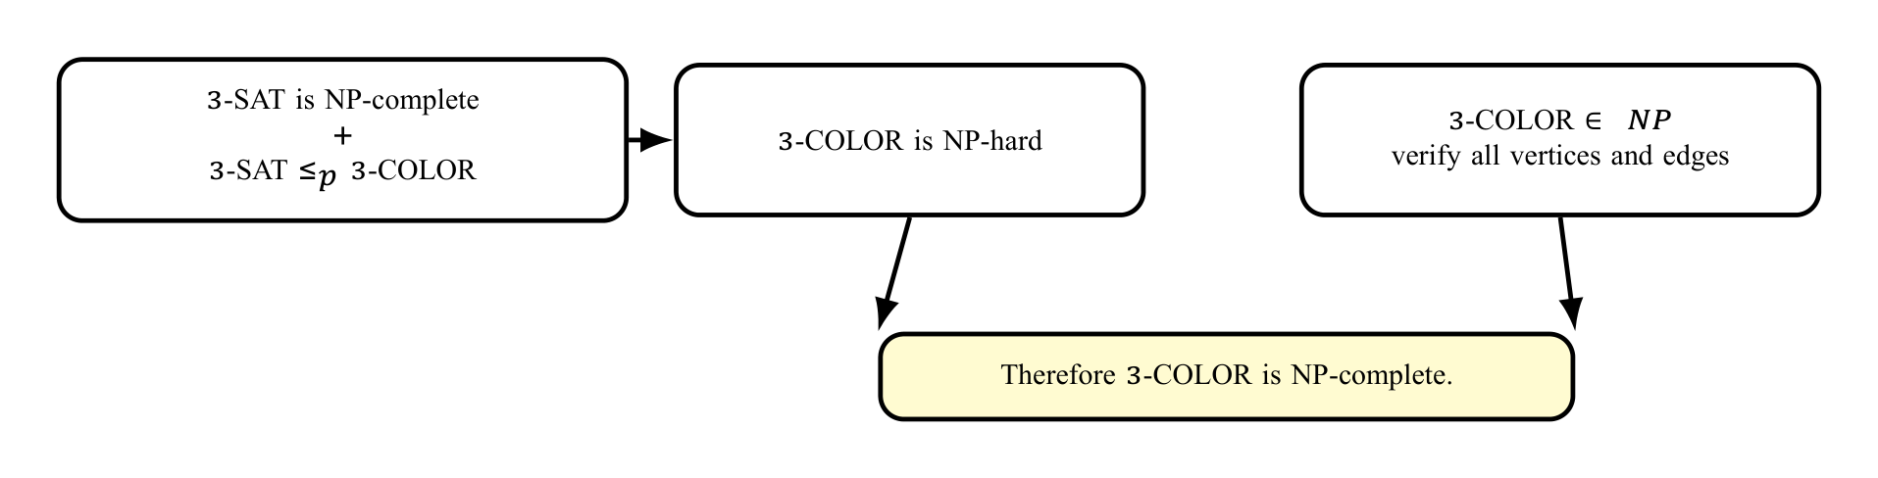
Element 134

Slide 135
Element 135
For $n$ variables and $m$ clauses:
$$|V|=3+2n+6m, |E|=3+3n+13m.$$
Enumerating the vertices and edges takes polynomial time.

Slide 136
A Second Reduction Pattern: 3-SAT reduces to CLIQUE
Notes:
Frame 14/16, 6:20–6:40. Give this only a brief explanation. No intraclause edges means an m-clique must contain exactly one vertex from each clause. The highlighted clique chooses x1 from C1, x2 from C2 and x1 from C3. The two x1 occurrences are distinct vertices and compatible. In the reverse direction choose one true literal per satisfied clause. CLIQUE membership in NP follows by checking the selected vertices’ pairwise edges.

Slide 137
Element 137
$$\begin{aligned}ϕ^{′}=​&(x_{1}∨¬x_{2}∨x_{3})∧(¬x_{1}∨x_{2}∨x_{3}) \\ &∧(x_{1}∨x_{2}∨¬x_{3}).\end{aligned}$$

Slide 138
Element 138
Create one vertex per literal occurrence.
Put vertices in clause groups.
Connect different-clause vertices when their literals are not contradictory.
Ask for $m$ pairwise adjacent vertices: an $m$-clique.

Slide 139
A Second Reduction Pattern: 3-SAT reduces to CLIQUE
Notes:
Frame 14/16, 6:20–6:40. Give this only a brief explanation. No intraclause edges means an m-clique must contain exactly one vertex from each clause. The highlighted clique chooses x1 from C1, x2 from C2 and x1 from C3. The two x1 occurrences are distinct vertices and compatible. In the reverse direction choose one true literal per satisfied clause. CLIQUE membership in NP follows by checking the selected vertices’ pairwise edges.

Slide 140
Element 140
$$\begin{aligned}ϕ^{′}=​&(x_{1}∨¬x_{2}∨x_{3})∧(¬x_{1}∨x_{2}∨x_{3}) \\ &∧(x_{1}∨x_{2}∨¬x_{3}).\end{aligned}$$

Slide 141
Element 141
Create one vertex per literal occurrence.
Put vertices in clause groups.
Connect different-clause vertices when their literals are not contradictory.
Ask for $m$ pairwise adjacent vertices: an $m$-clique.

Slide 142
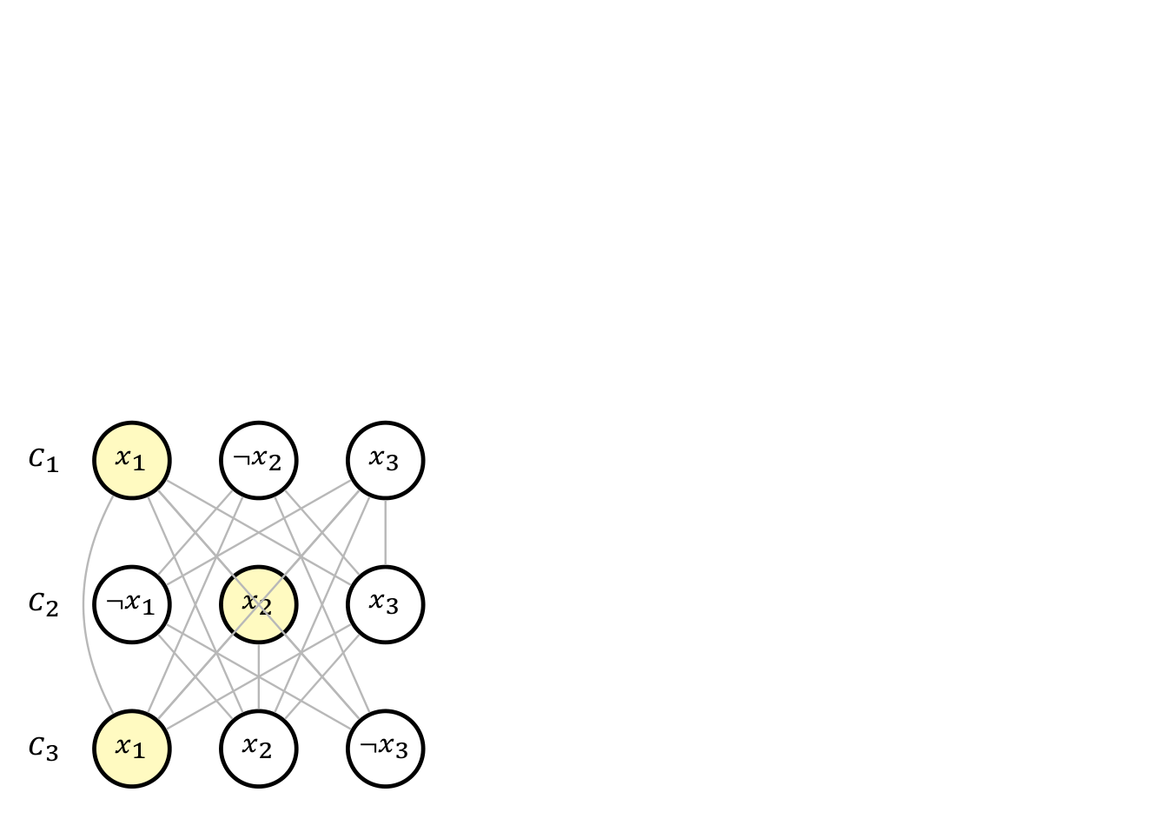
Element 142

Slide 143
A Second Reduction Pattern: 3-SAT reduces to CLIQUE
Notes:
Frame 14/16, 6:20–6:40. Give this only a brief explanation. No intraclause edges means an m-clique must contain exactly one vertex from each clause. The highlighted clique chooses x1 from C1, x2 from C2 and x1 from C3. The two x1 occurrences are distinct vertices and compatible. In the reverse direction choose one true literal per satisfied clause. CLIQUE membership in NP follows by checking the selected vertices’ pairwise edges.

Slide 144
Element 144
$$\begin{aligned}ϕ^{′}=​&(x_{1}∨¬x_{2}∨x_{3})∧(¬x_{1}∨x_{2}∨x_{3}) \\ &∧(x_{1}∨x_{2}∨¬x_{3}).\end{aligned}$$

Slide 145
Element 145
Create one vertex per literal occurrence.
Put vertices in clause groups.
Connect different-clause vertices when their literals are not contradictory.
Ask for $m$ pairwise adjacent vertices: an $m$-clique.
One pairwise noncontradictory literal occurrence from each clause forms a clique.

Slide 146
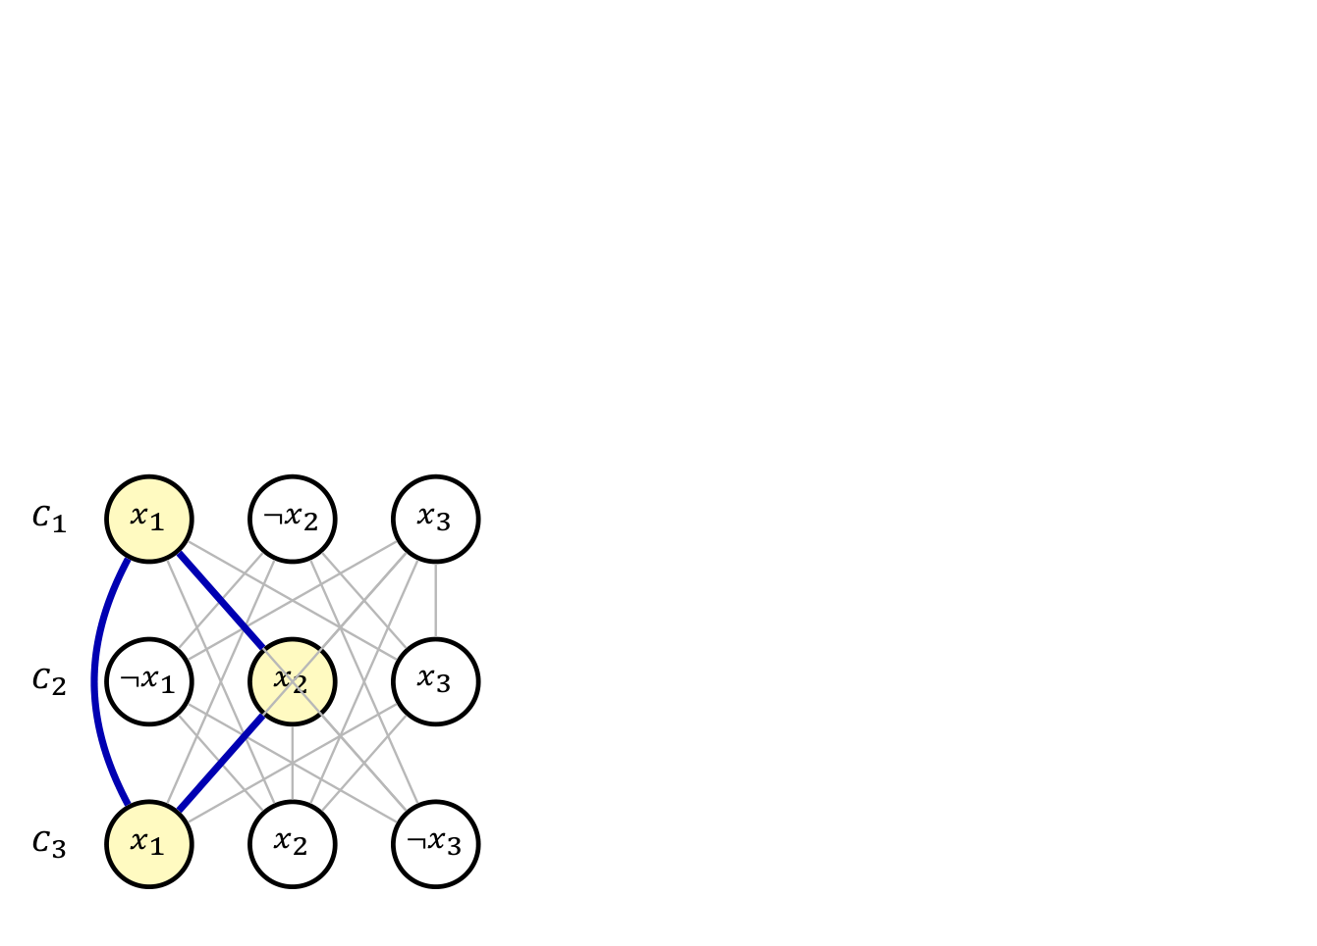
Element 146

Slide 147
Element 147
Conversely, an $m$-clique chooses one occurrence per clause with no complementary pair. Set them true.
Construction: $3m$ vertices and $O(m^{2})$ edges.

Slide 148
Takeaway
Notes:
Frame 15/16, 6:40–6:55. End with the proof recipe. If time permits, ask students which reduction direction proves B hard: A to B or B to A? Answer: known-hard A to target B.

Slide 149
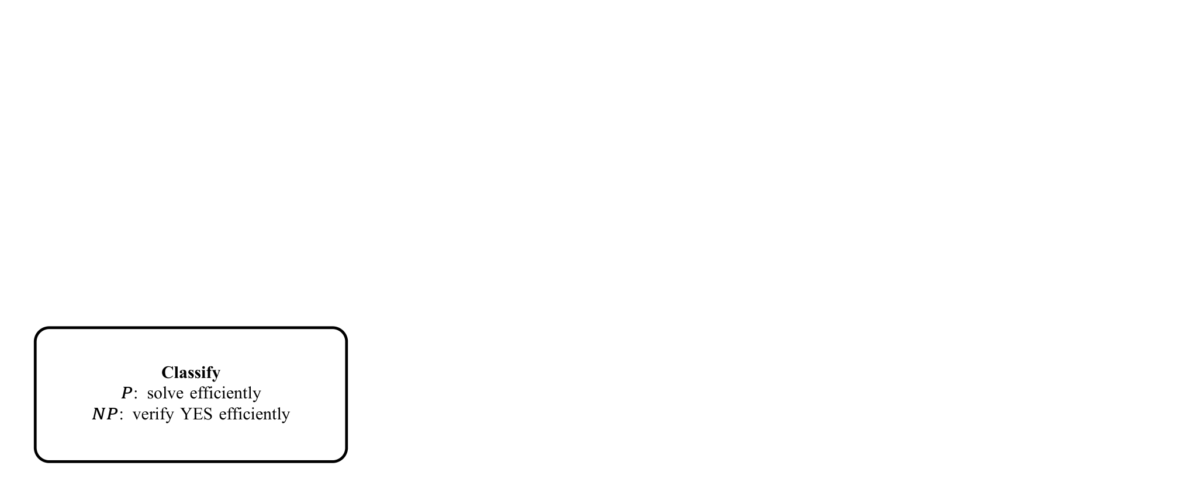
Element 149

Slide 150
Takeaway
Notes:
Frame 15/16, 6:40–6:55. End with the proof recipe. If time permits, ask students which reduction direction proves B hard: A to B or B to A? Answer: known-hard A to target B.

Slide 151
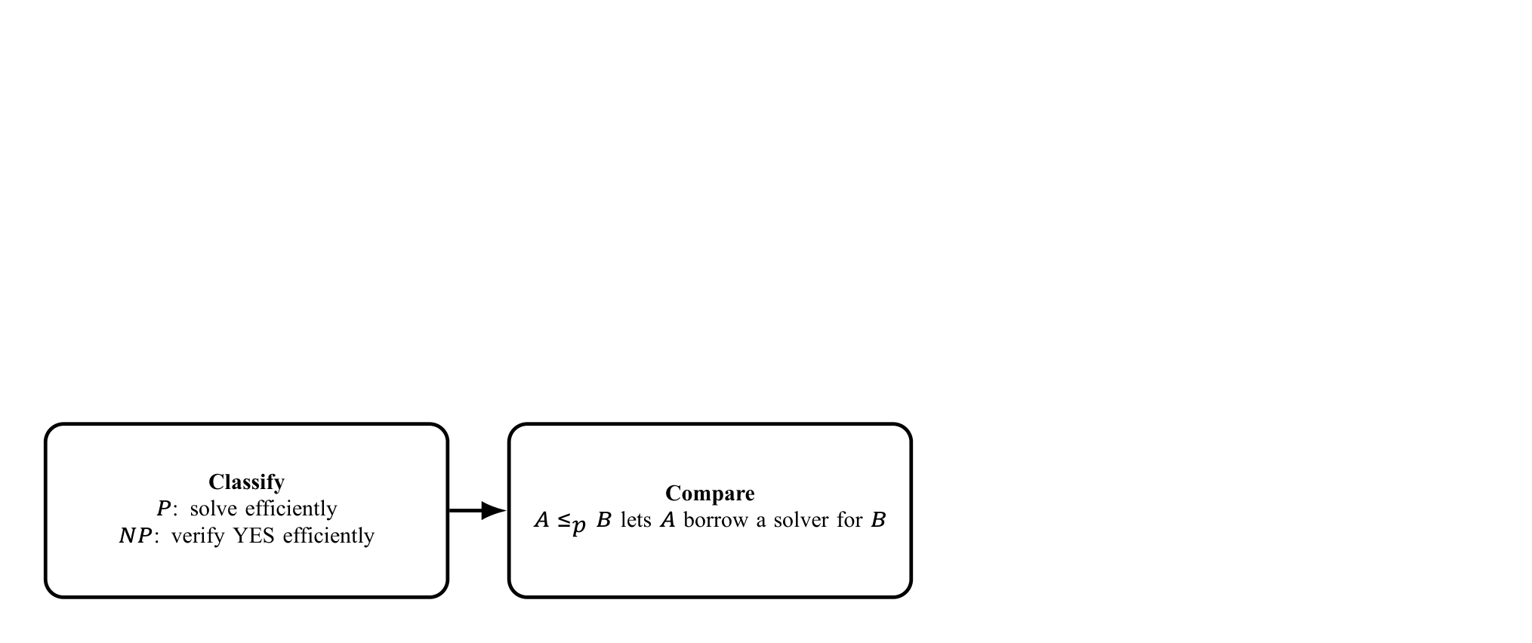
Element 151

Slide 152
Takeaway
Notes:
Frame 15/16, 6:40–6:55. End with the proof recipe. If time permits, ask students which reduction direction proves B hard: A to B or B to A? Answer: known-hard A to target B.

Slide 153
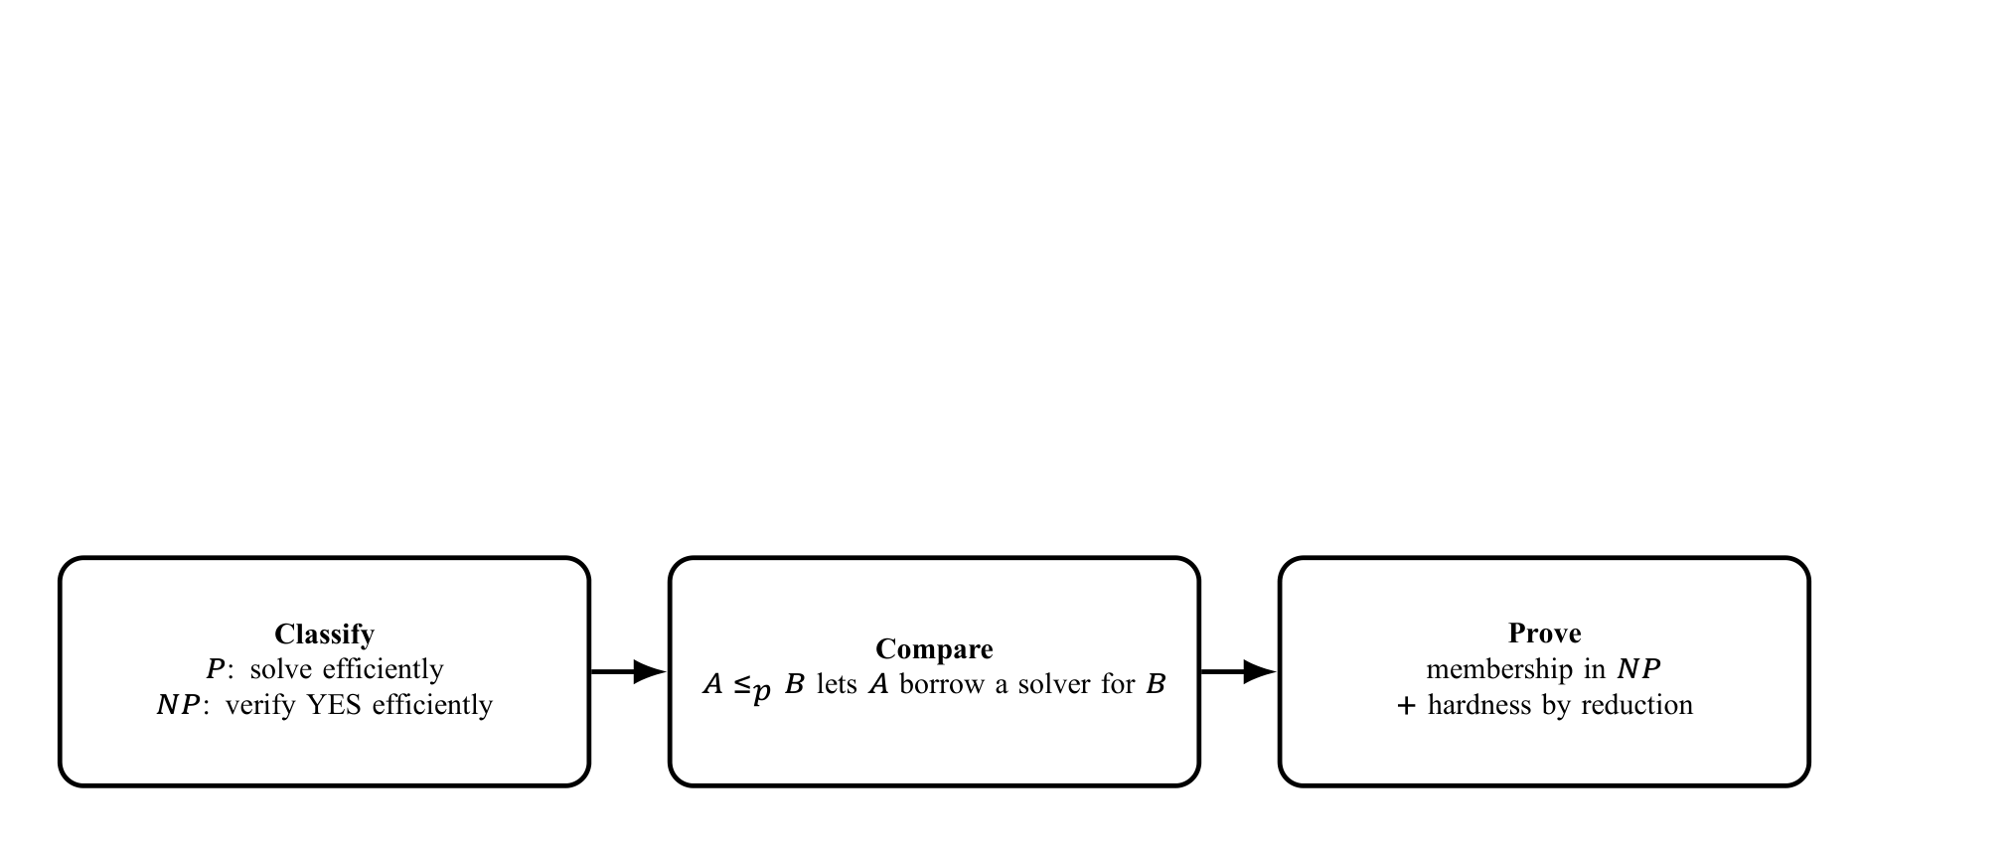
Element 153

Slide 154
Takeaway
Notes:
Frame 15/16, 6:40–6:55. End with the proof recipe. If time permits, ask students which reduction direction proves B hard: A to B or B to A? Answer: known-hard A to target B.

Slide 155
Element 155

Slide 156
Element 156
One reusable sentence
To prove a target $B$ NP-complete, show $B∈NP$ and reduce a known NP-complete problem $A$ to $B$ in polynomial time while preserving YES/NO answers.
Questions?
Core references: Sipser; Cormen–Leiserson–Rivest–Stein; Princeton COS 423 reduction notes.

Slide 157
References
Notes:
Frame 16/16, 6:55–7:00. Acknowledge the sources; do not read the bibliography aloud. Timing is across all reveals within each frame and leaves no discussion time. Allow substantially longer for a full first lesson.

Slide 158
Element 158
Primary references
Michael Sipser, Introduction to the Theory of Computation.
Cormen, Leiserson, Rivest and Stein, Introduction to Algorithms.
CMU 15-451/651 lecture notes on NP-completeness.
Princeton COS 423 lecture notes, Polynomial-Time Reductions.
The exact six-vertex clause gadget and its 13-edge construction follow the Princeton reduction notes.

