Slide 1
NP-Completeness and Reduction Techniques
How Efficient Transformations Prove Computational Hardness
Most. Sonia Khatun
BSc in Department of Computer Science and Engineering Bangladesh University of Engineering and Technology (BUET)
Demo Presentation for the Position of Lecturer Department of Computer Science and Engineering Green University of Bangladesh
Notes:
Frame 1/17. Introduce yourself and the learning objective. This is a rehearsed overview for students familiar with basic graphs, Boolean logic and polynomial time. The main text, tables and equations in this version are editable PowerPoint objects. Text inside the original TikZ figures is part of those images.

Slide 2
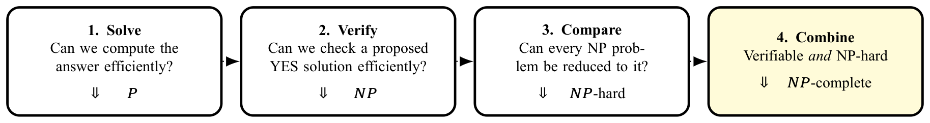
Why Do We Need NP-Completeness?
Notes:
Frame 2/17. Distinguish solving, verifying and comparing. Preview the direction: a known hard problem reduces to the new target.

Slide 3
Why Do We Need NP-Completeness?
The central proof question
How can we transfer the known hardness of one problem to a new problem?
Notes:
Frame 2/17. Distinguish solving, verifying and comparing. Preview the direction: a known hard problem reduces to the new target.

Slide 4
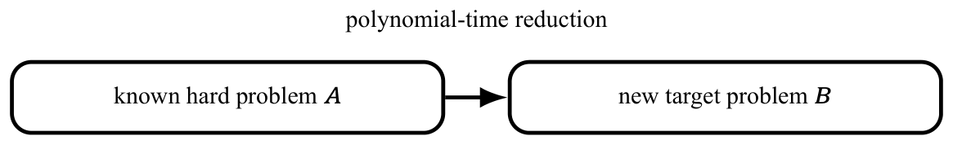
Why Do We Need NP-Completeness?
The central proof question
How can we transfer the known hardness of one problem to a new problem?
The dotted arrows show the learning sequence, not set containment.
Notes:
Frame 2/17. Distinguish solving, verifying and comparing. Preview the direction: a known hard problem reduces to the new target.

Slide 5
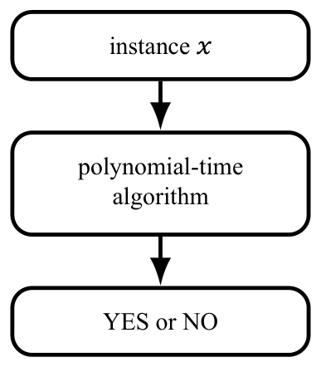
Start with P and NP
P: solve efficiently
Decision problems solvable by a deterministic algorithm in polynomial time.
Example: reachability can be solved by BFS or DFS.
Notes:
Frame 3/17. Explain the formula verbally: a YES instance has a short accepting certificate, and a NO instance has none. A verifier checks the color domain as well as the edges. The solver can ignore a certificate, proving P is contained in NP.

Slide 6
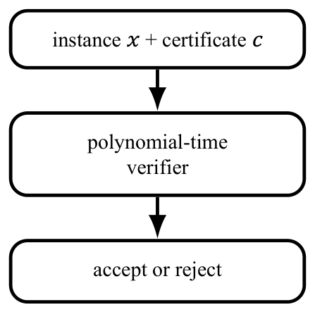
Start with P and NP
P: solve efficiently
Decision problems solvable by a deterministic algorithm in polynomial time.
NP: verify efficiently
There are a polynomial-time verifier $V$ and polynomial $p$ such that
$$x∈L⇔∃c: \begin{matrix}|c|≤p(|x|), \\ V(x,c)=1.\end{matrix}$$
Example: reachability can be solved by BFS or DFS.
For 3-COLOR, $c$ assigns one of three colors to every vertex; check every edge.
Notes:
Frame 3/17. Explain the formula verbally: a YES instance has a short accepting certificate, and a NO instance has none. A verifier checks the color domain as well as the edges. The solver can ignore a certificate, proving P is contained in NP.

Slide 7
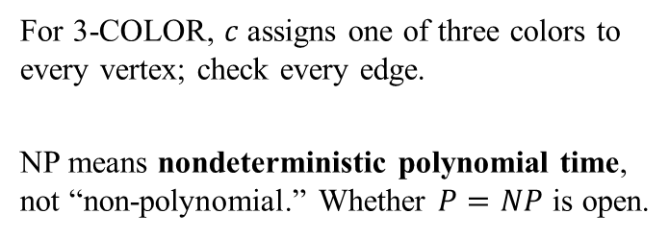
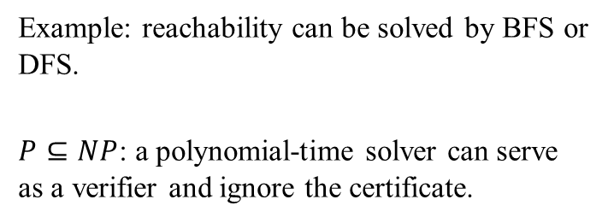
Start with P and NP
P: solve efficiently
Decision problems solvable by a deterministic algorithm in polynomial time.
NP: verify efficiently
There are a polynomial-time verifier $V$ and polynomial $p$ such that
$$x∈L⇔∃c: \begin{matrix}|c|≤p(|x|), \\ V(x,c)=1.\end{matrix}$$
Example: reachability can be solved by BFS or DFS.
$P⊆NP$: a polynomial-time solver can serve as a verifier and ignore the certificate.
For 3-COLOR, $c$ assigns one of three colors to every vertex; check every edge.
NP means nondeterministic polynomial time, not “non-polynomial.” Whether $P=NP$ is open.
Notes:
Frame 3/17. Explain the formula verbally: a YES instance has a short accepting certificate, and a NO instance has none. A verifier checks the color domain as well as the edges. The solver can ignore a certificate, proving P is contained in NP.

Slide 8
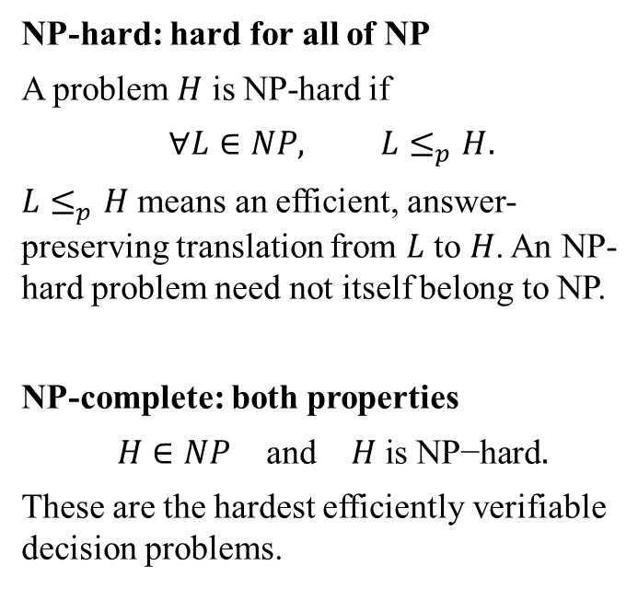
From NP-Hard to NP-Complete
NP-hard: hard for all of NP
A problem $H$ is NP-hard if
$$∀L∈NP, L≤_{p}H.$$
$L≤_{p}H$ means an efficient, answer-preserving translation from $L$ to $H$. An NP-hard problem need not itself belong to NP.
NP-complete: both properties
$$H∈NP \text{and} H\text{ is NP−hard}.$$
These are the hardest efficiently verifiable decision problems.
Notes:
Frame 4/17. Point at the intersection. NP-hardness does not imply membership in NP. NP-completeness does not prove that a polynomial algorithm is impossible; P versus NP remains open.

Slide 9
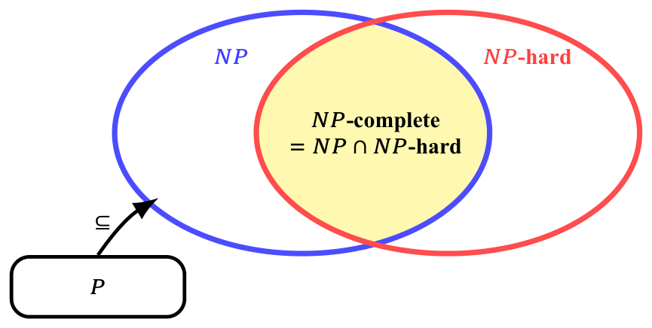
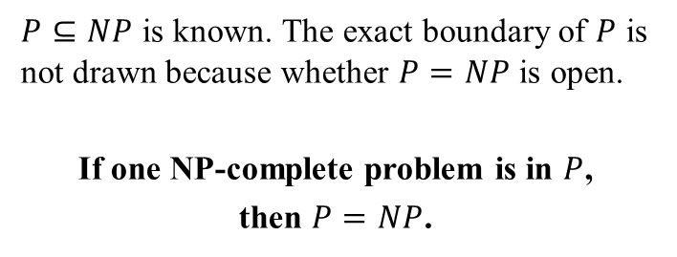
From NP-Hard to NP-Complete
NP-hard: hard for all of NP
A problem $H$ is NP-hard if
$$∀L∈NP, L≤_{p}H.$$
$L≤_{p}H$ means an efficient, answer-preserving translation from $L$ to $H$. An NP-hard problem need not itself belong to NP.
NP-complete: both properties
$$H∈NP \text{and} H\text{ is NP−hard}.$$
These are the hardest efficiently verifiable decision problems.
$P⊆NP$ is known. The exact boundary of $P$ is not drawn because whether $P=NP$ is open.
If one NP-complete problem is in $P$,
then $P=NP$.
Notes:
Frame 4/17. Point at the intersection. NP-hardness does not imply membership in NP. NP-completeness does not prove that a polynomial algorithm is impossible; P versus NP remains open.

Slide 10
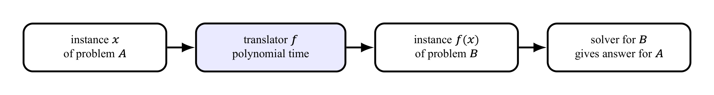
Polynomial-Time Reduction: an Answer-Preserving Translator
Notes:
Frame 5/17. Demonstrate both a YES and a NO instance. Doubling a binary integer is linear in its bit length. The reduction transforms instances without solving the hard source instance.

Slide 11
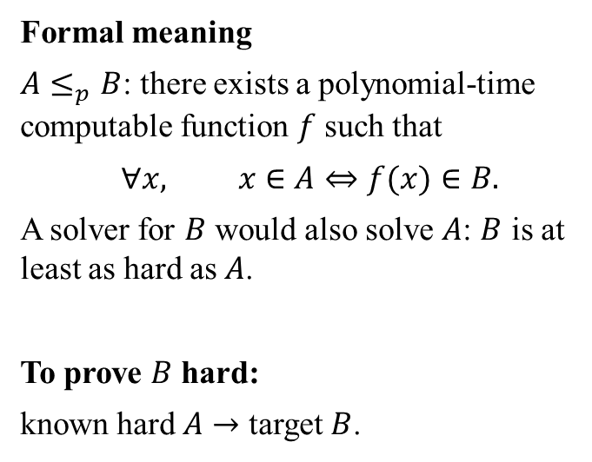
Polynomial-Time Reduction: an Answer-Preserving Translator
Formal meaning
$A≤_{p}B$: there exists a polynomial-time computable function $f$ such that
$$∀x, x∈A⇔f(x)∈B.$$
A solver for $B$ would also solve $A$: $B$ is at least as hard as $A$.
To prove $B$ hard:
known hard $A→$ target $B$.
Notes:
Frame 5/17. Demonstrate both a YES and a NO instance. Doubling a binary integer is linear in its bit length. The reduction transforms instances without solving the hard source instance.

Slide 12
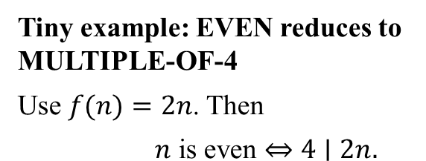
Polynomial-Time Reduction: an Answer-Preserving Translator
Formal meaning
$A≤_{p}B$: there exists a polynomial-time computable function $f$ such that
$$∀x, x∈A⇔f(x)∈B.$$
A solver for $B$ would also solve $A$: $B$ is at least as hard as $A$.
To prove $B$ hard:
known hard $A→$ target $B$.
Tiny example: EVEN reduces to MULTIPLE-OF-4
Use $f(n)=2n$. Then
$$n\text{ is even}⇔4∣2n.$$
N | f(n) | Preserved?
6: YES | 12: YES | YES
7: NO | 14: NO | YES
This illustrates the mechanics; a hardness proof starts from a known hard problem.
Notes:
Frame 5/17. Demonstrate both a YES and a NO instance. Doubling a binary integer is linear in its bit length. The reduction transforms instances without solving the hard source instance.

Slide 13
Reusable Recipe: Proving a Problem NP-Complete
1. Membership in NP
State a polynomial-size certificate.
Give a polynomial-time verifier.
$$B∈NP.$$
Notes:
Frame 6/17. Both obligations are necessary. Reducing an easy problem to B alone does not establish NP-hardness. The displayed implication requires A to be NP-hard.

Slide 14
Reusable Recipe: Proving a Problem NP-Complete
1. Membership in NP
State a polynomial-size certificate.
Give a polynomial-time verifier.
$$B∈NP.$$
2. NP-hardness
Choose a known NP-complete problem $A$.
Construct $f$ in polynomial time.
Prove $x∈A⇔f(x)∈B$.
If $A$ is NP-hard and $A≤_{p}B$, then $B$ is NP-hard.
Notes:
Frame 6/17. Both obligations are necessary. Reducing an easy problem to B alone does not establish NP-hardness. The displayed implication requires A to be NP-hard.

Slide 15
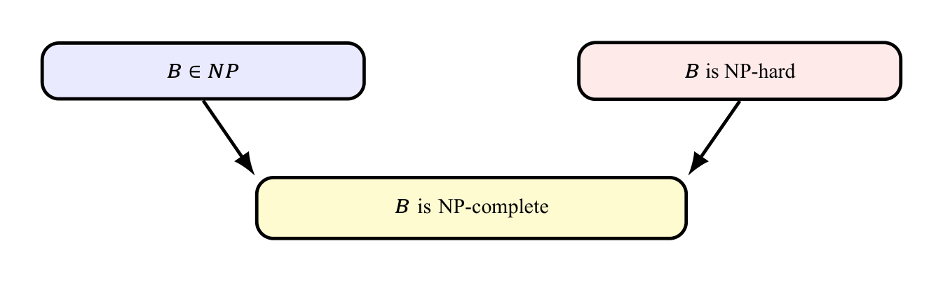
Reusable Recipe: Proving a Problem NP-Complete
1. Membership in NP
State a polynomial-size certificate.
Give a polynomial-time verifier.
$$B∈NP.$$
2. NP-hardness
Choose a known NP-complete problem $A$.
Construct $f$ in polynomial time.
Prove $x∈A⇔f(x)∈B$.
If $A$ is NP-hard and $A≤_{p}B$, then $B$ is NP-hard.
Direction mnemonic: the known hard problem goes into the target problem.
Notes:
Frame 6/17. Both obligations are necessary. Reducing an easy problem to B alone does not establish NP-hardness. The displayed implication requires A to be NP-hard.

Slide 16
Worked Reduction: 3-SAT reduces to 3-COLOR
Source: 3-SAT
A 3-CNF formula is an AND of clauses, each an OR of three literals:
$$φ=C_{1}∧⋯∧C_{m}.$$
Can a truth assignment satisfy every clause? A literal is a variable or its negation.
Target: 3-COLOR
Can the graph’s vertices be colored with three colors so that adjacent vertices have different colors?
Notes:
Frame 7/17. State the two decision questions before showing the construction. The translator builds the graph without knowing a satisfying assignment.

Slide 17
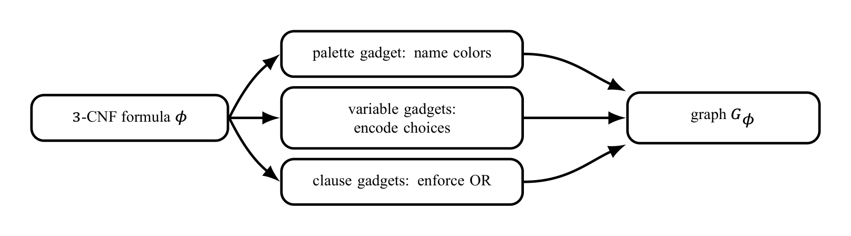
Worked Reduction: 3-SAT reduces to 3-COLOR
Source: 3-SAT
A 3-CNF formula is an AND of clauses, each an OR of three literals:
$$φ=C_{1}∧⋯∧C_{m}.$$
Can a truth assignment satisfy every clause? A literal is a variable or its negation.
Target: 3-COLOR
Can the graph’s vertices be colored with three colors so that adjacent vertices have different colors?
Notes:
Frame 7/17. State the two decision questions before showing the construction. The translator builds the graph without knowing a satisfying assignment.

Slide 18
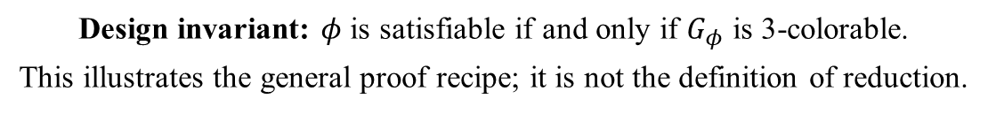
Worked Reduction: 3-SAT reduces to 3-COLOR
Source: 3-SAT
A 3-CNF formula is an AND of clauses, each an OR of three literals:
$$φ=C_{1}∧⋯∧C_{m}.$$
Can a truth assignment satisfy every clause? A literal is a variable or its negation.
Target: 3-COLOR
Can the graph’s vertices be colored with three colors so that adjacent vertices have different colors?
Design invariant: $φ$ is satisfiable if and only if $G_{φ}$ is 3-colorable.
This illustrates the general proof recipe; it is not the definition of reduction.
Notes:
Frame 7/17. State the two decision questions before showing the construction. The translator builds the graph without knowing a satisfying assignment.

Slide 19
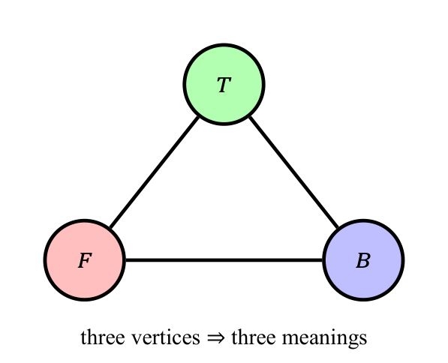

Encoding Truth with Colors
Palette gadget
A triangle forces three distinct colors. Name them $T$, $F$ and $B$ (base/helper).
Three vertices $⇒$ Three meaning
Notes:
Frame 8/17. Ask which color the negated variable must take once xi=T. The names T/F/B are relative to the palette; the physical paint colors can be permuted.

Slide 20
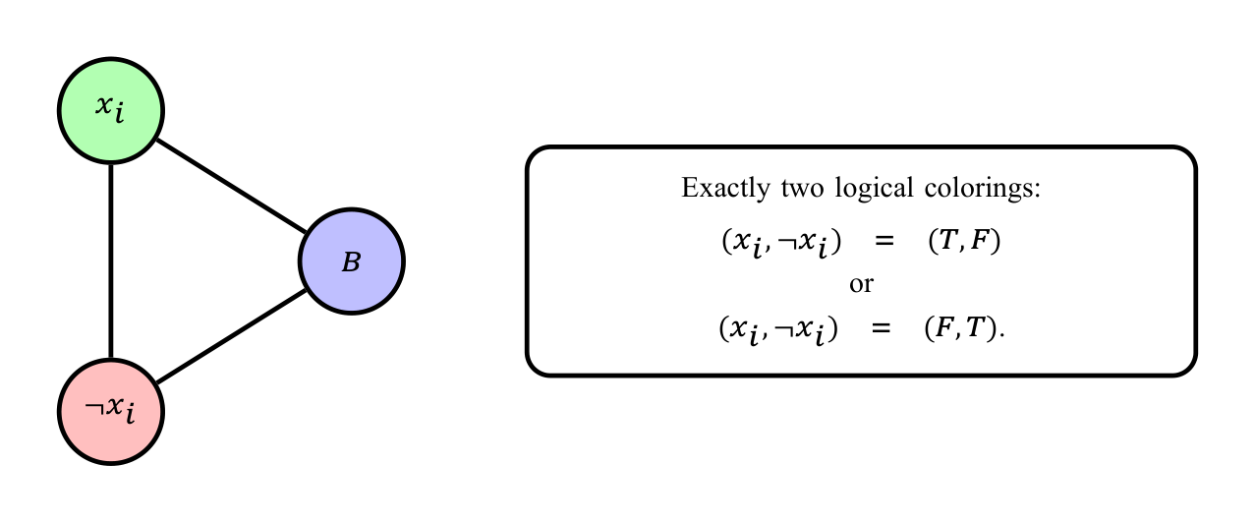

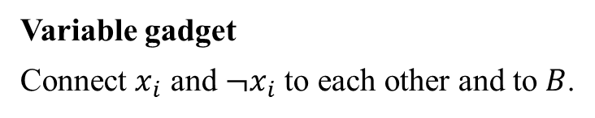
Encoding Truth with Colors
Palette gadget
A triangle forces three distinct colors. Name them $T$, $F$ and $B$ (base/helper).
Variable gadget
Connect $x_{i}$ and $¬x_{i}$ to each other and to $B$.
Three vertices $⇒$ Three meaning
Exactly one of $x_{i}$ and $¬x_{i}$ receives color $T$.
Notes:
Frame 8/17. Ask which color the negated variable must take once xi=T. The names T/F/B are relative to the palette; the physical paint colors can be permuted.

Slide 21
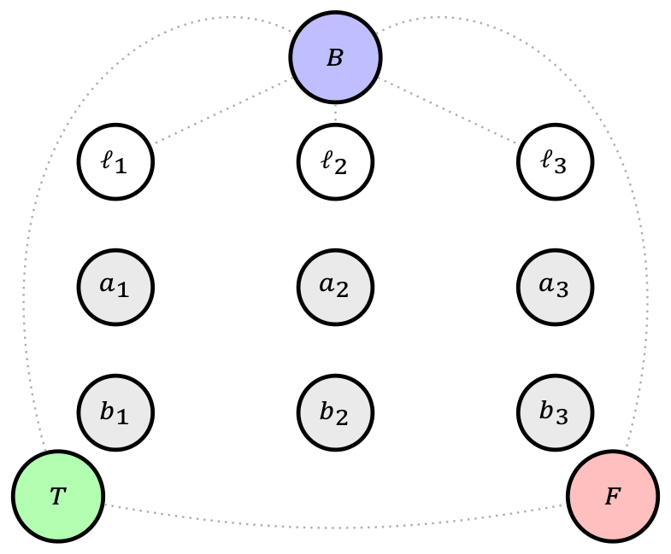
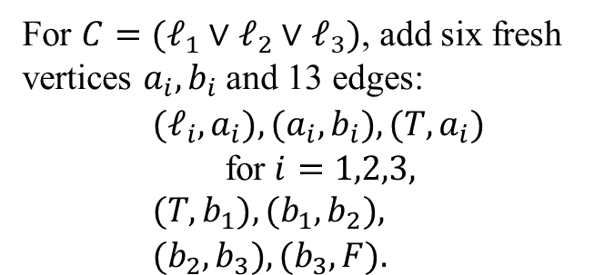
Constructing the Exact Clause Gadget
For $C=(ℓ_{1}∨ℓ_{2}∨ℓ_{3})$, add six fresh vertices $a_{i},b_{i}$ and 13 edges:
$$\begin{aligned}&(ℓ_{i},a_{i}),(a_{i},b_{i}),(T,a_{i}) \\ & \text{for }i=1,2,3, \\ &(T,b_{1}),(b_{1},b_{2}), \\ &(b_{2},b_{3}),(b_{3},F).\end{aligned}$$
Notes:
Frame 9/17. Show the vertices, literal arms, T links, and forcing path in order. Literal vertices already connect to B, so their fixed colors are T/F. Line crossings without a vertex circle are not junctions. The fixed palette edges still exist even when omitted here. The gadget’s result is extendability, not an output vertex color.

Slide 22

Constructing the Exact Clause Gadget
For $C=(ℓ_{1}∨ℓ_{2}∨ℓ_{3})$, add six fresh vertices $a_{i},b_{i}$ and 13 edges:
$$\begin{aligned}&(ℓ_{i},a_{i}),(a_{i},b_{i}),(T,a_{i}) \\ & \text{for }i=1,2,3, \\ &(T,b_{1}),(b_{1},b_{2}), \\ &(b_{2},b_{3}),(b_{3},F).\end{aligned}$$
Notes:
Frame 9/17. Show the vertices, literal arms, T links, and forcing path in order. Literal vertices already connect to B, so their fixed colors are T/F. Line crossings without a vertex circle are not junctions. The fixed palette edges still exist even when omitted here. The gadget’s result is extendability, not an output vertex color.

Slide 23
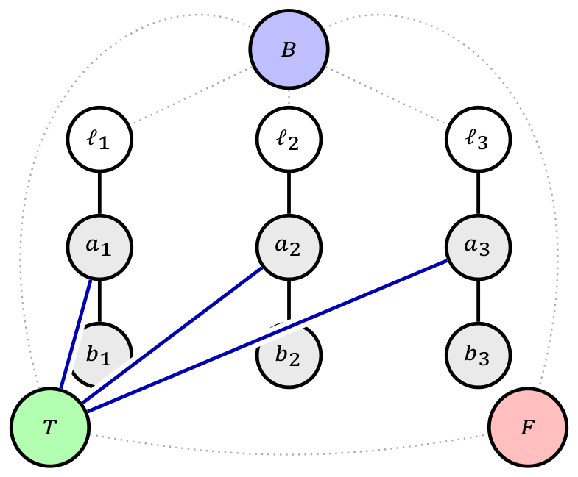
Constructing the Exact Clause Gadget
For $C=(ℓ_{1}∨ℓ_{2}∨ℓ_{3})$, add six fresh vertices $a_{i},b_{i}$ and 13 edges:
$$\begin{aligned}&(ℓ_{i},a_{i}),(a_{i},b_{i}),(T,a_{i}) \\ & \text{for }i=1,2,3, \\ &(T,b_{1}),(b_{1},b_{2}), \\ &(b_{2},b_{3}),(b_{3},F).\end{aligned}$$
Notes:
Frame 9/17. Show the vertices, literal arms, T links, and forcing path in order. Literal vertices already connect to B, so their fixed colors are T/F. Line crossings without a vertex circle are not junctions. The fixed palette edges still exist even when omitted here. The gadget’s result is extendability, not an output vertex color.

Slide 24
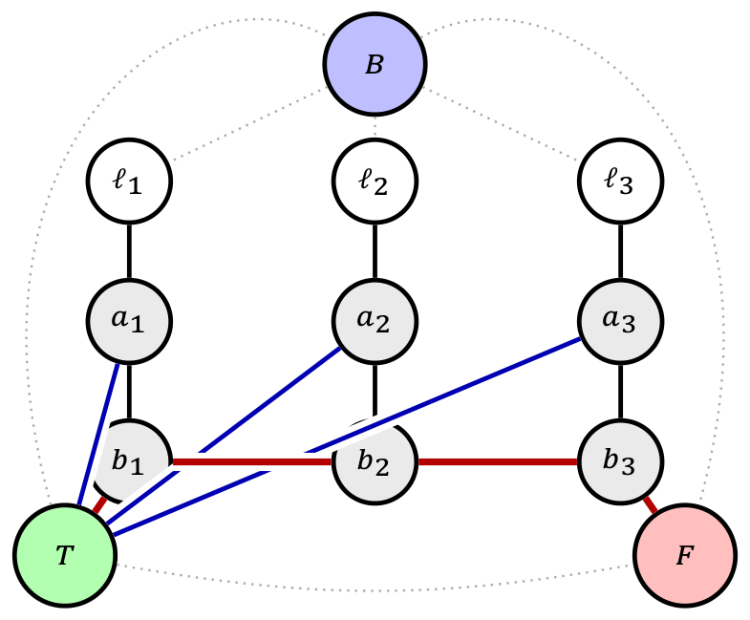
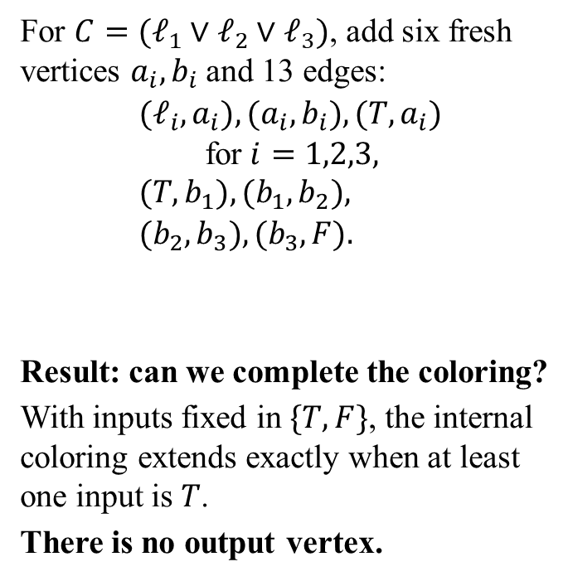
Constructing the Exact Clause Gadget
For $C=(ℓ_{1}∨ℓ_{2}∨ℓ_{3})$, add six fresh vertices $a_{i},b_{i}$ and 13 edges:
$$\begin{aligned}&(ℓ_{i},a_{i}),(a_{i},b_{i}),(T,a_{i}) \\ & \text{for }i=1,2,3, \\ &(T,b_{1}),(b_{1},b_{2}), \\ &(b_{2},b_{3}),(b_{3},F).\end{aligned}$$
Result: can we complete the coloring?
With inputs fixed in $\{T,F\}$, the internal coloring extends exactly when at least one input is $T$.
There is no output vertex.
Black: literal arms. Blue: $T$ links. Red: forcing path. Dotted gray: existing edges.
All lines are ordinary edges. White/gray vertices are unassigned, not extra colors.
Notes:
Frame 9/17. Show the vertices, literal arms, T links, and forcing path in order. Literal vertices already connect to B, so their fixed colors are T/F. Line crossings without a vertex circle are not junctions. The fixed palette edges still exist even when omitted here. The gadget’s result is extendability, not an output vertex color.

Slide 25
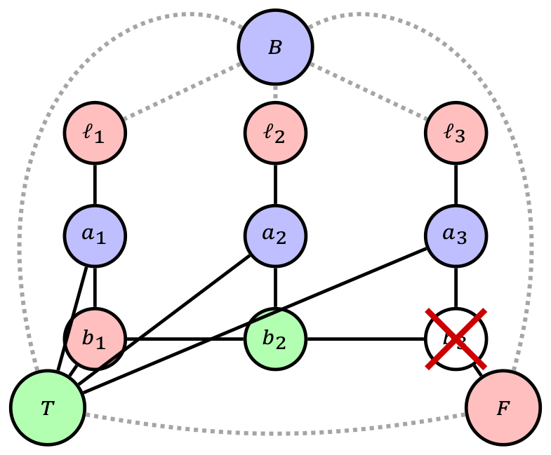
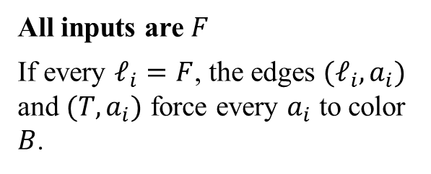
Why the Clause Gadget Encodes OR: Impossible Case
All inputs are $F$
If every $ℓ_{i}=F$, the edges $(ℓ_{i},a_{i})$ and $(T,a_{i})$ force every $a_{i}$ to color $B$.
Full clause gadget plus palette.
Notes:
Frame 10/17. The crossed white b3 means no legal color remains: its neighbors a3, b2, and F already use B, T, and F. White is unassigned, not a fourth color. Equivalently the forced path would demand b3=F and clash with the palette F. The drawing shows a failed partial coloring, not a valid coloring. Line crossings without vertex circles are not junctions.

Slide 26
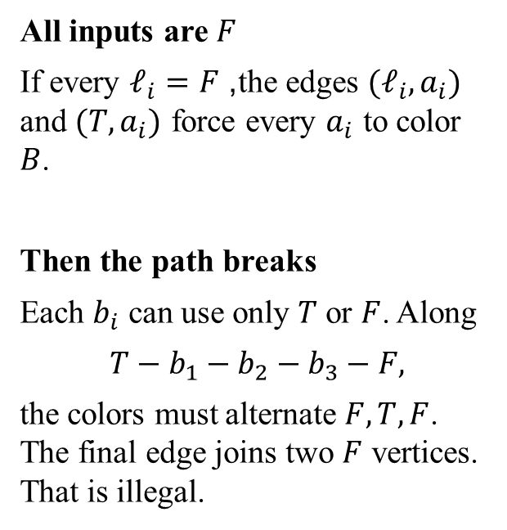
Why the Clause Gadget Encodes OR: Impossible Case
All inputs are $F$
If every $ℓ_{i}=F$, the edges $(ℓ_{i},a_{i})$ and $(T,a_{i})$ force every $a_{i}$ to color $B$.
Then the path breaks
Each $b_{i}$ can use only $T$ or $F$. Along
$$T−b_{1}−b_{2}−b_{3}−F,$$
the colors must alternate $F,T,F$. The final edge joins two $F$ vertices. That is illegal.
Full clause gadget plus palette.
Notes:
Frame 10/17. The crossed white b3 means no legal color remains: its neighbors a3, b2, and F already use B, T, and F. White is unassigned, not a fourth color. Equivalently the forced path would demand b3=F and clash with the palette F. The drawing shows a failed partial coloring, not a valid coloring. Line crossings without vertex circles are not junctions.

Slide 27
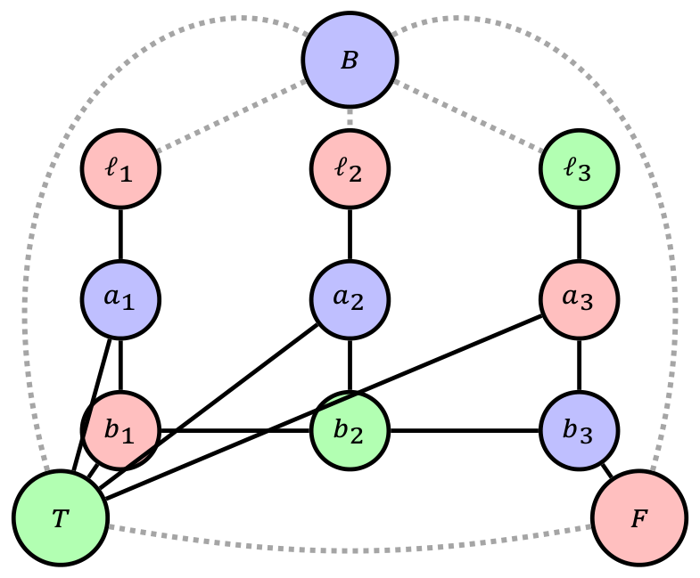
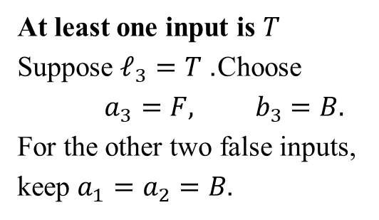
Why the Clause Gadget Encodes OR: Possible Case
At least one input is $T$
Suppose $ℓ_{3}=T$. Choose
$$a_{3}=F, b_{3}=B.$$
For the other two false inputs,
keep $a_{1}=a_{2}=B$.
Full clause gadget plus palette.
Notes:
Frame 11/17. The picture is the FFT example. To justify all satisfying patterns, choose any true input i, set ai=F and bi=B, and every other aj=B (legal even when another literal is true). Complete (b1,b2,b3) as (B,F,T) for i=1, (F,B,T) for i=2, or (F,T,B) for i=3. Verify the literal arms, T-links and path edges. Thus the example supports a general construction, not merely an assertion based on one truth pattern.

Slide 28
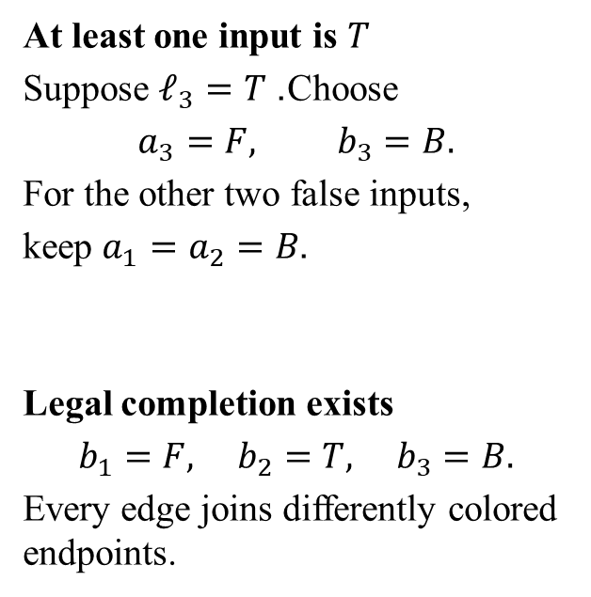
Why the Clause Gadget Encodes OR: Possible Case
At least one input is $T$
Suppose $ℓ_{3}=T$. Choose
$$a_{3}=F, b_{3}=B.$$
For the other two false inputs,
keep $a_{1}=a_{2}=B$.
Legal completion exists
$$b_{1}=F, b_{2}=T, b_{3}=B.$$
Every edge joins differently colored endpoints.
Full clause gadget plus palette.
Notes:
Frame 11/17. The picture is the FFT example. To justify all satisfying patterns, choose any true input i, set ai=F and bi=B, and every other aj=B (legal even when another literal is true). Complete (b1,b2,b3) as (B,F,T) for i=1, (F,B,T) for i=2, or (F,T,B) for i=3. Verify the literal arms, T-links and path edges. Thus the example supports a general construction, not merely an assertion based on one truth pattern.

Slide 29
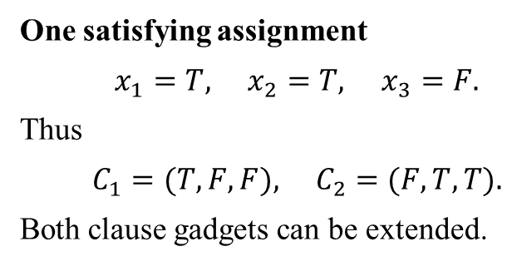
Evaluating One Complete Formula
$$φ=(x_{1}∨¬x_{2}∨x_{3})∧(¬x_{1}∨x_{2}∨¬x_{3}).$$
Clause input ports
$$C_{1}:(x_{1},¬x_{2},x_{3}),$$
$$C_{2}:(¬x_{1},x_{2},¬x_{3}).$$
Each clause receives its own six fresh internal vertices.
One satisfying assignment
$$x_{1}=T, x_{2}=T, x_{3}=F.$$
Thus
$$C_{1}=(T,F,F), C_{2}=(F,T,T).$$
Both clause gadgets can be extended.
Notes:
Frame 12/17. Evaluate both clauses under the displayed assignment. This assignment illustrates satisfiability after construction; the reduction need not discover it to build the graph.

Slide 30
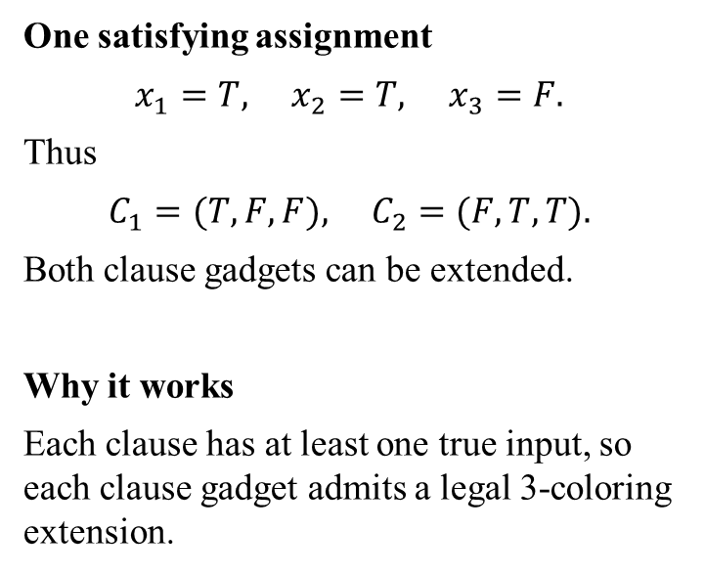
Evaluating One Complete Formula
$$φ=(x_{1}∨¬x_{2}∨x_{3})∧(¬x_{1}∨x_{2}∨¬x_{3}).$$
Clause input ports
$$C_{1}:(x_{1},¬x_{2},x_{3}),$$
$$C_{2}:(¬x_{1},x_{2},¬x_{3}).$$
Each clause receives its own six fresh internal vertices.
One satisfying assignment
$$x_{1}=T, x_{2}=T, x_{3}=F.$$
Thus
$$C_{1}=(T,F,F), C_{2}=(F,T,T).$$
Both clause gadgets can be extended.
Why it works
Each clause has at least one true input, so each clause gadget admits a legal 3-coloring extension.
Notes:
Frame 12/17. Evaluate both clauses under the displayed assignment. This assignment illustrates satisfiability after construction; the reduction need not discover it to build the graph.

Slide 31
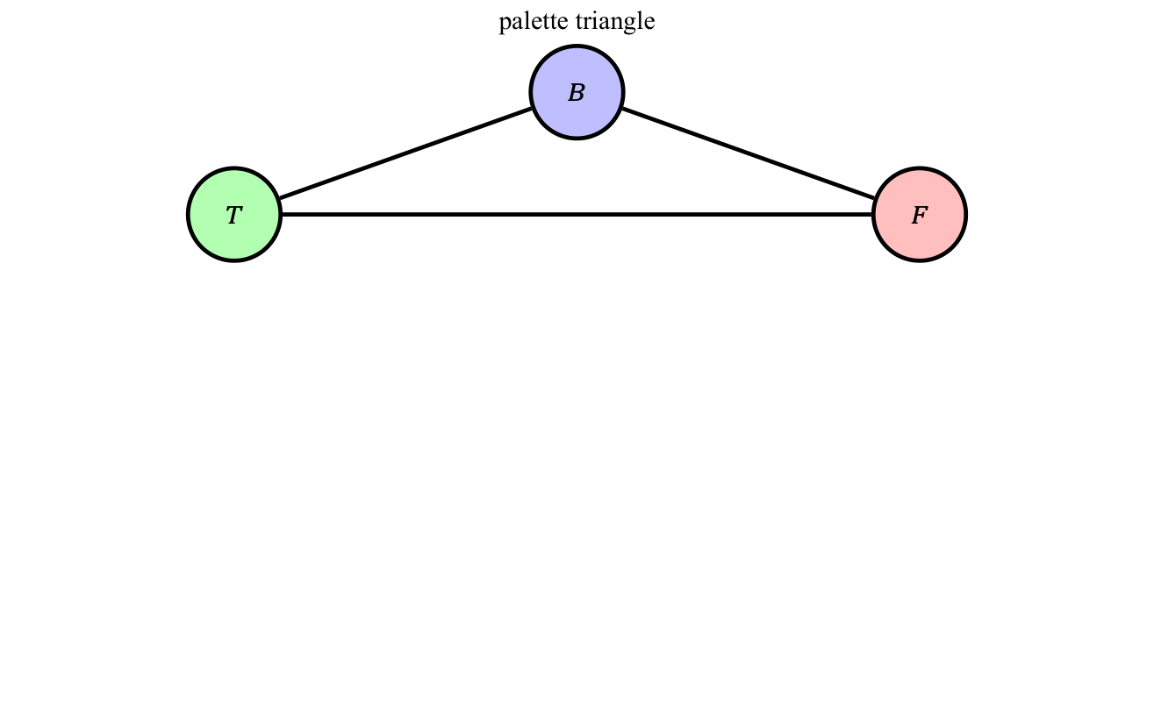
Assembling the Formula Graph
Notes:
Frame 13/17. This is an assembly schematic: the boxes represent copies of the exact gadget already proved. Shared literals enforce a consistent assignment across clauses. Each copy also uses palette T and F. No edges between distinct clauses’ internal vertices are needed.

Slide 32
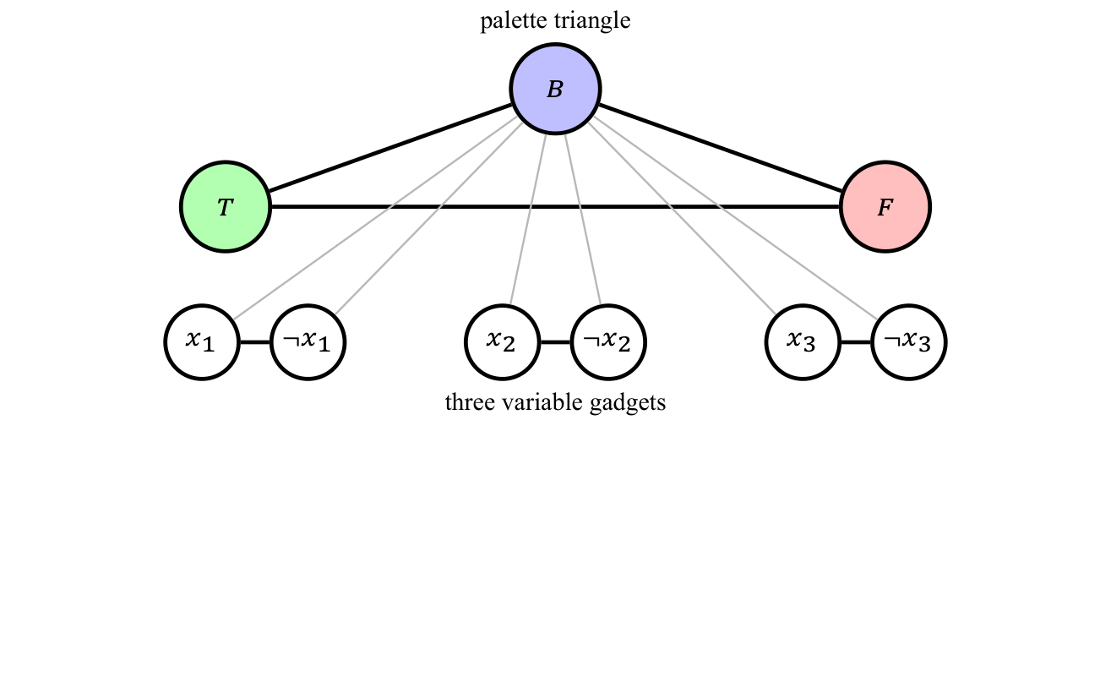
Assembling the Formula Graph
Notes:
Frame 13/17. This is an assembly schematic: the boxes represent copies of the exact gadget already proved. Shared literals enforce a consistent assignment across clauses. Each copy also uses palette T and F. No edges between distinct clauses’ internal vertices are needed.

Slide 33
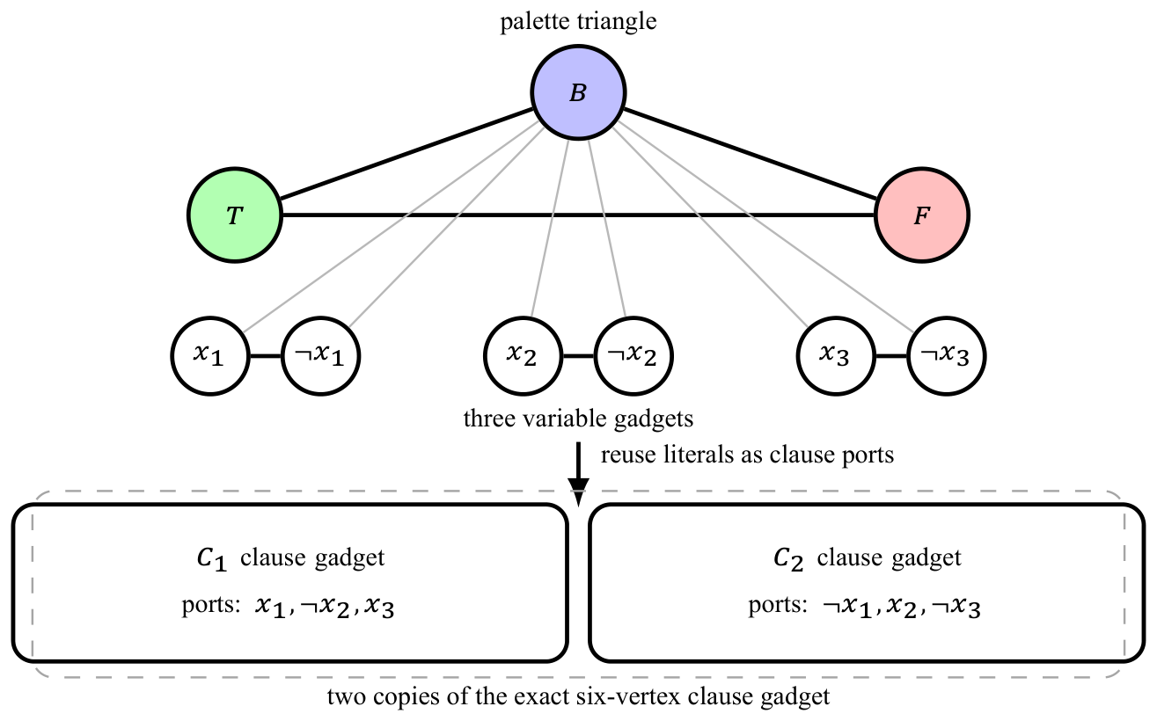
Assembling the Formula Graph
The palette and literal vertices are shared; each clause has fresh internal vertices.
Notes:
Frame 13/17. This is an assembly schematic: the boxes represent copies of the exact gadget already proved. Shared literals enforce a consistent assignment across clauses. Each copy also uses palette T and F. No edges between distinct clauses’ internal vertices are needed.

Slide 34
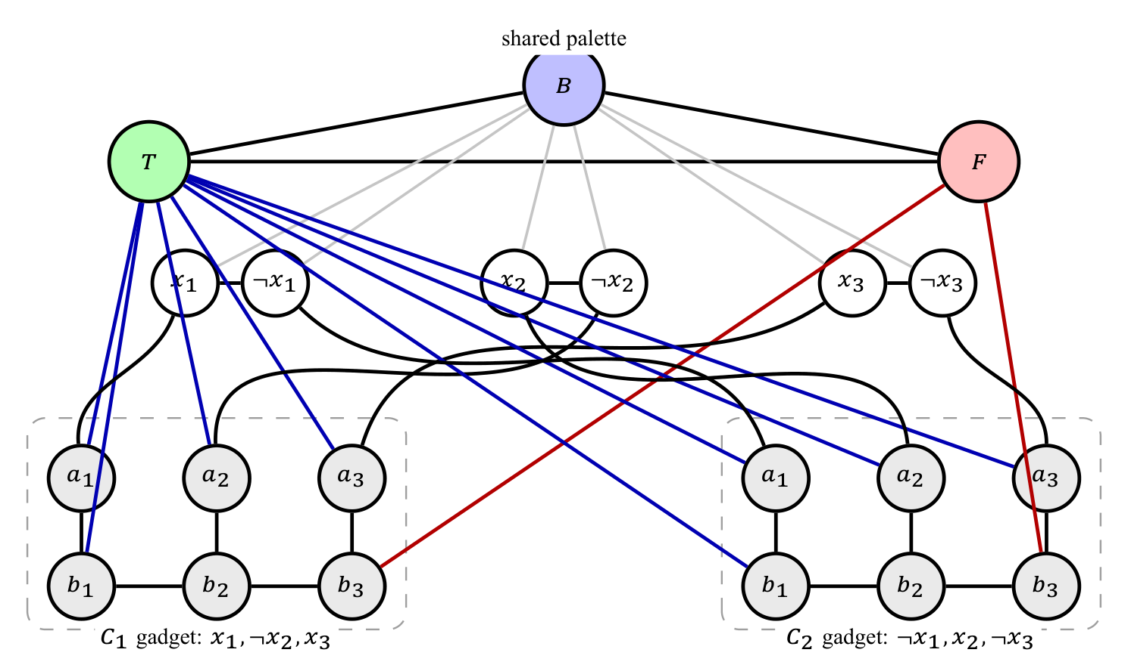
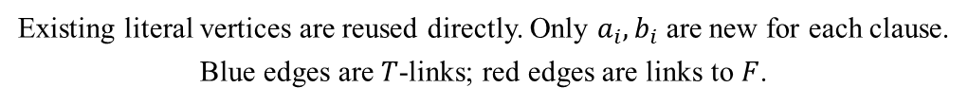
Full Construction for the Two Clauses
Existing literal vertices are reused directly. Only $a_{i},b_{i}$ are new for each clause.
Blue edges are $T$-links; red edges are links to $F$.
Notes:
Frame 14/17. Trace C1 ports x1, not-x2, x3 and C2 ports not-x1, x2, not-x3. Palette and variable vertices are shared, while each clause has six private internal vertices. There are 21 vertices and 38 edges for n=3,m=2. Crossings without circles are not vertices; repeated a/b labels are local to each dashed clause box. This full graph is uncolored at its variable/internal vertices, not a claim that gray is a fourth color.

Slide 35
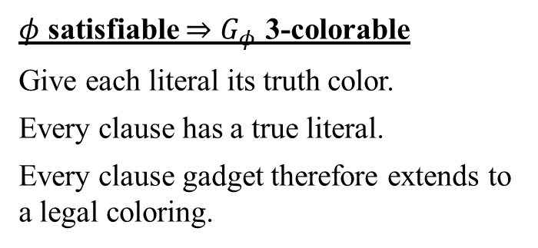
Correctness and Complexity of the Reduction
$φ$ satisfiable $⇒G_{φ}$ 3-colorable
Give each literal its truth color.
Every clause has a true literal.
Every clause gadget therefore extends to a legal coloring.
Notes:
Frame 15/17. State both directions, then the counts. Palette: three vertices/edges. Each variable: two vertices and three edges. Each clause: six vertices and thirteen edges. Verification is O(V+E); with NP-hardness this proves 3-COLOR NP-complete. Linear many graph records can require logarithmic-size vertex indices in a bit encoding.

Slide 36
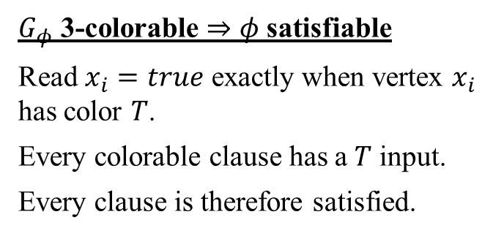
Correctness and Complexity of the Reduction
$φ$ satisfiable $⇒G_{φ}$ 3-colorable
Give each literal its truth color.
Every clause has a true literal.
Every clause gadget therefore extends to a legal coloring.
$G_{φ}$ 3-colorable $⇒φ$ satisfiable
Read $x_{i}=true$ exactly when vertex $x_{i}$ has color $T$.
Every colorable clause has a $T$ input.
Every clause is therefore satisfied.
Notes:
Frame 15/17. State both directions, then the counts. Palette: three vertices/edges. Each variable: two vertices and three edges. Each clause: six vertices and thirteen edges. Verification is O(V+E); with NP-hardness this proves 3-COLOR NP-complete. Linear many graph records can require logarithmic-size vertex indices in a bit encoding.

Slide 37
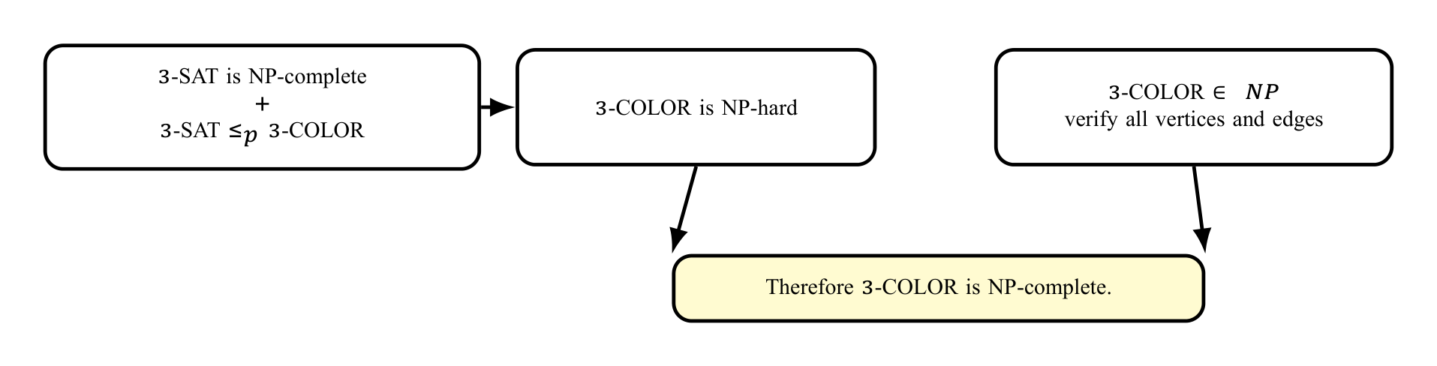
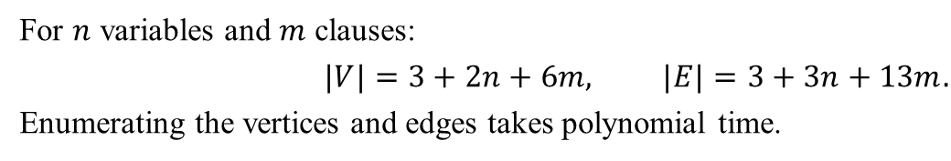
Correctness and Complexity of the Reduction
$φ$ satisfiable $⇒G_{φ}$ 3-colorable
Give each literal its truth color.
Every clause has a true literal.
Every clause gadget therefore extends to a legal coloring.
$G_{φ}$ 3-colorable $⇒φ$ satisfiable
Read $x_{i}=true$ exactly when vertex $x_{i}$ has color $T$.
Every colorable clause has a $T$ input.
Every clause is therefore satisfied.
For $n$ variables and $m$ clauses:
$$|V|=3+2n+6m, |E|=3+3n+13m.$$
Enumerating the vertices and edges takes polynomial time.
Notes:
Frame 15/17. State both directions, then the counts. Palette: three vertices/edges. Each variable: two vertices and three edges. Each clause: six vertices and thirteen edges. Verification is O(V+E); with NP-hardness this proves 3-COLOR NP-complete. Linear many graph records can require logarithmic-size vertex indices in a bit encoding.

Slide 38
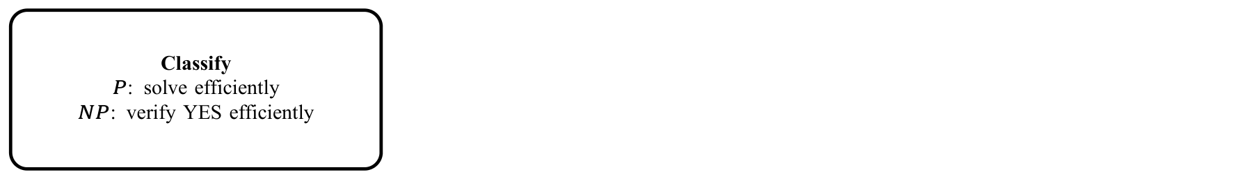
Takeaway
Notes:
Frame 16/17. End with the proof recipe. If time permits, ask students which reduction direction proves B hard: A to B or B to A? Answer: known-hard A to target B.

Slide 39
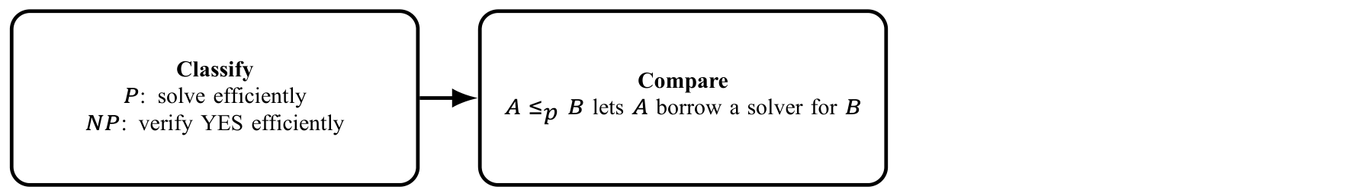
Takeaway
Notes:
Frame 16/17. End with the proof recipe. If time permits, ask students which reduction direction proves B hard: A to B or B to A? Answer: known-hard A to target B.

Slide 40
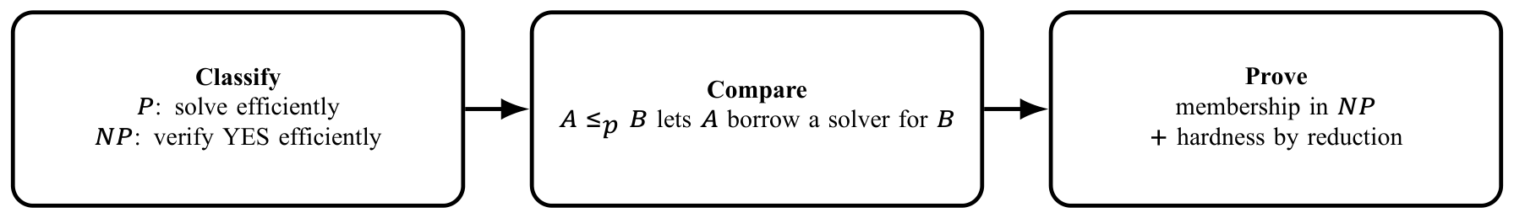
Takeaway
Notes:
Frame 16/17. End with the proof recipe. If time permits, ask students which reduction direction proves B hard: A to B or B to A? Answer: known-hard A to target B.

Slide 41
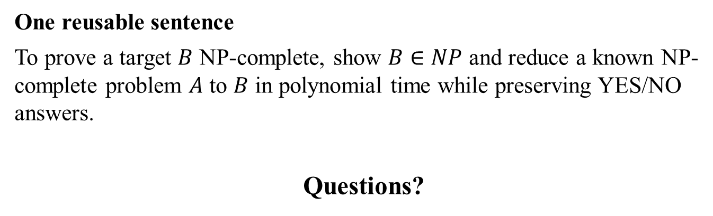
Takeaway
One reusable sentence
To prove a target $B$ NP-complete, show $B∈NP$ and reduce a known NP-complete problem $A$ to $B$ in polynomial time while preserving YES/NO answers.
Questions?
Notes:
Frame 16/17. End with the proof recipe. If time permits, ask students which reduction direction proves B hard: A to B or B to A? Answer: known-hard A to target B.

Slide 42
References
Primary references
Michael Sipser, Introduction to the Theory of Computation.
Cormen, Leiserson, Rivest and Stein, Introduction to Algorithms.
CMU 15-451/651 lecture notes on NP-completeness.
Princeton COS 423 lecture notes, Polynomial-Time Reductions.
The exact six-vertex clause gadget and its 13-edge construction follow the Princeton reduction notes.
Notes:
Frame 17/17. Acknowledge the sources; do not read the bibliography aloud. Timing is across all reveals within each frame and leaves no discussion time. Allow substantially longer for a full first lesson.

