Slide 1
Scheduling, not just dose
The order of sun exposure changes how much UV darker skin needs
Ahaan Nigam¹, Rabira Tusi², Pulkit Grover², [Fourth Author]²
¹Independent researcher · ahaannigam27@gmail.com
²Carnegie Mellon University · rtusi@cmu.edu · pulkitgrover@cmu.edu
CMU BME Forum 2026 · Nigam, Tusi, Grover
Notes:
Public health guidance tells you to get regular sun for vitamin D. It tells you roughly how long. It never tells you when. I'm going to show you that for the same annual amount of ultraviolet, the order of the sessions is worth about a third of the total dose, and that the saving is largest for the darkest skin.

Slide 2
Three coupled states
D(t)
serum 25(OH)D
Serum 25(OH)D
g(D)
feedback
what the schedule has to hold above 50 nmol/L
synthesis
attenuates
Melanin index
UV session (SED)
tanning
M(t)
melanin index
tans under UV, then suppresses the next session
thickening
Stratum corneum
SC(t)
stratum corneum
thickens under UV, on a slower clock
M and SC relax between sessions
CMU BME Forum 2026 · Nigam, Tusi, Grover
Notes:
So we built a three-state model: serum 25-hydroxyvitamin D, a melanin index, and stratum corneum thickness, all coupled. Ultraviolet drives synthesis, and the same ultraviolet drives the two attenuating states that suppress future synthesis. Synthesis is logarithmic in dose, scaled by exposed body surface area, attenuated multiplicatively by constitutive pigment, by the facultative tan, and by the stratum corneum, then inhibited by homeostatic feedback from circulating D itself. Between sessions all three states relax analytically; each session applies a saturating jump.

Slide 3
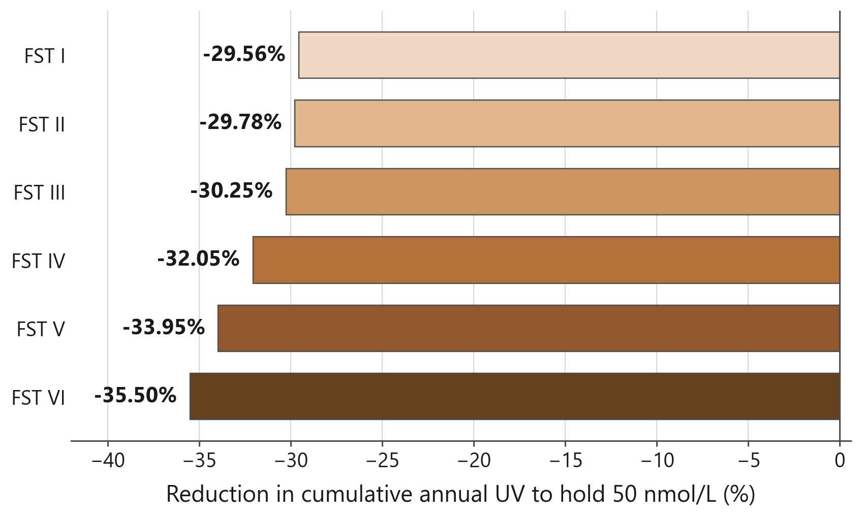
Same sessions. Same limits. 30–36% less UV.
−29.56% at FST I
lightest skin
−35.50% at FST VI
darkest skin
−42.41% at a 183-session budget
tighter budget, larger saving
CMU BME Forum 2026 · Nigam, Tusi, Grover
Notes:
Here's the result. Same number of sessions, same erythema ceiling, same sufficiency floor. Only the order changes. Front-loading cuts the cumulative ultraviolet required by twenty-nine and a half percent at Fitzpatrick type one, and thirty-five and a half percent at type six. The saving grows monotonically with pigmentation, and at tighter session budgets it reaches forty-two percent for type six.

Slide 4
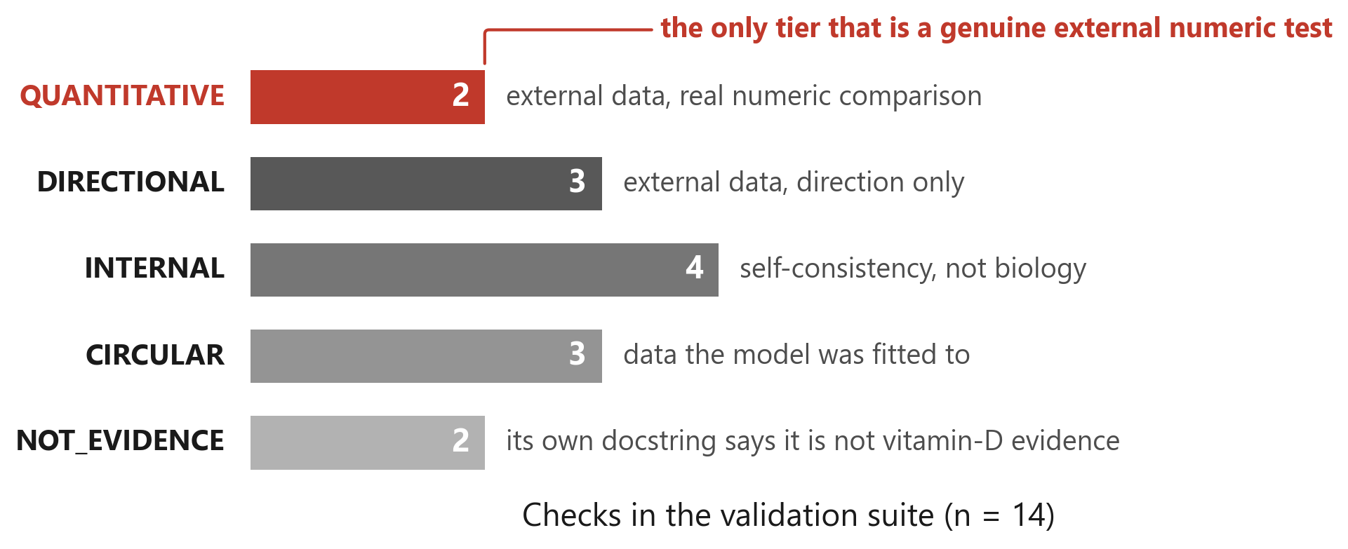
What this does and does not show
14/14 checks — 2 are external and quantitative
The one held-out test fails
The ranking transfers; the minutes don't yet
four internal, three direction-only, three circular, two not vitamin-D evidence
Webb/Kift 2018, FST V : FST II, 3.01× against a reported 2.5–3.0×
stratum-corneum priors are uncalibrated
CMU BME Forum 2026 · Nigam, Tusi, Grover
Notes:
Now the limits, because they matter more than the result. Our pipeline reports fourteen of fourteen validation checks passing, and that number is close to meaningless on its own. We tier every check by what it actually tests: four are internal self-consistency, three are direction-only, three are circular against data we fitted to, and two are labelled in their own source as not vitamin D evidence. Two are genuine external quantitative comparisons. Our one fully held-out test fails, by half a percent, sitting between two published lamp studies that disagree with each other by a factor of two. Absolute minutes are not a dosing instruction yet. What transfers is the ranking: the order of exposure is a free variable, it's worth about a third of the dose, and it helps the people who need the most sun the most. Thank you.

