Slide 1



RESUME PROJECT CHALLENGE #13

Slide 2
CONTENTS
INTRODUCTION
PROBLEM STATEMENT
PRIMARY AND SECONDARY ANALYSIS QUESTIONS
AD-HOC REQUESTS
DASHBOARDS
DASHBOARD INSIGHTS
RECOMENDATIONS

Slide 3
INTRODUCTION
GoodCabs, a cab service company established two years ago, has gained a strong foothold in the Indian market by focusing on tier-2 cities. It primarily serves two types of cities in India: tourism-based and business-based cities. The company is committed to supporting local drivers, helping them earn a sustainable living in their hometowns while providing excellent service to passengers. GoodCabs continually strives to grow and improve passenger satisfaction.
It primarily operates in:
Tourism-based cities: Jaipur, Mysore, Chandigarh, Kochi
Business-based cities: Surat, Vadodara, Coimbatore, Indore, Lucknow, Visakhapatnam

Slide 4
PROBLEM STATEMENT
The CEO of the company Bruce Haryali want to assess the company’s performance using key metrics:
Trip volume
Revenue Growth
Passenger satisfaction
Repeat passenger rate
Trip distribution
Balance between new and repeat passengers

Slide 5


PRIMARY AND SECONDARY ANALYSIS QUESTIONS

Slide 6
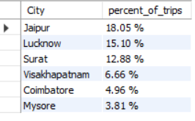
QUESTION 1:
IDENTIFY THE TOP 3 AND BOTTOM 3 CITIES BY TOTAL TRIPS OVER THE ENTIRE ANALYSIS PERIOD.
INSIGHTS:
The maximum percent of trips are coming from a tourism based city whereas second and third cities are business based.

Slide 7
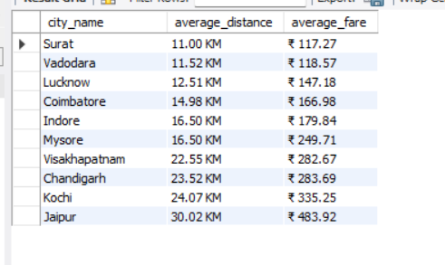


QUESTION 2:
CALCULATE THE AVERAGE FARE PER TRIP FOR EACH CITY AND COMPARE IT WITH THE CITY'S AVERAGE TRIP DISTANCE.
IDENTIFY THE CITIES WITH THE HIGHEST AND LOWEST AVERAGE FARE PER TRIP TO ASSESS PRICING EFFICIENCY ACROSS LOCATIONS.
INSIGHTS:
There is a positive correlation between the average fare and the average distance. There is a deviation in Indore and Mysore, where the same average distance has a different average fare. Tourism-based cities have high-distance trips, whereas business-based cities tend to have shorter trips.

Slide 8


QUESTION 3:
CALCULATE THE AVERAGE PASSENGER AND DRIVER RATING FOR EACH CITY,SEGMENTED,BY PASSENGER TYPE
(NEW VS REPEAT).IDENTIFY THE CITIES WITH HIGHEST AND LOWEST AVERAGE RATINGS..
INSIGHTS:
Passengers in Vadodara are not very happy, possibly due to issues like limited service availability or inconsistent quality of rides. On the other hand, drivers in Surat show dissatisfaction, which might stem from low earnings, unfair ride distribution, or longer waiting times.

Slide 9
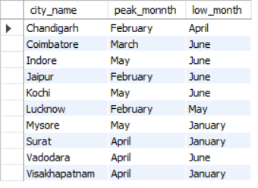
QUESTION 4:
PEAK AND LOW DEMAND MONTHS BY CITY.FOR EACH CITY IDENTIFY THE MONTH WITH THE HIGHEST TOTAL TRIPS(PEAK DEMAND) AND THE MONTH WITH LOWEST TRIPS(LOW DEMAND).THIS ANALYSIS WILL HELP GOOD CABS TO UNDERSTAND SEASONAL PATTERNS AND ADJUST RESOURCES-- ACCORDINGLY.
INSIGHTS:
We can see that the trip demand is higher mainly in the months of February, May, and April, whereas the low-demand months are January and June.

Slide 10
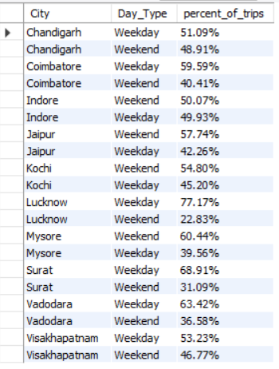
QUESTION 5:
WEEKEND VS WEEKDAY TRIP DEMAND BY CITY
INSIGHTS:
We can see that there is a balance between weekend and weekday trips in some cities, whereas in tourism-based cities like Jaipur,Kochi,Mysore weekend trips are higher than weekday trips. However, in Lucknow, Surat, and Vadodara, we observe a significant difference, with the majority of trips occurring on weekdays.

Slide 11
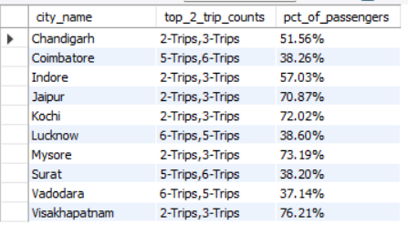
QUESTION 6:
REPEAT PASSENGER FREQUENCY AND CITY CONTRIBUTIONS ANALYSIS. ANALYSE THE FREQUECY OF TRIPS TAKEN BY REPEAT PASSENGERS IN EACH CITY. PERCENT OF REPEAT PASSENGERS TAKING 2 TRIPS,3 TRIPS ETC
INSIGHTS:
We can see that Coimbatore, Lucknow, Surat, and Vadodara have a more loyal customer base, with the top two trip contributions coming from '5-Trips' and '6-Trips' monthly. Customers are enjoying the GoodCabs services.

Slide 12
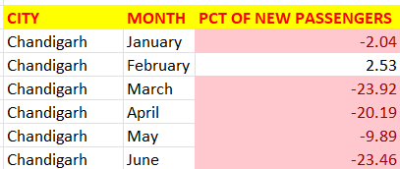
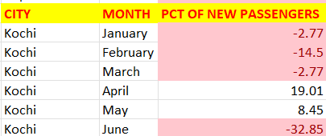
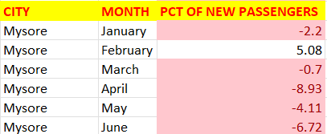
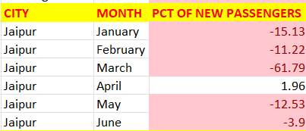
QUESTION 7:
MONTHLY TARGET ACHIEVEMENTS ANALSIS OF NEW PASSENGERS:
TOURISM BASED CITIES
INSIGHTS:
We can see that the acquisition is not going well for GoodCabs, as they are failing to achieve their targets in tourism based cities. However, some improvement is observed in February, April, and May.

Slide 13
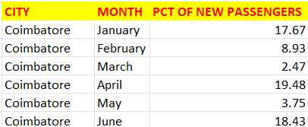
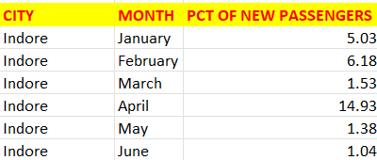
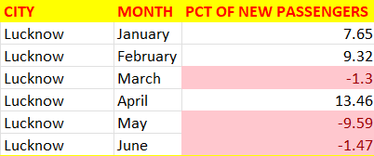
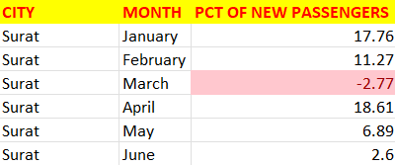
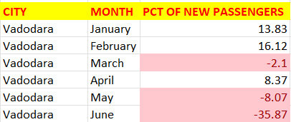
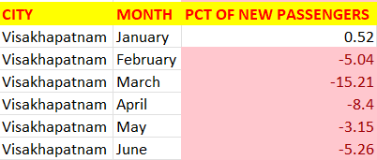
BUSSINESS BASED CITIES:
INSIGHTS:
Coimbatore, Indore, and Surat are performing well, whereas Lucknow and Vadodara are struggling in March, May, and June. Vishakapatnam needs close attention, as new passengers are not opting for GoodCabs.

Slide 14
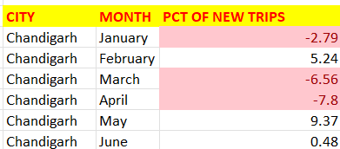
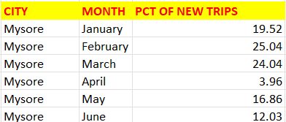
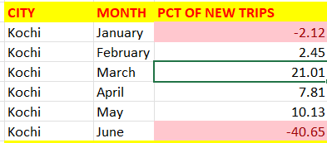
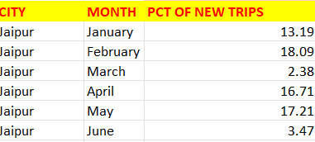
MONTHLY TARGET ACHIEVEMENTS ANALYSIS OF TRIPS:
TOURISM BASED CITIES
INSIGHTS:
Mysore and Jaipur are full filling their targets,whereas Chandigarh,Kochi need to improve.

Slide 15
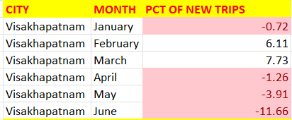
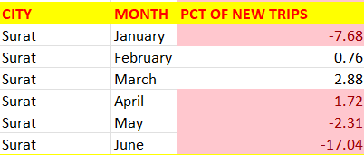
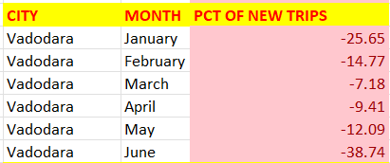
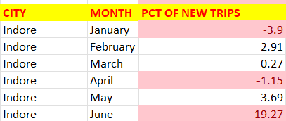
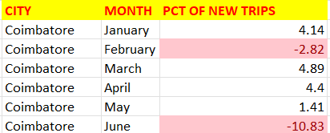
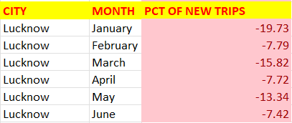
BUSSINESS BASED CITIES
INSIGHTS:
Lucknow and Vishakapatnam need attention, as there may be a lack of services during peak hours or poor route optimization. Revising the pricing strategy and improving service availability during high-demand periods could help address these issues

Slide 16
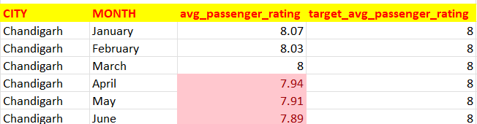
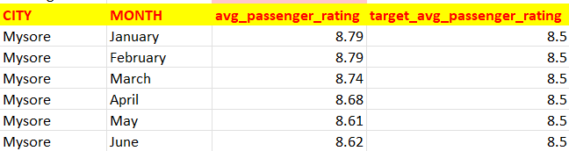
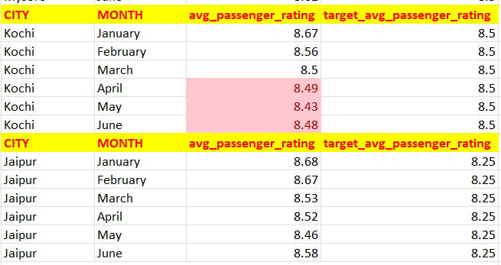
MONTHLY TARGET ACHIEVEMENTS ANALYSIS OF AVERAGE PASSENGER RATING:
TOURISM BASED CITIES
INSIGHTS:
Chandigarh and Kochi need to focus on improving customer satisfaction. Additionally, a noticeable trend is observed only in April, May, and June.

Slide 17
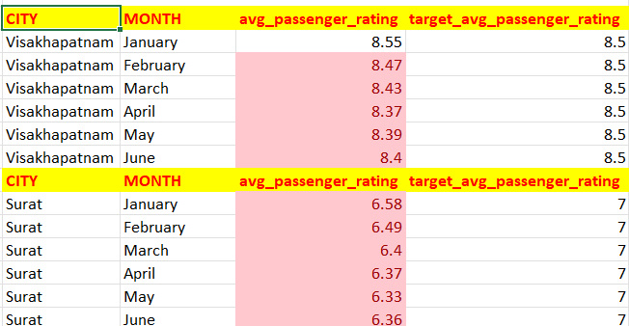
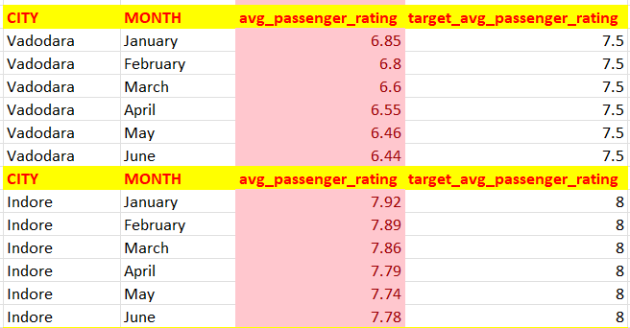
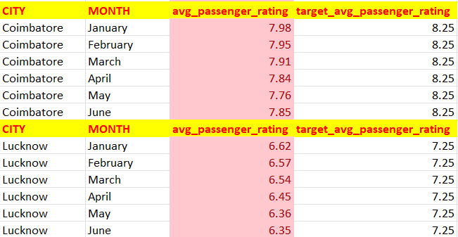
MONTHLY TARGET ACHIEVEMENTS ANALYSIS OF AVERAGE PASSENGER RATING:
BUSSINESS BASED CITIES
INSIGHTS:
The daily commuters are not satisfied with the cab service.

Slide 18
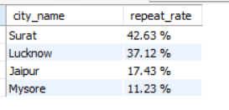
QUESTION 8:
HIGHEST AND LOWEST REPEAT PASSENGER RATE FOR EACH CITY ACROSS THE SIX MONTH PERIOD.IDENTIFY THE TOP 2 AND BOTTOM 2 CITIES BASED ON THEIR RPR TO DETERMINE THE LOCATIONS HAVE THE STRONGEST AND WEAKEST RATES.
INSIGHTS: The two business based cities has the strongest passenger repeat rate.The daily commuters are preferring GoodCabs.

Slide 19
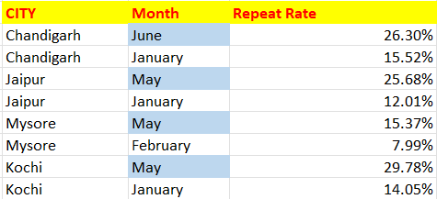
SIMILARLY ANALYSE THE RPR% FOR MONTHS ACROSS ALL CITIES AND IDENTIFY THE MONTHS WITH HIGHEST AND LOWEST RPR ACROSS EACH CITY.
TOURISM BASED CITIES
INSIGHTS:
Here, we observe an interesting trend tourists are returning to GoodCabs in May and June, whereas January and February have the lowest RPR%.

Slide 20
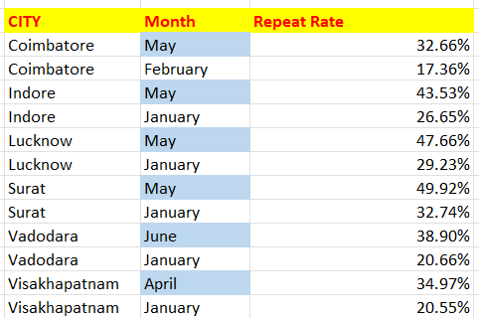
BUSSINESS BASED CITIES
INSIGHTS:
Similarly for business based cities we can observe the similar trend of repeat RPR%

Slide 21
AD-HOC REQUESTS

Slide 22
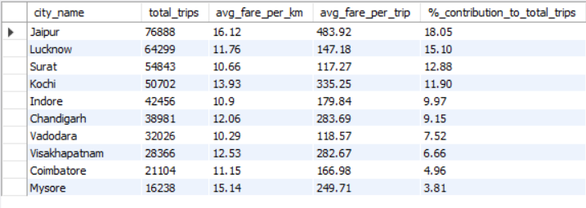
REQUEST 1:
GENERATE A REPORT THAT DISPLAYS THE TOTAL TRIPS,AVERAGE FARE PER KM,AVERAGE FARE PER TRIP AND THE PERCENTAGE CONTRIBUTION OF EACH CITY'S TRIP.
THIS REPORT WILL HELP IN ASSESSING TRIP,VOLUME,PRICING EFFICIENCY,AND EACH CITY'S CONTRIBUTION TO OVERALL TRIP COUNT.
FIELDS:
city_name
total_trips
avg_fare_per_km
avg_fare_per_trip
%_contribution_to_total_trips.

Slide 23
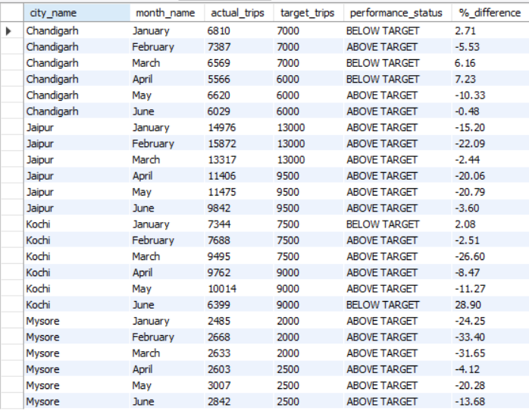
REQUEST 2:
GENERATE A REPORT THAT EVALUATES THE TARGET PERFORMANCE FOR TRIPS AT THE MONTHLY AND CITYLEVEL.
FOR EACH CITY AND MONTH AND COMPARE THE ACTUAL TOTAL TRIPS WITH THE TARGET TRIPS AND CATEGORISE THE PERFROMANCE AS FOLLOWS .
IF ACTUAL TRIPS ARE GREATER THAN TARGET TRIPS,MARK IT AS "ABOVE TARGET".
IF ACTUAL TRIPS ARE LESSER THAN TARGET TRIPS ,MARK IT AS "BELOW TARGET“.
FIELDS:
city_name
month_name
actual_trips
target_trips
performance_status
%_difference
TOURISM BASED CITY

Slide 24
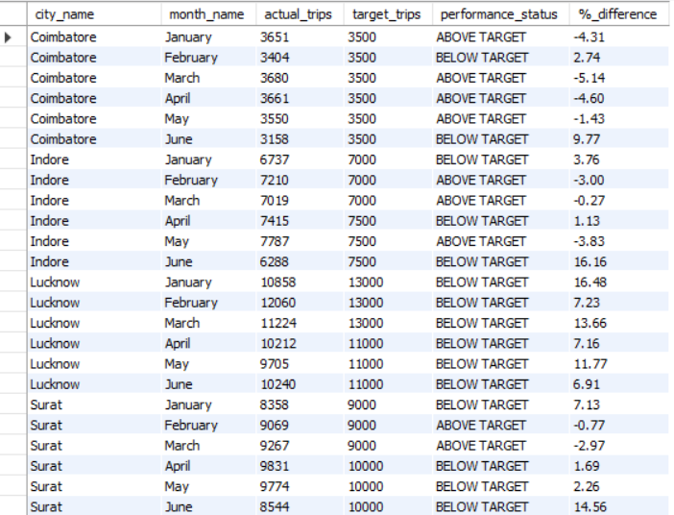
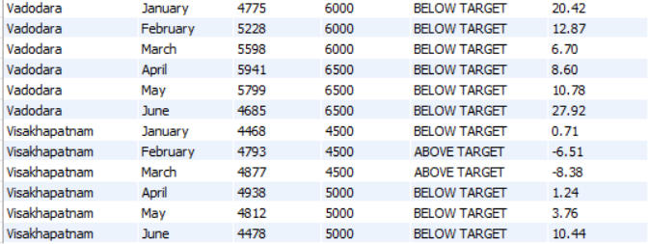
BUSSINESS BASED CITIES

Slide 25
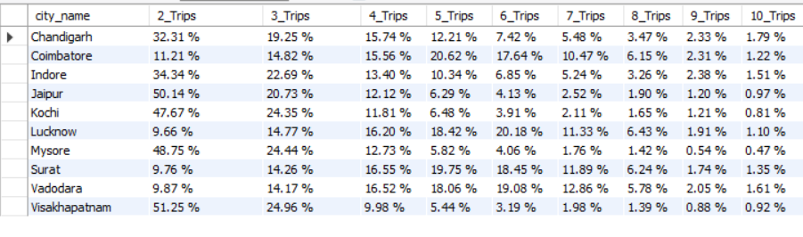










REQUEST-3:
CITY-LEVEL REPEAT PASSENGER TRIP FREQUENCY REPORT.GENERATE A REPORT THAT SHOWS THE PERCENTAGE DISTRIBUTON OF REPEAT PASSENGERS BY THE NO OF TRIPS THEY HAVE TAKEN IN EACH CITY.CALCULATE THE PERCENTAGE OF REPEAT CUSTOMERS WHO TOOK 2-TRIPS,3-TRIPS,.. AND SO ON.EACH COLUMN SHOULD REPRESENT A TRIP COUNT CATEGORY,DISPLAING THE PERCENTAGE OF REPEAT PASSENGERS WHO FALL INTO THAT CATEGORYOUT OF TOTAL REPEAT PASSENGERS FOR THAT CITY.
FIELDS:
city_name
2-trips
3-trips
4-trips6-trips
7-trips8-trips
9-trips
10-trips

Slide 26
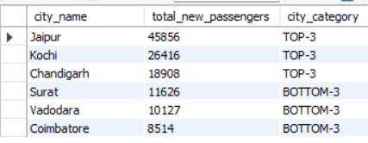
REQUEST 4:
IDENTIFY CITIES WITH HIGHEST AND LOWEST TOTAL NEW PASSENGERS.GENERATE A REPORT THAT CALCULATES THE TOTAL NEW PASSENGERS FOR EACH CITY AND RANKS THEM BASED ON THIS VALUES.IDENTIFY THE TOP 3 CITIES WITH HIGHEST NUMBER OF NEW PASSENGERS AS WELL THE BOTTOM 3 CITIES WITH THE LOWEST NUMBER OF NEW PASSENGERS,CATEGORISING THEM AS TOP-3 OR BOTTOM 3 ACCORDINGLY
FIELDS:
city_name
total_new_passengers
city_category ("top-3,bottom-3")

Slide 27
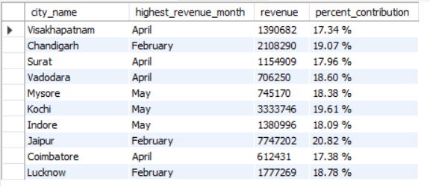
REQUEST 5:
IDENTIFY MONTH WITH HIGHEST REVENUE FOR EACH CITY.GENERATE A REPORT THAT IDENTIFIES THE MONTH WITH HIGHEST REVENUE FOR EACH CITY.FOR EACH CITY,DISPLAY THE MONTH NAME,THE REVENUE AMOUNT FOR THAT MONTH AND THE PERCENT CONTRIBUTION OF THAT REVENUE TO THE CITY'S TOTAL REVENUE.
FIELDS
city_name
highest_revenue_month
Revenue
percent_contribution

Slide 28
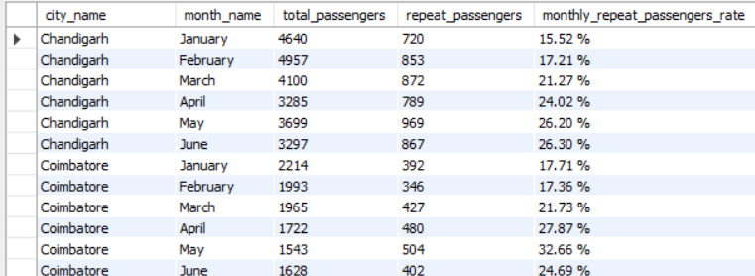
REQUEST 6:
REPEAT PASSENGER RATE ANALYSIS GENRATE A REPORT THAT CALCULATE TWO METRICS:THESE METRICS WILL
PROVIDE INSIGHTS INTO MONTHLY REPEAT TRENDS AS WELL AS OVERALL REPEAT BEHAVIOUR OF EACH CITY
FIELDS:
city_name
Month
total_passengers
repeat_passengers
monthly_repeat_passengers_rate(%): REPEAT PASSENGER RATE AT THE CITY AND MONTH LEVEL
city_repeat_passengers_rate(%): Overall repeat passenger rate for each city,aggregated across months

Slide 29
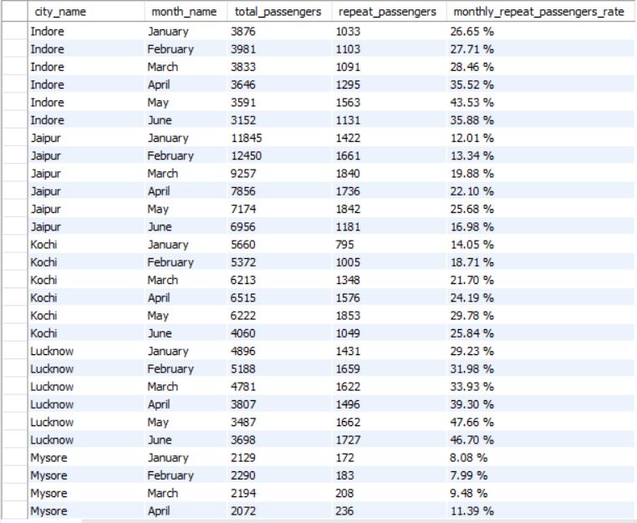

Slide 30
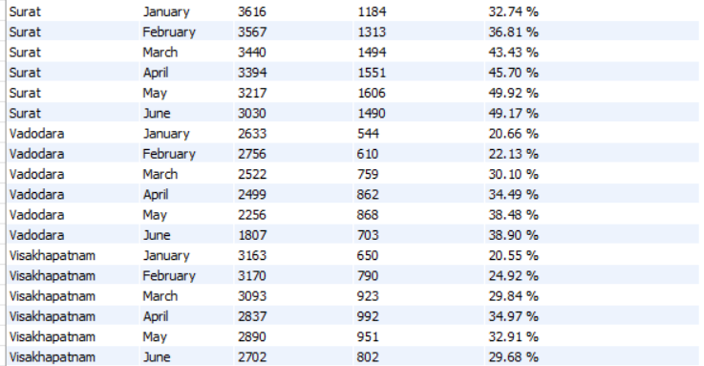

Slide 31

DASHBOARDS

Slide 32
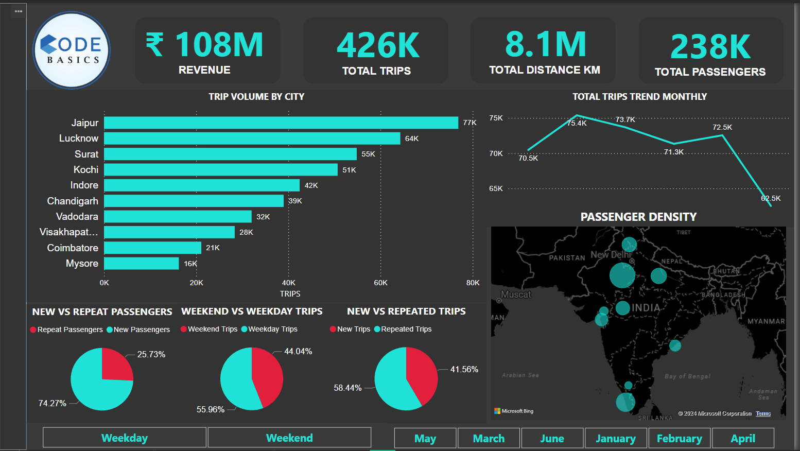

Slide 33
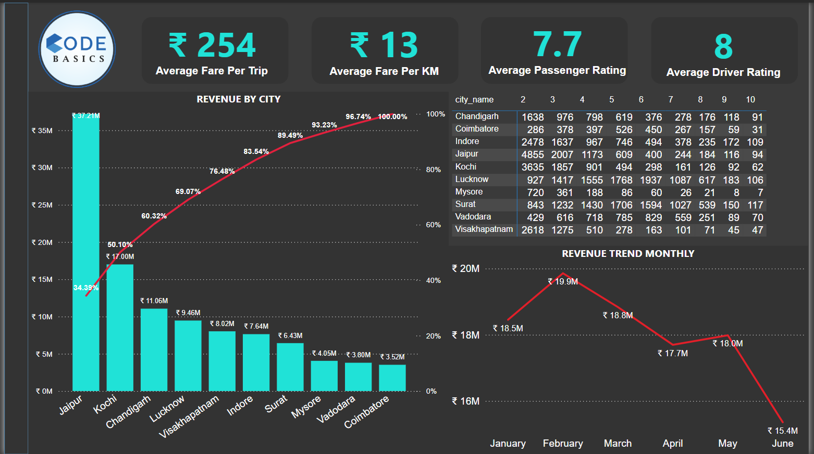

Slide 34
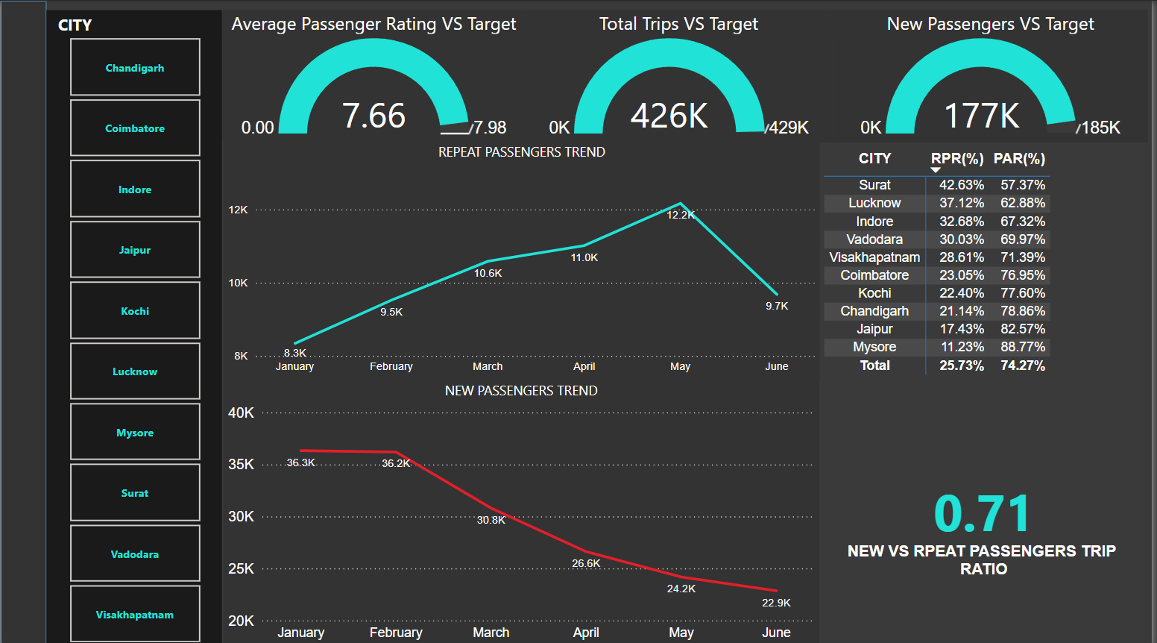

Slide 35
DASHBOARD INSIGHTS
High Trip Volume:
The maximum number of trips are originating from Jaipur, followed by Lucknow and Surat.
Monthly Trip Trend:
The number of trips is decreasing month over month.
Customer Base:
Most customers are from Jaipur, followed by Kochi and Chandigarh.
Revenue Contribution:
Around 60% of the company’s revenue comes from the cities of Jaipur, Kochi, and Chandigarh.
Revenue Trend:
Revenue has shown a gradual decline over the past six months.
Repeat Passengers:
The number of repeat passengers has increased gradually but dropped between May and June.
New Passengers:
The trend of new passengers has declined.

Slide 36
RECOMENDATIONS
Enhance services in tourism cities (Jaipur, Kochi, Mysore) by focusing on weekends and introducing seasonal offers and collaborations with local tourism boards and hotels.
Optimize weekday services in business cities (Lucknow, Surat, Vadodara) with better route planning and subscription plans for daily commuters.
Improve passenger experience in Vadodara by addressing issues like limited service availability and inconsistent ride quality.
Address driver dissatisfaction in Surat by optimizing ride distribution, reducing waiting times, and improving earnings.
Introduce loyalty programs and personalized discounts to increase repeat passenger retention in cities like Coimbatore and Surat.
Maintain strong repeat passenger rates in tourism cities with targeted marketing campaigns during peak months like May and June.
Conduct a pricing strategy review to address revenue decline and balance competitive pricing with profitability.
Focus on high-demand months (February, April, May) with special marketing campaigns to boost revenue.
Target underperforming cities like Lucknow and Vishakapatnam by improving service availability, expanding the fleet, and optimizing operations.
Incentivize top-performing drivers in cities like Jaipur and Mysore and enhance passenger amenities.
Improve customer satisfaction in Chandigarh and Kochi through feedback mechanisms and quality assurance programs.
Introduce demand-driven dynamic pricing and better route optimization in cities with peak-hour issues like Lucknow and Vishakapatnam.
Create discounted packages to boost travel during low-demand months like January and June.

Slide 37
THANK YOU

