Slide 1
AI BASED DIABETES PREDICTION SYSTEM
PHASE 5

Slide 2
Problem DESCRIPTION
An AI-based diabetes prediction system is a sophisticated software or model that leverages artificial intelligence techniques, such as machine learning and deep learning, to analyze a wide range of data, including medical records, patient demographics, lifestyle factors, and genetic information, to predict the likelihood of an individual developing diabetes.
This system typically functions by training on historical data to identify patterns and risk factors associated with diabetes, enabling it to make personalized predictions for individuals.

Slide 3
Phases
Phase 1 is about the idea presentation to predict Diabetes using AI.
Phase 2 is about Creating the innovative idea presentation for diabetes prediction using AI.
Phase 3 is the development of code part 1 for diabetes prediction.
Phase 4 is the development of code part 2 for diabetes prediction.
Phase 5 is the documentation and Presentation.

Slide 4
Dataset
The diabetes dataset from Kaggle is a commonly used dataset that contains ten baseline variables, such as age, sex, body mass index (BMI), average blood pressure, and six blood serum measurements, for a group of diabetes patients.
It’s often utilized in machine learning and data analysis to predict diabetes progression or assess factors related to the disease. Researchers and data scientists use this dataset for various analytical and predictive tasks to gain insights into diabetes and its progression.
https://www.kaggle.com/datasets/mathchi/diabetes-data-set

Slide 5
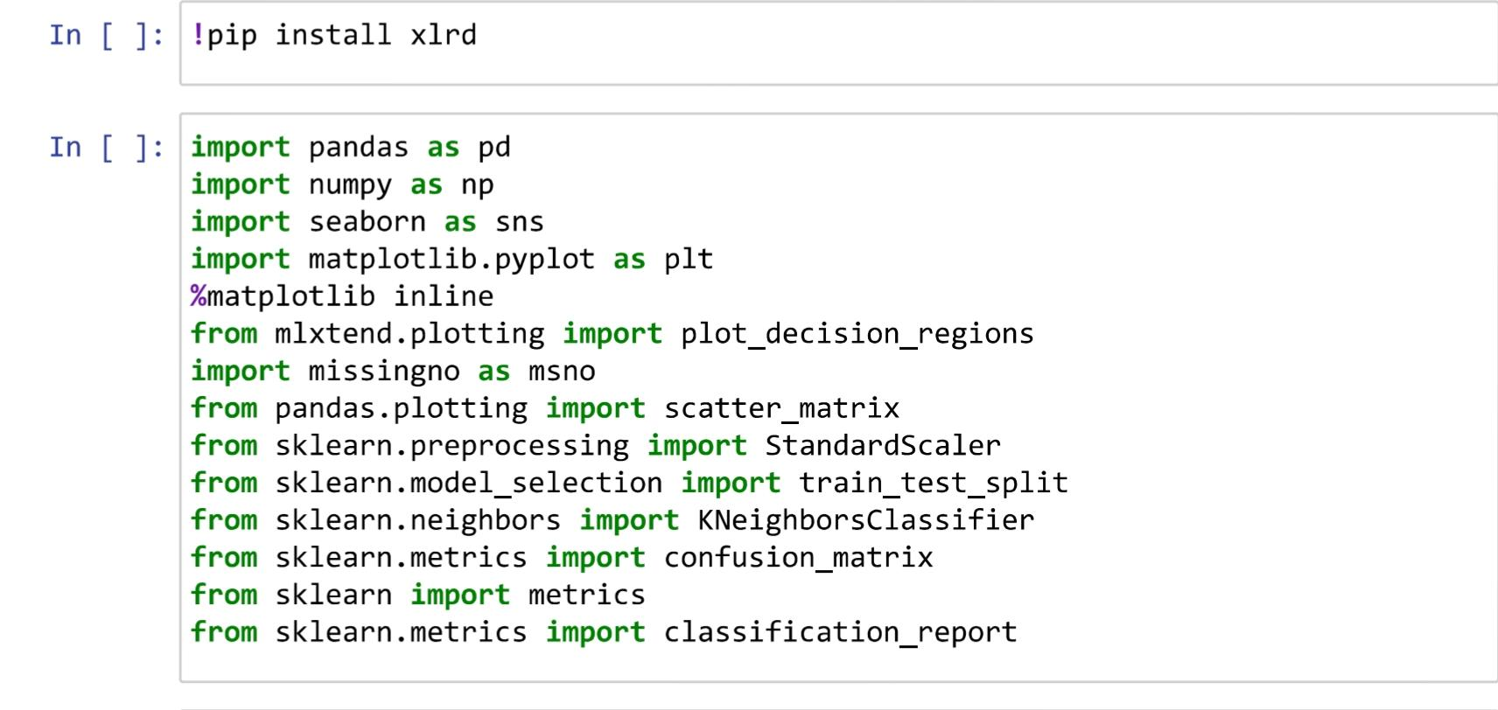
Imported libraries
Pandas is a Python library primarily used for data manipulation and analysis. It is widely used in machine learning for tasks such as data pre-processing and data cleaning.

Slide 6
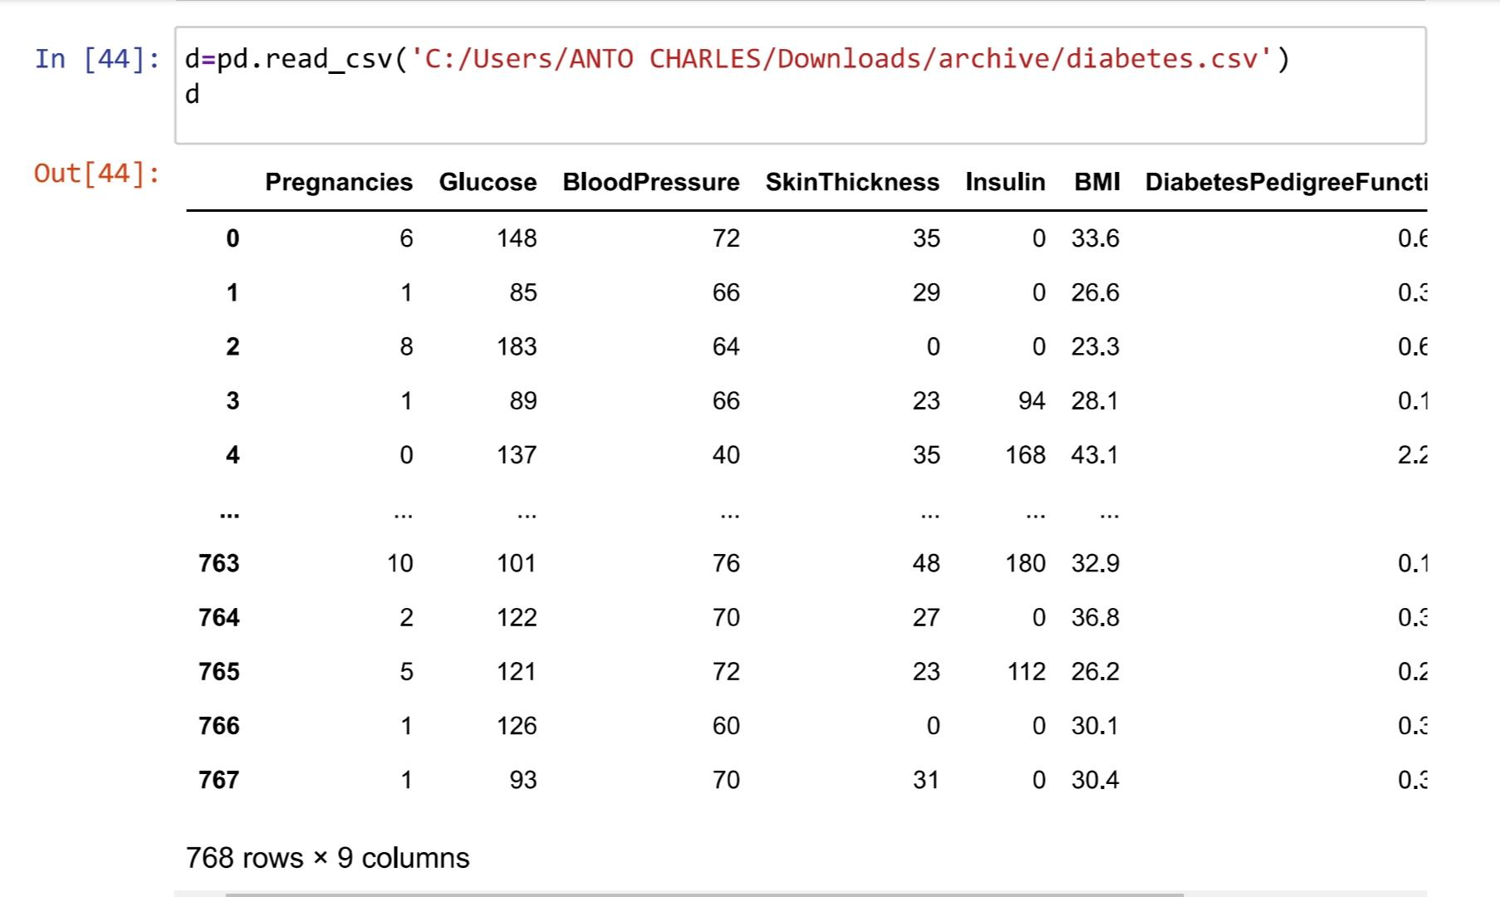
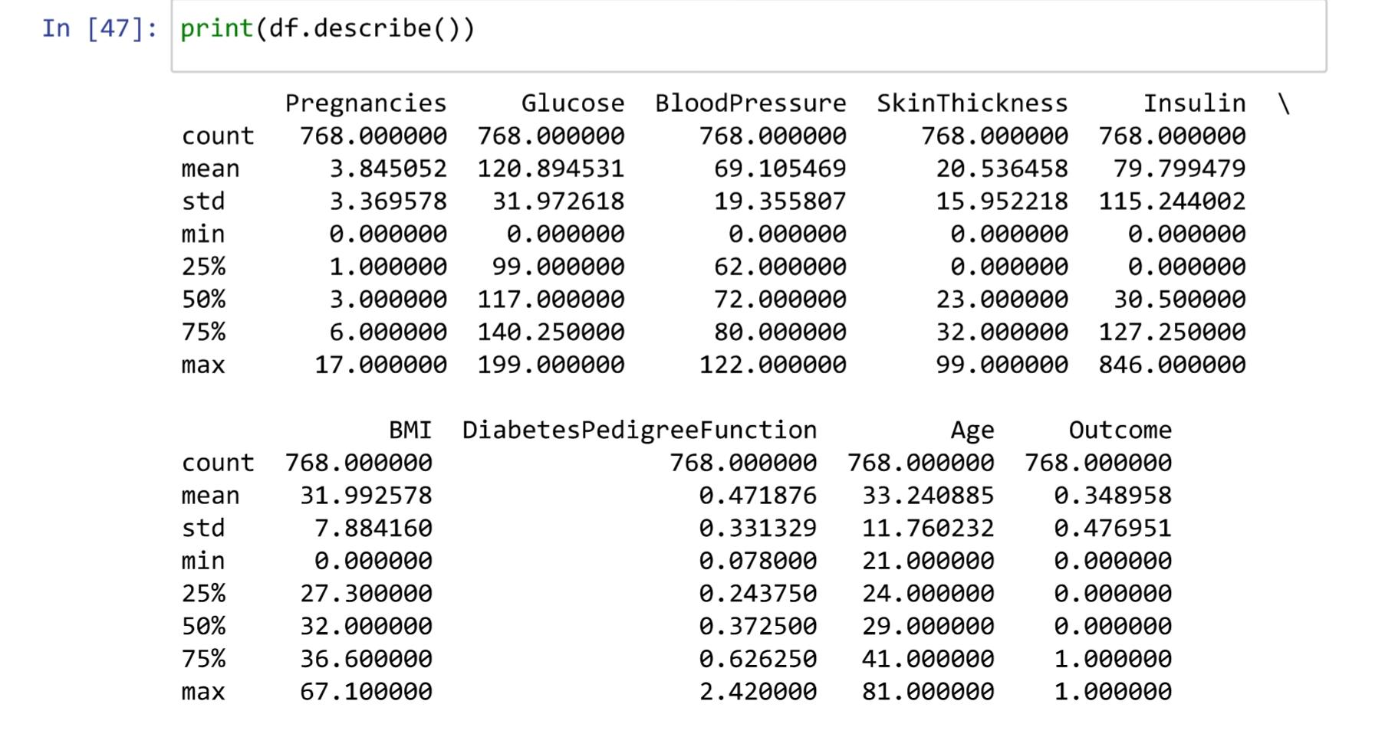
Data Description
This includes details such as the type of data, the structure of the dataset, the variables it contains, and statistics like mean, median, and standard deviation for numeric data.

Slide 7
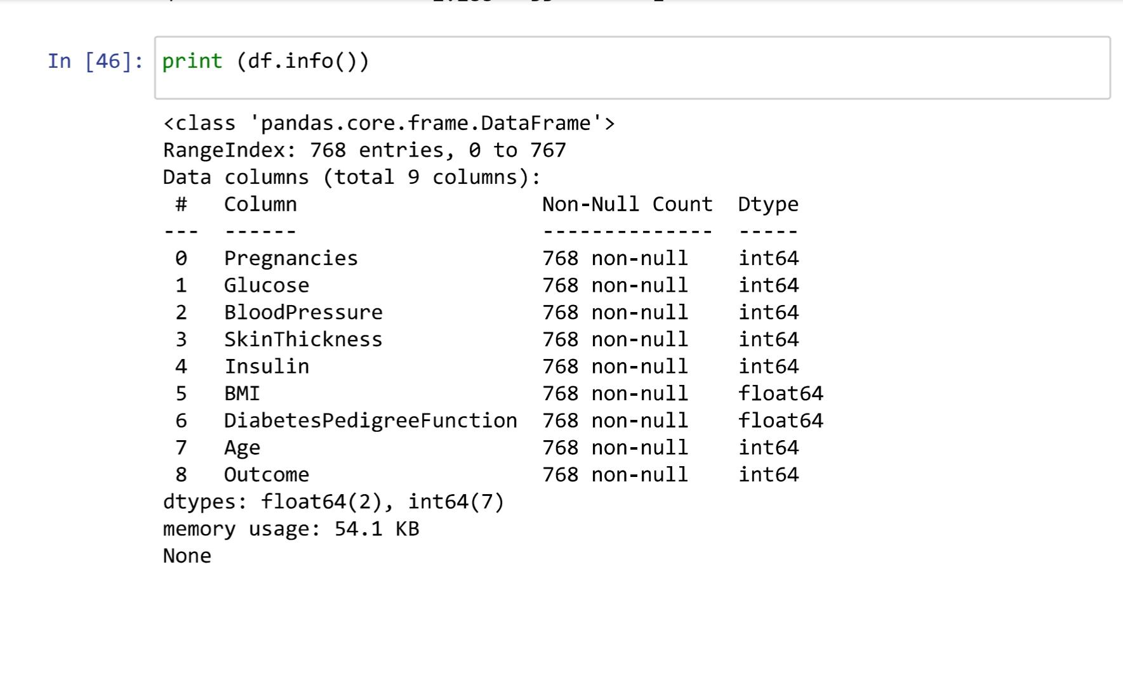
Data information
The meaningful and useful knowledge or insights derived from data. It’s the result of processing, analyzing, and interpreting raw data to extract relevant facts, patterns, trends, or conclusions that can be used to make informed decisions, solve problems.

Slide 8
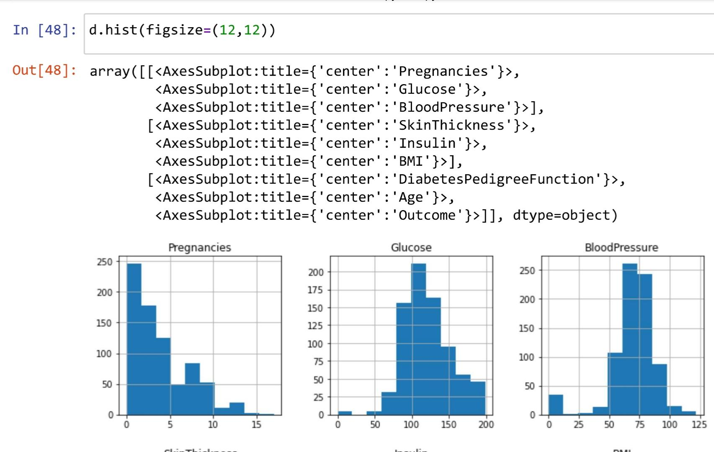
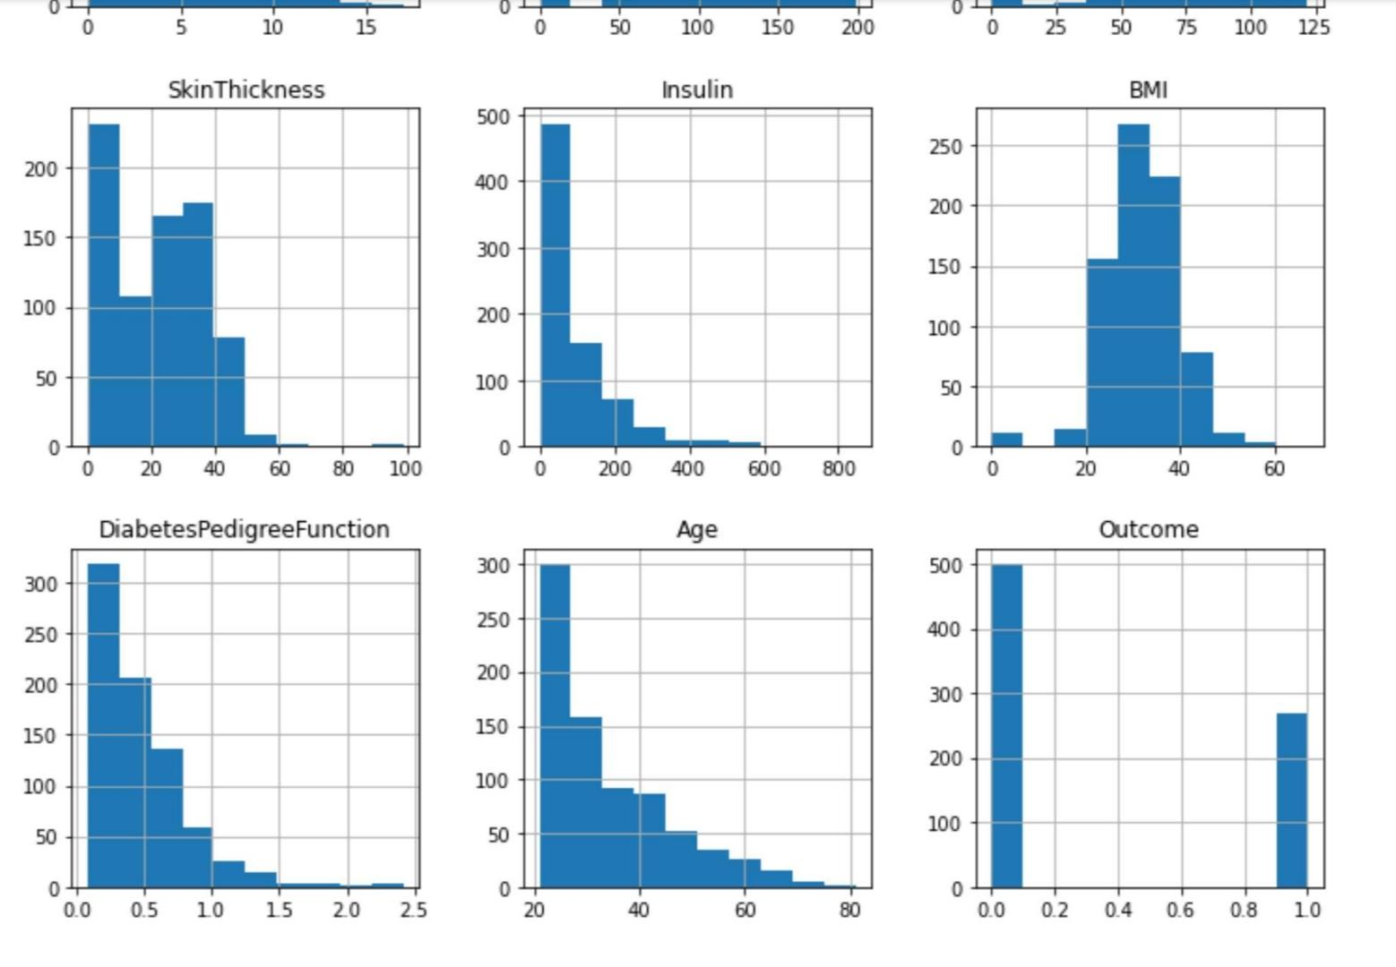
Data Pre-processing
This step is The process of cleaning, transforming, and organizing raw data into a format that is suitable for analysis or for training machine learning models.

Slide 9
Model and Algorithm Selection
The Random Forest classifier is a powerful machine learning algorithm employed in the project.
This algorithm operates by constructing multiple decision trees during training and combines their predictions to make more accurate and robust classifications.
This ensemble method is particularly useful for tasks like classification and regression.

Slide 10
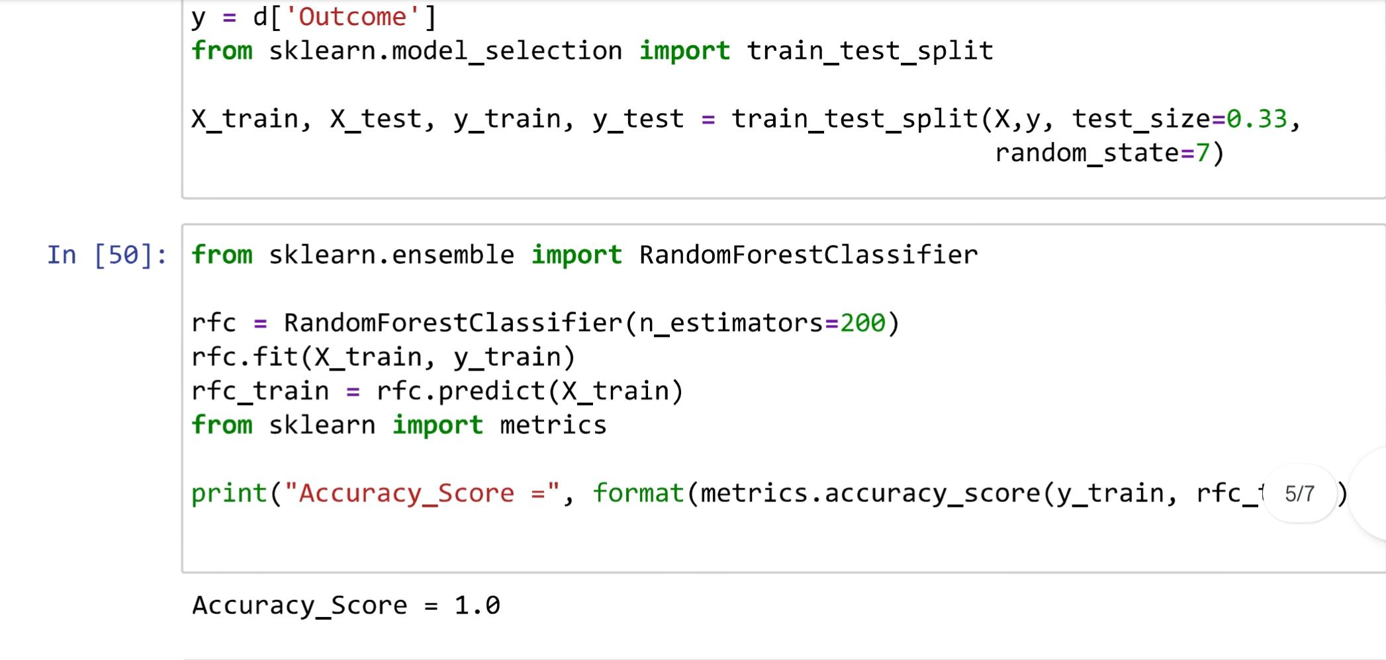
Training data
The context of machine learning and artificial intelligence, is a subset of a dataset used to train a machine learning model.

Slide 11
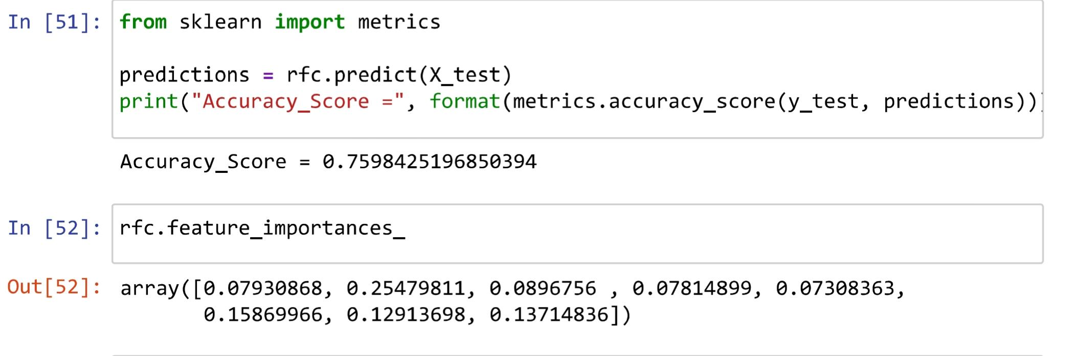
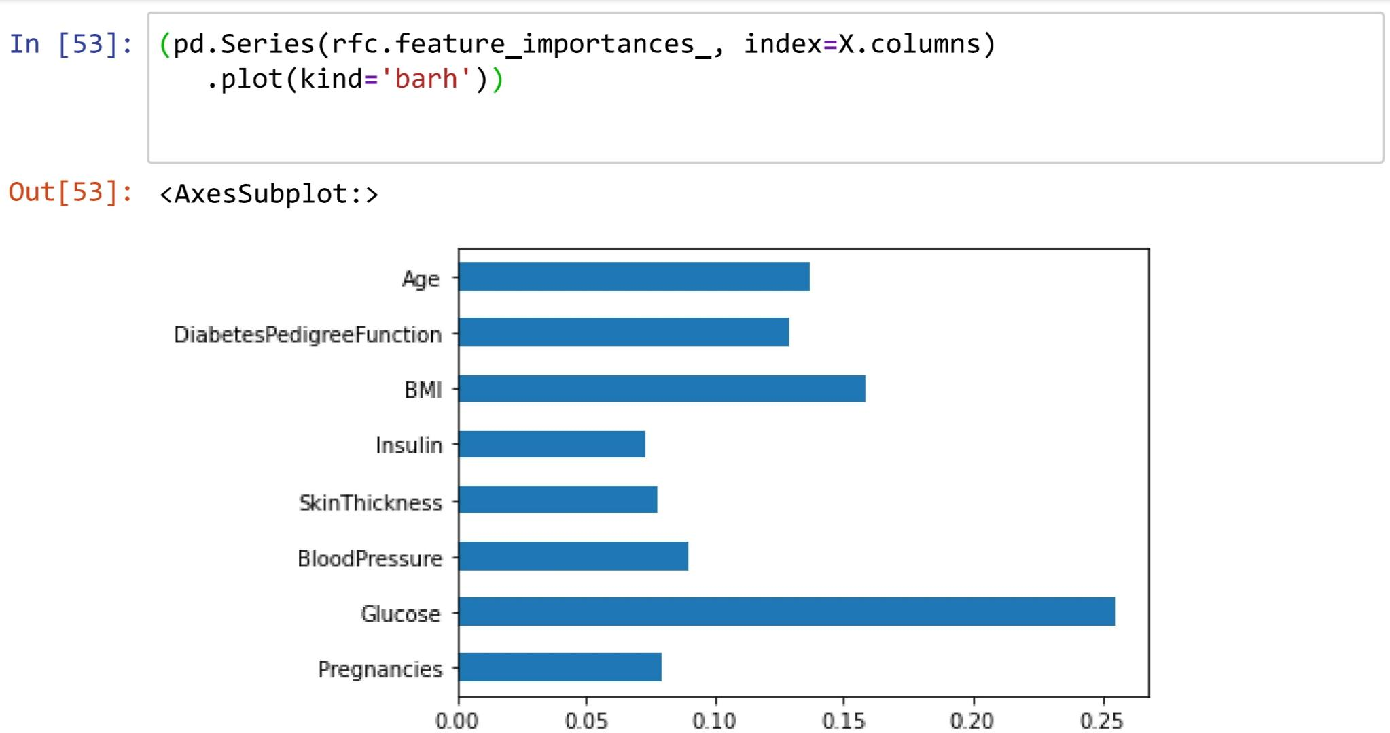
Import metrics

Slide 12
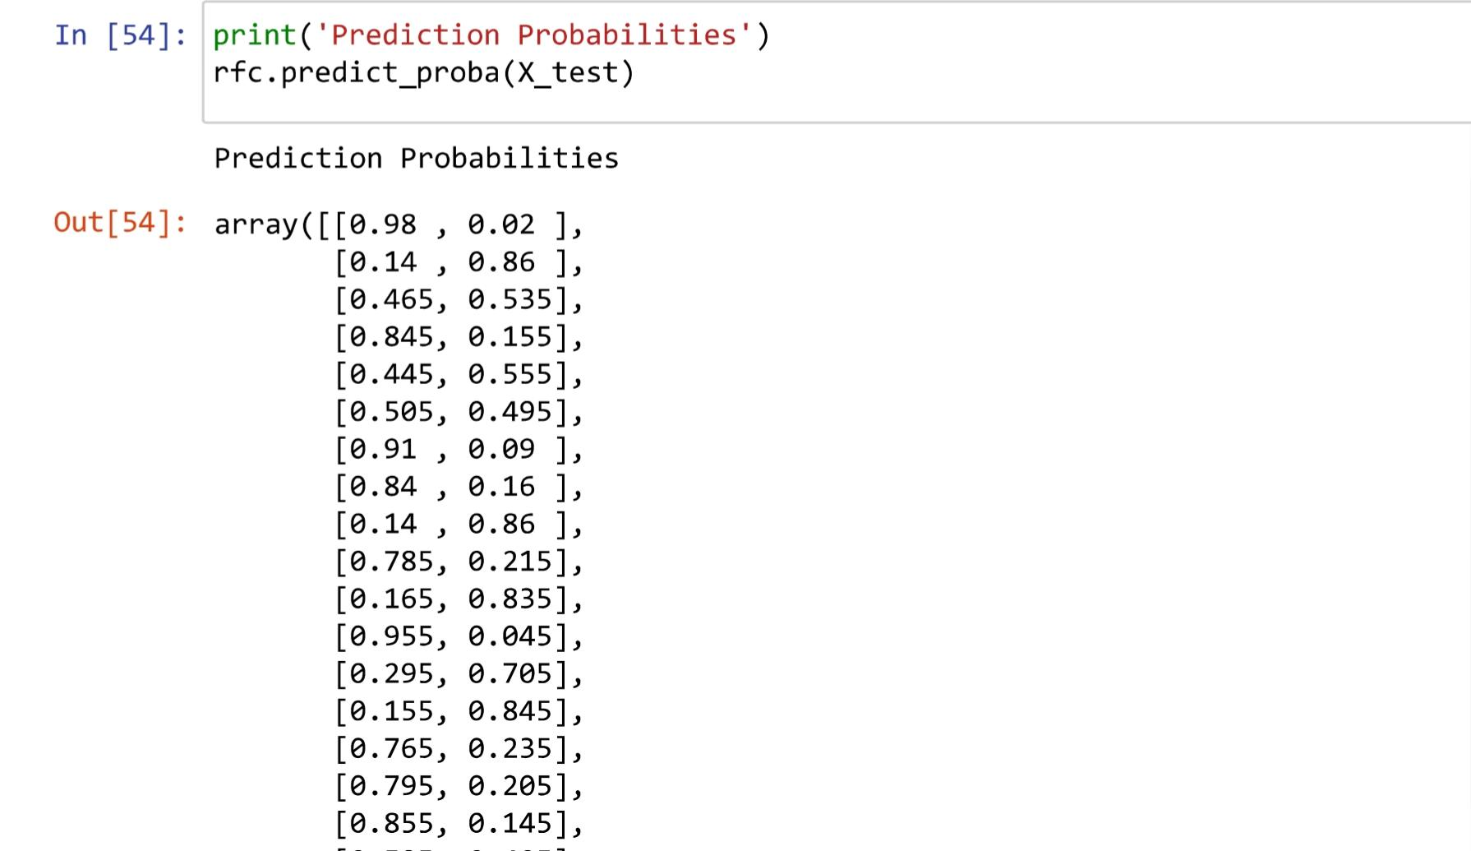
Probability prediction
The context of machine learning and statistics, refers to the estimation of the likelihood or probability of a particular event or outcome occurring.

Slide 13
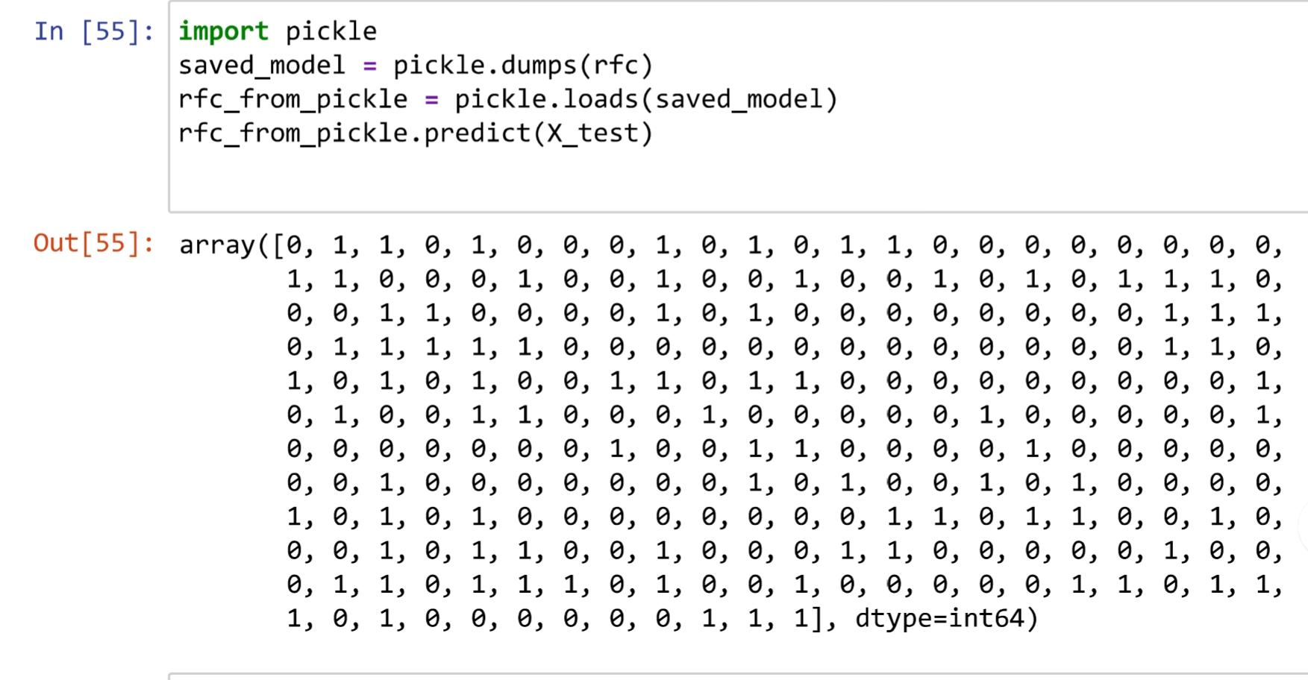
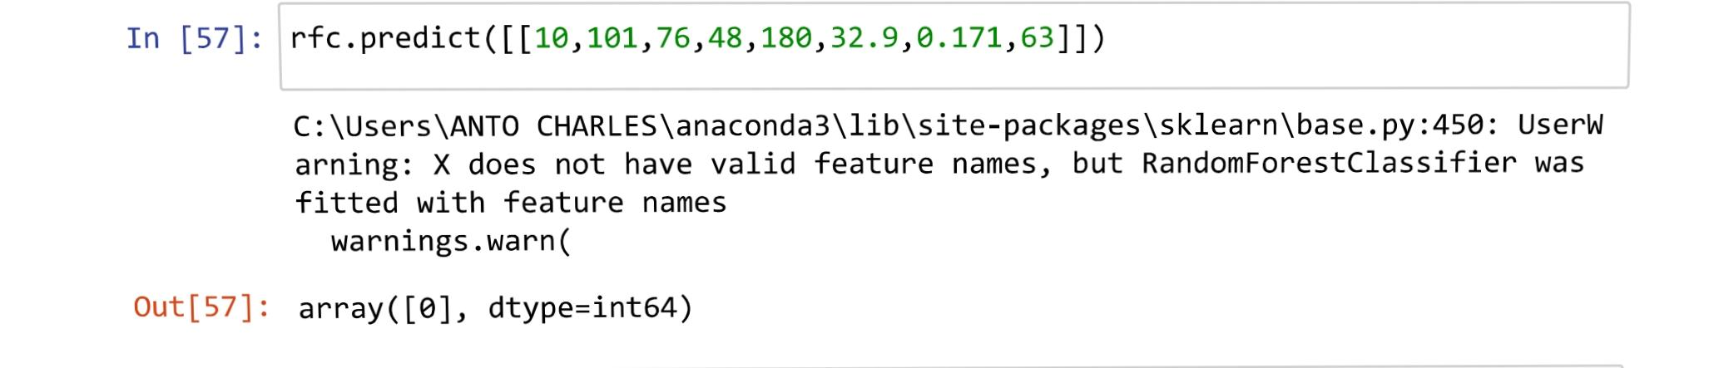
Solution

Slide 14
Conclusion
The diabetes prediction system employing the Random Forest classifier demonstrates its effectiveness in accurately predicting diabetes risk.
By leveraging ensemble learning and feature importance ranking, it enhances the reliability of predictions and provides valuable insights for early intervention and prevention.
This system is a valuable tool in improving healthcare outcomes for individuals at risk of diabetes.

Slide 15
Thank you

