Slide 1
Chapter-10
Location –Based Services

Slide 2
Location-based services is known as LBS.
LBS apps follow the location and offer extra services such as locating facilities close at hand,presenting suggestions for route planning etc.

Slide 3
Track the location
Locating the services nearby
Location-Based Services
Offering suggestions for route planning

Slide 4
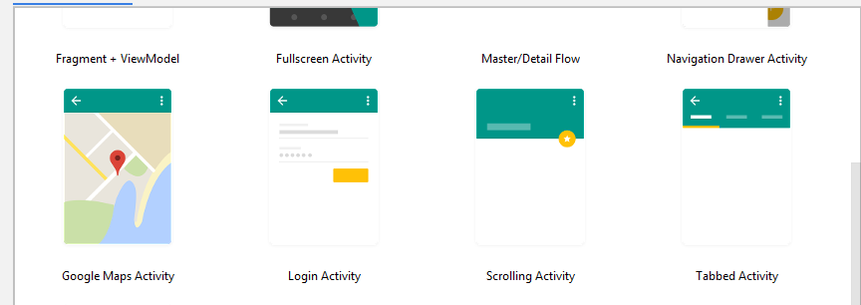
Step-1
Take mapActivity->File->new ->new project

Slide 5
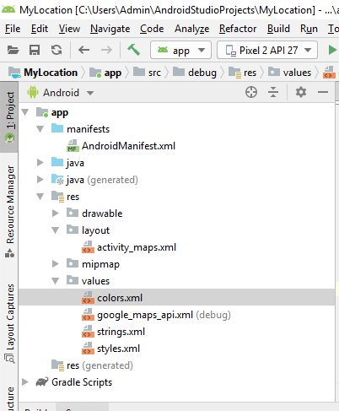
Step 2
Take google_maps_api.xml file from the values

Slide 6
Getting the maps API key ->
Copy the following link from the Google api.xml file and paste it to the Google
https://developers.google.com/maps/documentation/android/start#get-key
And follow the steps which we provided by google

Slide 7
Displaying the map for that two main responsibilites.
-> Modify the AndroidManifest.xml file by adding the <uses-library>element and the INTERNET permission
->Add the Map View element to yout UI.Displaying Google Maps.
Add the following code in main.xml file
<uses-library android:name=“com.google.android.maps”/>
<uses-permission android:name=“android.permission.INTERNET”>
</uses-permission>

Slide 8
To display Google Maps in the application,we want to have the INTERNET permission in the manifest file.
Then add the com.google.android.maps.Map View>element to UI file(main.xml)to tmbed the map within the activity.
The actitvity of the application extends the MapActivity calss,which itself is an extension of the activity class.
Fir that we implement onr method :isRouteDisplayed()

Slide 9
Built in zoom control
<ZoomControls android:id="@+id/simpleZoomControl" android:layout_width="wrap_content" android:layout_height="wrap_content" />
Important Methods Of Zoom Controls:
hide()
show()

Slide 10
Main activity.java
Import the following packes
importcom.google.android.maps.MapActivity import com.google.android.maps.MapView
Public class MainActivity extends MapActivity
{
Mapview mapview; //To view the map which the services provided by google

Slide 11
Public void onCreate(Bundle savedInstanceState)
{
Super.onCreate (savedInstanceState)
setContentView(R.layout.main);
Mapview=(MapView) findViewById(R.id.mapView);
mapView.setBuiltInZoomControls(true);
}

Slide 12
Public boolean onKeyDowm(int keyCode,keyEvent event)
{
MapController mc=mapView.getController();
Switch(keyCode)
{case KeyEvent.KEYCODE_1:
Mc.zoomIn();
break;
case KeyEvent.KEYCODE_2:
Mc.zoomOut();
break;

