Slide 1

Rental Market Analysis
-- “Making Smarter Choices”

Slide 2

About me
B-Tech
This field excites me because it constantly evolves, offering opportunities to learn and apply new techniques. Ultimately, I want to leverage Data Science to make impactful contributions across industries.

Slide 3

Bussiness Problem
Understanding Rental Market Trends for Better Decision Making.
We collected rental property data from a real estate website to analyze how different factors influence rental prices and availability.

Slide 4

Objective
Understand rental price trends based on multiple factors.
Analyze location-based rental variations.
Evaluate the impact of furnishing type & tenant preference.
The goal is to help tenants, landlords, and investors make informed decisions by identifying trends in: Rental pricing across different locations, property types, and BHKs Tenant preferences (Bachelors vs. Family) and its effect on price. Which locations are expensive or affordable

Slide 5

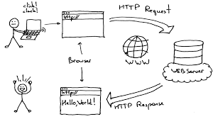
Web Scraping Details
Website Used: MagicBricks (Real Estate Portal)
Scraping Tools: BeautifulSoup
Process Followed:
Identified required rental details (Location, Price, BHK, etc.).
Extracted structured data using Python scripts.
Saved it in CSV format for analysis.
Challenges:
Handling dynamic website content.
Managing missing values,Invalid & duplicate data.

Slide 6
Summary Of Data
Total Rows: 967
Total Columns: 9
Key Features:
Property Type - Here we have flats , house, villas.
Location - Where the property located city names.
BHK – number of rooms.
Furnishing – Property is furnished or not.
Bathrooms - numbers of bathrooms.
Balconies – number of balconies
Carpet Area – How much area of the property in sqft.
Rental Price – How much is the rent for the property.
Tenant Preferred. – bachelors or family preferred.

Slide 7
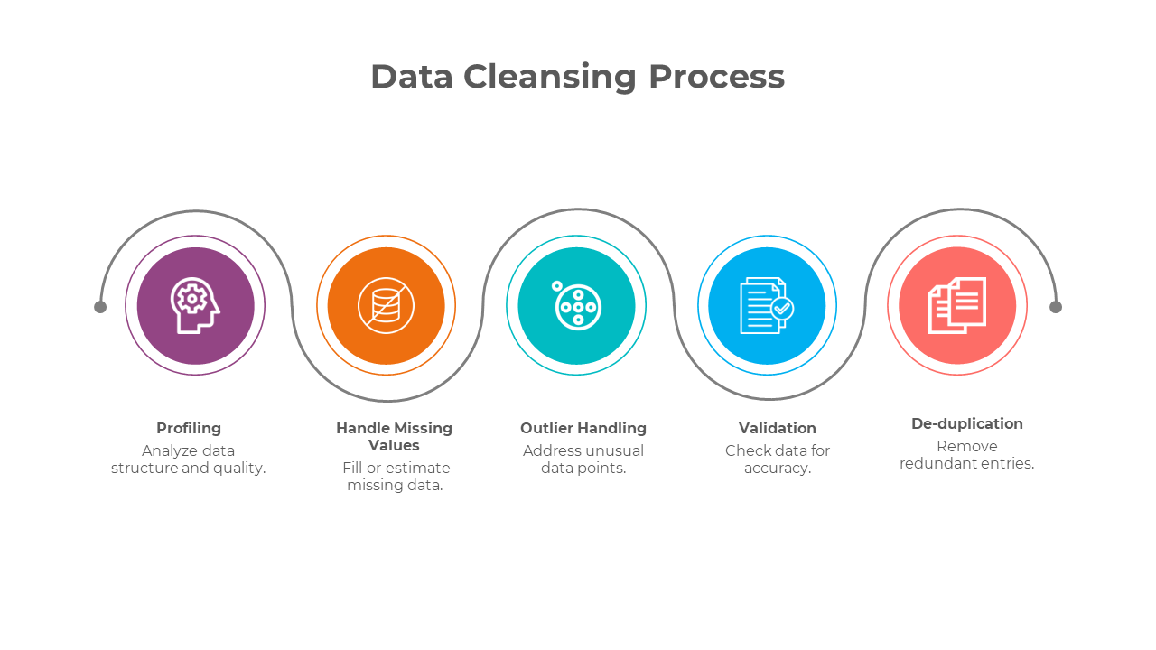
Data Cleaning Steps
Handled Missing Values:
Columns like "Society Name", "Facing Direction", and "Floor Details" have too many missing values, so we droped them.
bhk, furnishing, bathrooms, balconies, carpet_area, rental_price, tenant_preferred have some mising values , so we used fillna method to handle the missing values
Removed Duplicates:
In the data we get 5 duplicated values we remove them by using drop_duplicates()
Fixed Data Types:
Converted numerical columns like rental_price, bhk to valid types.
Invalid values:
columns like bhk, balconies, rental_price has invalid values like ‘n’ and ‘,’.

Slide 8
EDA
Exploratory Data Analysis

Slide 9
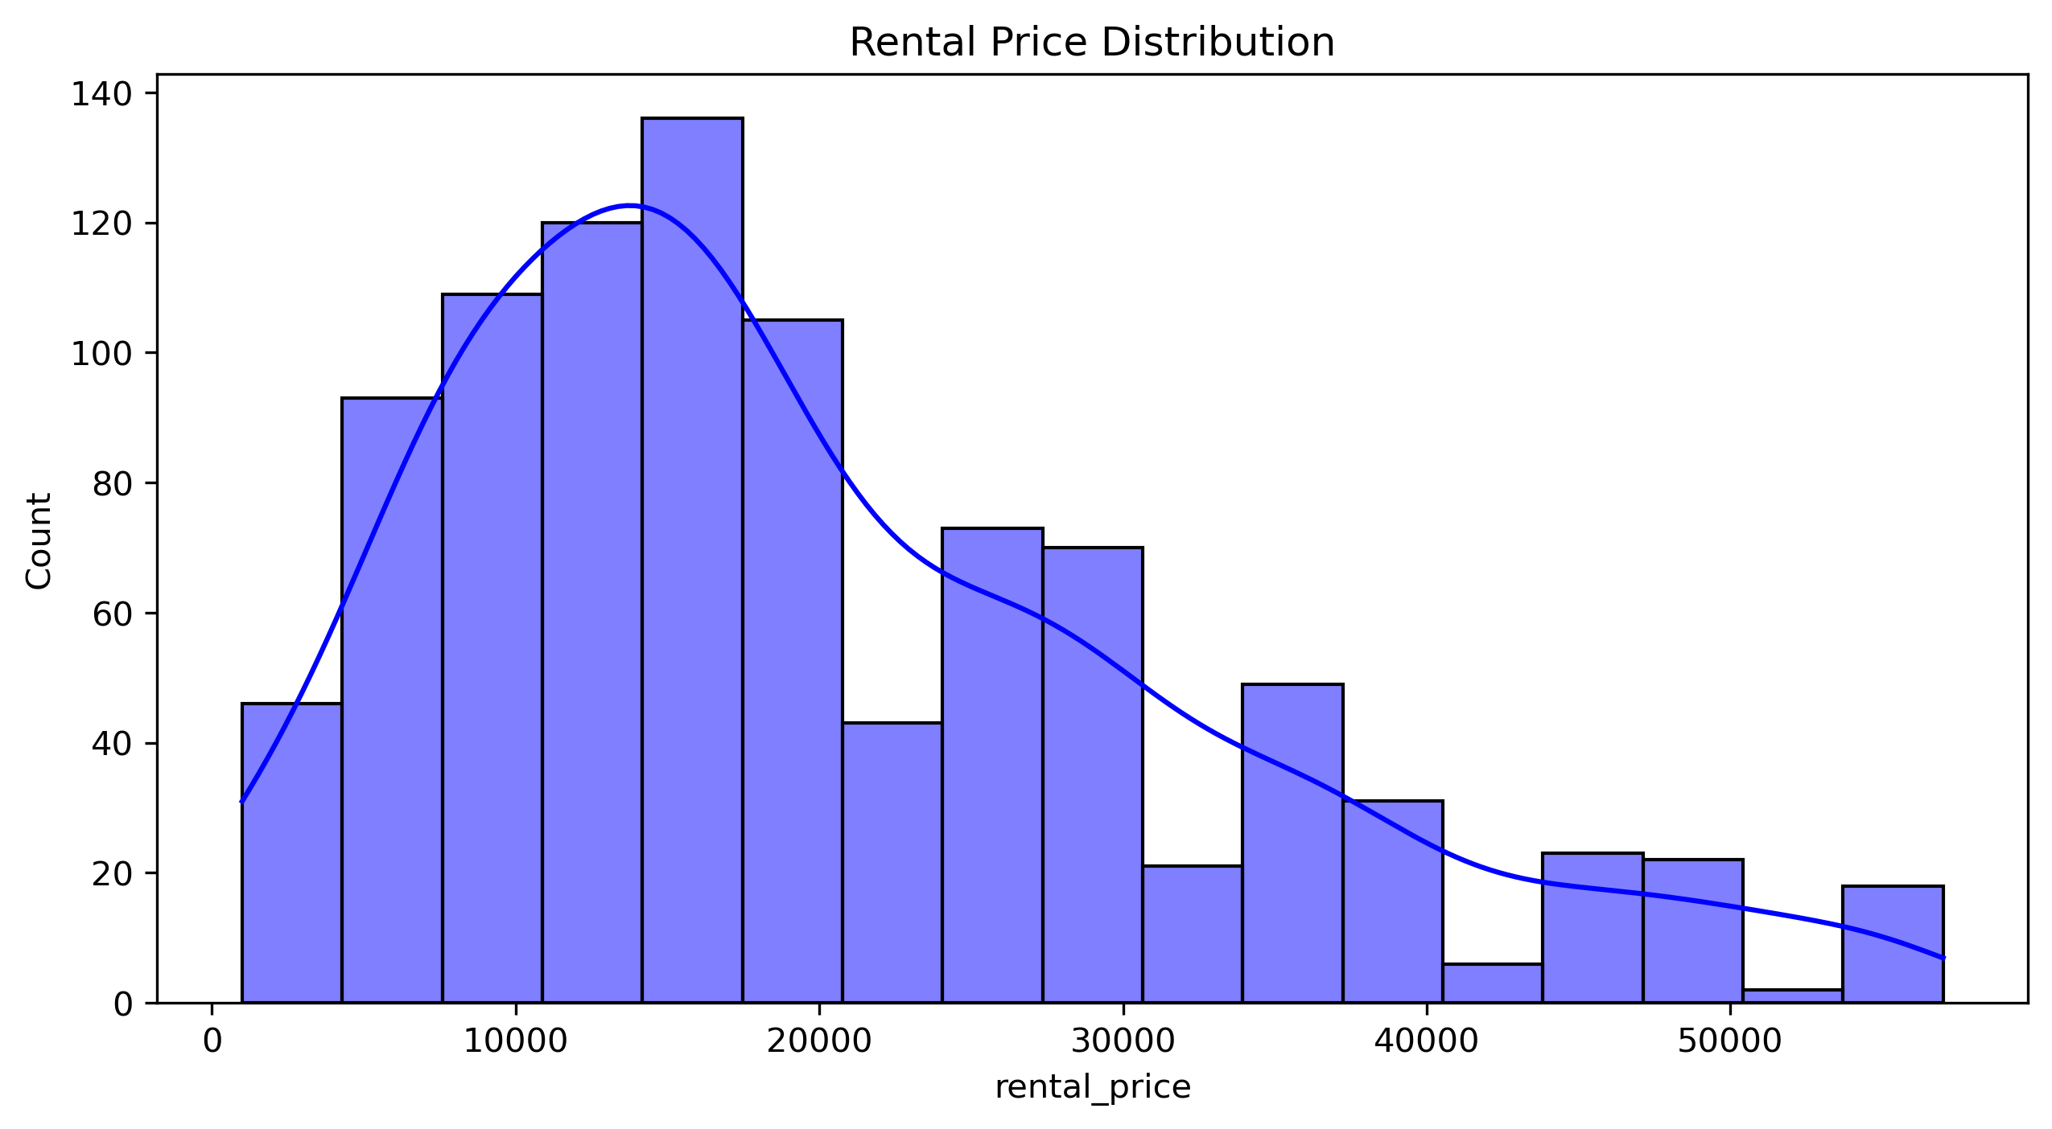
Univariate Analysis
Rental Price Insights:
Most rentals concentrated between ₹5,000 - ₹20,000, making them more accessible.
A sharp decline in frequency is observed beyond ₹30,000, so we say here premium properties.

Slide 10
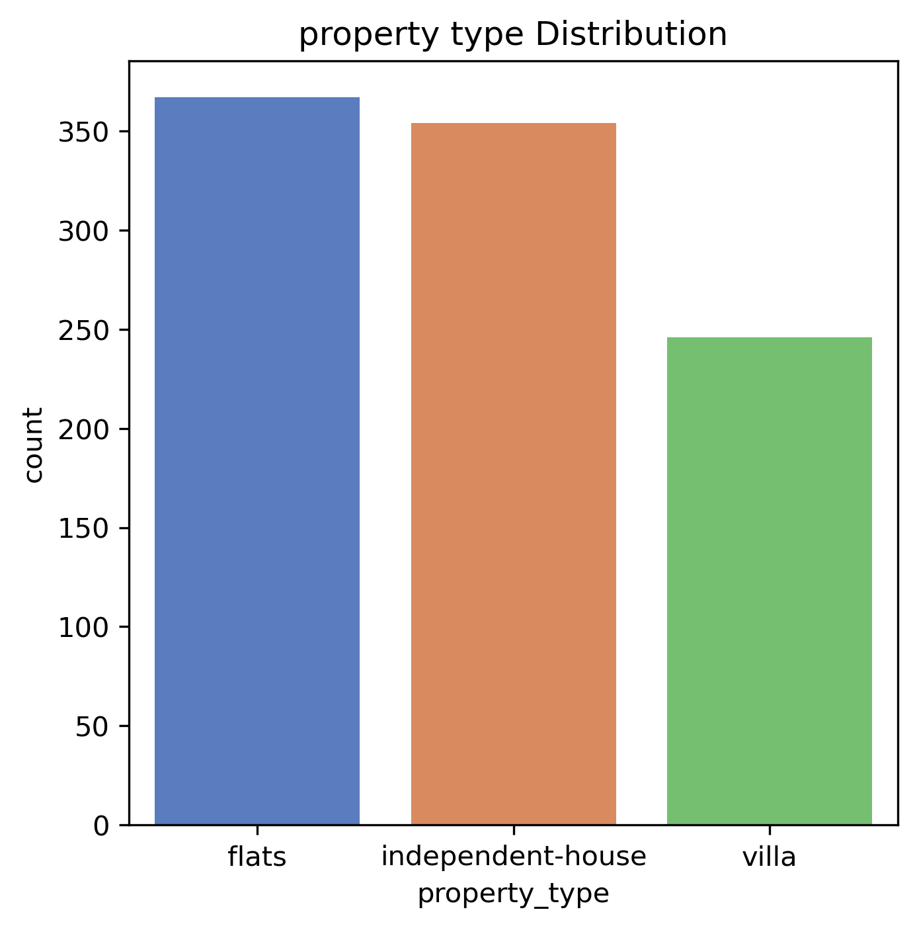
Property Type Insights:
Flats are the most common rental property, followed closely by independent houses.
Villas are the least available. Reason might be as they come under premium property
Tenants have different options of properties to choose from.
.

Slide 11
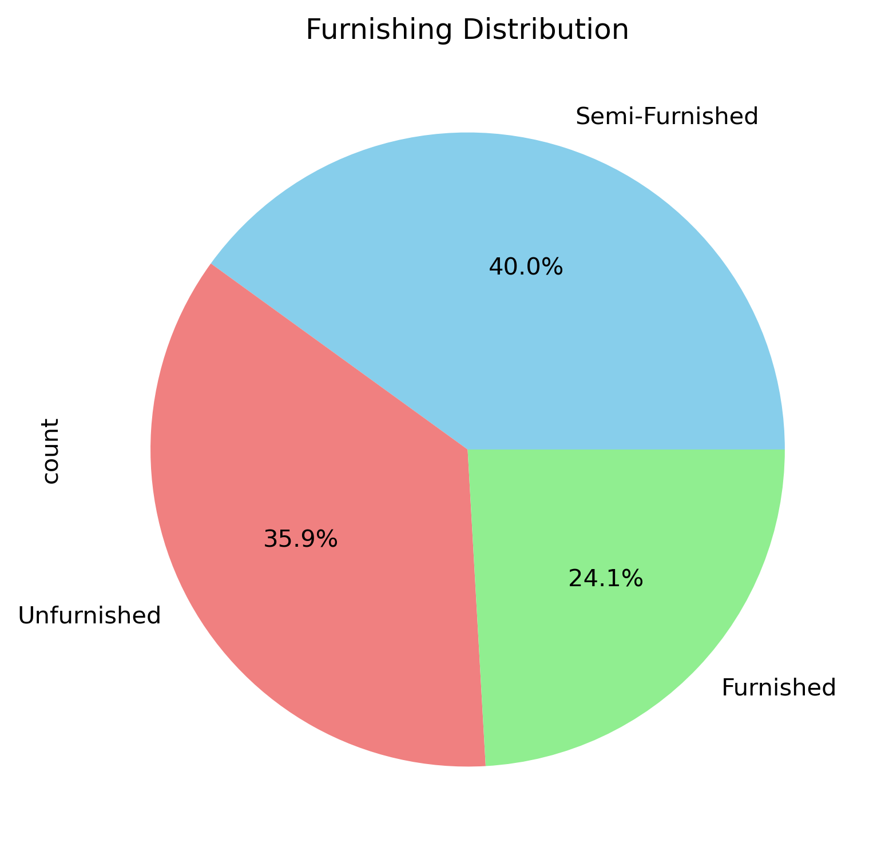
Property Type Insights:
Most homes are semi-furnished (40%), meaning they come with some basic furniture.
Unfurnished homes (35.9%) are also common, where tenants need to bring everything.
Furnished homes (24.1%) are the least available, likely because they cost more..
People mostly prefer semi-furnished homes as they offer a good balance of cost and convenience.

Slide 12
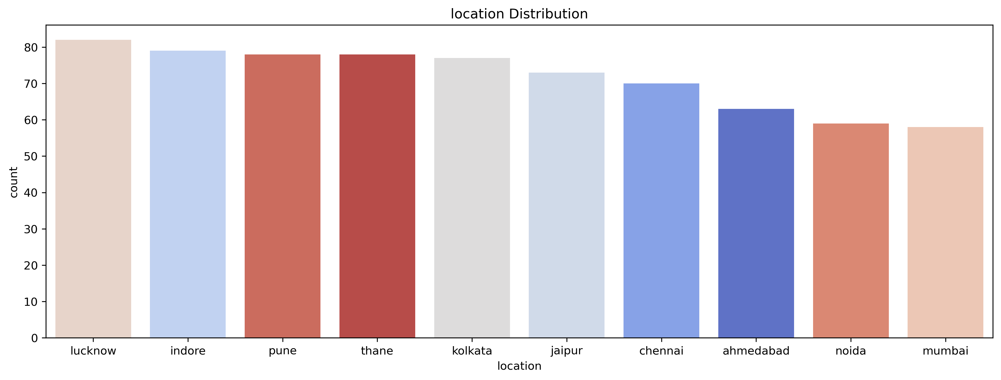
Location Insights:
The distribution of rental properties across different cities shows that Lucknow has the highest number of listings, indicating a greater availability of rental options. Cities like Indore, Pune, and Thane also have a significant number of listings, making them popular choices for renters. On the other hand, Mumbai and Noida have the least number of listings, which could be due to higher demand, limited supply, or expensive rental markets. Overall, cities like Lucknow and Pune offer more rental choices, while Mumbai and Noida may have fewer options, possibly making it more competitive for tenants.

Slide 13
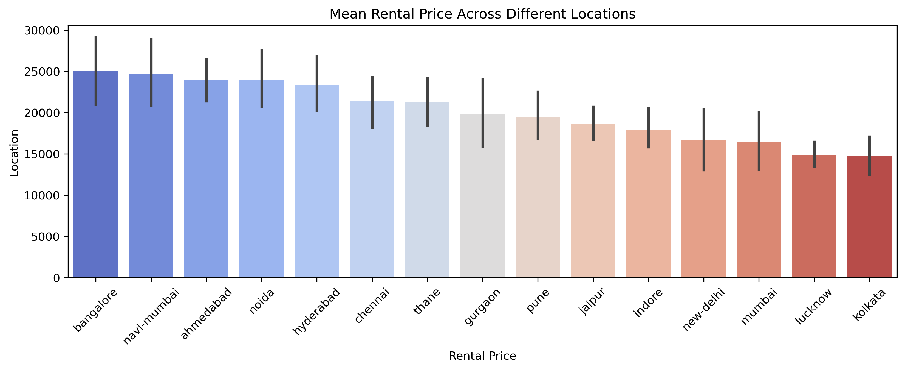
Bivariate Analysis
Rental Price Trends Across Different Locations
Bangalore and Navi Mumbai have the highest average rental prices, indicating that these cities might be more expensive due to high demand, better infrastructure, or job opportunities. Ahmedabad, Noida, and Hyderabad also show relatively high rental costs, suggesting a growing real estate market.
Cities like Kolkata, Lucknow, and Mumbai have lower average rental prices, making them comparatively more affordable. The variation in rental prices could be influenced by factors such as economic development, population density, employment hubs, and availability of housing options.

Slide 14
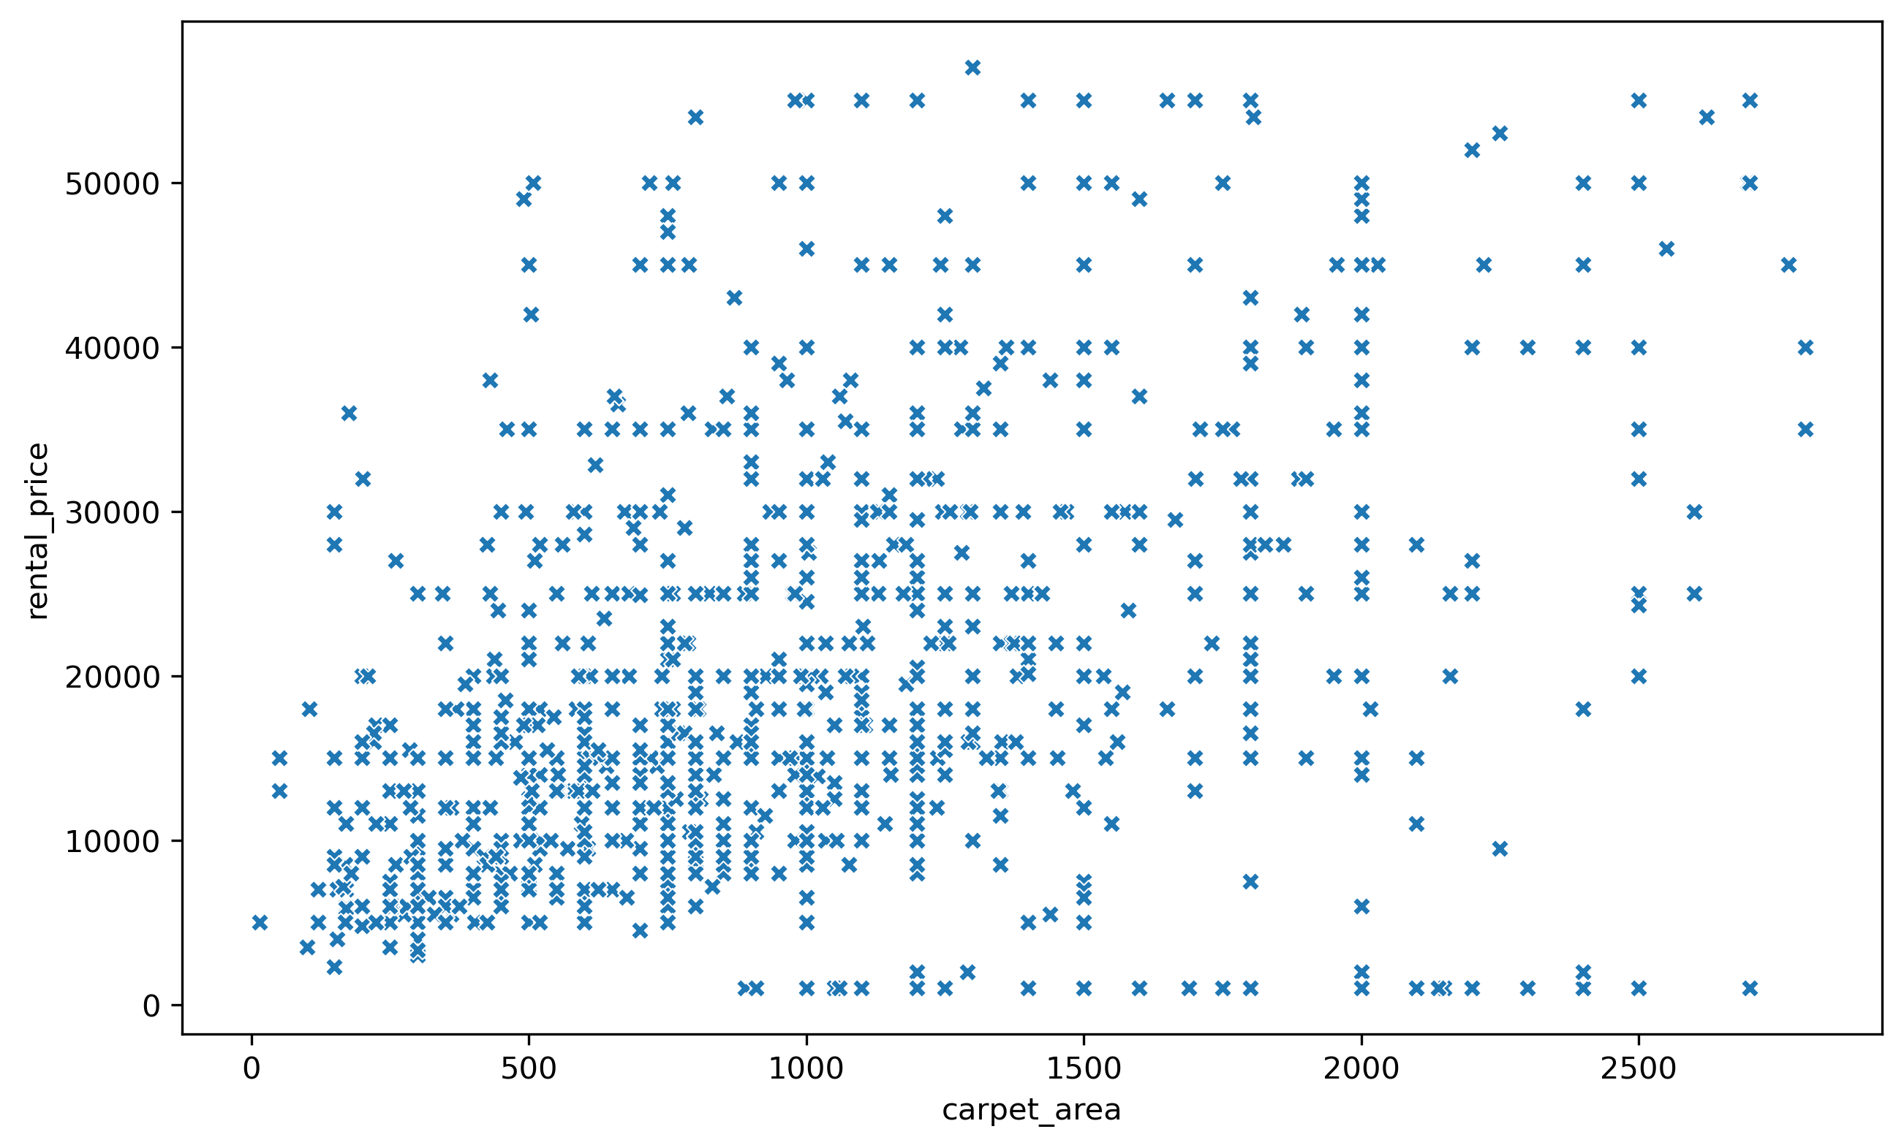
Impact of Carpet Area on Rental Prices: Trends and Variability
For Renters: Mid-sized apartments (500-1500 sqft) provide a broad range of rental options, allowing flexibility based on budget.
For Investors: The luxury market (2000+ sqft) has high price volatility, suggesting opportunities in premium locations.
For Real Estate Analysis: Pricing models should not be based on carpet area alone but should incorporate factors like location, property age, and amenities to get a more accurate rental estimate.

Slide 15
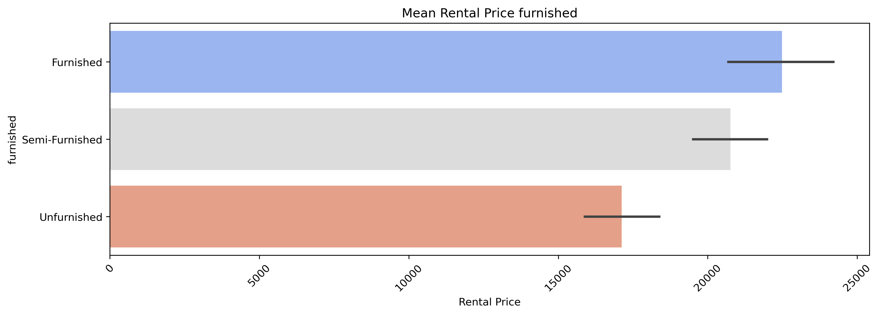
Impact of Furnishing Type on Rental Prices
Furnished Properties: These demand the highest rental prices, averaging around ₹25,000. They are ideal for corporate professionals.
Semi-Furnished Properties: These offer a balance between cost and convenience, averaging around ₹20,000. They attract long-term tenants like families who prefer some flexibility in furnishing.
Unfurnished Properties: These are the most budget-friendly, averaging around ₹17,000. They are suitable for tenants who own furniture and prefer lower monthly expenses.

Slide 16
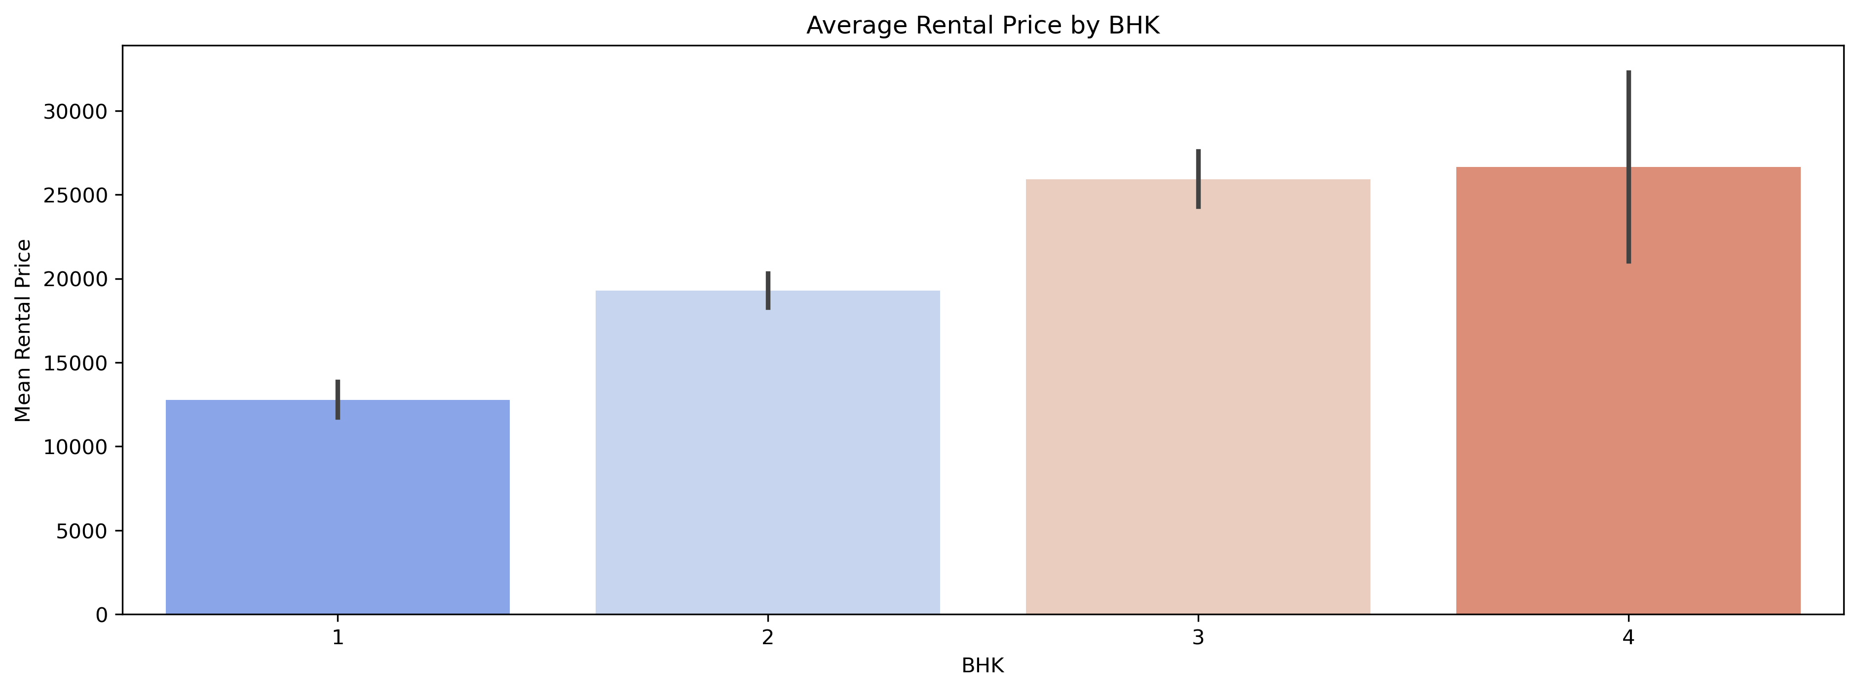
Average Rental Price by BHK Count
The graph shows that rent increases as the number of BHKs goes up. 1BHK homes have the lowest rent, while 4BHK homes are the most expensive.
The jump in rent from 1BHK to 2BHK is big, meaning people pay more for extra space. Higher BHK homes have more price variation, likely due to luxury features. Other factors like location and amenities also affect rent.

Slide 17
Key Business Question
1. How does the number of BHKs impact rental affordability?
1 BHK is the most affordable found in Kolkata, Lucknow , 2 BHK balances cost and space, while 3+ BHK units are premium, found in high-end areas like Bangalore, Navi- Mumbai, Hyderabad.
2. Are certain areas significantly cheaper than others?
Budget-friendly locations like Kolkata, Mumbai, Lucknow offer affordable rents, while mid-range zones provide a good balance of cost and amenities like Chennai, Thane, Pune. Premium locations offer luxury but at higher costs like Bangalore, Navi- Mumbai, Hyderabad.
3. Which locations provide the highest rental income?
Investors seeking high rental yield should target areas near IT hubs & business districts, where demand for rental housing is strong.
Bangalore, Navi Mumbai, Hyderabad, and Pune have some of the best rental returns, driven by high demand from working professionals in the IT and corporate sectors..
4. Do furnished properties attract higher rental prices?
Fully furnished properties have higher rents, ideal for corporate tenants, while semi-furnished units attract families and professionals.

Slide 18
Conclusion
Rental Prices: Higher in metro cities (Mumbai, Bangalore, Delhi); influenced by BHK, furnishing, and location.
Space & Availability: Larger carpet area, more bathrooms, and balconies increase rent.
Useful for property selection, investment planning, and rental market trends analysis.
For Tenants: Choose furnished units for convenience or unfurnished for cost savings.
For Investors/Landlords: Furnished properties yield higher rental income but require maintenance, while semi-furnished units offer a steady tenant base.
Final Thoughts: Findings help tenants, landlords, and investors make data-driven decisions.

Slide 19
Experience/Challenges working on Web Scraping – Data Analysis Project.
Many real estate websites implement anti-scraping measures, such as CAPTCHAs and IP blocking, which made continuous data extraction challenging.
Some listings had incomplete details (missing BHK, rental price, or furnishing status), requiring data imputation and cleaning.
The same property was often listed multiple times, requiring deduplication techniques to ensure accuracy.

Slide 20

THANK YOU

