Slide 1
Summer Internship at LSI
Presentation
-Anantha Krishnan

Slide 2
The idea given
To use the shapefile given and georefernce it to the map.
Works assigned:
  -- Understanding affine transformation.
  -- Reading the shapefile and picking out 8 points from the shapefile
  -- Applying affine transformations and make a gui for the table that would contain all the value that are generated during the affine transformation and finding out the best 6 points obtained during the transform.
  -- Now changing the shapefile based on the new 6 points obtained.

Slide 3
Understanding Affine Transform
. Reading the theory related to affine transform and how affine transformation changes the shape of any vector .
The complete equations and procedure of picking 3 points at a time and then calculating the A to F values for every 3 points .
Then finding the error and then finding the best A to F values obtained from all the A to F values.
Then taking the new coordinates and finding out the error from the previously present coordinates and finding out the error .

Slide 4
Work progress
Initially i was finding out the countours and was trying to overlay 2 shapefile but later after discussion with sir i came to know the exact work to be done .
The entire work was to be coded in python.

Slide 5
Concepts needed
Understanding affine transformation
Understading pyqt as it was used for developing gui.
Understanding a little about qgis for reading the shapefile.

Slide 6
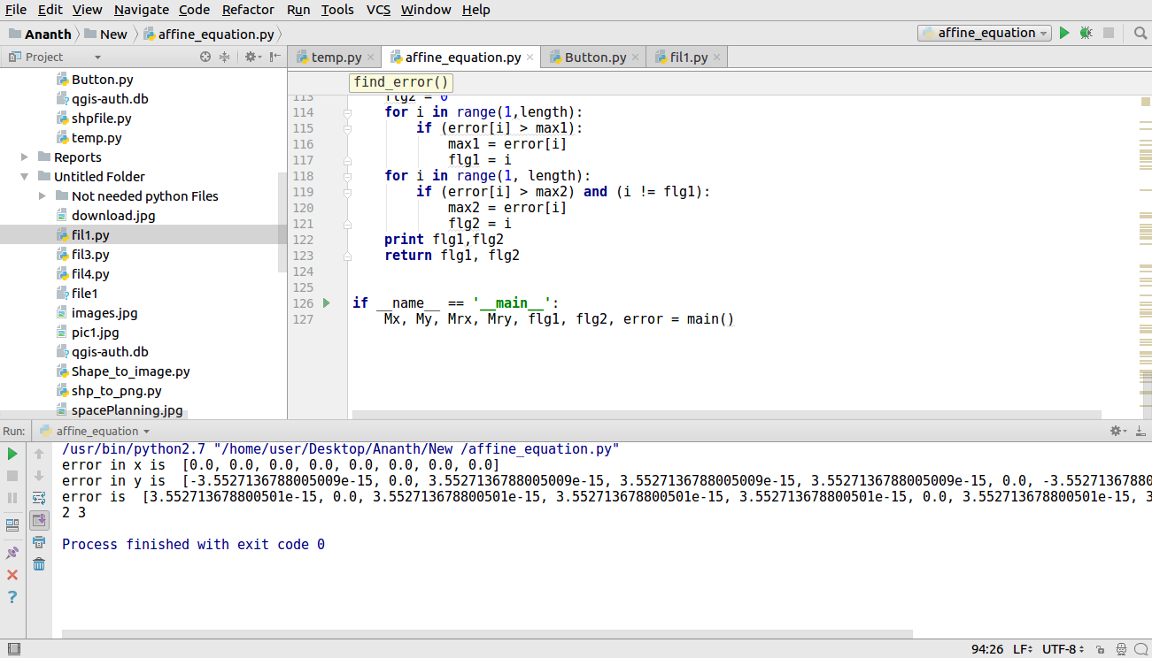
Affine transfomation ouput

Slide 7
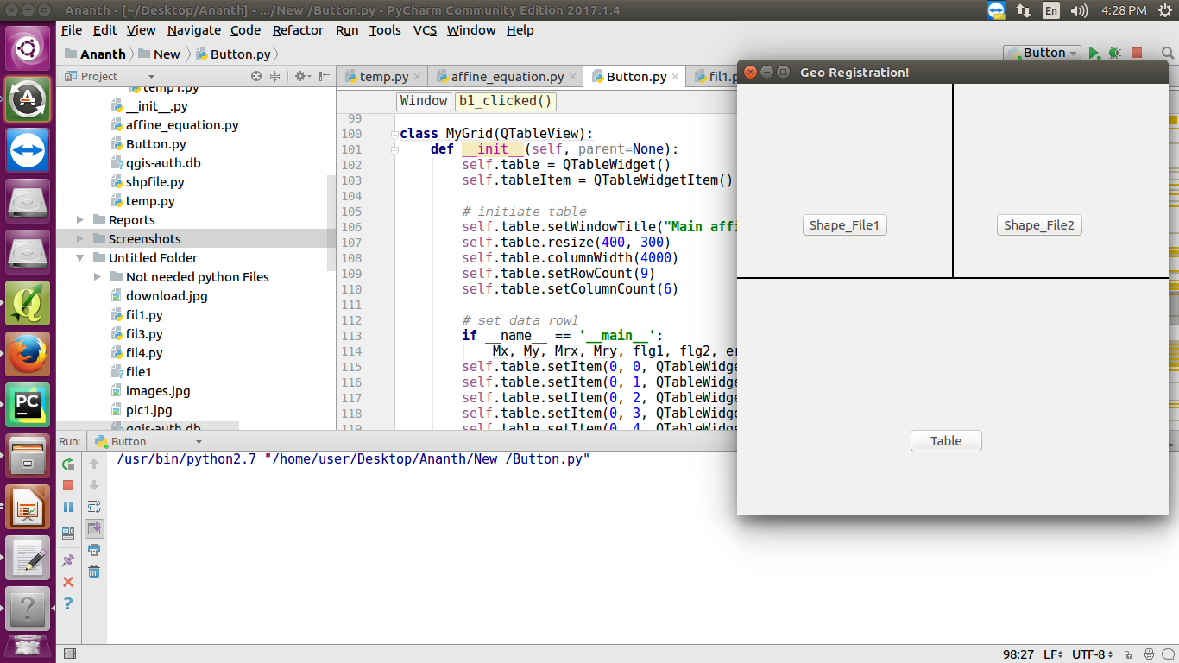
Gui
When the execution starts the window pops up

Slide 8
When shapefile is clicked the corresponding shapefile pop’s up.
And the cooresponding coordinates have to be brought and given to the affine equations.
When the table is clicked the affine equation module is called so the table will have all the values in it

Slide 9
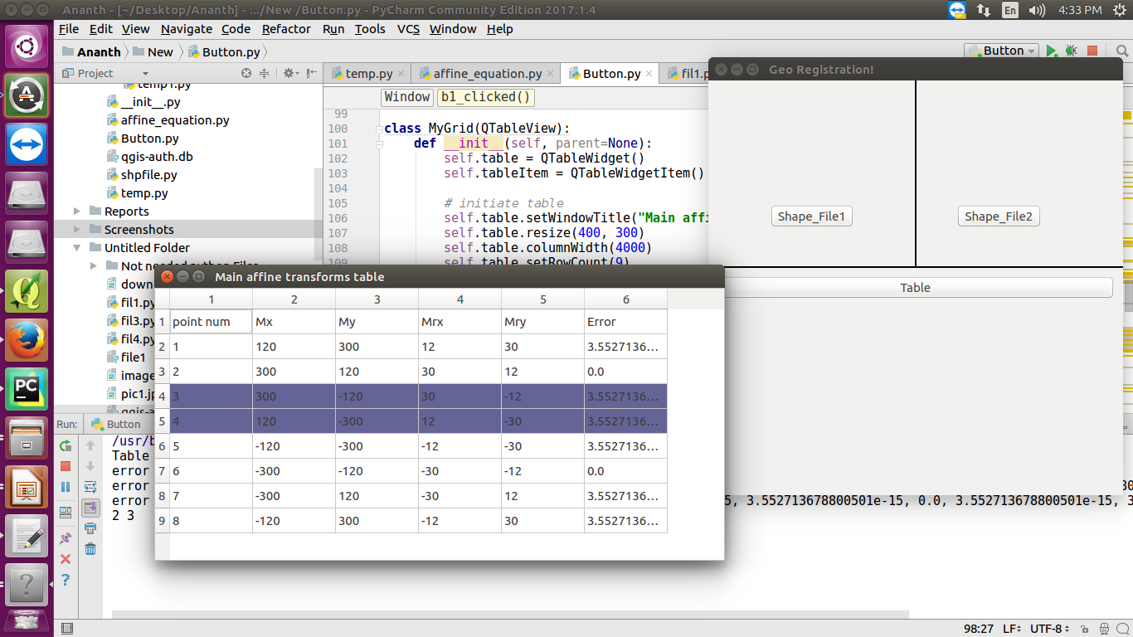
Table after affine transformation

Slide 10
Progress
Work needed to be done
Read the coordinates from the shape file and then give those coordinates to the affine transformation for transformation.
Work done:
1)affine transformation function has been written.
2)small gui has been built
3)coordinates manually given the code is working fine.

Slide 11
Thank You

