Slide 1


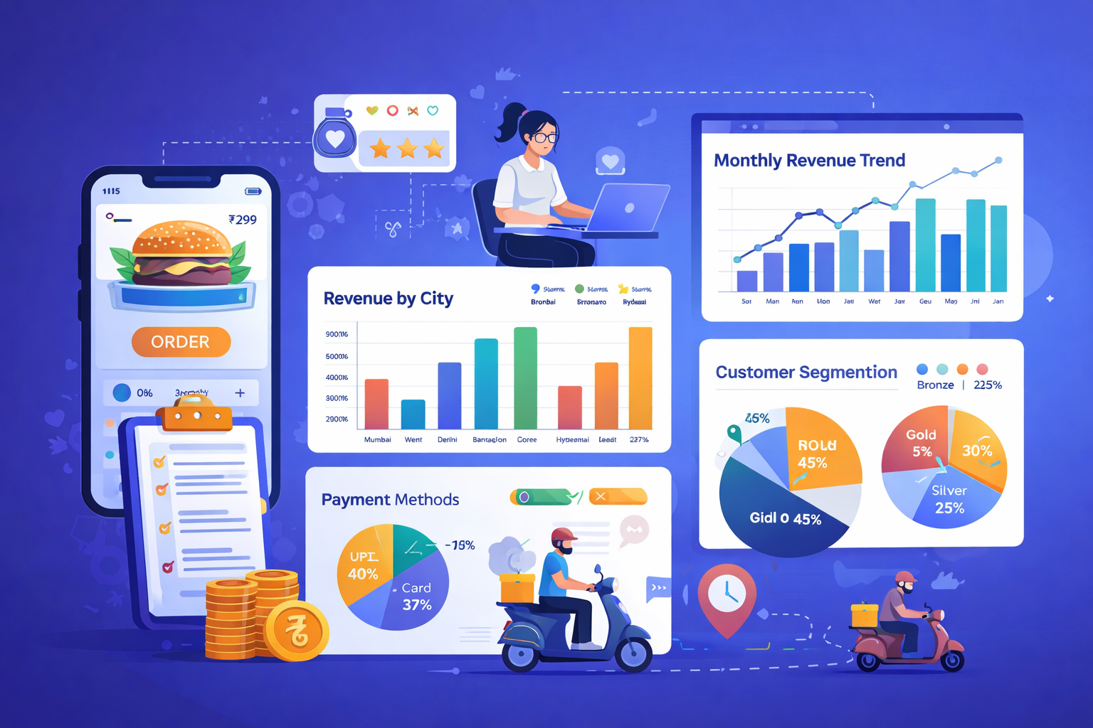
Online Food Delivery Data Analytics System
SQL & Data Analytics Capstone Project
Ananya Sindhe

Slide 2

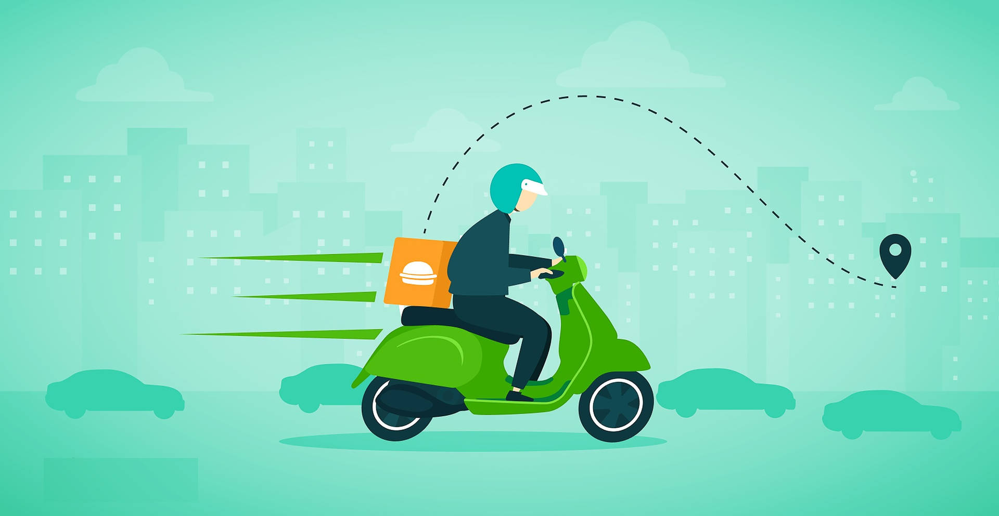




Introduction & Problem Statement
Online food delivery platforms generate massive transactional data. Analyzing this data helps improve revenue performance, customer retention, restaurant growth, and operational efficiency.
High-Value Customers
Restaurant Performance
Delivery Delays
Minimizing late orders and churn
Identifying and retaining top spenders
Tracking quality and revenue drivers
Discount Effectiveness
Measuring ROI of promotional offers

Slide 3
CHAPTER 1
OBJECTIVES
Business Objectives
01
02
Revenue & Order Trends
Customer Segmentation
Analyze patterns across time and geography
Segment customers by spending behavior
03
04
Restaurant Evaluation
Delivery Efficiency
Benchmark performance and ratings
Monitor and optimize delivery times
05
06
Payment & Discount Impact
Data-Driven Decisions
Assess payment methods and promo effectiveness
Support strategic planning with actionable insights

Slide 4





CHAPTER 2
DATA ARCHITECTURE
Dataset & ER Structure
Customers
Demographics & contact info
Restaurants
Customers
Orders
PK: customer_id — demographics & contact
PK: order_id — transactions & timestamps
Cuisine, ratings & location
Orders
Transactions & timestamps
Order Items
Delivery Agents
Order Items
PK: order_item_id — line-level details
PK: agent_id — performance & routes
Line-level product details
Delivery Agents
The Orders table acts as the central entity connecting customers, restaurants, order items, and delivery agents.
Agent performance & routes

Slide 5
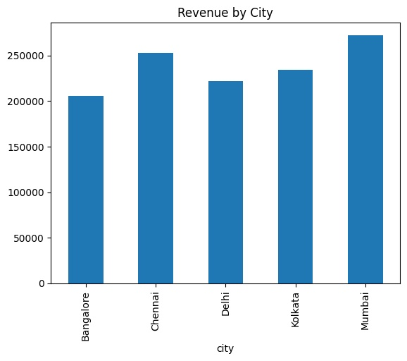
CHAPTER 3
CUSTOMER INTELLIGENCE
Exploratory Analysis & Customer Segmentation
🥇 Gold
🥈 Silver
Top spenders driving the highest lifetime value
Consistent mid-tier customers with growth potential
🥉 Bronze
Occasional buyers needing engagement strategies
Revenue and order volume were analyzed per city to identify geographic hotspots. Top customers were ranked by total spending, then segmented into tiers. Segmentation enables targeted marketing, personalized offers, and efficient resource allocation.
Gold customers contribute the majority of revenue, highlighting the importance of loyalty programs.

Slide 6
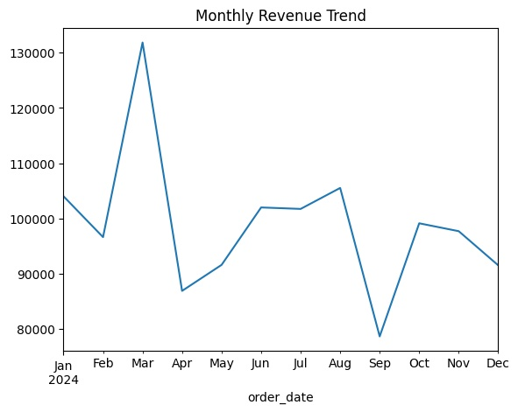
CHAPTER 4
PERFORMANCE
Restaurant & Delivery Performance
Restaurant Insights
Top restaurants ranked by total revenue contribution
Higher ratings correlate with higher revenue — quality drives repeat orders
Delivery Metrics
Average delivery time benchmarked across cities
Late deliveries directly reduce customer satisfaction and increase churn risk

Slide 7
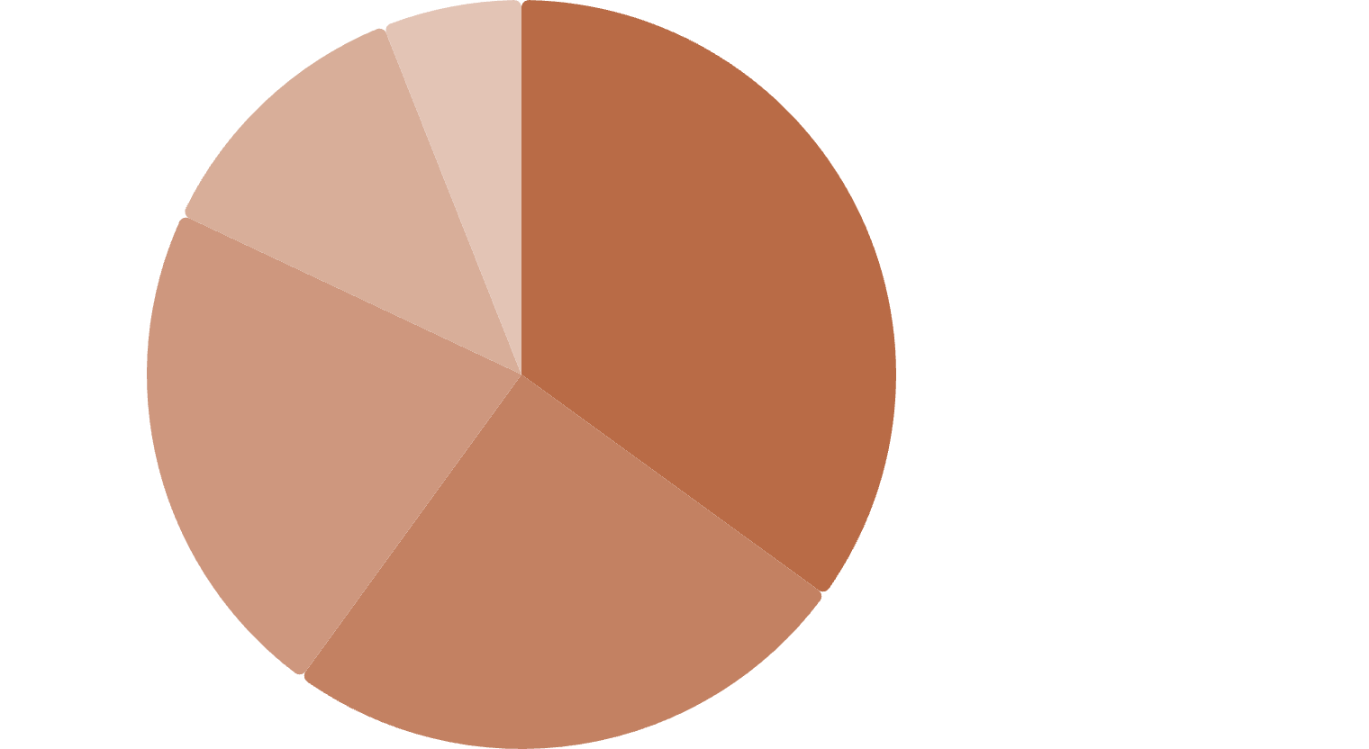
CHAPTER 5
FINANCIAL ANALYTICS
Payment, Discounts & Advanced SQL Insights
Credit Card·35%
·35%
·
Debit Card·25%
·25%
·
UPI·22%
·22%
·
Cash on Delivery·12%
·12%
·
Wallet·6%
·6%
·
Discount Impact
Monthly Trends
Window Functions
Discounts boost order volume but must be optimized to protect margins
Revenue tracked monthly to identify seasonal patterns and growth
Restaurants ranked using SQL window functions for comparative analysis

Slide 8
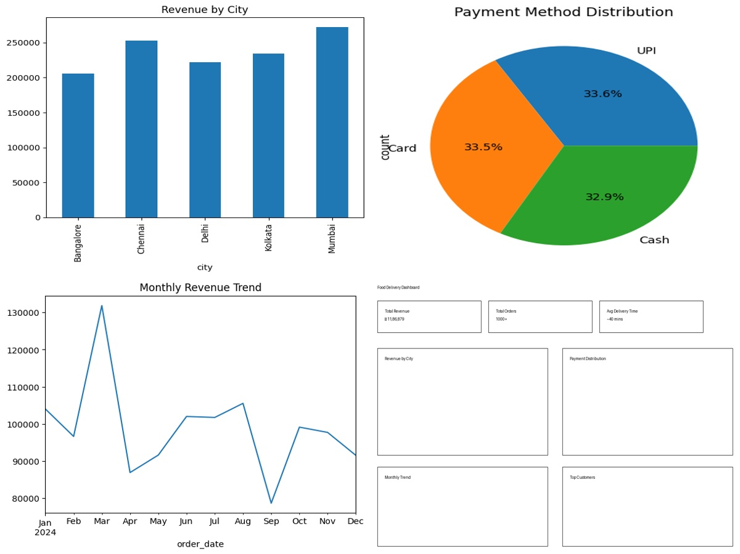

CHAPTER 6
TECHNICAL IMPLEMENTATION
Automation, Optimization & Dashboard
SQL Backend
Views & Stored Procedures
Reusable queries for consistent reporting
Triggers
Automated data integrity and event handling
Indexing
Optimized query performance at scale
Power BI Dashboard — Integrates KPIs, revenue trends, city performance maps, and payment distribution into a single interactive view.

Slide 9







CHAPTER 7
INSIGHTS & RECOMMENDATIONS
Key Insights & Recommendations
Insight
Revenue concentrated in major cities; high-value customers drive profits
Insight
Ratings influence restaurant success; delivery delays hurt experience
Insight
Discounts increase order volume but need strategic optimization
Loyalty Programs
Reward premium customers to maximize retention
Improve Logistics
Target delay-prone areas with better routing
Promote Top Restaurants
Amplify visibility of high-performing partners
Optimize Discounts
Balance volume growth with margin protection

Slide 10
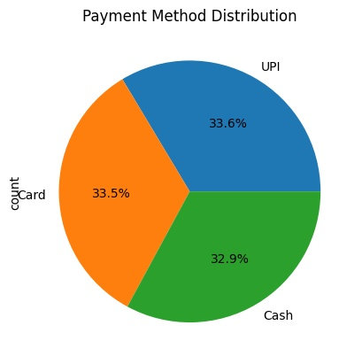
Data-Driven Decisions Power the Future of Food Delivery
By transforming raw data into actionable intelligence, businesses can optimize every touchpoint — from customer acquisition to last-mile delivery — and build a sustainable competitive advantage.
Ananya Sindhe

