Slide 1
Database Course

Slide 2
Why We Need Database?
Databases help organize and structure large amounts of data in a systematic way.
Retrieving information from a well-designed database is faster and more efficient than searching through individual files.
Databases enforce data integrity. For example, a database can be designed to prevent invalid or incomplete information entry.
Databases allow multiple users to interact with data at the same time. Almost every application in the modern day uses databases to store their data.

Slide 3
Relational and Non-Relational Databases
Relational
Non-relational
Relational databases use a table-based structure with rows and columns
MySQL, MSSQL, SQL Lite
Non-relational databases allow more flexible data models without insisting on a fixed design.
MongoDB, Redis, Couchbase and Apache HBase

Slide 4
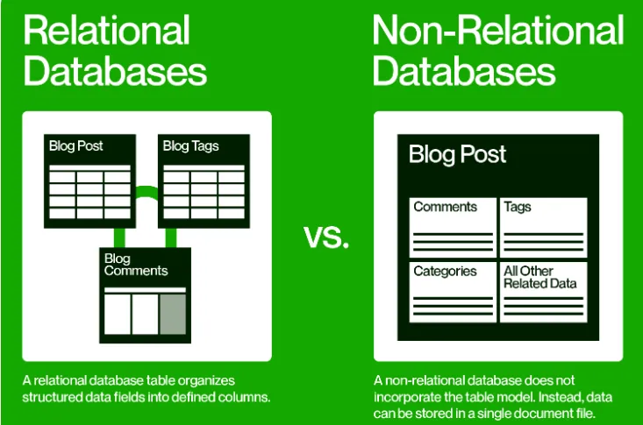
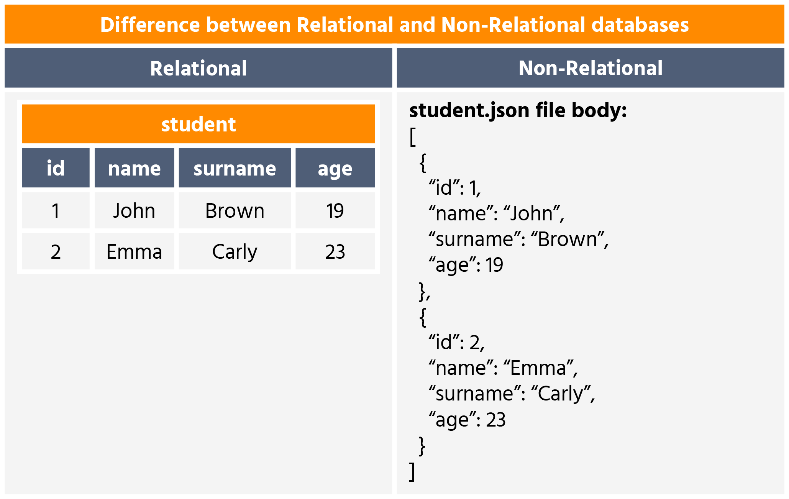

Slide 5
Fields
A table contains a collection of records and fields represented as rows and columns respectively.
Each record contains the data for one object, person, or place.
Fields are the categories for each piece of data in the table.
In this example, each record is a single song track.
TrackID | Title | Artist | Genre
1 | Float away | The Springs | Pop
2 | In denial | Rocketts | Rock
3 | With you | Funzo | Pop
4 | Us | The Feast | RnB
🔑

Slide 6
Creating Database.
In place of `database_name`, write the name of the database you want.
CREATE DATABASE database_name;
Deleting Database.
In place of `database_name`, write the name of the database.
DELETE DATABASE database_name;
To see all the tables inside your database, you can use the following command.
SHOW TABLES;

Slide 7
Creating Table.
CREATE TABLE table_name{ here will come the fields or columns of the table};
Example
CREATE TABLE Product {
product_id INT,
};

