Slide 1

Dr B R Ambedkar National Institute of Technology, Jalandhar G T Road Bye Pass, Jalandhar – 144011 (Punjab)
Department of Electronics and Communication
PROJECT REPORT
SUMMER INTERNSHIP-CUM-TRAINING
JUNE-JULY (2019)
Mohammad Anas 16104045 Electronics and Communication Engineering

Slide 2
TO DEVELOP A CHATBOT & integrate it with the following API’s of the Meridian Project:
Simple Estimate
Retail Estimate
Medical Services
Medical Service Components
Name: Mohammad Anas
Roll No: 16104045
Discipline: Electronics and Communication Engineering
Name of the Organization: UnitedHealth Group (UHG) - Optum Global Solutions,
Hyderabad, Telangana, India.
Name of the Institute: Dr B R Ambedkar National Institute of Technology, Jalandhar, Punjab, India.

Slide 3

PROJECT REPORT
PROJECT NAME: MERIDIAN
TASK ASSIGNED: To develop a chat bot with a modernized user touchpoint and integrate it with the patient estimation API as well as the other API's of the meridian project, which internally connects with the back-end systems and provide the data as per the request.
REPORT BY:
PRODUCT OWNER: M.S SRINATH
MOHAMMAD ANAS
PROJECT MANAGER:
INTERN @ OPTUM GLOBAL SOLUTIONS
SRUJANA SHREEVASTAV
MENTOR: SOURABH DWIVEDI
TENURE:3rd JUNE 2019 - 26th JULY 2019
H.R. MANAGER:RAJNI
1

Slide 4

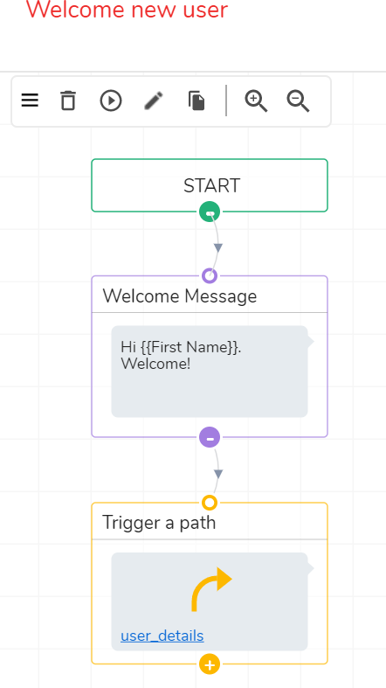
HOW TO BUILD A CHATBOT WITH ENGATI.COM
PROJECT: MERIDIAN
To build a chatbot here, we need to develop paths or flows. These paths are analogous to intents. Each path symbolizes a specific set of operations to be performed by the bot. On engati platform, I developed a bot which determines the weather conditions in any city the user wants.
I used 5 paths for this purpose and named the bot as weather bot.
Details of the 5 paths are as follows:-
Welcome new user:
This path, as the name suggests, is used to welcome a new user.
A welcome message can be written here which will be displayed in the beginning.
Here {{First_Name}} is an attribute . Its value is taken from the user.
The path user_details which is triggered here is explained in the upcoming sections.

Slide 5
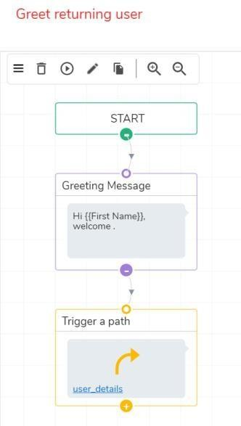
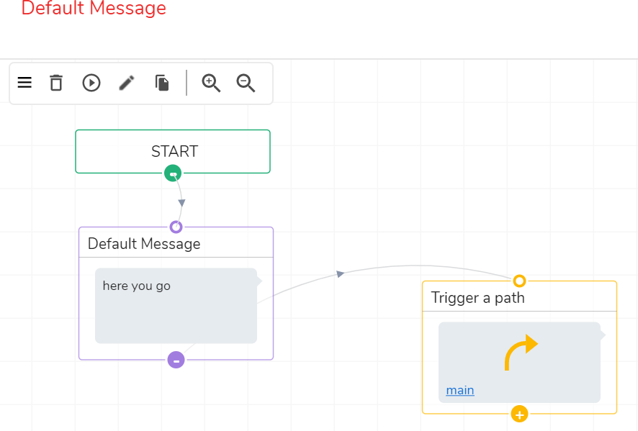
PROJECT: MERIDIAN
2. Greet returning user:
Greet returning user path is used to greet a user who has returned to the conversation i.e. he is not a new user.
The path user_details which is triggered here is explained in the upcoming sections.
3. Default Message:
This path will become active when user enters a value which the bot cannot understand or any invalid value.
For eg : If user enters “deli” for a city then Default Message path will be triggered.
I have linked the Default Message path to the main path which will be explained in coming sections.
4. User_details

Slide 6
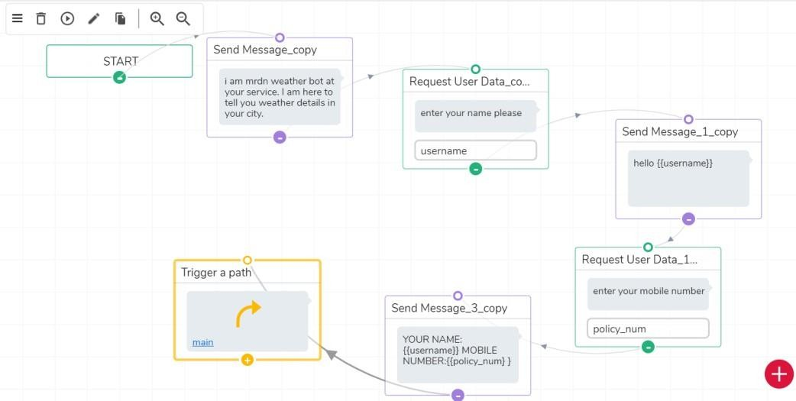
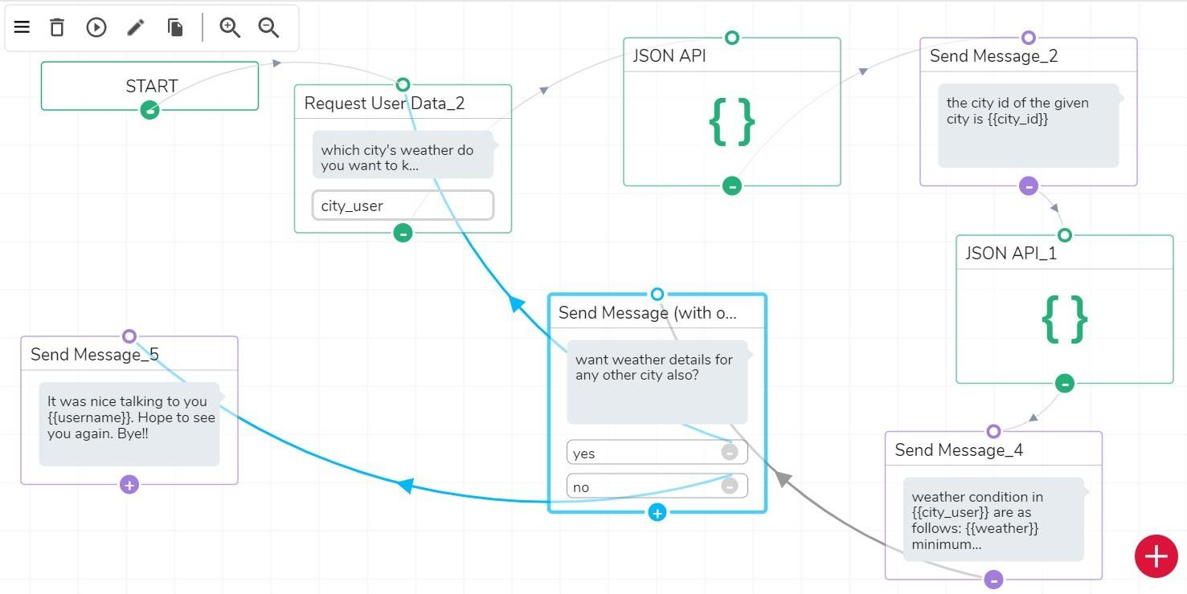
PROJECT: MERIDIAN
This path is very important as it collects the user information (name and mobile number) and calls the main path.
Main
This is most important path of the entire logic. External API is integrated to the bot in this path. I have made 2 API calls here:
  https://www.metaweather.com/api/location/search/?query={{city_us er}} (JSON API)
  https://www.metaweather.com/api/location/{{city_id}} (JSON API_1)
Details of JSON API PLUGIN:

Slide 7
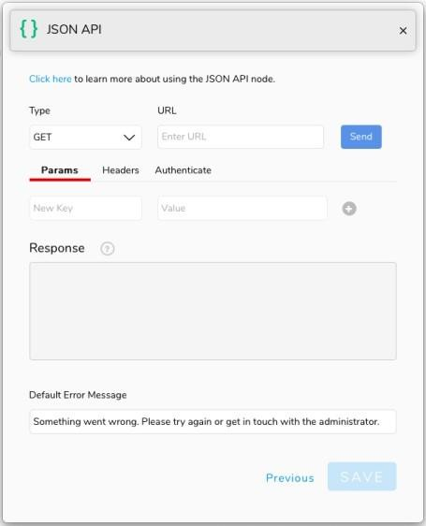
PROJECT: MERIDIAN
The JSON API Plugin provides flexibility for the bot admin to make HTTP requests, parse and store the responses into attributes and use the data across the platform. You can choose between GET, PUT and POST to make the HTTP requests.
PARAMS
Click the Params tab to open the data editor for URL parameters. When you add key- value pairs, the JSON API Plugin automatically combines it with the URL while making the API call.
HEADERS
Clicking on the Headers tab shows the headers key-value editor. You can add your API request headers here for all method types.You can pass authentication tokens, app secret, passwords and other credentials as per the requirements of the end - point.
STORING API VALUES
To store values into attributes from responses from APIs:
Click on the key from the response whose value you want to use in the flow
The attribute is created right below the response box
You can change the name of these attributes as per your desire Thereafter, you can use these attributes anywhere in the flow.

Slide 8
C++ CODE
PROJECT: MERIDIAN
Following is the C++ code for implementing basic functionalities of a conversational Chat Bot.
#include <iostream> #include <string> #include <vector> #include <ctime>
const int MAX_RESP = 3;
typedef std::vector<std::string> vstring; vstring find_match(std::string input);
void copy(const char* array[], vstring& v);
typedef struct {
const char* input;
const char* responses[MAX_RESP];
}record;
//char* x = "WHAT IS YOUR NAME"; record KnowledgeBase[] = {
{"WHAT IS YOUR NAME",
{"MY NAME IS CHATTERBOT2.",
"YOU CAN CALL ME CHATTERBOT2.", "WHY DO YOU WANT TO KNOW MY NAME?"}
},
{"HI",
{"HI THERE!",
"HOW ARE YOU?",
"HI!"}
},
{"HOW ARE YOU",
{"I'M DOING FINE!",
"I'M DOING WELL AND YOU?",
"WHY DO YOU WANT TO KNOW HOW AM I
},
DOING?"}

Slide 9
PROJECT: MERIDIAN
{"WHO ARE YOU",
{"I'M AN A.I PROGRAM.",
"I THINK THAT YOU KNOW WHO I'M.", "WHY ARE YOU ASKING?"}
},
{"ARE YOU INTELLIGENT",
{"YES,OFCUORSE.", "WHAT DO YOU THINK?",
"ACTUALY,I'M VERY INTELLIGENT!"}
},
{"ARE YOU REAL",
{"DOES THAT QUESTION REALLY MATERS TO YOU?", "WHAT DO YOU MEAN BY THAT?",
"I'M AS REAL AS I CAN BE."}
}
};
size_t nKnowledgeBaseSize = sizeof(KnowledgeBase) / sizeof(KnowledgeBase[0]);
int main() {
srand((unsigned)time(NULL));
std::string sInput = ""; std::string sResponse = "";
while (1) {
std::cout << ">"; std::getline(std::cin, sInput);
vstring responses = find_match(sInput); if (sInput == "BYE") {
std::cout << "IT WAS NICE TALKING TO YOU USER, SEE YOU
NEXTTIME!" << std::endl;
break;
}
else if (responses.size() == 0) {
std::cout << "I'M NOT SURE IF I ARE TALKING ABOUT."
<< std::endl;
}
else {
UNDERSTAND WHAT YOU

Slide 10
PROJECT: MERIDIAN
int nSelection = rand() % MAX_RESP;
sResponse = responses[nSelection]; std::cout << sResponse << std::endl;
}
}
return 0;
}
// make a search for the user's input
// inside the database of the program vstring find_match(std::string input) {
vstring result;
for (int i = 0; i < nKnowledgeBaseSize; ++i) {
if (std::string(KnowledgeBase[i].input) == input) { copy(KnowledgeBase[i].responses, result); return result;
}
}
return result;
}
void copy(const char* array[], vstring& v) { for (int i = 0; i < MAX_RESP; ++i) {
v.push_back(array[i]);
}
}

Slide 11



PROJECT: MERIDIAN
After learning various techniques of building a conversational chat bot and integrating it with the REST API’s, I started building the bot for the Meridian project.
Technologies/Platforms/Tools:
Microsoft Azure Cloud Computing Platform and Services
Visual Studio 2019
Engati Platform

Slide 12

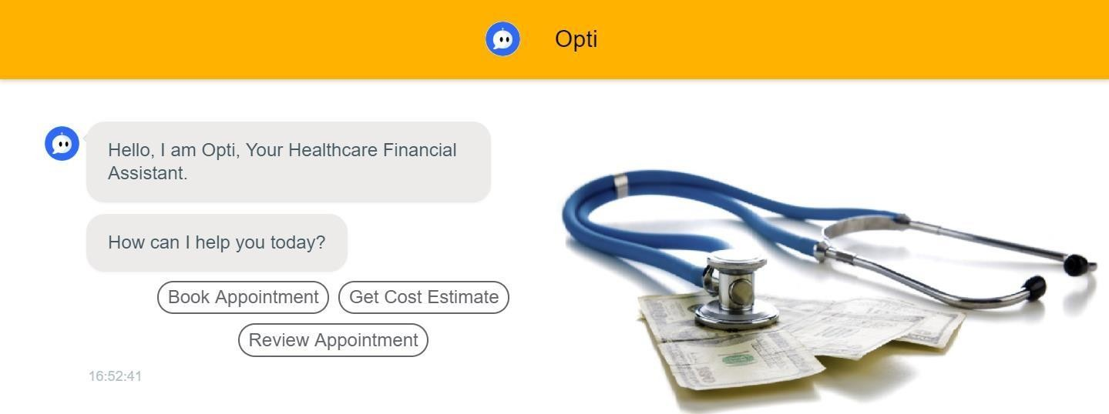
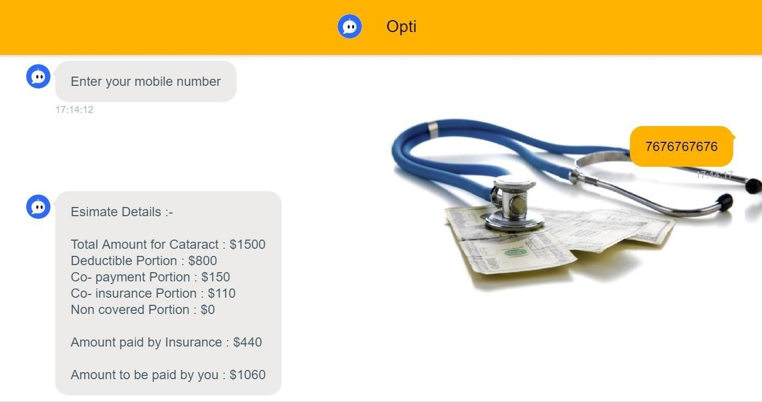
BOT NAME: OPTI
PROJECT: MERIDIAN
Various components of Opti are described below:-
1.) WELCOME NEW USER & GREET RETURNING USER :
2.) REVIEWING PAST APPOINTMENTS : A.) ESIMATE DETAILS:

Slide 13
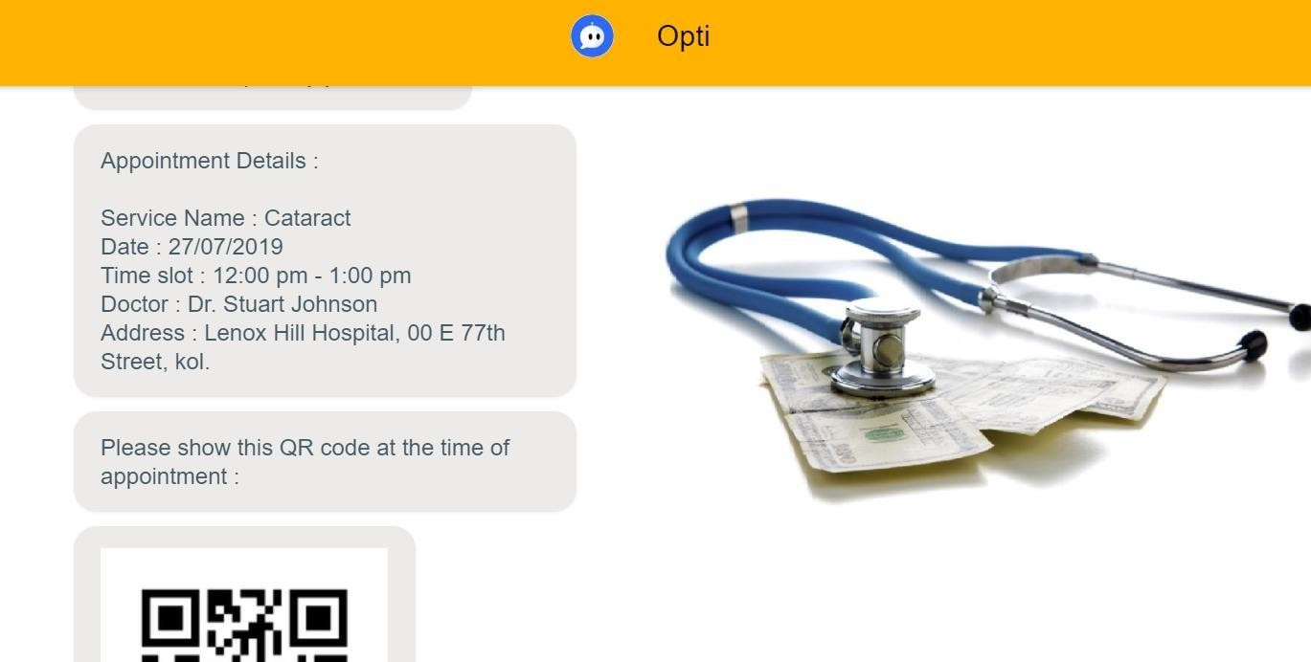
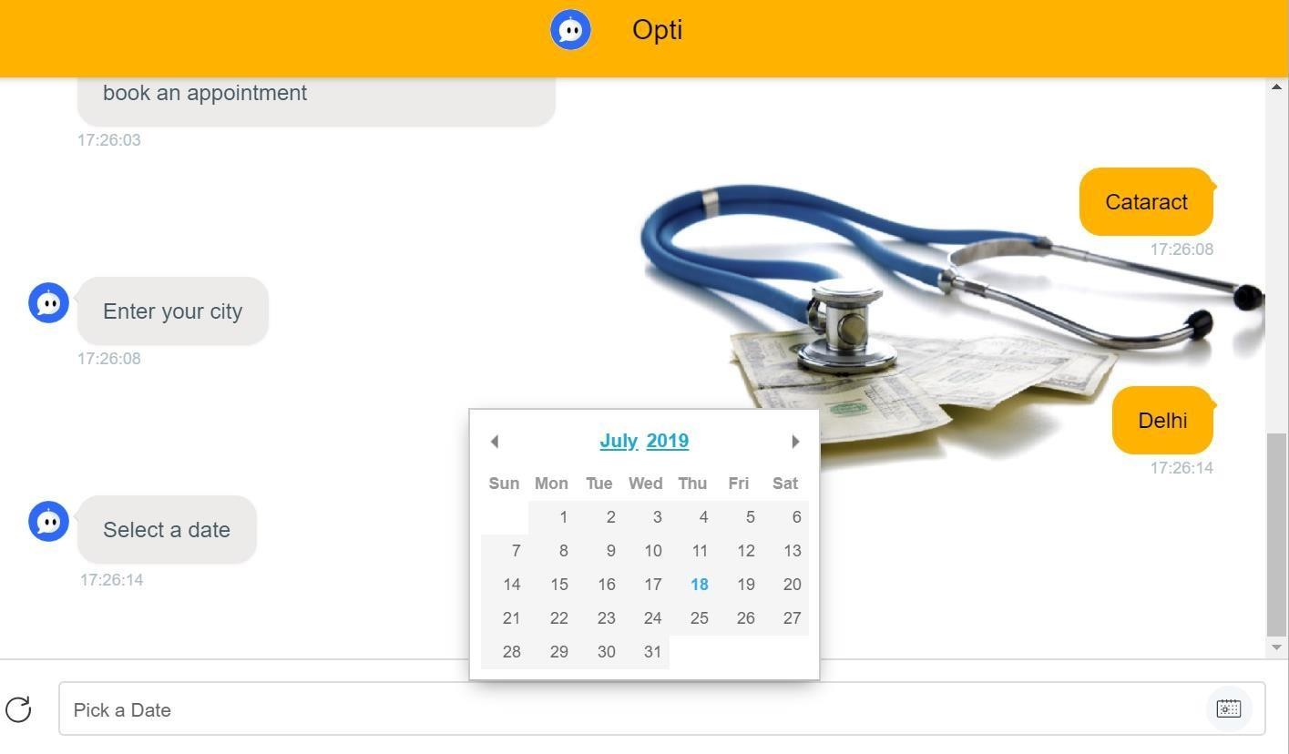
PROJECT: MERIDIAN
B.) APPOINTMENT DETAILS :
3.) BOOKING AN APPOINTMENT :

Slide 14
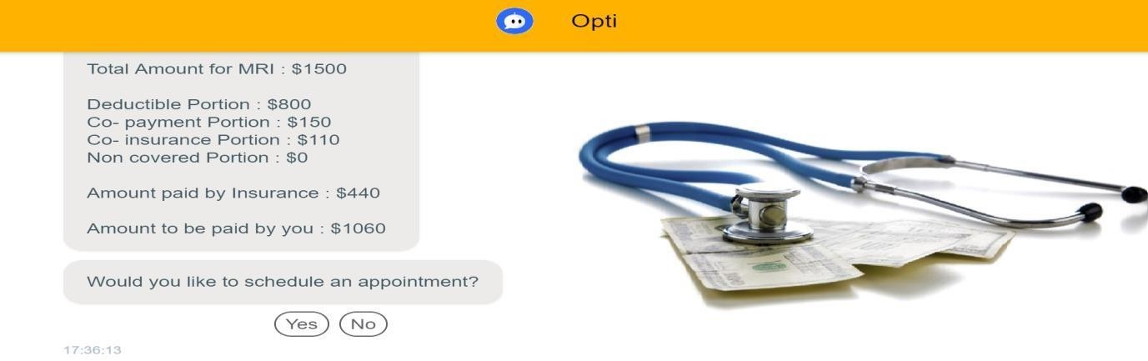
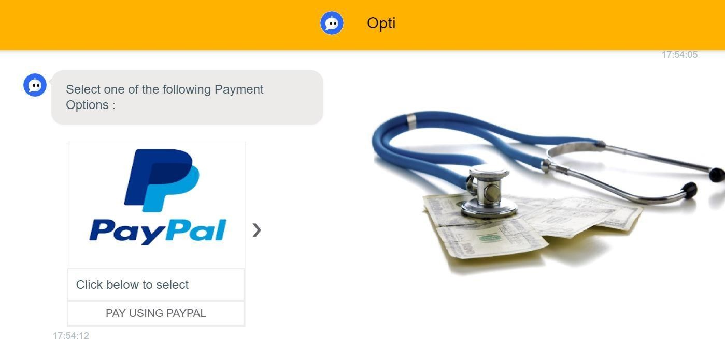
PROJECT: MERIDIAN
4.) GET COST ESTIMATE :
5.) PAYMENT :
6.) SAMPLE JSON INPUT :
{
"inNetwork": true, "industryPayerId": "AUTO1",

Slide 15
PROJECT: MERIDIAN
"dateOfService": "2019-12-27",
"subscriber": {
"dateOfBirth": "1978-08-13", "gender": "MALE", "memberId": "00918345566",
"planEffectiveDate": "2018-02-01", "name": {
"firstName": "JULIE", "lastNameOrOrgName": "EVANS",
"middleName": "",
"prefix": "",
"suffix": ""
}
},
"medicalServiceId": 1,
"placeOfService": 24,
"planId": "121212",
"provider": {
"name": { "firstName": "",
"lastNameOrOrgName": "HOUSTON MEDICAL IMAGING",
"middleName": "",
"prefix": "MD",

Slide 16
PROJECT: MERIDIAN
"response271":"ISA*00* *00* *ZZ*841162764 *30*621249087
*190205*0556*^*00501*036055635*0*P*:~GS*HB*841162764*621249087*20190205*0556*1*X*005010 X279A1~ST*271*000000001*005010X279A1~BHT*0022*11*295337315*20190205*0656~HL*1**20*1~N
M1*PR*2*GEHA*****PI*440545275~HL*2*1*21*1~NM1*1P*1*TRAUTMANN*PAUL****XX*1942385091~
HL*3*2*22*0~NM1*IL*1*Sosa*Roxanne*M***MI*23751754~REF*HJ*0~REF*6P*10000001*Federal Employee Health Benefit Program~N3*354 Rio Azul~N4*Pipe Creek*TX*780636175~DMG*D8*19780813*F~EB*1*FAM*30*PR*Standard Option Medical FEHB~DTP*291*D8*20150622~EB*P***********W~MSG*UNLESS OTHERWISE REQUIRED BY LAW, THIS NOTICE IS NOT A GUARANTEE OF PAYMENT. BENEFITS ARE SUBJECT TO ALL CONTRACT LIMITS AND THE MEMBER'S STATUS ON THE DATE OF SERVICE. ACCUMULATED AMOUNTS SUCH AS DEDUCTIBLE MAY CHANGE AS ADDITIONAL CLAIMS ARE
PROCESSED.~EB*C*IND*30***23*350*****W~EB*C*IND*30***29*341.1*****W~III*ZZ*12~EB*C*FAM*30
***23*700*****W~EB*C*FAM*30***29*219.17*****W~III*ZZ*10~EB*C*FAM*30***23*700*****W~EB*C*FA M*30***29*219.17*****W~III*ZZ*11~EB*C*FAM*30***23*700*****W~EB*C*FAM*30***29*219.17*****W~II I*ZZ*24~EB*G*FAM*30***23*6000*****Y~EB*G*FAM*30***29*5449.96*****Y~III*ZZ*12~EB*G*FAM*30*** 23*6000*****Y~EB*G*FAM*30***29*5449.96*****Y~III*ZZ*11~EB*G*FAM*30***23*6000*****Y~EB*G*FA M*30***29*5449.96*****Y~III*ZZ*10~EB*G*FAM*30***23*6000*****Y~EB*G*FAM*30***29*5449.96*****Y
~III*ZZ*24~EB*A*IND*5*****.22****Y~III*ZZ*22~EB*A*IND*5*****.21****Y~III*ZZ*21~EB*A*IND*5*****.20*
***Y~III*ZZ*20~EB*A*IND*30*****.12****Y~III*ZZ*12~EB*A*IND*30*****.11****Y~III*ZZ*11~EB*A*IND*30*
****.10****Y~III*ZZ*10~EB*A*IND*98*****.32****Y~III*ZZ*32~EB*A*IND*98*****.31****Y~III*ZZ*31~EB*A*I ND*98*****.30****Y~III*ZZ*30~SE*42*000000001~GE*1*1~IEA*1*036055635~",
"taxonomyCode": "1212121212" }
7.) SAMPLE JSON OUTPUT :
{
"transactionUuid": "a172a6a2-9262-4dea-8d47-165eb4c916b5", "benefits": {
"outOfPocket": { "remaining": 5449.96, "family": {
"max": 6000,
"met": 550.04,
"remaining": 5449.96
},
"individual": { "max": null,
"met": null, "remaining": null
}
},
"deductible": {

Slide 17
PROJECT: MERIDIAN
"remaining": 219.17, "family": {
"max": 700,
"met": 480.83,
"remaining": 219.17
},
"individual": { "max": 350,
"met": 8.9,
"remaining": 341.1
}
},
"copayment": 0,
"coinsuranceRate": 0.11,
"limitationAmount": 0
},
"estimate": { "patientResponsibility": { "deductiblePortion": 219.17,
"copaymentPortion": 0,
"coinsurancePortion": 415.8913,
"nonCoveredPortion": 0,
"amount": 635.0613
},
"payerResponsibility": { "amount": 3364.9387
},
"amount": 4000
},
"serviceLines": [
{
"cptCode": "91000",
"modifier1": "M1",
"modifier2": "M2",
"modifier3": "",
"modifier4": "",

Slide 18
REFERENCES
https://www.expertsystem.com/chatbot/
https://www.infoworld.com/article/3244546/9-chatbot-building-tools.html
https://chatbotslife.com/dialogflow-restaurant-bot-tutorial-1-45ce1d3c0ab5
https://www.analyticsvidhya.com/blog/2019/04/learn-build-chatbot-rasa-nlp-ipl/
https://engati.com/
https://knowledgebase.engati.com/kb/
https://visualstudio.microsoft.com/
https://www.google.com/search?q=azure+portal&oq=azure&aqs=chrome.1.69i57j0l3j69i61l2.258 7j0j4&sourceid=chrome&ie=UTF-8
https://swagger.io/

