Slide 1

SOLVING PROBLEMS FACED BY RASTOGI MOTORS
BDM CAPSTONE PROJECT
Submitted by
Name: ANAY
Roll number: 21f1003985
IITM Online BS Degree Program,
Indian Institute of Technology, Madras, Chennai
Tamil Nadu, India, 600036

Slide 2
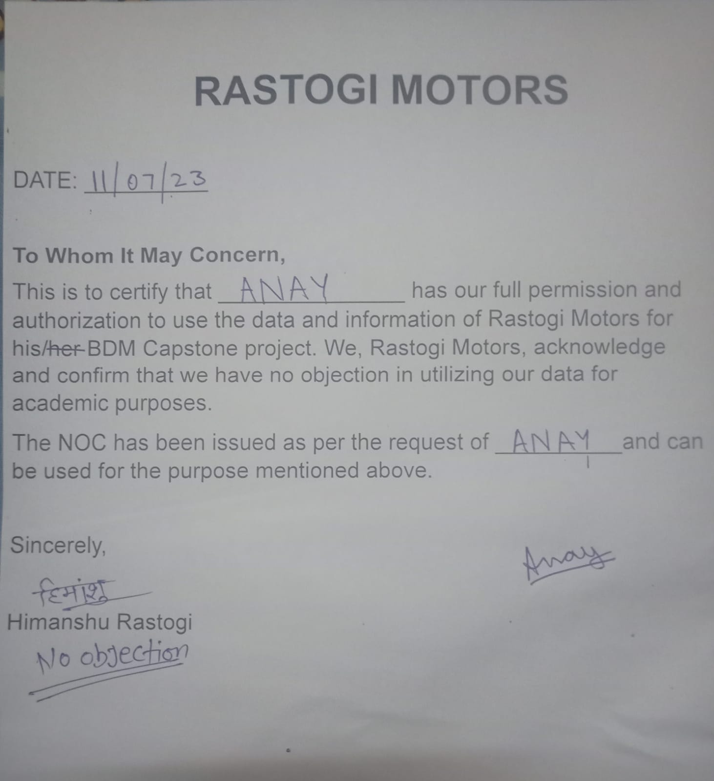
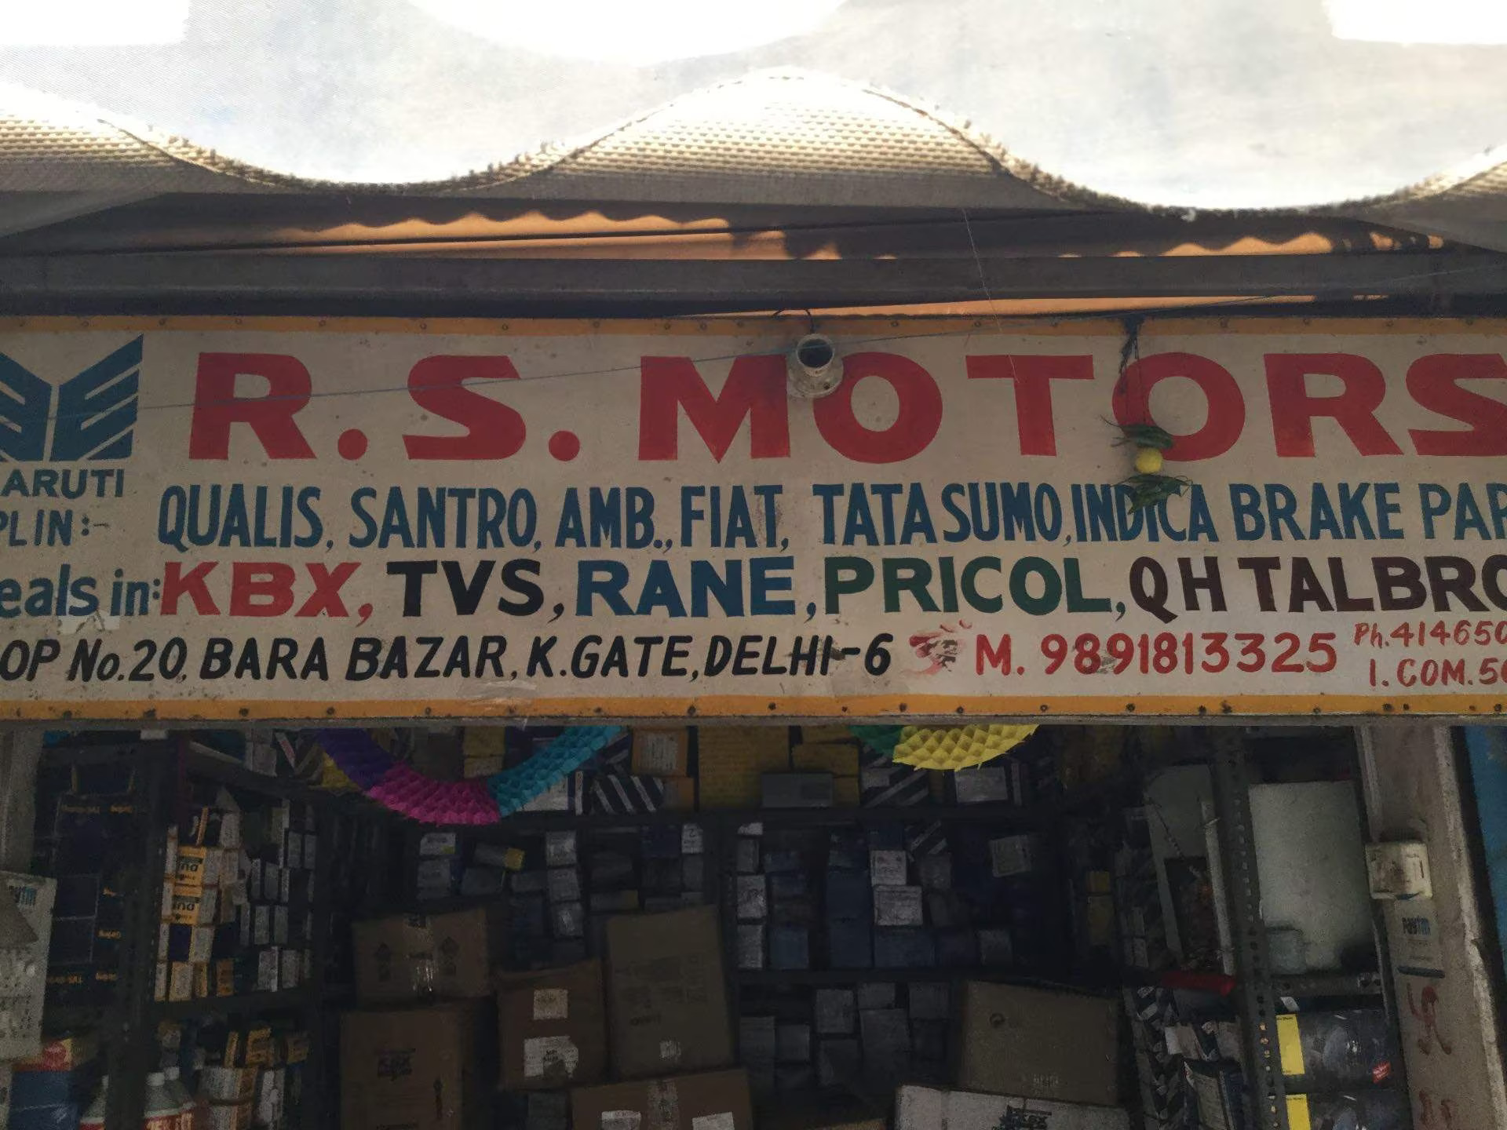
DETAILS OF THE ORGANIZATION
Garage Name: RASTOGI MOTORS
Location: Located at Kashmiri Gate, Central Delhi.
Garage Owner: Shyam Rastogi is proud owner of Rastogi Motors.
Manager: Shop is managed by Himanshu Rastogi(son of Shyam Rastogi)
Type of business: Business to Customers (B2C)
Time Period of the data: 3 months
Garage Operating Hours: Roughly around 10AM-7PM (6 days a week)
Garage is closed on Mondays for market weekly off.
Number of Workers in Shop: 2 permanent workers

Slide 3
PROBLEM STATEMENT
INVENTORY MANAGEMENT: The shop facing issues such as uncertain demand patterns, inaccurate inventory forecasting. As a result, shop is experiencing issues such as stockouts, excessive inventory, low turnover rates, and increased costs.
How can the garage address challenges posed by uncertain demand, inaccurate forecasting, stockouts, excessive inventory, low turnover, and high costs in its current inventory management system?
WORKFORCE MANAGEMENT: Due to cutthroat competition and uneven demand pattern of skilled workers leads to waiting time and eventually bad customer experience or the hired workers are free for most of the time of the day which is wastage of resources.
How can the shop effectively manage its workforce to meet variable service demand, ensuring minimal wait times and resource wastage, thereby enhancing customer experiences and optimizing worker utilization amidst competition?

Slide 4
PROCEDURE
INVENTORY MANAGEMENT PROBLEM
WORKFORCE MANAGEMENT PROBLEM
The closing balance column is analyzed to identify occurrences of stockouts.
Conditional formatting was used to visually highlight the stockout.
The reorder point is calculated which is the inventory level at which a new order should be placed to replenish stock.
The safety stock is calculated which is a additional buffer of inventory maintained to account for uncertain demand and lead time variability
Workforce composition comparison was done between the permanent workers and extra hired help.
Average number of tasks done by both the categories was analyzed.
Alteration in the workforce composition was done based on the number of tasks done.
Pay parity was resolved to avoid any work place envy between the workers.

Slide 5
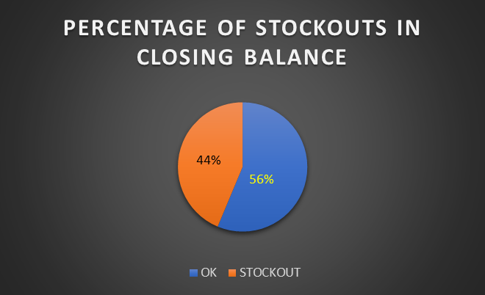
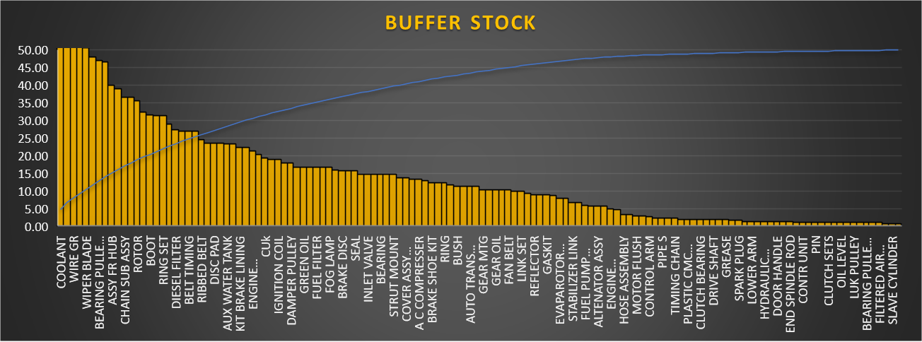
RESULTS AND FINDINGS
INVENTORY MANAGEMENT PROBLEM
Conditional formatting of the closing balance was done.
Pie chart here depicts stockout percentage of the total products available at garage.
Reorder point is calculated it is the inventory level at which a new order should be placed to replenish stock.
After the reorder point calculation, the buffer stock is calculated.
Buffer stock helps like a cushion for unpredicted demands.

Slide 6
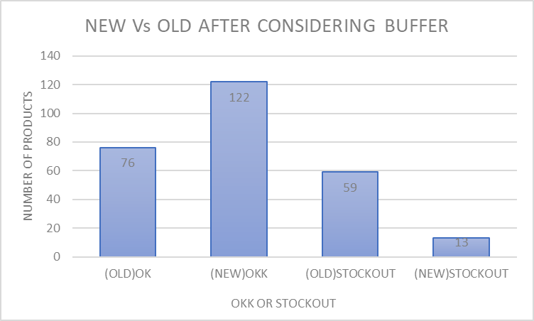
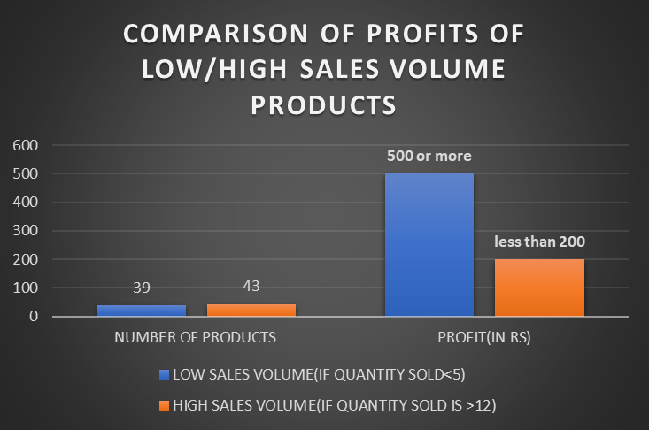
With buffer stock in hand conditional formatting is applied again. A bar chart is made to visually show the stockout comparisons after and before the BUFFER STOCK.
It can be seen in the bar chart that after the buffer stock, there is major drop in stockouts.
With this the INVENTORY MANAGEMENT PROBLEM is resolved.
A pattern was observed between the sales and the quantities of products sold by the garage.
It was observed that some products were sold less in number but gives higher profits.
In contrast certain products with even higher sales volume yield out low profits.

Slide 7
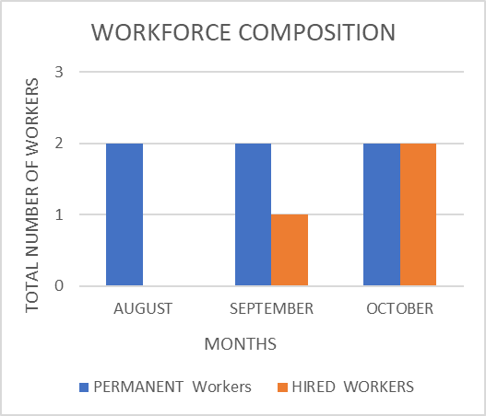
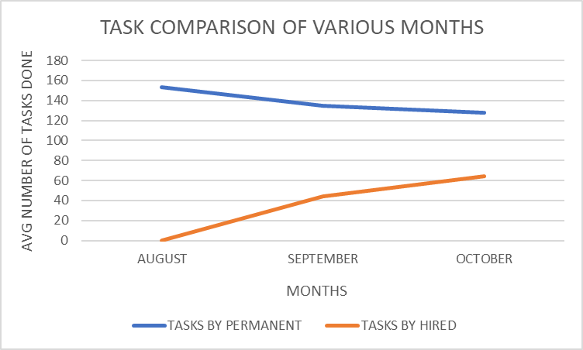
WORKFORCE MANAGEMENT PROBLEM
3 months of workforce data is used.
Workforce composition for the months is visualized.
There are 2 permanent workers plus 1 hired worker in month of September.
Two extra workers were hired in the month of October.
Line chart is made of the average number of tasks done by hired and permanent workers to show month wise comparisons.
It clearly shows that there is the dip in the number of tasks done by permanent workers in the month of September.
There is further dip in number of tasks done by permanent workers in month of October when extra workers were hired.

Slide 8
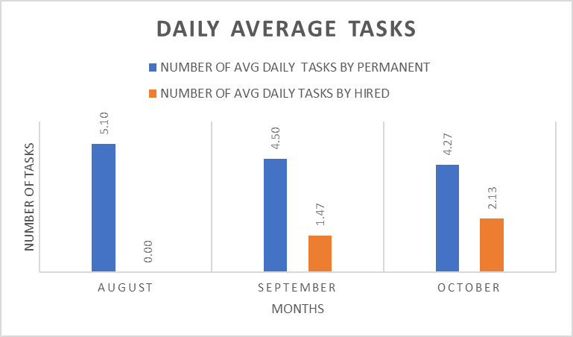
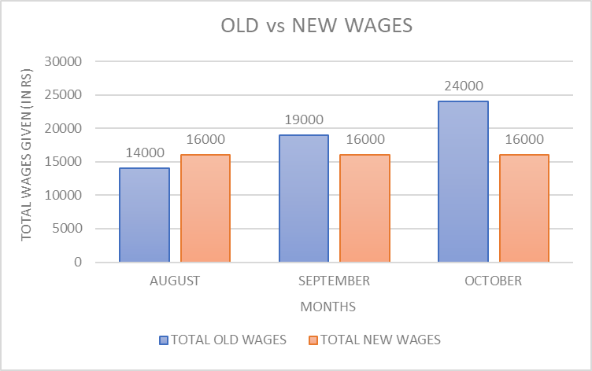
To further prove the point, number of works done per day by workers is calculated in each month.
This clearly shows the decrease in the number of tasks done by permanent workers in month of SEPTEMBER and OCTOBER.
The bar chart also shows the hiring of extra workers was not always directly related to the total number of works coming to the garage.
Extra help is needed to do certain tasks which the permanent workers are not able to perform due to lack of skills.
New approach is taken for the workforce management.
One of the permanent workers is fired and skilled worker is hired and both are given a raise.
As the bar chart shows this will clearly decrease the total amount of wages to be given to the workers.

Slide 9
RECOMMENDATIONS
INVENTORY MANAGEMENT PROBLEM
Maintain a buffer stock to deal with uneven and unpredicted demands.
The variety of products in the garage is high, decrease the variety and focus more on the limited product range.
Try pushing products with high profit margin even if they are selling less in the volume.
WORKFORCE MANAGEMENT PROBLEM
Fire one of the permanent workers currently working in the garage.
A better skilled labor should be hired.
Both the current employed workers will be given raise and have same amount of wages to avoid any envious behavior during work.
The old permanent worker will learn in the shadow of new more skilled worker and will become a better asset for the garage.
This will end the need to hire extra workers and the productivity of the garage will increase due to less commotions.

Slide 10
THANK YOU

